Slide 1
Smart City
Yang Guang, Shelby Kiewel
2017-11-10

Slide 2
What is smart city？
Core :
  Sustainability：economic, society, environment
  High Efficiency
  Supporting business and investment
Methods and trends
  Public Transportation
  Traffic management
  Power supply(electricity, gas)
  Water supply
  Waste disposal
  Living quality
    security, medical service, air condition, climate, greenfield.
  City administration/monitoring ability
New ideas
  Big data, Clouds, IoT, LPWAN

Slide 3
Current standards & white papers
OneM2M
  White paper: “Smart Cities done smarter”
GSA
  White paper: “The Central Role of Telecoms in The Smart City”
IEC
  White Paper: “Orchestrating infrastructure for sustainable Smart City”
GB/T
  GB/T 33356-2016“Evaluation indicators for new-type smart cities”
ITU
  ITU-T Y 4250 Series, smart sustainable cities, “Overview of smart sustainable cities infrastructure”.

Slide 4
Difficulties and Challenge
No two identical cities
  size and type, climate, economic level, culture,, existing infrastructure, budget
  Political aspect
Hard to make “use case” for all different level of cities
  Hard to find an universal pattern
  Use case must be useful and common for most cities, big or small
  Mostly long-term projects
  Laws and regulations maybe helpful, or not
    Autonomous Vehicles
Single network can’t cover all IoT Applications
  Multi networks are needed
    Licensed or Unlicensed spectrum
    Interwork with 3GPP, Wi-Fi alliance...
  High data throughput networks(LTE, WIFI) and LPWA(GPRS, NB-IoT, LoRa) networks are both needed
  NB-IoT maybe a good LPWAN choice for many small-data use cases of smart city

Slide 5

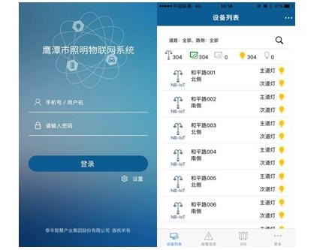
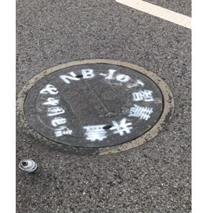
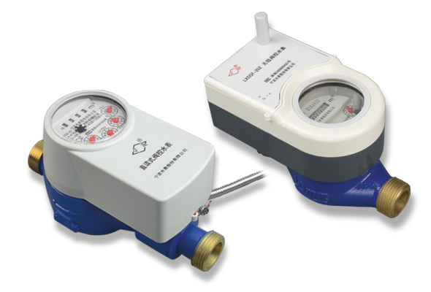
Choose use cases for smart city
Choose most popular and affordable use cases firstly
Smart metering: water, gas , electricity
  Improving efficiency
  Leak response quickly
  Environmental sustainability
Smart street lightening
  Improving efficiency
  Reduce crime
Environment monitoring
  Air and water quality---water supply
  Sea level, river level monitor---Flood forecast
  Temperature, humidity---weather forecast
Greenfield
  Better living condition
  Similar to smart agriculture
Ying Tan city(Province Jiang Xi) is the global First Smart city based on NB-IoT (LPWAN)Technology

Slide 6
Use Case Example: Smart water metering
Resource: ITU-T Y 4250 Series, smart sustainable cities, “Overview of smart sustainable cities infrastructure”.

Slide 7
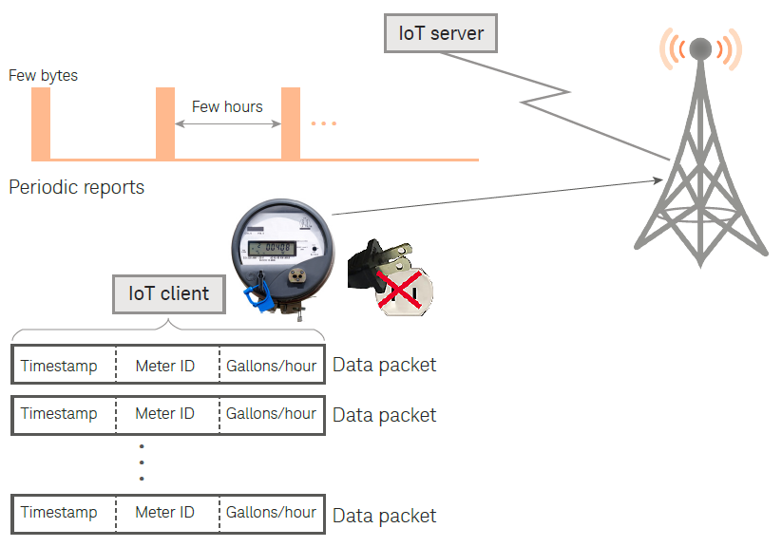
Smart water metering overview
Typical LPWA IoT network
  Low power consumption (>6 years battery life)
  Wide area coverage (3~5Km radius)
  Small data (couples or hundreds of bytes)
  High density deploy
Based on Unlicensed and licensed communication network
  LoRa : gateway, server,
  NB-IoT, GPRS: MNOs, base stations,
Customers
  Personal
  Water Supplier
  Company
  Building administrator
  City management

Slide 8
How should OneM2M engage with a city?
Open and easy to deploy
  IoT device Manufactures prefer simple protocol, data format...
  One step service: format, protocol, platform, App...
  Based on mature ready-to-use networks: GPRS, NB-IOT, LoRa, LTE
Start Conformance test and certificate
  Release 1 Conformance test & certificate?
  Labs could help develop and spread technology
Commercial Trial
  Choose several proper cities or area
  Multi-players(Government, operators, manufactures, Labs, service providers) evolved

