Slide 1
REQ-2017-0072-Autopilot_IoT_architecture_slideset
Miodrag Djurica (TNO)
13-11-2017

Slide 2
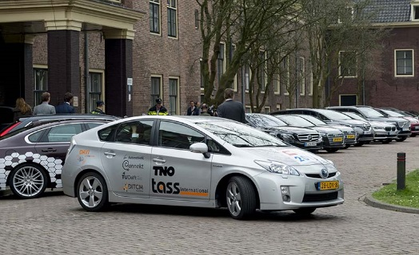
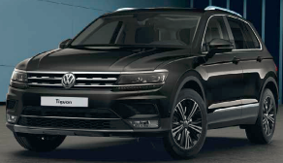
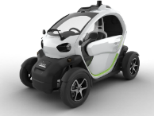
















PILOT SITE BRAINPORT (NL)
A total of 10 vehicles used:
  TNO/Tass: 3 Toyota Prius
  TU/e: 1 Toyota Prius and 3 VFLEX
  VALEO: 1 VW Tiguan
  NEVS: 3 electric vehicle (D-class)
  TT: 1 mobile mapping van
Partners involved:

Slide 3






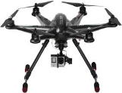









Brainport architecture overview
Sensinov IoT
(oneM2M) platform
REST API
Brainport applications platform (TNO, NEC, IBM)
FIWARE IoT platform
Pre 5G core network
(TNO)
REST API
Image
processing
REST API
WATSON IoT platform
local breakout
REST API
Public internet
MEC applications platform
MEC-node with
IoT (oneM2M)
platform
Huawei IoT platform
Application server
DLR drone
eNB
(4G) Helmond
TASS
systems
Tactical
data via LTE
(100ms+)
eNB (commercial)
Helmond
Time critical
data via G5
(10-20ms)
Fiber backbone
ITS-G5
RSU
ITS-G5
RSU
In-vehicle IoT
and Apps Platform

Slide 4


IoT stack and initial functionality
IN IoT node
Collect global (IoT) non-time critical local from other data sources and platforms
Strategic
services
Run services relevant for vehicle globally – for example platoon subscription, road planning, waypoint calculation, targeting rendezvous for joining platoon,…
Get parking places for AVP (from smart city / smart garage platforms, …)
Pass road and vehicles data from MEC to IN IoT node.
Collect global (IoT) non-time critical local (for given road segment covered by MEC node) data relevant for AD functions.
MEC IoT node
Tactical
services
Run services relevant for vehicle on a given road segment (HD maps distribution, current state of traffic lights, …), platoon management (cars joining / leaving).
In-vehicle non-time critical services
In vehicle non-time critical services: navigation based on waypoints
Pass vehicle state data to MEC and IN IoT node.
Collect global (IoT) non-time critical data relevant for AD functions (waypoints, traffic lights states, platooning,…)
Vehicle IoT node
AD functions
Collect vehicle state data and run AD functions – lane assist, platooning (keep distance, speed,…). Pass vehicle state data to vehicle’s IoT node.

Slide 5
Autopilot In-vehicle IoT platform

