Slide 1
ETSI STF 529 on Attribute Based Encryption for IoT, Cloud, mobile
Presentation to oneM2M SEC WG4, July 5, 2017
Dr. Giovanni Bartolomeo (CNIT), François Ambrosini (IBIT Ambrosini UG (Haftungsbeschränkt))

Slide 2
Objectives for today’s call
Introduction to Attribute-based encryption
Objectives of STF 529
Mapping to oneM2M architecture
Next steps with oneM2M

Slide 3
What is Attribute-Based Encryption?

Slide 4
What is Attribute-Based Encryption? (1)
Encryption is widely used to protect confidentiality of data in untrusted environments
Where a message has to be transmitted to several parties, it has to be encrypted separately for each party
The sender must know in advance the identity and public key of each individual to whom the data should be disclosed
Such encryption schemes provide a simple “access control” solution
To provide full access control, conventionally encryption schemes have to be integrated with a key management and access control infrastructure
The general structure adopted to date is that Attribute Based Access Control (ABAC)
In ABAC, Access Control Policies (ACPs) are based on attributes that one or more authorities provide to parties

Slide 5
What is Attribute-Based Encryption? (2)
Attribute Based Encryption (ABE)…
…is a crypto scheme that provides a level of protection similar to ABAC, leveraging on crypto algorithms only (no software-based PEP/PDP, the algorithm is the PEP)
…has two main variants: CP-ABE and KP-ABE
Can support different trust models
Data at rest (data storage) and B2B data sharing
Processing at isolated (offline) devices
Platform Provider
Different use cases in IoT, Cloud, Mobile
Current focus on confidentiality of PII and personal data

Slide 6
What is Attribute-Based Encryption? (3)
Composition of a KP-ABE cryptosystem
Setup(k): takes as input the security parameter k and outputs a master public key MPK and a master secret key MSK.
Encryption(MPK,A,m): takes as input the master public key MPK, a set of attributes A, and a message m, and outputs a ciphertext C associated with the attributes from A.
KeyGeneration(MSK,MPK,AS): takes as input the master secret key MSK, the master public key MPK, and an access structure AS, and outputs a secret key SK_{AS} associated with the access structure AS.
Decryption(SK_{AS},MPK,C): takes as input a secret key associated with an access structure AS, a master public key MPK, and a ciphertext C associated with some attributes, and outputs a message m if the attributes in C satisfy the access structure AS or an error code that indicates that decryption failed
(from draft ETSI TS 173 532 clause 4.2)

Slide 7
What is Attribute-Based Encryption? (4)
Composition of a CP-ABE cryptosystem
Setup(k): takes as input the security parameter and outputs a master public key MPK and a master secret key MSK.
Encryption(MPK,AS,m): takes as input the master public key MPK, an access structure AS, and a message m, and outputs a ciphertext C associated with the access structure AS.
KeyGeneration(MSK,MPK,A): takes as input the master secret key MSK, the master public key MPK, and a list of attributes A, and outputs a secret key SK_{A} associated with the set of attributes A.
Decryption(SK_{A},MPK,C): takes as input a secret key associated with a set of attributes A, a master public key MPK, and a ciphertext C associated with some access structure, and outputs a message m if the attributes in sk_{A} satisfy the access structure in the ciphertext or an error code that indicates that decryption failed.
(from draft ETSI TS 173 532 clause 4.3)

Slide 8
What is Attribute-Based Encryption? (5)
ABAC laymans‘ terms for use of ABE schemes
In KP-ABE
the ciphertext holds attributes describing the data
the private key holds the access policy
Distributing a private key is similar to granting access rights to the subject
In CP-ABE
the ciphertext holds the access policy,
the private key holds attributes describing the subject
Distributing a private key is similar to granting a role to the subject
This is only a rough, first approximation
One challenge with ABE lies in the balance between giving attributes to subjects vs. giving attributes to objects

Slide 9
Objectives of STF 529

Slide 10
Objectives of STF 529
Develop and ABE-based toolkit for data access control
cloud, mobile and IoT
Interoperability and flexibility is a key requirement
Two drafts under development at TC CYBER
TS 103 458 - Use Cases (Q1/2018)
TS 103 532 - Functional Architecture and Protocols (Q1/2018)
Aspects addressed in TS 103 532
Variants definition (CP-ABE, KP-ABE)
Revocation (attributes, keys, expiration…)
Distribution (keys, attributes, policies)
Multi-authority scheme(s)
Expressiveness and limitations (compared to ABAC)
Trust and assertions (data capture, data access…)
Performance and overhead (public-key crypto)

Slide 11
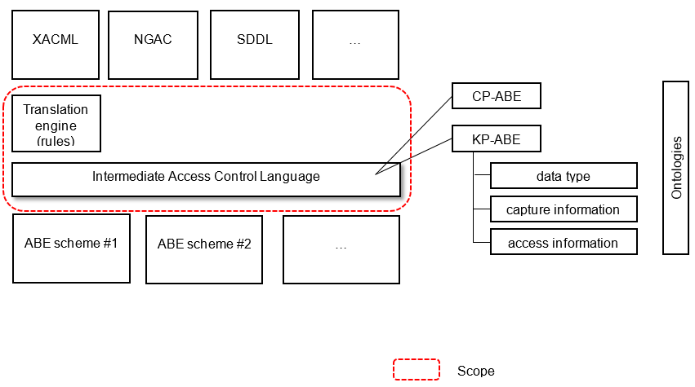
Objectives of STF 529 (2)
Intermediate Access Control Language to ensure interoperability of ABE-based access control
Binds ABE primitives to an access control language
Adaptable to ABAC, NGAC and others
Takes ontologies into account for data types and attribute semantics
Our current model:
(from draft ETSI TS 173 532 clause 7.4)

Slide 12
ABE and the Internet of Things

Slide 13
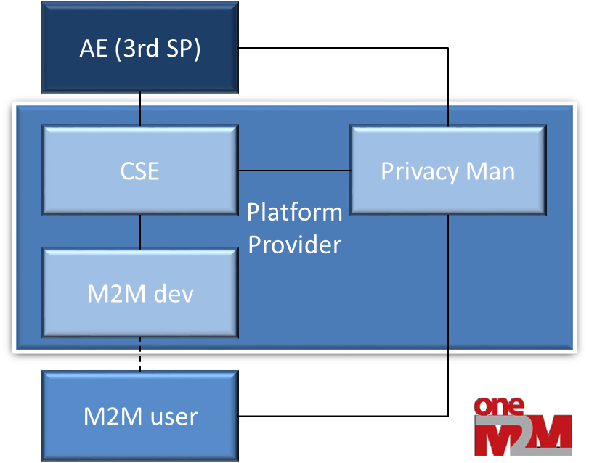
ABE and the Internet of Things (1)
OneM2M (TS-0003r2) use cases for ABE
Platform Provider model
ABAC based ACP/tokens
Focus on interoperability (Restful API, json, URI, ontologies)

Slide 14
ABE and the Internet of Things (2)
Additional IoT use cases for ABE
Best supported by KP-ABE
Cover the industrial sectors where employee personal data is interleaved with business data
Support PII protection, according to data owner instructions, with accessibility to trusted third-parties such as
Basic health information for emergency responders
(including offline requests)
emergency / work incident (e.g. location update)
Lone worker situations
Incident audits
Business improvement audits
Data processing by third-parties
Untrusted data stores

Slide 15
Next steps with oneM2M

Slide 16
Proposed next steps with oneM2M
STF 529 and TC CYBER have identified oneM2M as a potential user of our ABE-toolkit
The ABE-based access control toolkit should be flexible yet address the needs of users
Check interest within oneM2M
The STF would welcome
discussion on requirements / use cases from oneM2M SEC group (and other groups?) that would help us progress the work
further collaboration in order to ensure the toolkit can be easily used (or adapted) in oneM2M specifications

Slide 17
Contact
Liaisons Statements should be sent to ETSI TC CYBER
Presenters’ contact information:
giovanni.bartolomeo AT uniroma2.it (STF Leader)
francois.Ambrosini AT famb.info
Check STF 529 activities on the ETSI portal
THANK YOU!
About ETSI:
ETSI produces globally-applicable standards for Information and Communications Technologies (ICT), including fixed, mobile, radio, converged, broadcast and internet technologies and is officially recognized by the European Commission as a European Standards Organization. ETSI is a not-for-profit organization whose Member Organizations benefit from direct participation and are drawn from countries worldwide. For more information, please visit: www.etsi.org
About ETSI Specialist Task Forces (STF):
STFs are teams of highly-skilled experts working together over a pre-defined period to draft an ETSI standard under the technical guidance of an ETSI Technical Body and with the support of the ETSI Secretariat. The task of the STFs is to accelerate the standardization process in areas of strategic importance and in response to urgent market needs. For more information, please visit the STF home page

