Slide 1
IoT Week Korea 2018
Peter J. Kim
TTA
TP37 September 2018

Slide 2
IoT Week Korea 2018
IoT Week Korea 2018 held at COEX Conference Center
International Exhibition held for 3 days (September 12~14)
Nearly 20,000 visitors from over 40 countries
TTA’s booth consisted of;
oneM2M
Testing and Certification
SME support project
oneM2M Industry Day held on Sept. 14

Slide 3
oneM2M exhibition
9 companies with oneM2M implementation participated
Chordant
ntels
KETI
Sensinov
Spirent Communications
ETSI
KDDI Research
N2M
Korea University of Technology and Education
Visited by
Korea Ministry of Science and ICT
Korea’s ICT & IoT related agency and association VIPs
ETSI Director General
11 East Asian country ICT Ministers and Vice ministers
Samsung Electronic African partners

Slide 4
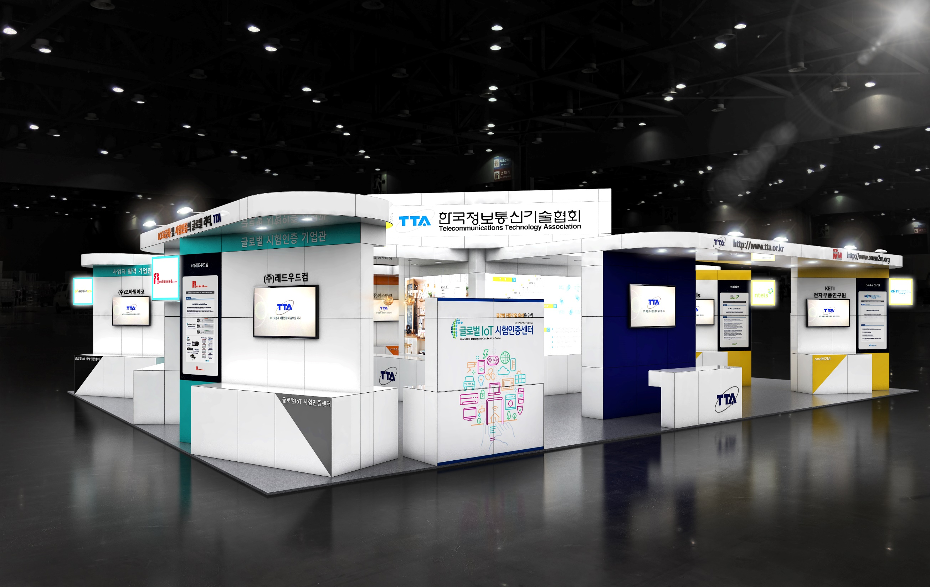
oneM2M booth

Slide 5
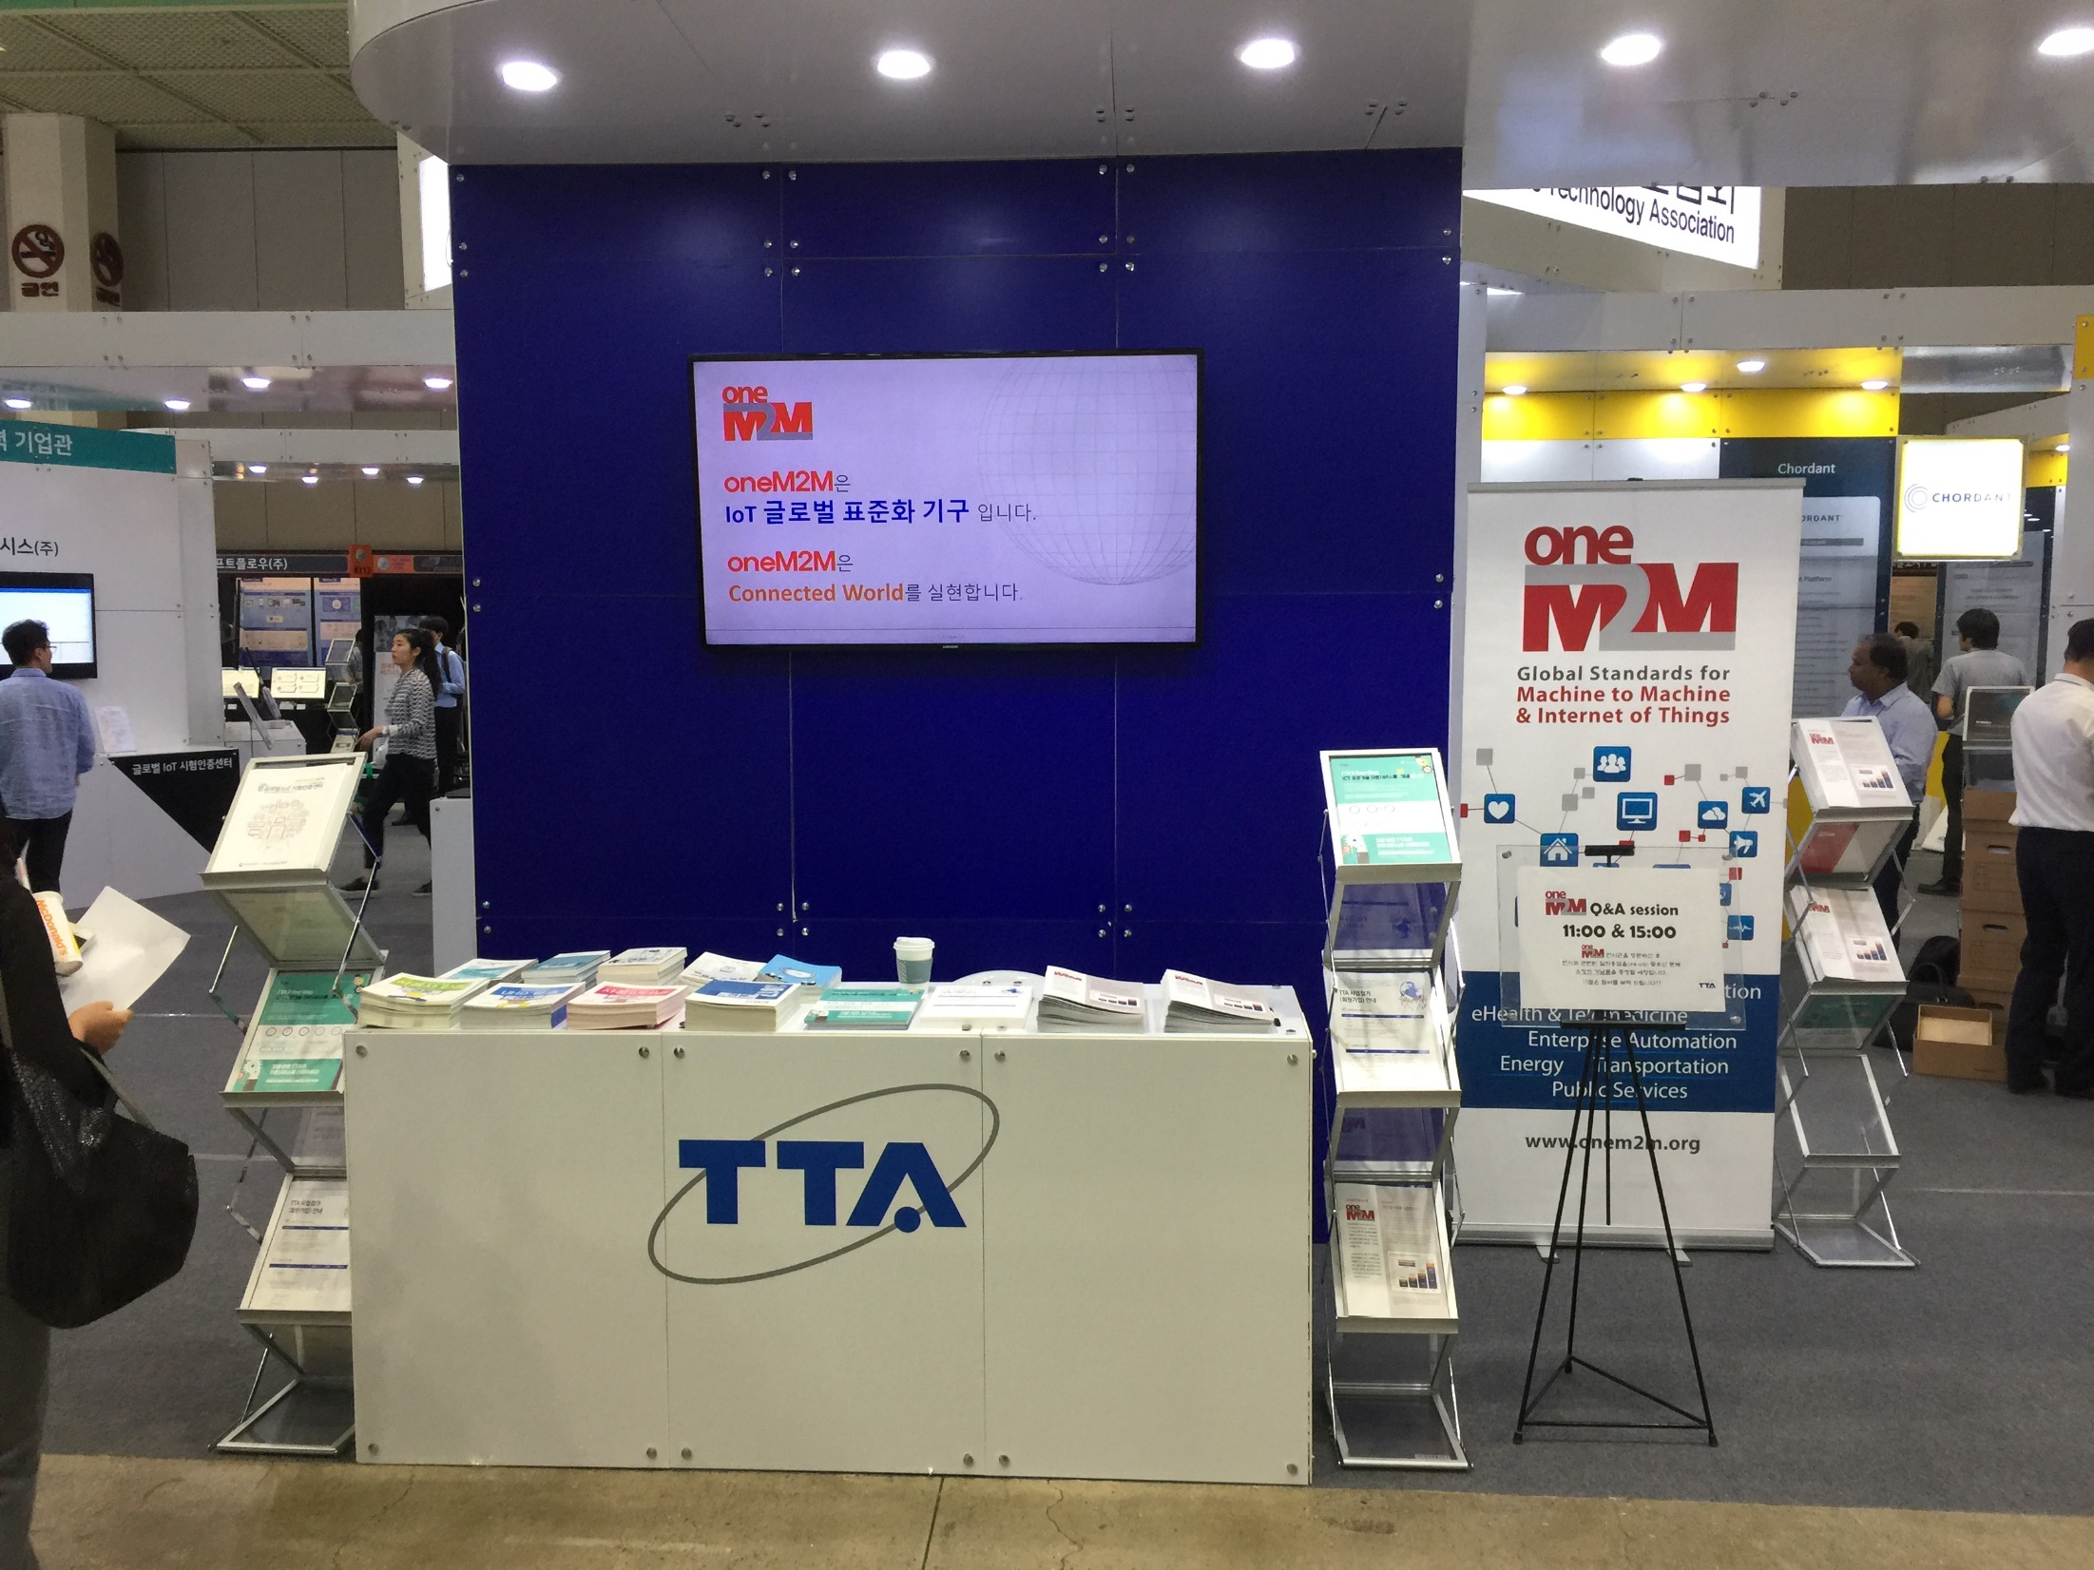
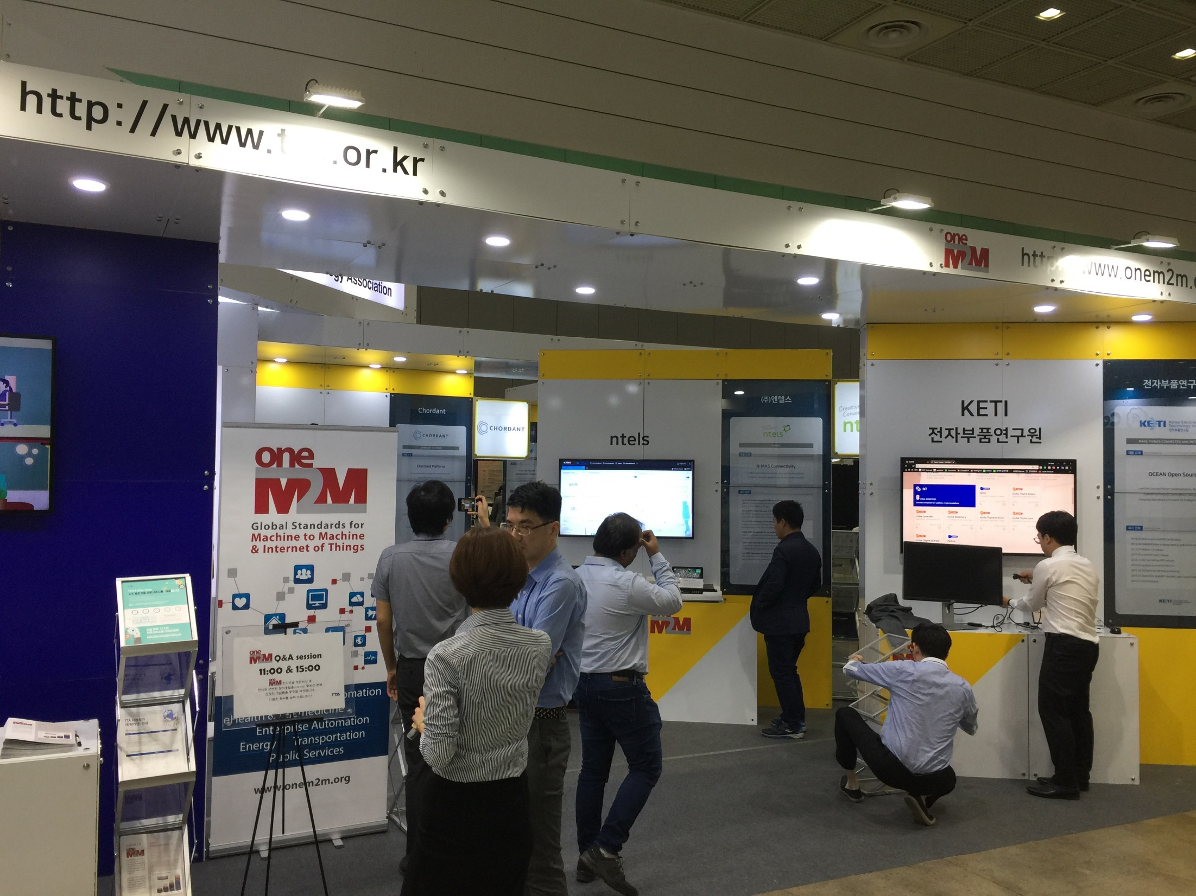
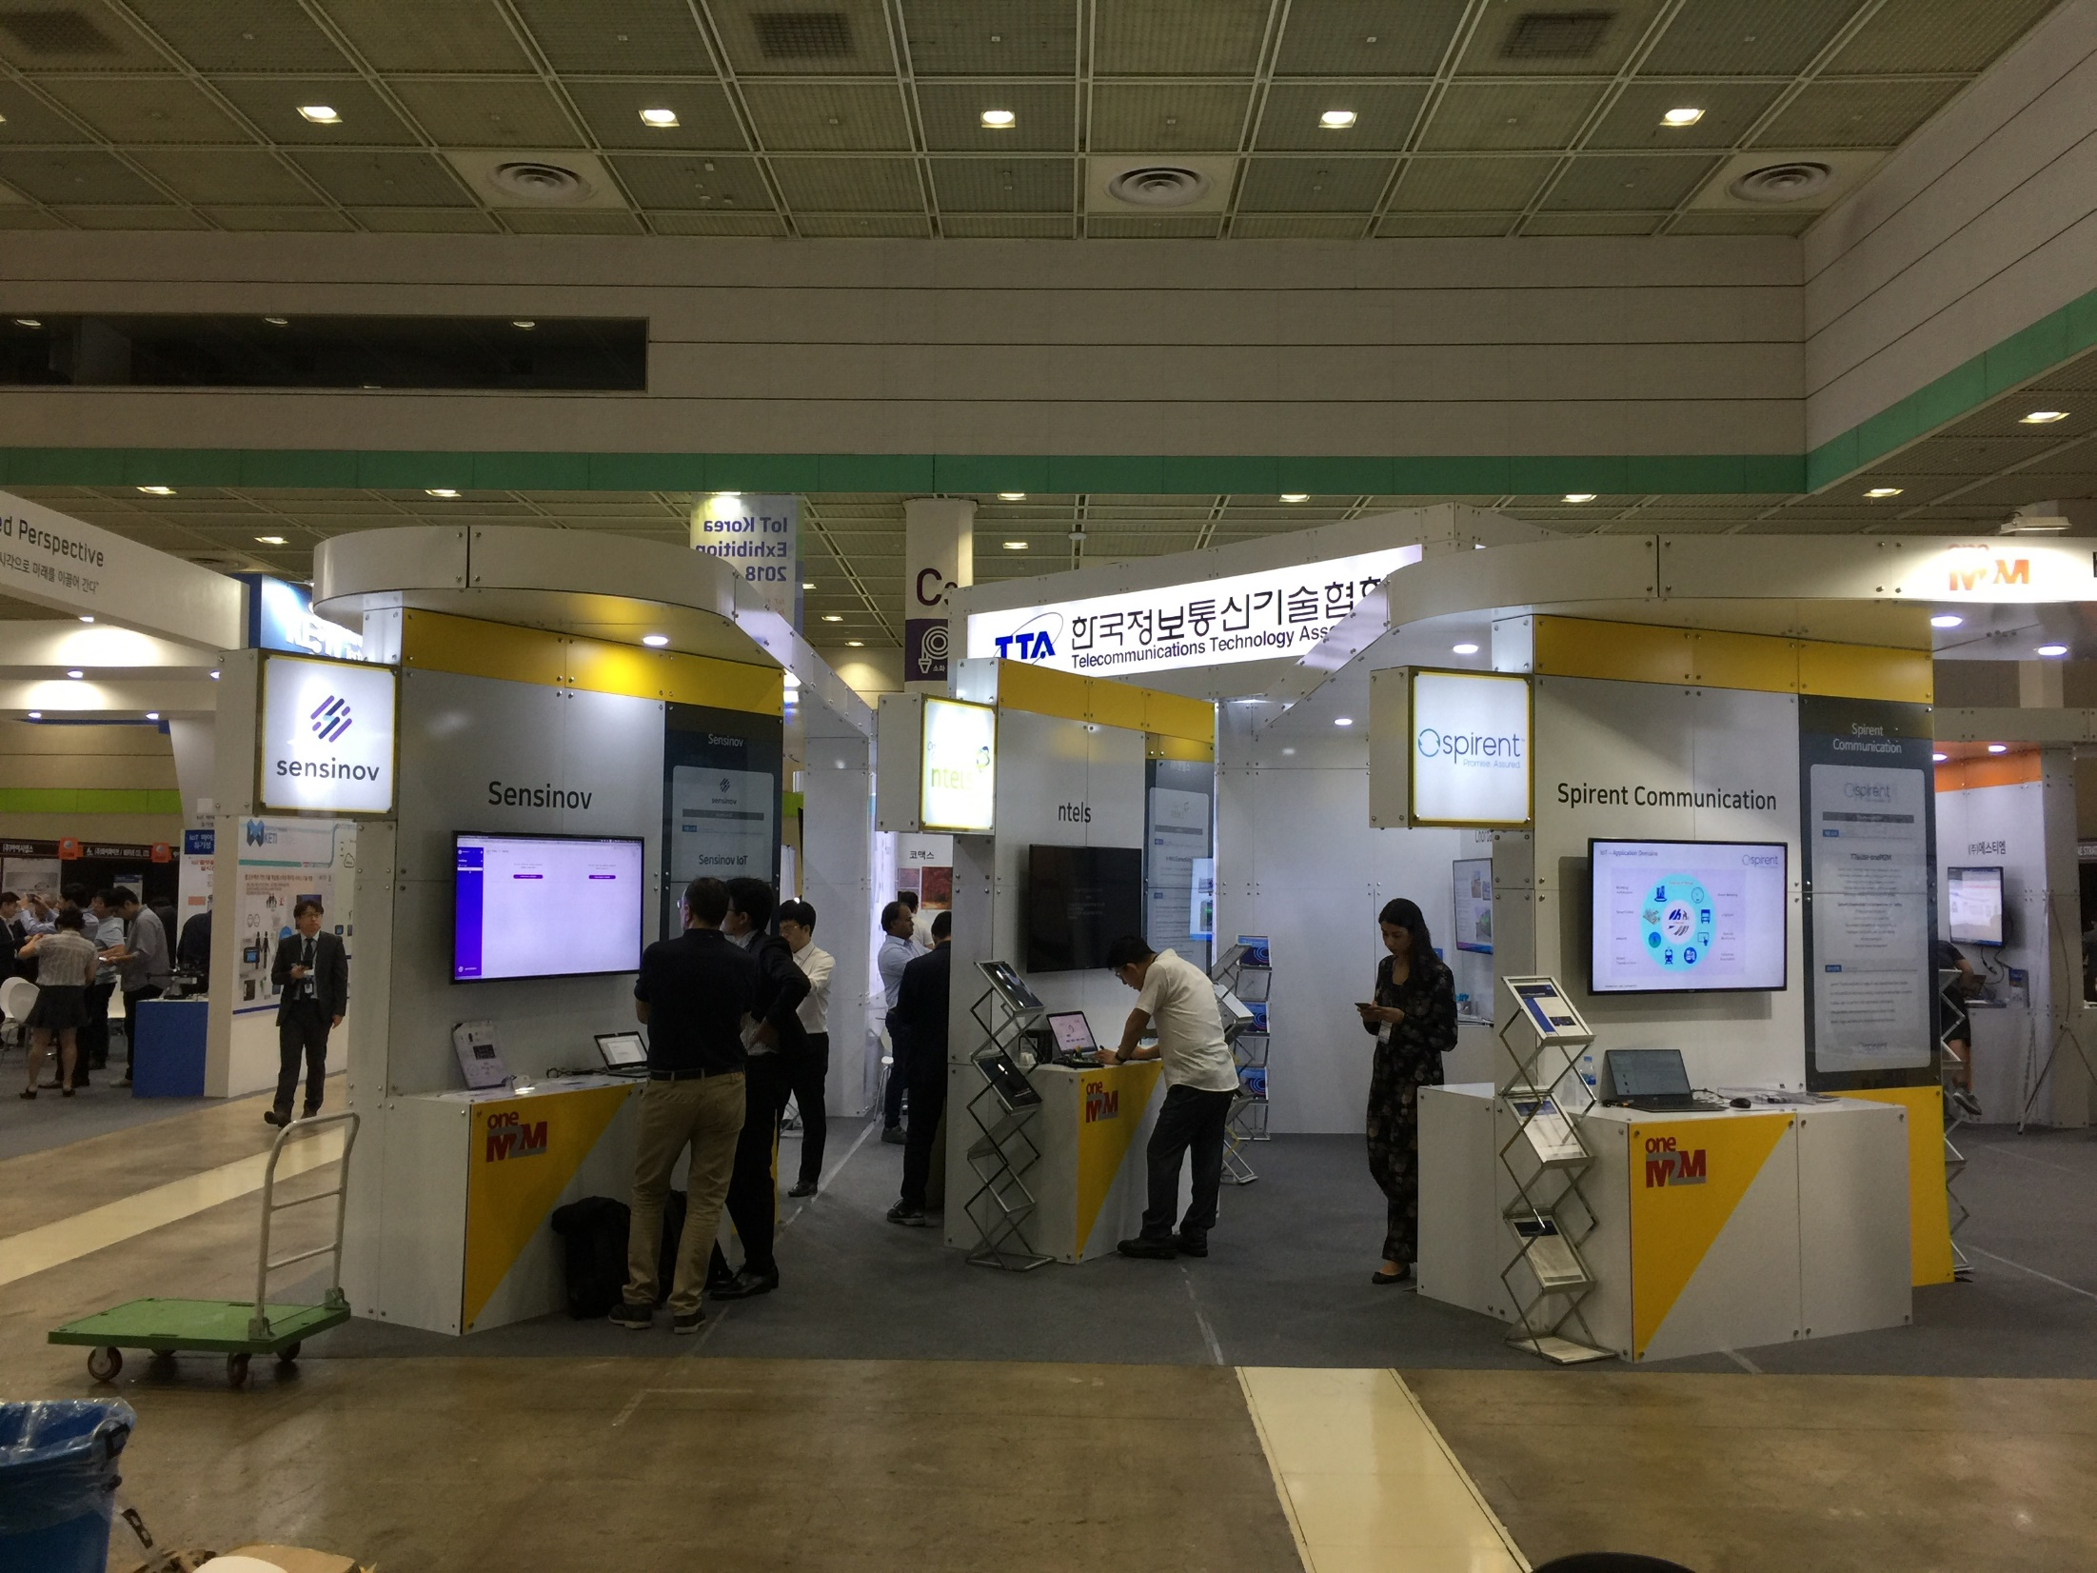
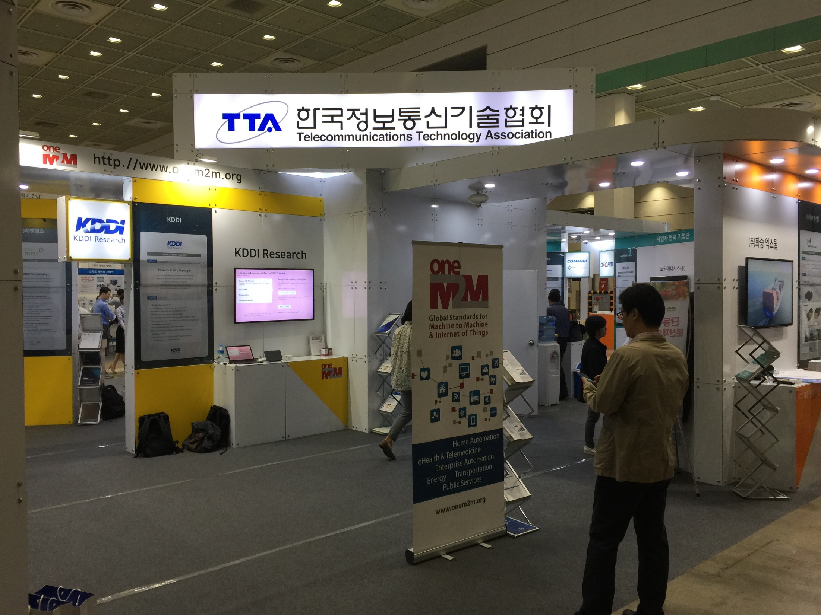
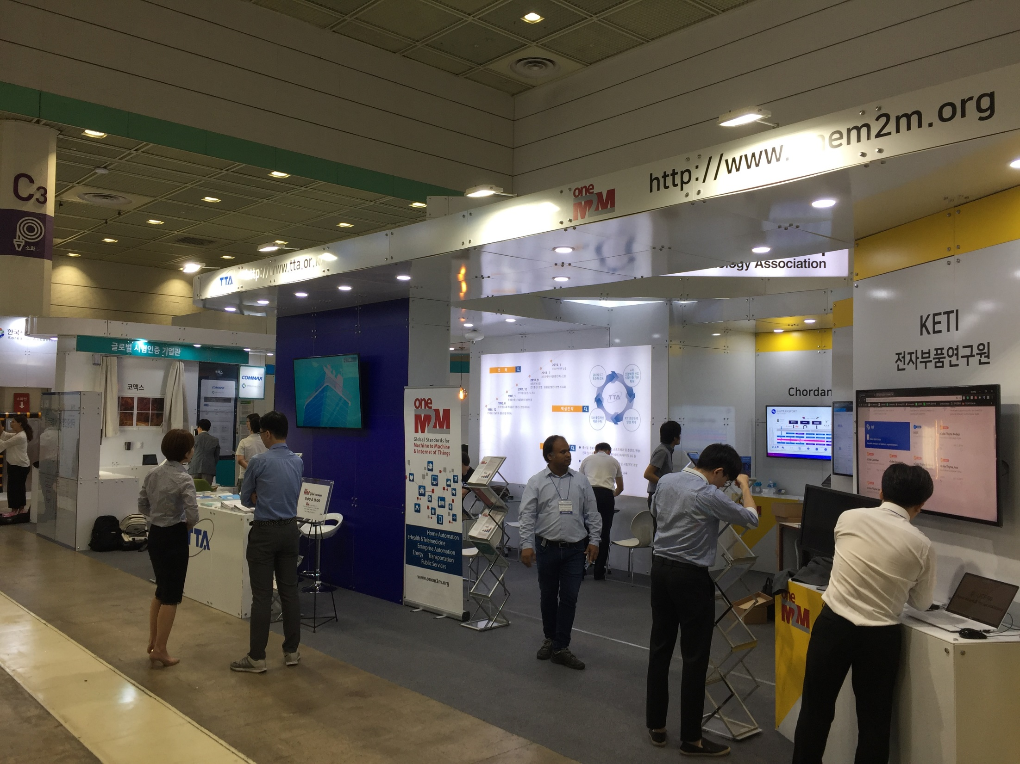
oneM2M booths

Slide 6
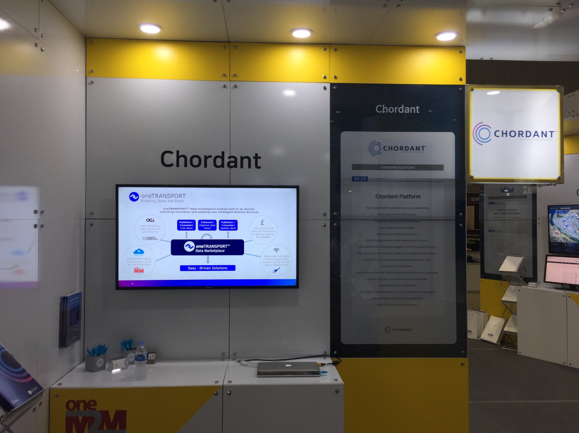
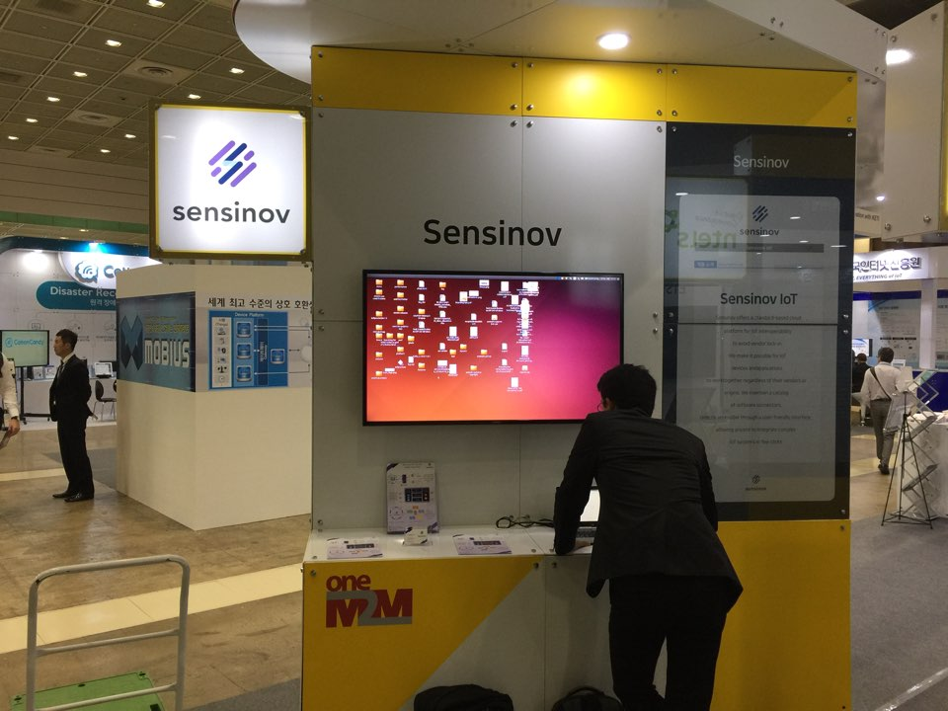
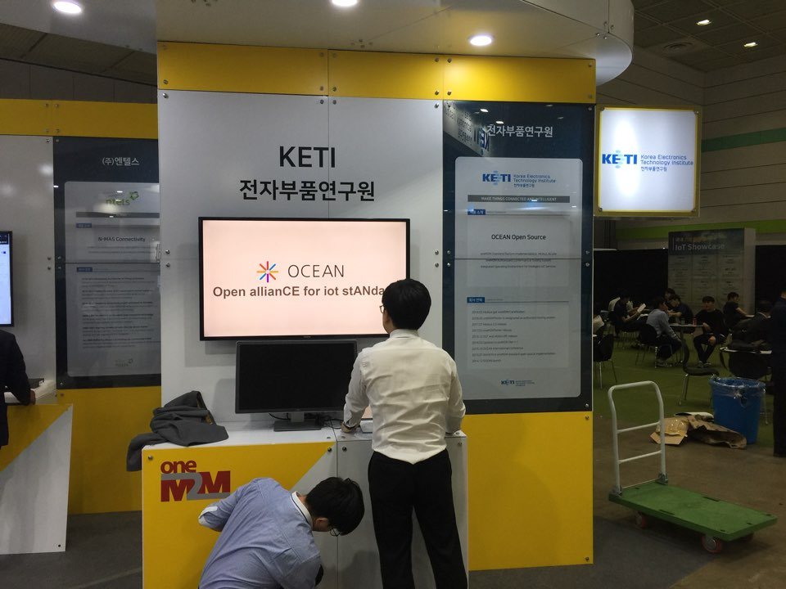
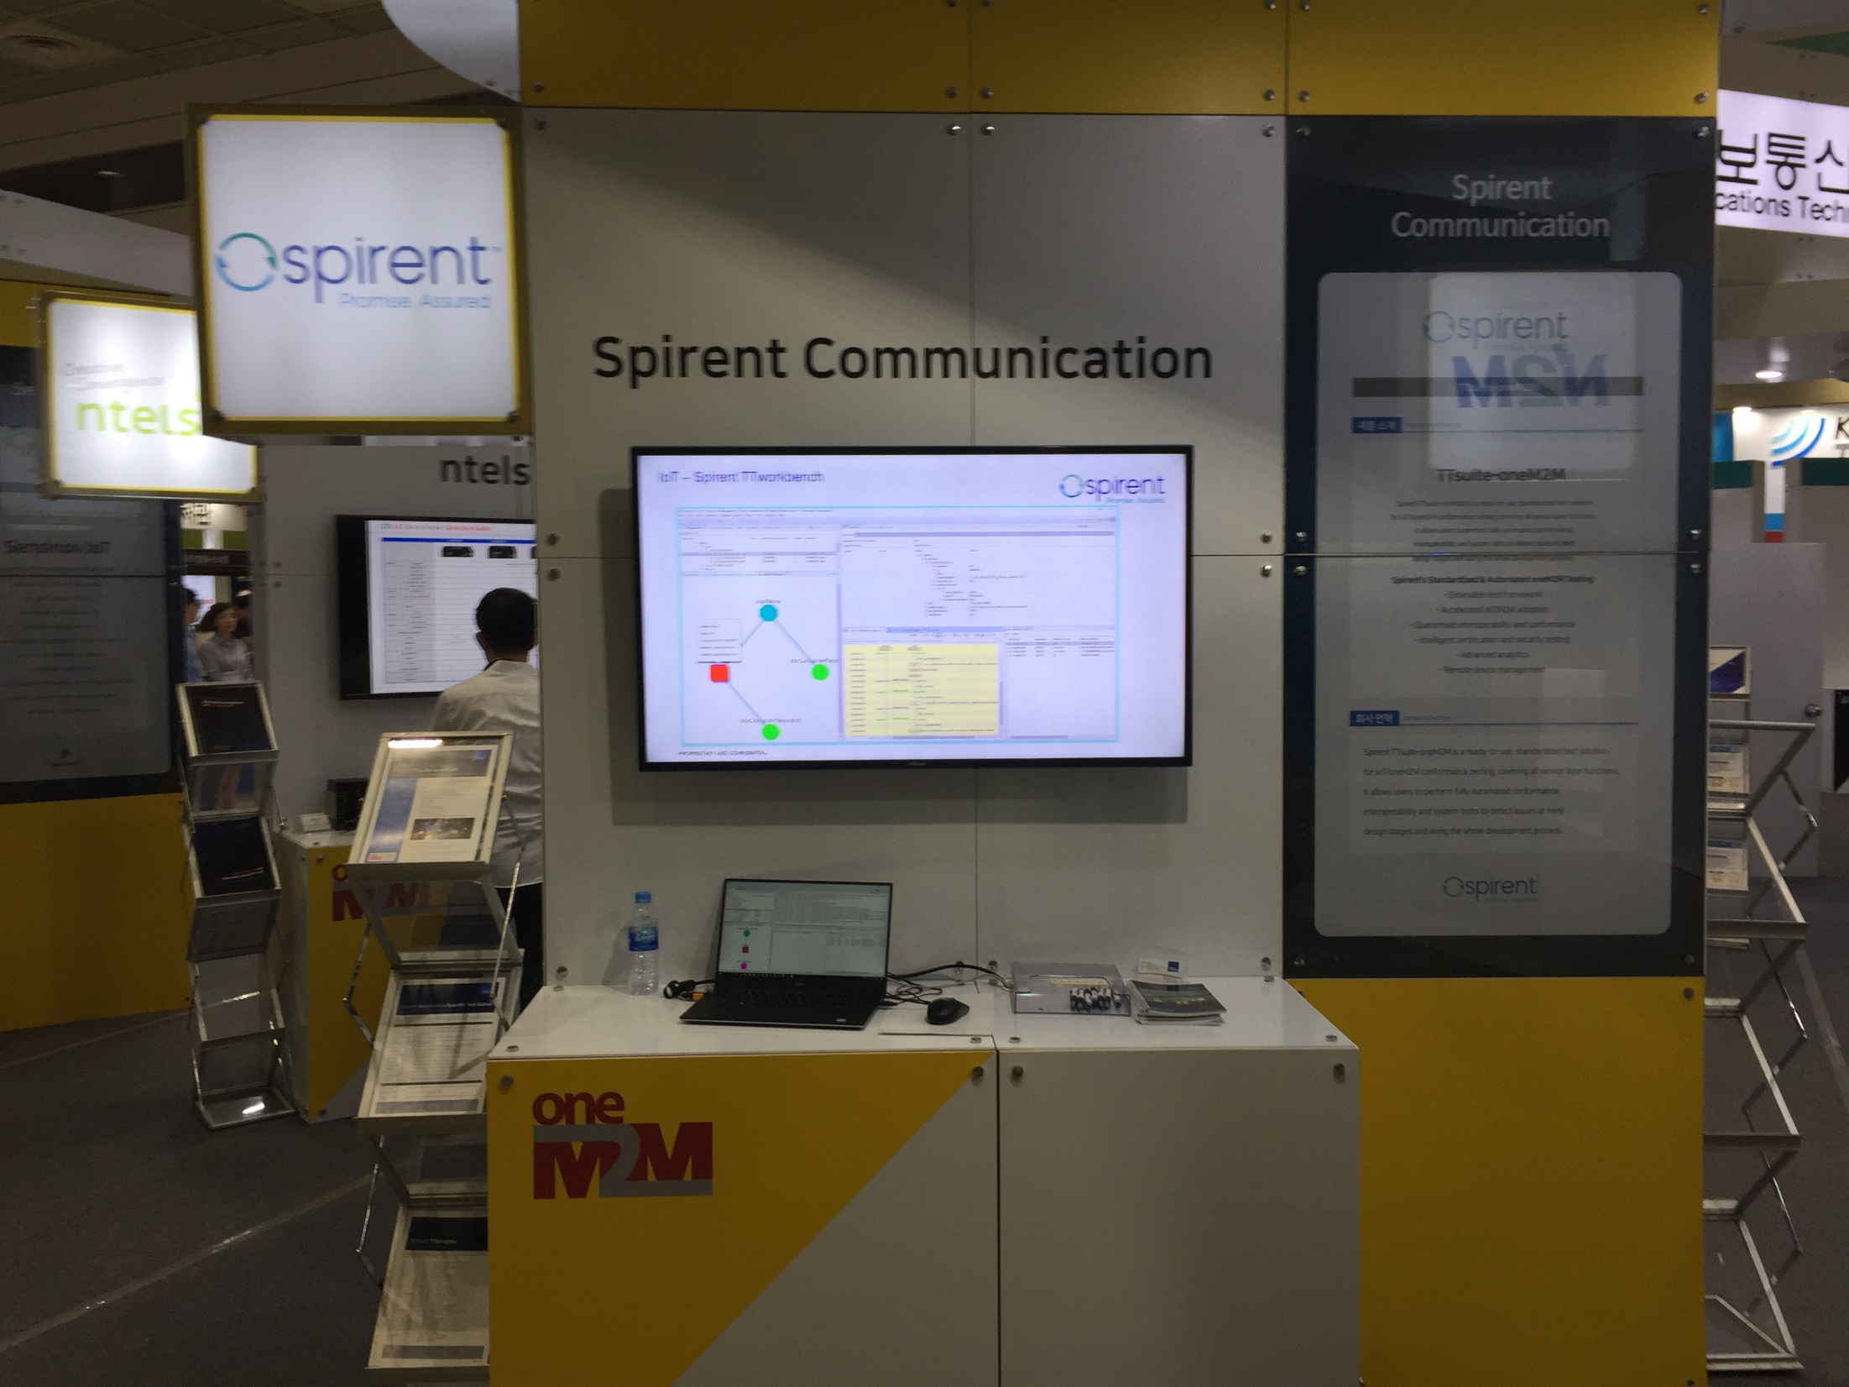
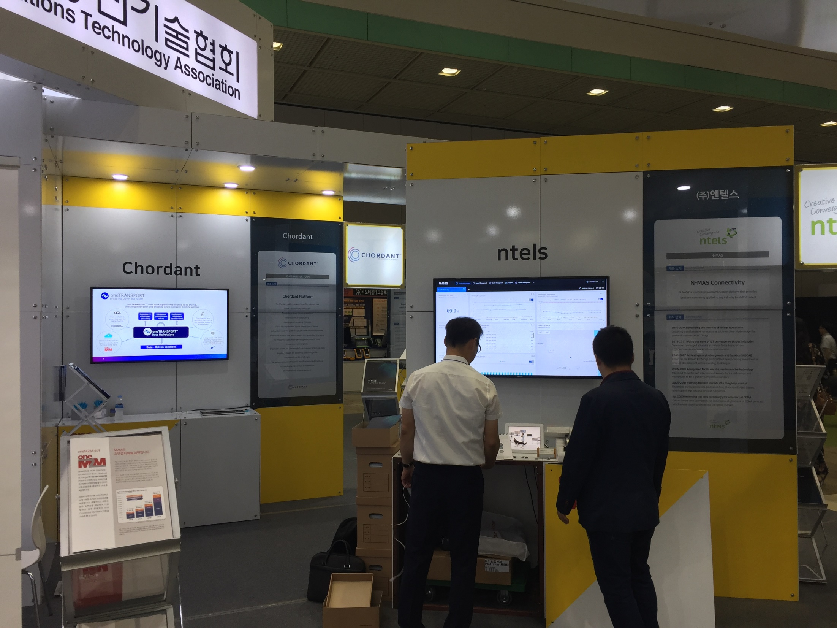
oneM2M participants

Slide 7
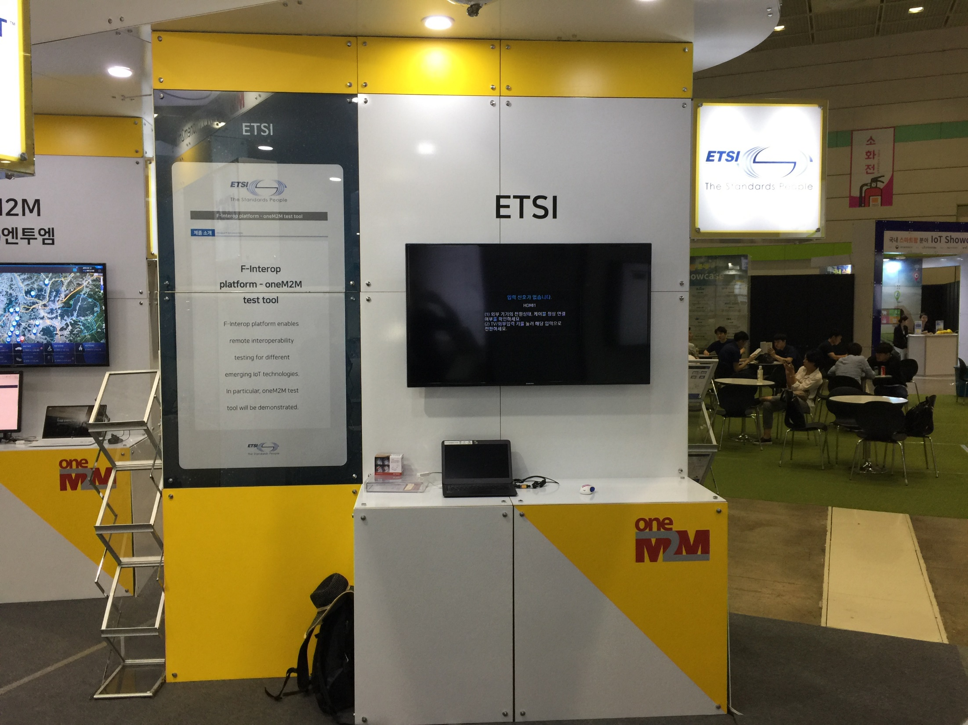
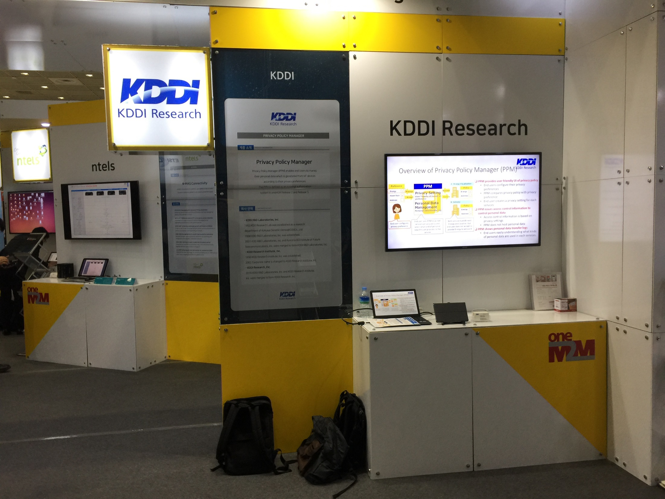
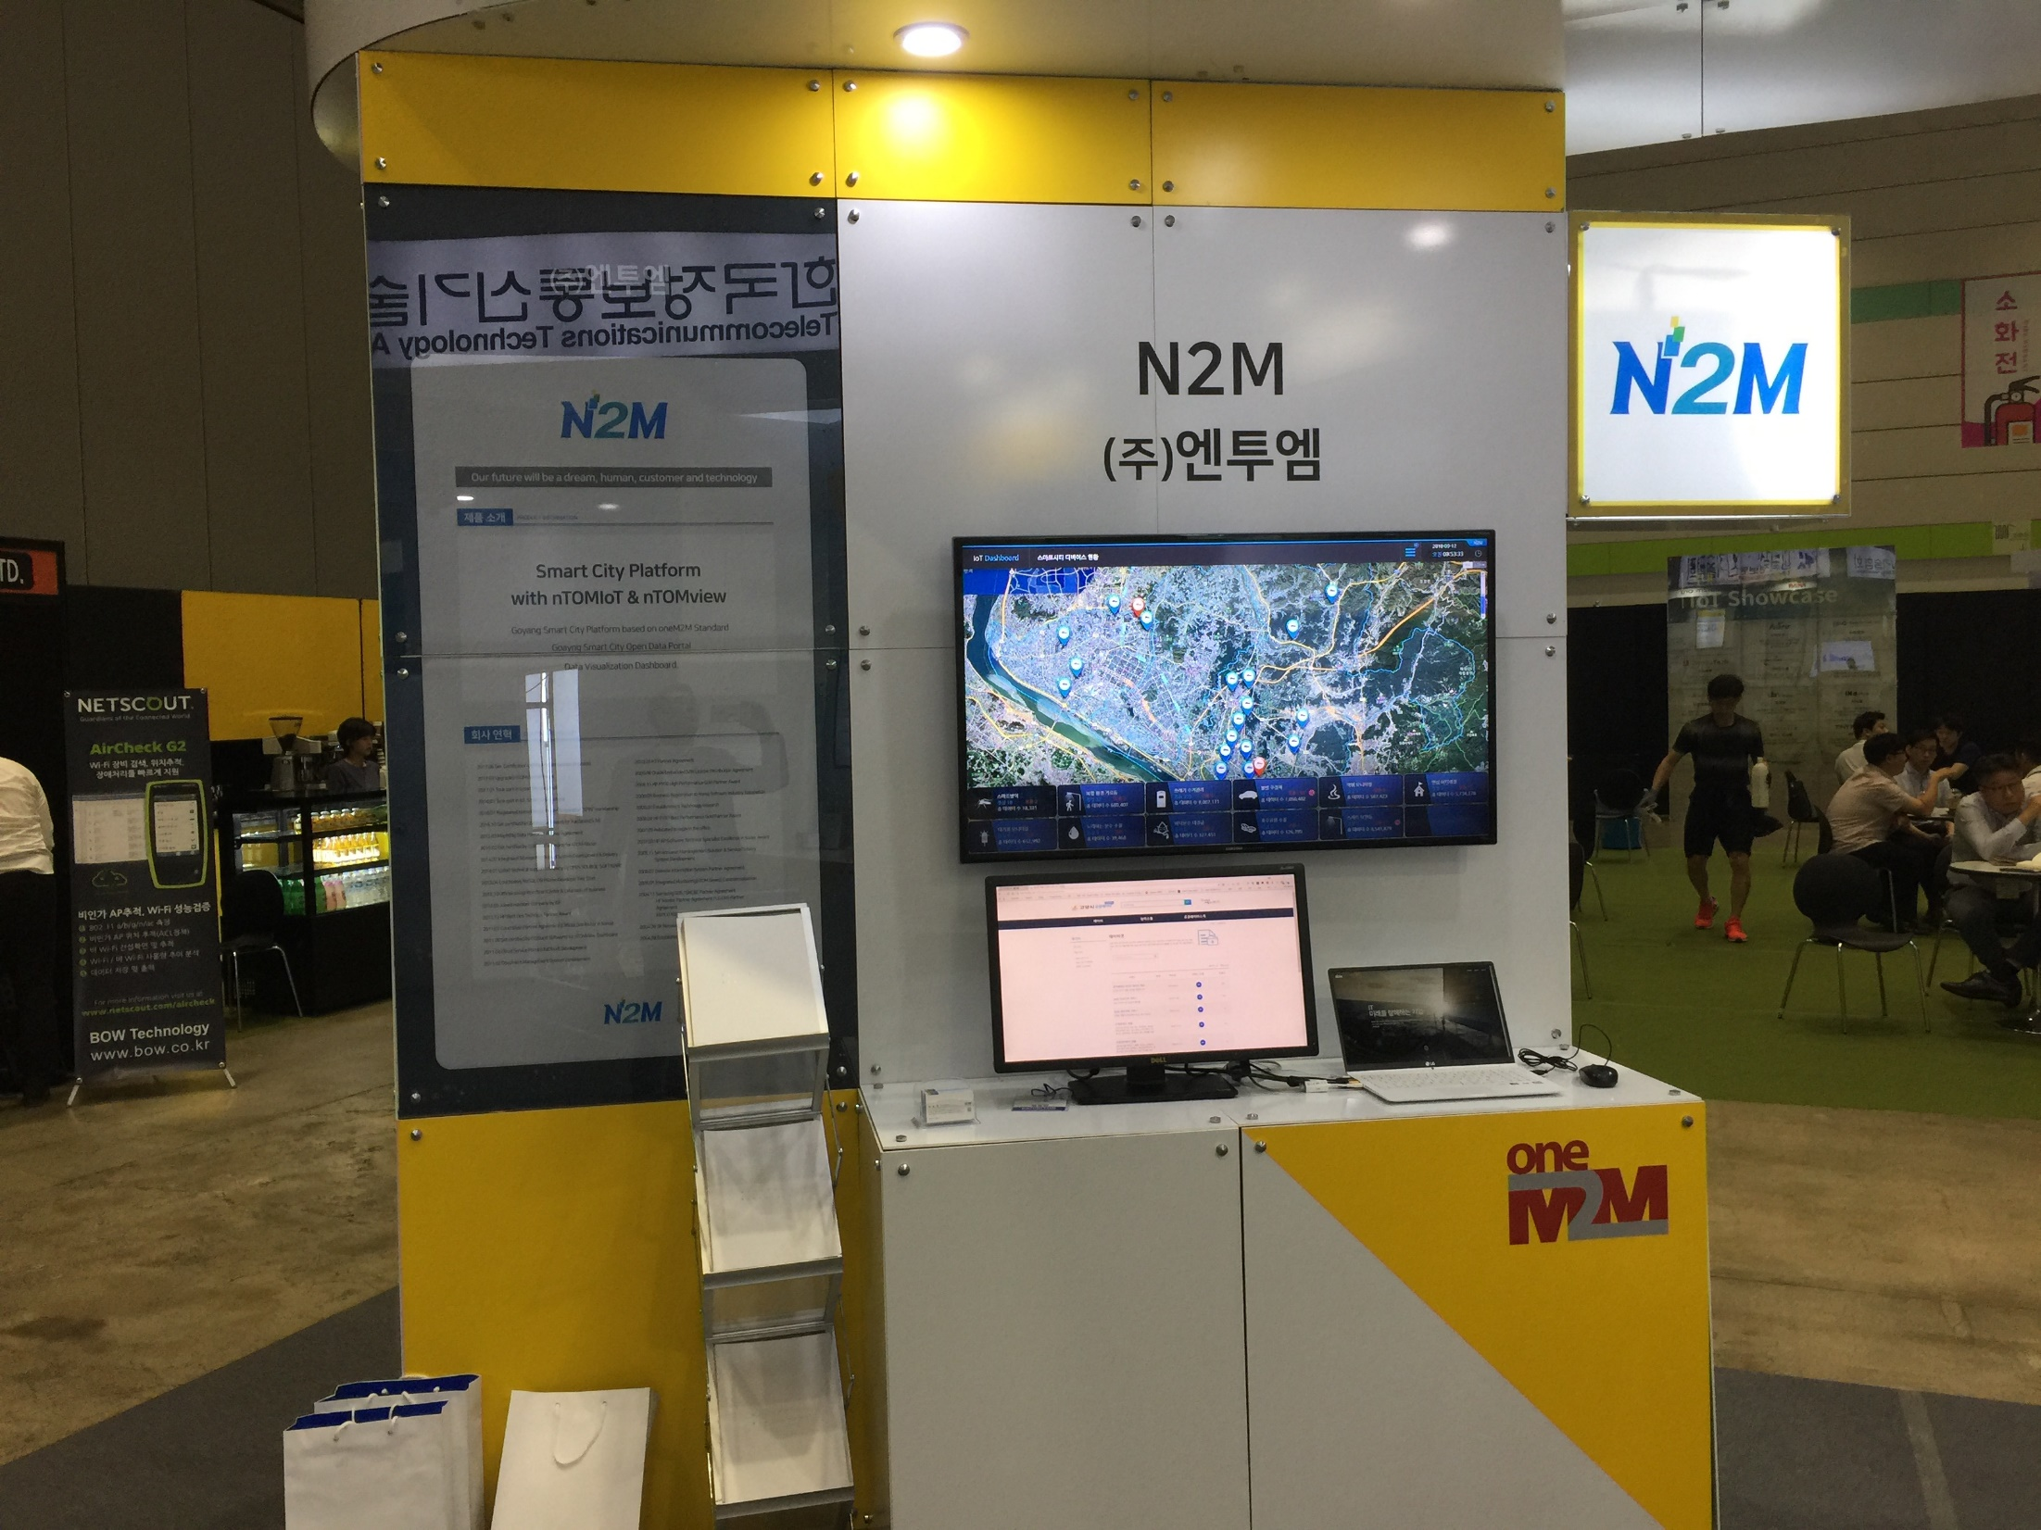
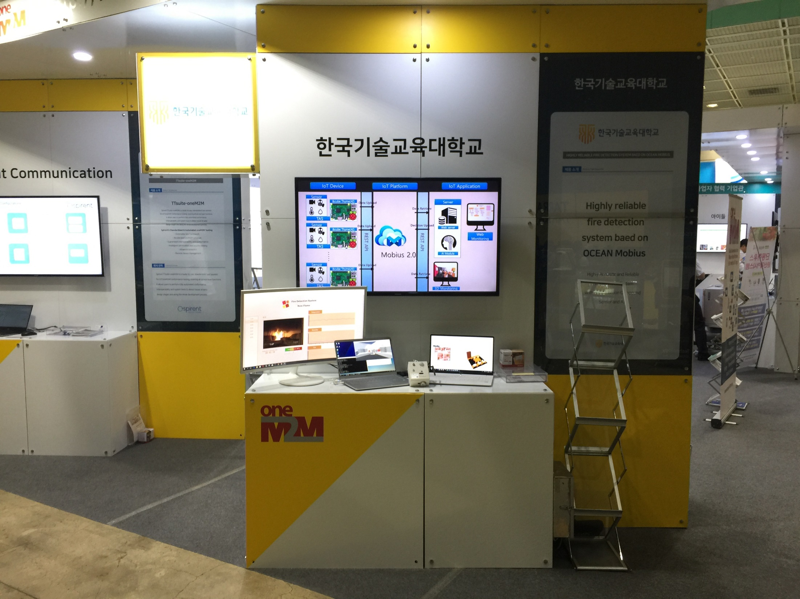
oneM2M participants

Slide 8
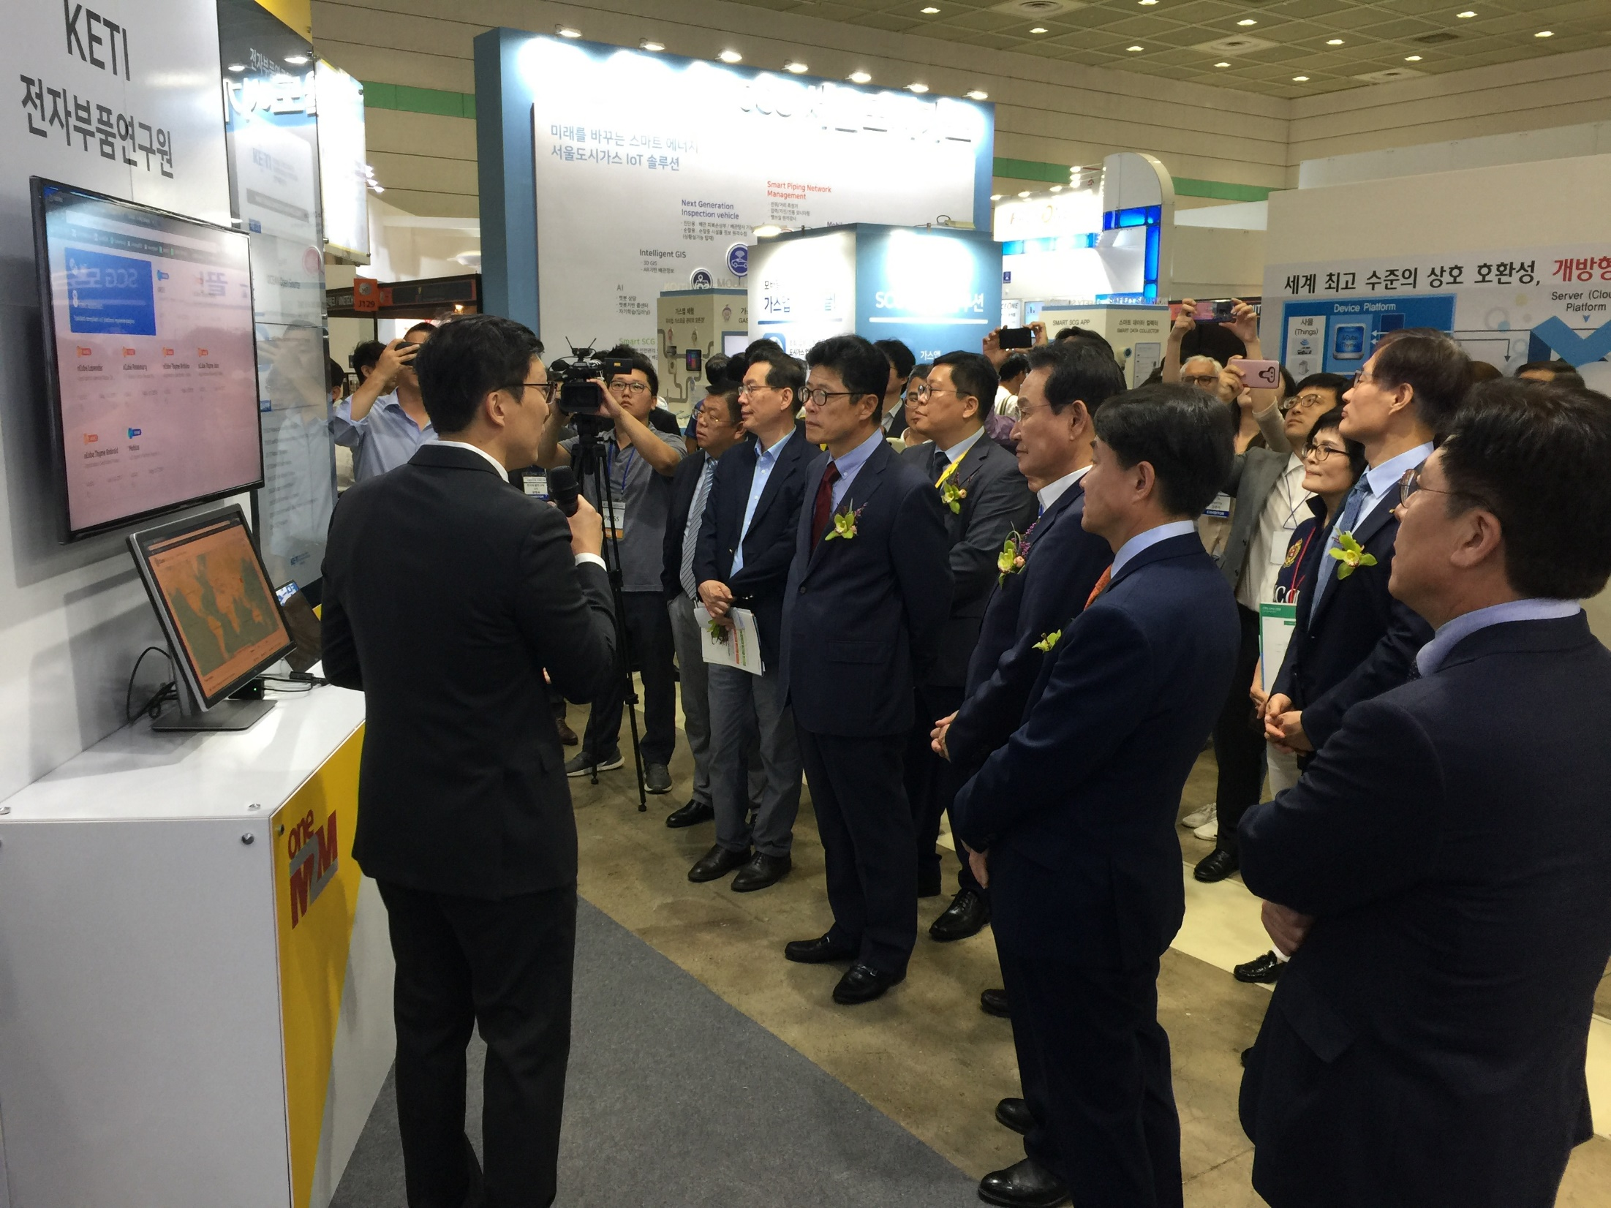
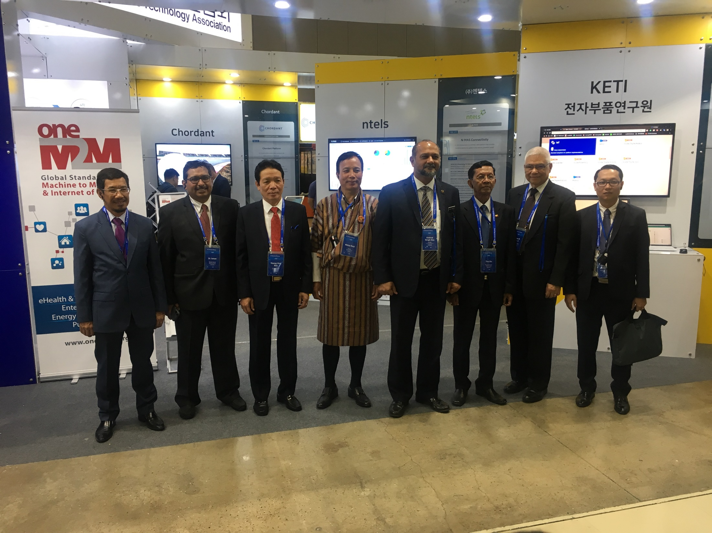
oneM2M Attendees

Slide 9
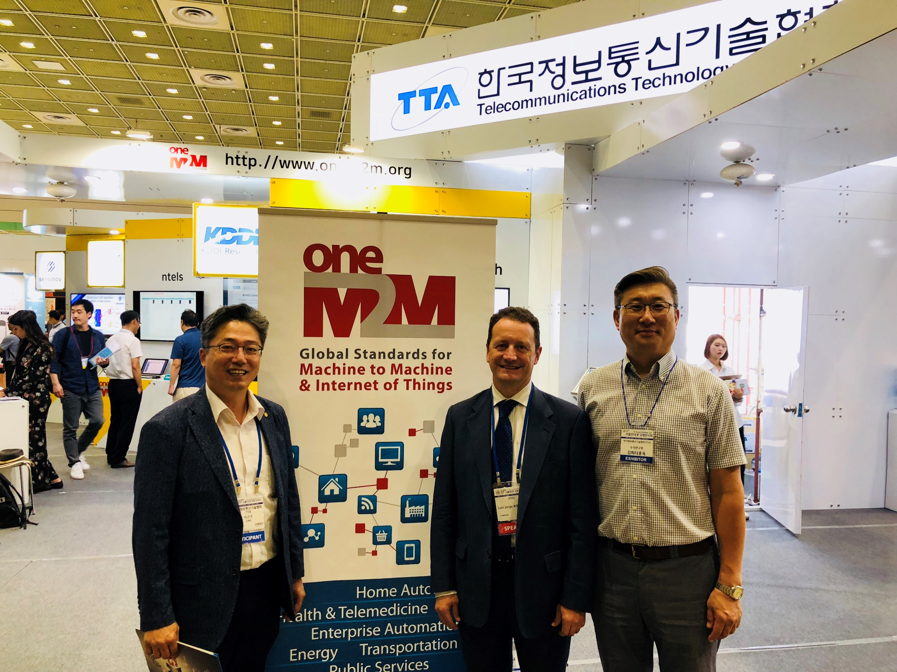
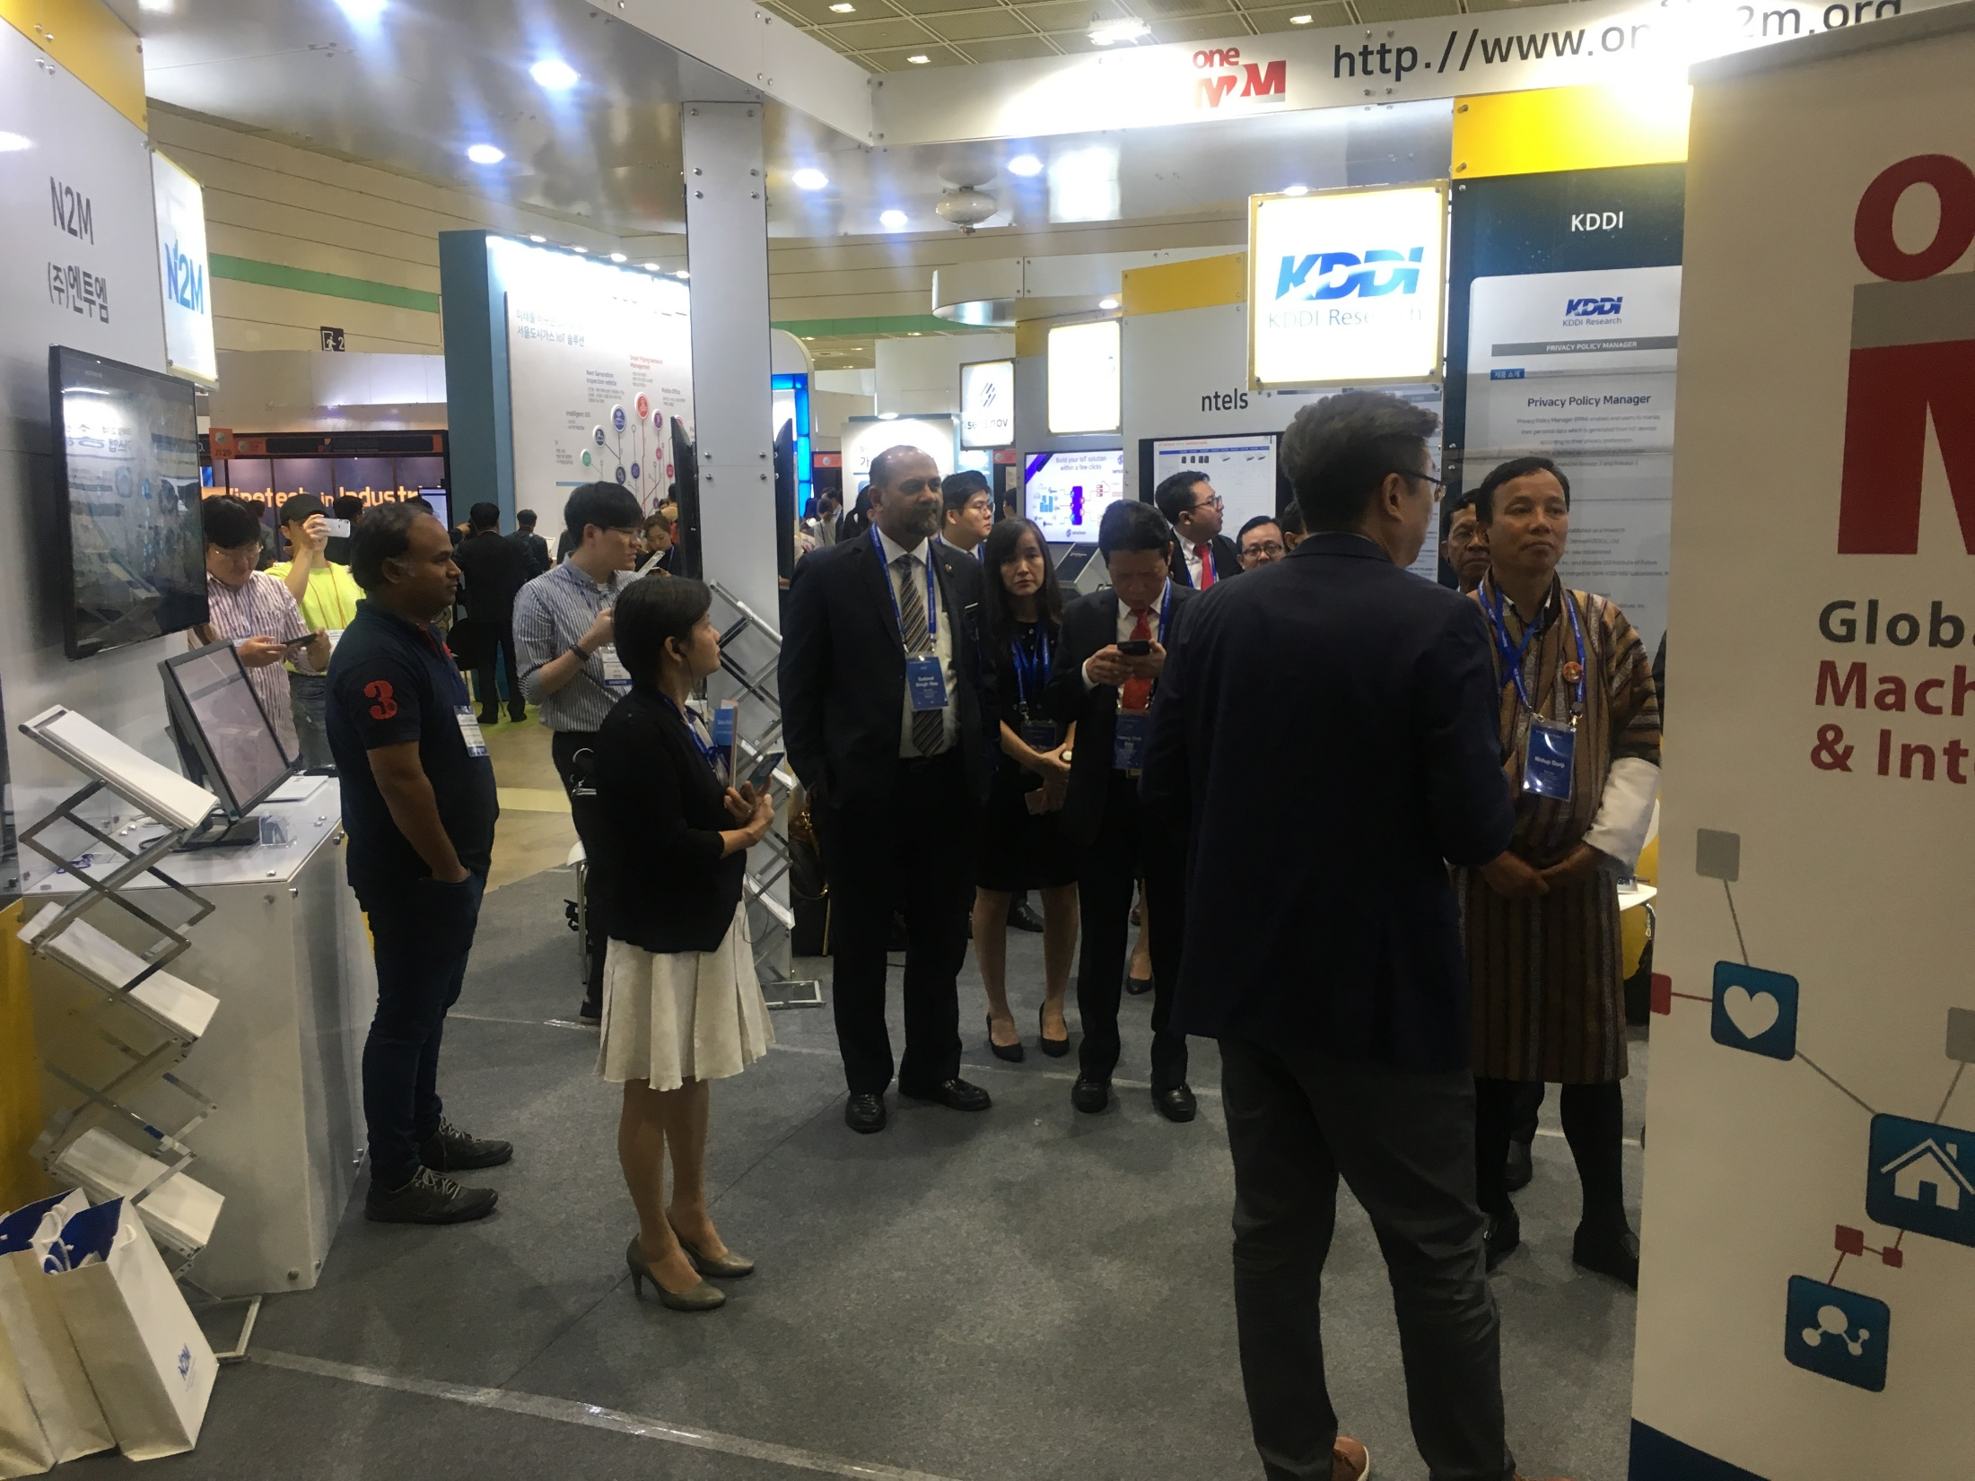
oneM2M Attendees

Slide 10
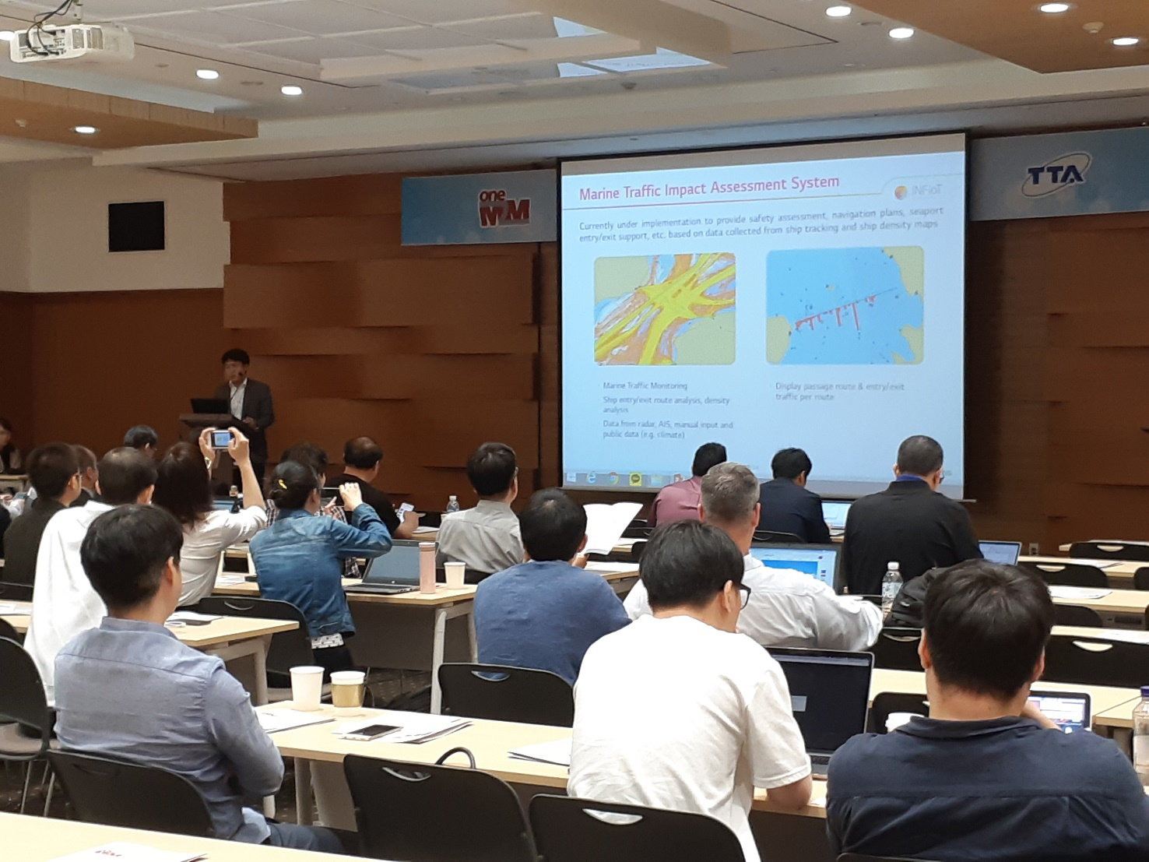
oneM2M Industry Day
Held at COEX conference room
Approximately 80 participants
7 presentations on oneM2M and its Domestic and Global market Adoptions
3 presentations on oneM2M Open Source and Certification

Slide 11
Thank you

