Slide 1
Linked Smart City IoT Open Data
TP-2020-0011-Linked_Smart_City_IoT_Open_Data
Group Name: TP#44
Source: JaeSeung Song, KETI
Meeting Date: February 18, 2020

Slide 3
Linked Data
It describes HTTP-based Data Access by Reference for the Web
Current web is changing from hypertext links (link documents) to hyperdata links (linking data)
Linked data provides a powerful mechanism for meshing disparate and heterogeneous data
Four Rules for linking data
Use URIs as names for things
Use HTTP URIs so that people can look up those names
When someone looks up a URI, provide useful information (URI dereferencing)
Include links to other URIs, so that they can discover more things

Slide 4
W3C SWEO Linking Open Data Project
Project aims to
Publish existing open license datasets as linked data on the web
Interlink things between different data sources
Develop clients and applications that consume linked data from the web

Slide 5
Bubbles in May 2007
Over 500M RDF triples
Around 120K RDF links between data sources

Slide 6
Bubbles in April 2008
>2B RDF triples
Around 3M RDF links

Slide 7
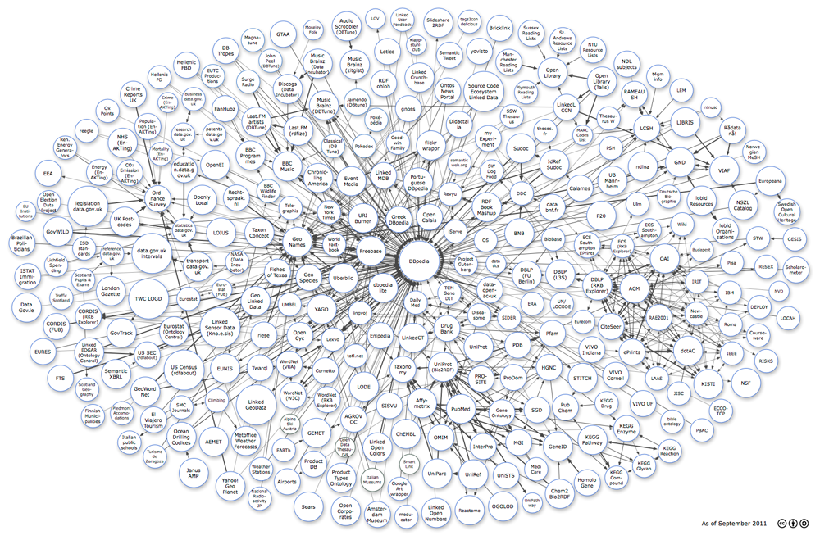
And 2011

Slide 8
And 2011

Slide 9
Semantics & LoD
LoD is one of key factors to make Semantics successful
LoD projects make LoD visible and growing faster
Some projects (exerpt from Wiki):
DBpedia – a dataset containing extracted data from Wikipedia; it contains about 3.4 million concepts described by 1 billion triples, including abstracts in 11 different languages
FOAF – a dataset describing persons, their properties and relationships
GeoNames – provides RDF descriptions of more than 7,500,000 geographical features worldwide.
UMBEL – a lightweight reference structure of 20,000 subject concept classes and their relationships derived from OpenCyc, which can act as binding classes to external data; also has links to 1.5 million named entities from DBpedia and YAGO
Wikidata – a collaboratively-created linked dataset that acts as central storage for the structured data of its Wikimedia Foundation sister projects
Global Research Identifier Database (GRID) – an international database of 89,506 institutions engaged in academic research, with 14,401 relationships, models two types of relationships: a parent-child relationship that defines a subordinate association, and a related relationship that describes other associations

Slide 10
oneM2M-based Smart City is ready to be connected
oneM2M supports all the ingredient to make smart city data to be linked
Semantic features (ontoloty, annotation, etc)
Various smart cities around the world using oneM2M
Smart City services are generating data even at this moment
Linked Data concept is not yet introduced in oneM2M
Ontology management portal is needed
Also some tools converting exsiting city data to become part of LOD are required
Question:
Why don’t we support such cities to link their open data like what the LOD project did?

Slide 11
oneM2M-based Smart City is ready to be connected
Linked Open Smart City IoT Data
LIOD Alliance
Existing LoD
Busan (?)
Bordeaux (?)
London (?)
Montreal (?)
Ho Chi Minh (?)
More Cities or City Projects
Existing Smart City
Support
LIOD crawler
Smart City Ontology Management Portal

