Slide 1
oneM2M Technical Plenary #47
AI/ML for IoT: Enriching oneM2M with generic AI capabilities
A Proof-of-Concept
Ken Figueredo
ETSI Specialist Task Force 584
3 Nov. 2020

Slide 2
Agenda
Project introduction and context (15 minutes)
Use cases implemented by Sensinov (30 minutes)
Use case implemented by Ubiwhere (15 minutes)
Concluding discussion and avenues for future work (30 minutes)

Slide 3
Project Introduction & Context

Slide 4
ETSI Specialist Task Force (STF) 584 Artificial Intelligence for IoT Systems
Objectives
Provide an initially validated architecture that describes how IoT systems can make use of Artificial Intelligence (AI) and Machine Learning (ML) for the management and interpretation of data from IoT devices
Identify the requirements to extend/adapt oneM2M to improve the integration of AI/ML techniques and ensure that the associated management of data is properly handled by the IoT Service Layer

Slide 5
Project Team and Approach
Multi-disciplinary and International Project Team
Mahdi Ben Alaya, Sensinov Emmanuel Darmois, CommLedge
Ricardo Vitorino, Ubiwhere Ken Figueredo, More with Mobile
João Garcia, Ubiwhere
PROJECT PLAN & DELIVERABLES
Identify ‘AI for IoT’ Architecture Evolutions
Proof of Concept Implementations
Dissemination toward IoT and oneM2M community
ETSI TR 103 674:
SmartM2M: Artificial Intelligence and the oneM2M architecture
ETSI TR 103 675:
SmartM2M: AI for IoT - Proof of Concepts and Open-source Code
Presentation at
oneM2M Technical Plenary #47

Slide 6
Analysis of representative use-cases
AI/ML USE-CASES: POINT-SOLUTION & HORIZONTAL CAPABILITIES
ID | Use-Case
1 | Fault management and isolation for IoT field devices
2 | Detection of patterns in video streams
3 | Language-based pattern recognition in social media/crowdsourced data
4 | Supervisory road-network traffic management for journey planning or to manage transportation logistics
5 | Autonomic Management and Control of Communications Networks
6 | Occupancy Prediction in Smart Parking
7 | Knowledge graphs and semantic reasoning in smart buildings
8 | Trustworthy AI
9 | Verifiable AI
SOURCE: ETSI TR 103 674: SmartM2M: Artificial Intelligence and the oneM2M architecture (to be published)

Slide 7
Definitions: A generic IoT system
Application(s)
Toolkit of Common Services
Application Management
Connectivity management
Device management
Security
Others ….
Middleware
Devices & Connectivity

Slide 8
oneM2M Framework: A single API for a toolkit of common service functions
Toolkit of Common Service Functions
IoT Application Layer
Registration
Discovery
Security
AE
API
Group Management
Communication Management
Data Management & Repository
oneM2M Common Services Layer
CSE
Subscription & Notification
Device Management
Application & Service Management
API
IoT Devices and Connectivity Layer
Network Service Exposure
Location
Service Charging & Accounting
AE
Semantics
Transaction Management
AE
In oneM2M terminology, an AE represents an Application Entity
CSE
In oneM2M terminology, an CSE represents an Common Services Entity

Slide 9
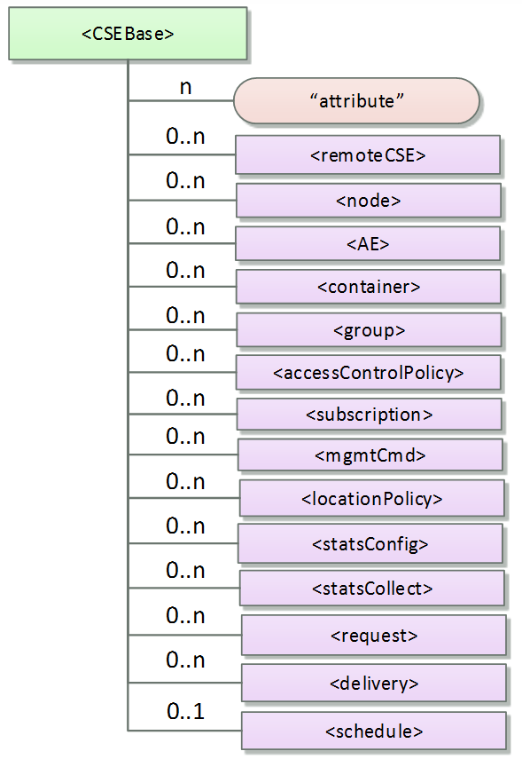
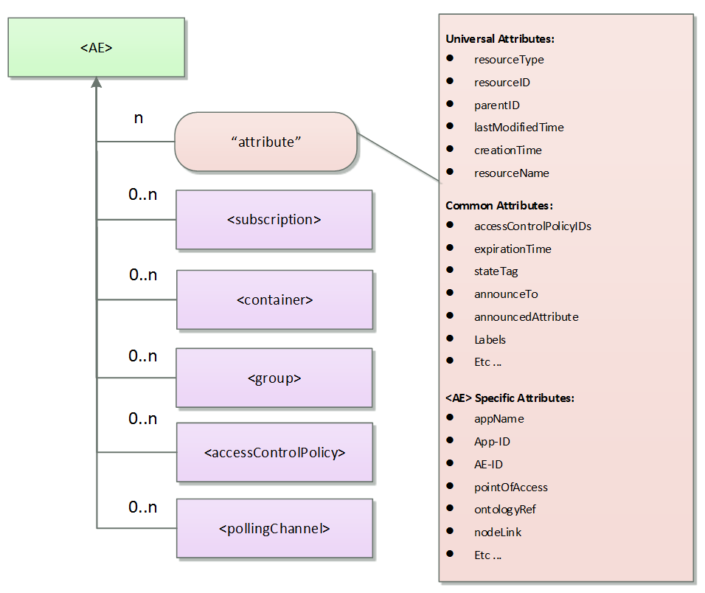
oneM2M Framework: All entities in a oneM2M system are represented as addressable resources in the CSE
IoT Application Layer
AE
API
oneM2M Common Services Layer
CSE
API
IoT Devices and Connectivity Layer
AE
SOURCE: https://www.onem2m.org/getting-started/onem2m-overview/application-program-interfaces-api/onem2m-resources
Notes:
All entities in the oneM2M System, such as AEs, CSEs, application data representing sensors, commands, etc. are represented as resources in the CSE. Each resource is addressable and can be the target of CRUD operations specified in oneM2M primitives.
Each resource has its own specific type.
Each resource type has a defined set of mandatory and optional attributes as well as child resources.
A resource can contain child resources.

Slide 10
Framework for AI/ML in IoT
Knowledge Rules-based AI
Reasoning
Rule-based
Pattern recognition
Decision Making
Recommendations
Automated actions
Supervision
Meta reasoning
Federated reasoning
Explainable AI
Causal inferencing
Fault-tree analysis
AI/ML in the Application Layer
Signal Processing / Machine Learning
Data Processing
Filter
Normalise or Contextualise
Feature extraction
Fusion/Machine Learning (combine streams)
Data mining/ unsupervised learning
Knowledge Representation
Pattern recognition/ Classification
Symbolic mapping/ representation
Data mining/ supervised learning
Device/Data Management
Data Sourcing
Device Management
Communications Management
Data management
Service Layer
Registration & Identity Management
Authentication
Other common services

Slide 11
AI/ML for IoT Challenge: Traditional Approach
Application
Knowledge & Rules-based AI
Signal Processing/Machine Learning
Service layer functions
Application has to ingest and store data
Concentrates all intelligence in the Application layer
Developers recreate basic capabilities for each application they build
Limitations for reuse and replicability
Ingest
Data
Sensor

Slide 12
AI/ML for IoT Challenge: Scalable & Developer-friendly Approach
Application
Knowledge & Rules-based AI
Signal Processing/Machine Learning
AE
Create a bi-directional abstraction layer between Applications and the underlying technologies for data and sensor management
Developers use a standard API in combination with a Subscription/Notification service to access data when notified of changes
CSE
Registration
Device management
Data management
Subscription/Notifications
Other common services
Common Services Layer
API
API
AE
Data
AE
Sensor
AE
Application Entity
CSE
Common Services Entity

Slide 13
Two implications for Common Services Layer capabilities
Knowledge Rules-based AI
1. Convert AI/ML capabilities into “as-a-service” capabilities in the Common Services Layer
Signal Processing / Machine Learning
Device/Data Management

Slide 14
Two implications for Common Services Layer capabilities
Knowledge Rules-based AI
Signal Processing / Machine Learning
1. Convert AI/ML capabilities into “as-a-service” capabilities in the Common Services Layer
2. Feed CSL information to applications in order to improve AI/ML performance
Device/Data Management

Slide 15
Three use-cases selected Proof of Concept testing
ID | Use-Case | PoC Tester
1 | Fault management and isolation for IoT field devices | Sensinov
2 | Detection of patterns in video streams | Sensinov
3 | Language-based pattern recognition in social media/crowdsourced data | Ubiwhere
4 | Supervisory road-network traffic management for journey planning or to manage transportation logistics
5 | Autonomic Management and Control of Communications Networks
6 | Occupancy Prediction in Smart Parking
7 | Knowledge graphs and semantic reasoning in smart buildings
8 | Trustworthy AI
9 | Verifiable AI

Slide 16
Use Case 1 - Fault Management and Isolation for IoT Field Devices (Sensinov)

Slide 17
Use Case 1: Fault management and isolation for IoT field devices Overview
User
Compute
Deviation
Send
Alerts
Models
Training data
4
Receive
prediction
5
3
2
1
Perform Prediction
Send
Measurement
Fault Detection
Service
Sensor

Slide 18
Use Case 1: Fault management and isolation for IoT field devices Architecture
Fault detection aims to identify defective states and conditions within IoT systems, based on measurements from field devices
In this use case, an IoT module will be prototyped for fault detection and isolation in a smart building environment using both a rule-based and a self-learning fault detection algorithms
The main goal is to extend oneM2M with fault detections capability to make it possible for oneM2M developers and users to detect malfunctions in real time, as soon and as surely as possible.
Fault Management PoC Architecture
Application
Configure fault detection
Receive notification when anomalies are detected
AE
CSE
MCA
Accept Fault detection configuration parameters from AEs
Fault detection service: Rule-based/ML-based
Send notification to AEs
Common Services Layer
MCA
MCA
AE
AE
Data
Sensor
Send measurements
Manufacturer worksheets

Slide 19
Use Case 1: Fault management and isolation for IoT field devices Impact on oneM2M
Common Service Function modifications
Data management: extend oneM2M resources (e.g. containers, flexContainers, etc.) with fault detection attributes.
Application and Service Layer Management: Extend the oneM2M MCA interface to support configuration of fault detection parameters (CRUD)
Discovery: Discover resources based on fault detection attributes (Extend filter criteria with fault detection attributes)
Subscription and Notification: Notify an application when an anomaly is detected
Security: Define dedicated access control policies related to fault detection, creation, configuration and notification.
New AI/ML CSF requirements
Rule-based fault detection CSF: configurable service that detect faults based on predefined rules and notifies an application when it detects anomalies in the data (data loss, spikes, crossing of thresholds, etc.)
ML-based fault detection CSF: configuration service that detect faults based on ML algorithms (e.g. exponential smoothing, auto-regressive Integrated Moving Average (ARIMA), etc.) and notify an application when it detects anomalies in the data

Slide 20
Use Case 1: Fault management and isolation for IoT field devices Call flow
AE
Monitoring
CSE
Fault Detection Service
AE Sensor
Register monitoring application in CSE
Register sensor in CSE
Create container to store sensor data
Create fault detection policy rules in CSE
Create content instance (send sensor measurement)
Fault detection using fault detection service
Notify application of a fault detection

Slide 21
Use Case 1: Fault management and isolation for IoT field devices Resource tree
CSE
AE
0…N
faultDetectionPolicy
0..N
targetContainers
0..N
notificationURIs
0..1
threshold
0..1
MaxValue
0..1
MinValue
0..1
latency
1
0..1
deviationThreshold
MinLatency
1
0..1
method
MaxLatency
1
0..1
optimizer
ARIMA
1
p
1
d
1
q

Slide 22
Use Case 1: Fault management and isolation for IoT field devices Demonstration
Demonstration UC1

Slide 23
Use Case 2 – Detection of Patterns in Video Streams (Sensinov)

Slide 24
Use Case 2: Detection of patterns in video streams Overview
Verify
Classification
Score
User
Models
Training data
Send
Alerts
4
Send classification Report
4
3
2
1
Perform classification
Send
images
Visual Recognition
Service
Camera

Slide 25
Use Case 2: Detection of patterns in video streams Architecture
Video Pattern Detection PoC Architecture
Visual recognition represents a relative understanding of visual environments and their context involving many academic subjects, such as computer science, mathematics, engineering, physics, biology and cognitive science.
In this use case, an IoT module performs image classification using machine learning and trained data. A camera periodically reads images from a data store and pushes them to the oneM2M platform and receive notifications when trained categories are recognized.
The main goal is to extend the oneM2M architecture with visual recognition capabilities to make it possible for oneM2M developers to gain high-level understanding from digital images through the construction of explicit, meaningful descriptions of physical objects, and scenes and use them to make relevant decisions.
Monitoring Application
Visual recognition configuration and training
Receive notification related to relevant scenes, objects, and situations.
AE
MCA
Classifier CSF
Accept classification configuration and training data from AEs
Perform predefined-classification / Custom classification
Send notification to AEs
AE
Common Services Layer
MCA
MCA
MCA
AE
AE
Training data
Camera
Smart City images

Slide 26
Use Case 2: Detection of patterns in video streams Impact on oneM2M
Common Service Function modifications
Data management: use existing oneM2M resources (e.g. containers, flexContainers, etc.) or create new ones to store training images, real images coming from cameras, and the result of the classification.
Application and Service Layer Management: Extend the oneM2M MCA interface to support the configuration and train of the visual recognition service (CRUD).
Discovery: Discover resources based on the visual recognition attributes (Extend filter criteria with image classification attributes, types, etc.)
Subscription and Notification: Notify an application when a car vandalism is detected within the city
Security: Define dedicated access control policies related to visual recognition creation configuration and notification
New AI/ML CSF Requirements
Predefined-classifier CSF. The CSF comes with a predefined and pretrained classifier for Object detection, Object tracking, Semantic Segmentation, Instance Segmentation, etc.).
Custom classifier CSF image classification CSF. Allow an application to create its own classifier and train it to implement specific visual recognition use cases.

Slide 27
Use Case 2: Detection of patterns in video streams Call flow
AE
Monitoring Application
CSE
Image Recognition Service
AE Camera
Register AE monitor in CSE
Register AE camera in CSE
Create container images
Create ‘car-vandalism’ classifier
Store ‘car-vandalism’ classifier
Create ‘broken-window’ class
Store ‘broken-window’ class
Create ‘flat-tire’
class
Store ‘wheel flat-tire’
class
Create content instance (publish camera screenshot)
Pattern recognition triggers visual recognition report
Send report to notify monitoring application

Slide 28
Use Case 2: Detection of patterns in video streams Resource tree
CSE
AE
0..N
classifier
0..N
NotificationURis
1
name
1
Status
0..N
targetContainers
1
0..N
class
name
0..N
0..N
Images
Report
1
1
timestamp
id
1
1
timestamp
image
1
1
source
container
1..N
1
className
output
1
Score

Slide 29
Use Case 2: Detection of patterns in video streams Demonstration
Demonstration UC2

Slide 30
Use Case 3 – Language-based Sentiment Classification (Ubiwhere)

Slide 31
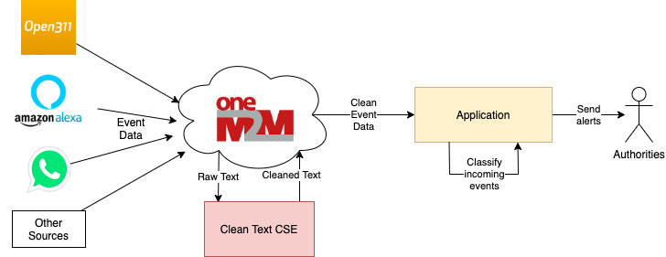
Use Case 3: Language Based sentiment Classification Overview
Prior Experimentation Motivated the Use Case 3 PoC
Notes:
An experiment by UbiWhere
A high-level architecture with an interworking proxy
The interworking proxy supports multiple classifiers: predefined and custom models

Slide 32
Use Case 3: Language Based sentiment Classification Architecture
Language-based Classification PoC Architecture
IoT data can take many forms including numeric and textual.
The aim of this PoC is to handle text-format data in a smart cities context.
The use case involves the analysis of crowdsourced text data (e.g. from social networks or specific mobile applications) to detect the occurrence and location of disasters.
Law Enforcement App
Citizen Application
Occurrence Management App
GloVE Vectorization
Deep Neural Network (Long-Short Tem Memory classifier)
AE
Text data cleaning function (typos, URLs, emojis, stop words, html, punctuation etc.)
Language/idiom configuration
Common Services Layer
CSE
API
API
AE
AE
Data
Mobile Devices
Database with source data from Kaggle
User feedback (Twitter content or other types of messages)

Slide 33
Use Case 3: Language Based sentiment Classification Impact on oneM2M
Law Enforcement App
Citizen Application
COMMON SERVICE FUNCTION MODIFICATIONS
Discovery to detect sources of data
Data management to process the extracted data
Security to restrict access to private data and make sure the data is not tampered with
Subscription and Notification: Notify applications when content is published
NEW AI/ML CSF REQUIREMENTS
Feature extraction through common NLP tasks such as Tokenization, Part-of-Speech Tagging, Name-entity recognition, Topic modeling, Speech recognition
Occurrence Management App (NLP App)
AE
Common Services Layer
CSE
API
API
AE
AE
Data
Mobile Devices
Database with source data
Tweets (or other types of messages)

Slide 34
Use Case 3: Language Based sentiment Classification Call flow (1/3)

Slide 35
Use Case 3: Language Based sentiment Classification Call flow (2/3)

Slide 36
Use Case 3: Language Based sentiment Classification Call flow (3/3)

Slide 37
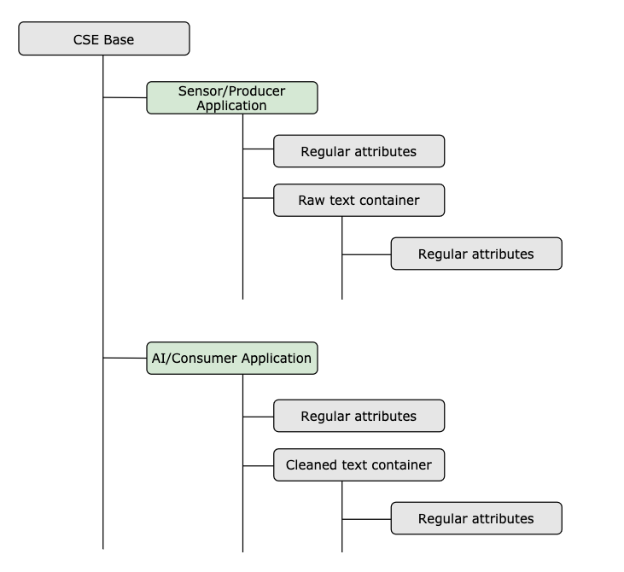
Use Case 3: Language Based sentiment Classification Resource tree

Slide 38
Use Case 3: Language Based sentiment Classification Test procedure and performance results
Train the NLP Classifier Model in the Occurrence Management App (NLP)
Start up oneM2M gateway (OpenMTC)
Start up the NLP AE
Start up the Device AE
We will see one gateway logging the application, container and content instances being registered and the upper AE (NLP) being notified of content generated by the lower AE (Device).
Occurrence Management App
AE
oneM2M CSE
(open source openMTC)
CSE
Text cleaning CSF
AE
User-provided data (Kaggle)
NOTE: OpenMTC source - http://www.openmtc.org/

Slide 39
Use Case 3: Language Based sentiment Classification Demonstration
Demonstration UC3

Slide 40
Project Findings, Q&A and Next Steps

Slide 41
Project Findings
Lessons learned from PoC testing
oneM2M’s architectural framework is well suited to separate ‘decision making’ from routine or repetitive ‘housekeeping’ forms of AI/ML in IoT systems
Easier to extend CSF capabilities using a micro-services platform architecture compared to a monolithic one
Architectural dependencies that make it ‘easy’
oneM2M’s framework, APIs and resource model provide foundations for extensible, ‘AI-as-a-Service’ tools in the service layer of the IoT solution stack
Subscription and notification CSFs can enable lighter-weight and operationally efficient AI/ML methods in the applications layer

Slide 42
Discussion and next steps
Audience questions
….?
Ideas from project team
What approach should oneM2M take to standardize AI/ML in IoT through work items that build on recent data-management initiatives?
Retain focus on oneM2M’s horizontal approach to standardize general-purpose CSFs
Keep AI/ML services as simple as possible to avoid adding complexity to oneM2M
Provide educational information and tools that will help (non-IoT-expert) AI/ML developers to experiment with oneM2M

Slide 43
Project deliverables to be published by end-2020
ETSI TR 103 674: SmartM2M: Artificial Intelligence and the oneM2M architecture
Will be publicly available before the end of 2020
ETSI TR 103 675: SmartM2M: AI for IoT - Proof of Concepts and Open-source Code
Will be publicly available this week
Open source implementations on ETSI GitHub portal
Available to ETSI members at https://forge.etsi.org/rep/stf584

Slide 44
Thank you for your attention
STF584: https://portal.etsi.org/STF/STFs/STFHomePages/STF584
Contact Details:
Mahdi Ben Alaya, Sensinov
benalaya@sensinov.com
+33 6 71 93 90 45
Emmanuel Darmois, CommLedge
emmanuel.darmois@commledge.com +33 6 32 51 53 93
Ken Figueredo
ken@more-with-mobile.com +1 202 262 7344
Ricardo Vitorino, Ubiwhere
rvitorino@ubiwhere.com
+351 913 850 631

