Slide 1
Use of MBT for test suites development- discussion
Group Name: TST WG
Source: Easy Global Market (EGM)
Meeting Date: 2016-03-14

Slide 2
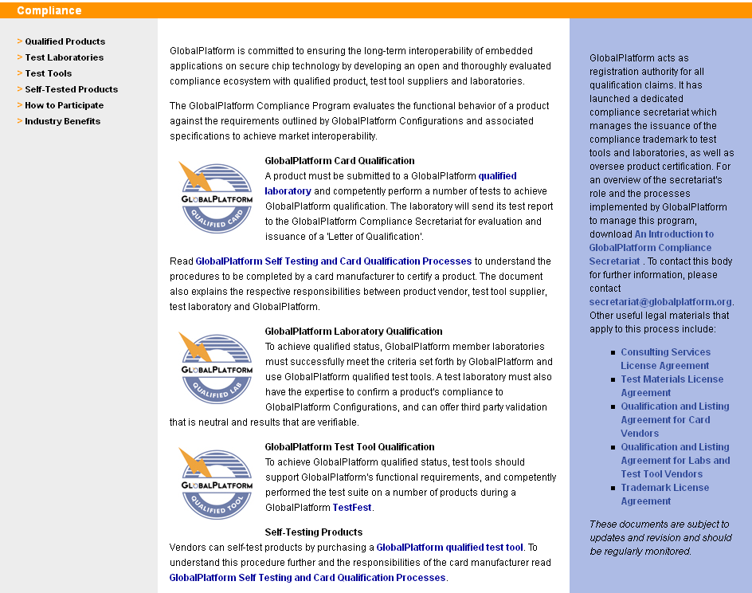
Reminder: Global Platform certification programme
58 Test Tools from
5 member companies
14 Qualified Test Labs
operated by
8 member companies
150 Qualified Products
card and TEE from
25 different companies
Taken from: TST-2016-0012-GlobalPlatform_Compliance_and_Certification_collaboration)

Slide 3
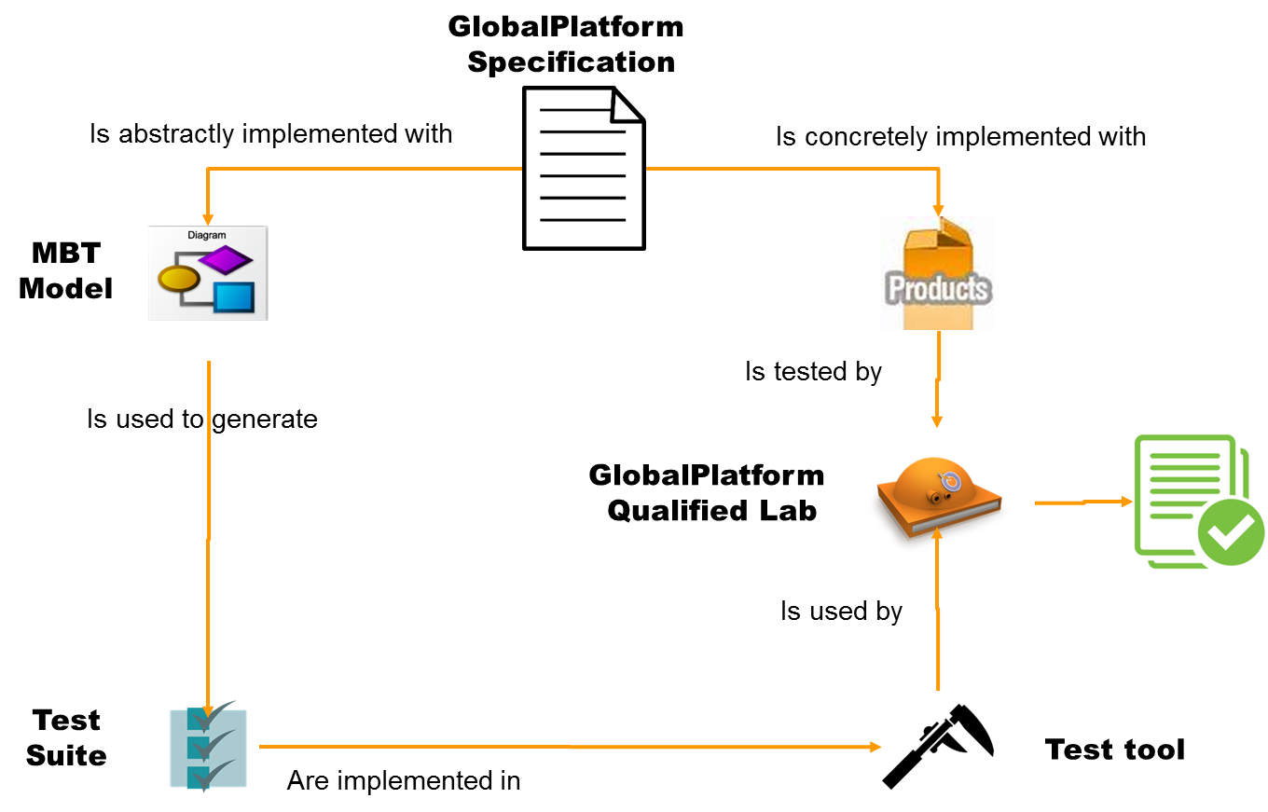
Global platform test suites generation process
Taken from: TST-2016-0012-GlobalPlatform_Compliance_and_Certification_collaboration)

Slide 4
Managing profile
Manage the variants/options from one profile to another
1 Generic specification (with options)
1 Profile per domain = dedicated spec are derived from the generic specification
Generic
Specification
Telecom
Profile
Bancaire
Identity
Profile
Banking
Profile
Option 1
Option 1
Option 1
Option 1
Option 2
Option 2
Option 2
Option 2
Option 3
Option 3
Option 3
Option 3
Option 4
The model handles all the options
Tools are used to publish Test Suites according to each Profile
Global Platform approach
Tests
Telecom
Profile
Tests
Banking
Profile
Tests
Identity
Profile
Option 1
Option 1
Option 1
Option 1
Option 2
Option 2
Option 2
Option 2
Option 2
Option 3
Option 4

Slide 5
Adaptation to oneM2M
oneM2M
Specification
Test purposes
Is described as
Is concretely implemented with
Is abstractly implemented with
MBT
Model
Is tested by
Is used to generate
oneM2M
Qualified Lab(s)
Documentation
Is used by
Test
Suite(s)
Are implemented in
Test tools

Slide 6
Detailed MBT process
Test Design
oneM2M requirements
& TPs
MBT Model
Generated Tests
Test analyst
Abstract tests (TTCN-3)
Quality review
Initial states spec (doc)
Adaptation layer spec (PDF)
oneM2M certification group
Test plan (HTML)

Slide 7
Value proposition (1/2)
Advantages of a systemized automated approach for ALL oneM2M actors
Specification developers
Early feedback on the specification consistency, flaws etc.
oneM2M labs
Structured and formal proofs for compliance for (security) audits.
Product developers (platform, device, network ... )
Ready test suites with wide covering of oneM2M requirements
Model artefacts that can be re-used to create eventually new tests.
Test implementors
Traceability features

Slide 8
Value proposition (2/2)
Capitalization and reuse of the model
Especially in profile like approach
Shorten the evolution cycle
One evolution made into the model is then automatically propagated to all the generated tests:
No correction miss / No inconsistency
The compliance test suite quality does not deteriorate over the time
Maintain the stability of the repository
Maintains traceability between requirements/specification and test cases

Slide 9
Proposed demonstration
To be run at next Interop (Seoul – May)
Covering at least the 8 TPs having TTCN-3 tests demonstrated by ETSI.
Any other TPs to be considered ?
Running on TITAN? Other TTCN-3 tool vendors welcome to participate

