Slide 1
4.2 [3] How to Engage Vertical Participation
ATIS Delegation
Presenter: Gale Lightfoot (Cisco Systems)
Meeting of Potential M2M Consolidation Partners #2
Washington DC, USA
17-18 August 2011
M2MCons02_08

Slide 2
Leverage Regional Relationships with Verticals
Participating Regional SDO’s seek to be a bridge between the M2M Global Harmonization Initiative (MGHI) and verticals.
Encourage their Participation
Preferable that the VMPs be global in scope & represent industry balance
Examples include: Connected Home, Connected Vehicle/telematics, eHealth, Smart Grid, etc.
Present MGHI Desire for Vertical Membership AND Participation
Agreement for equal participation, rights and position for VMPs
Create environment that fosters MGHI acceptance by regional verticals
Articulate Strategy and Structure for MGHI
Don’t mess with “what works” -> Address Service Layer Perspective
Encourage Verticals to assist in identifying requirements relative to MGHI
Gather requirements from verticals that will not be involved MGHI, while continuing to foster relationship with MGHI

Slide 3
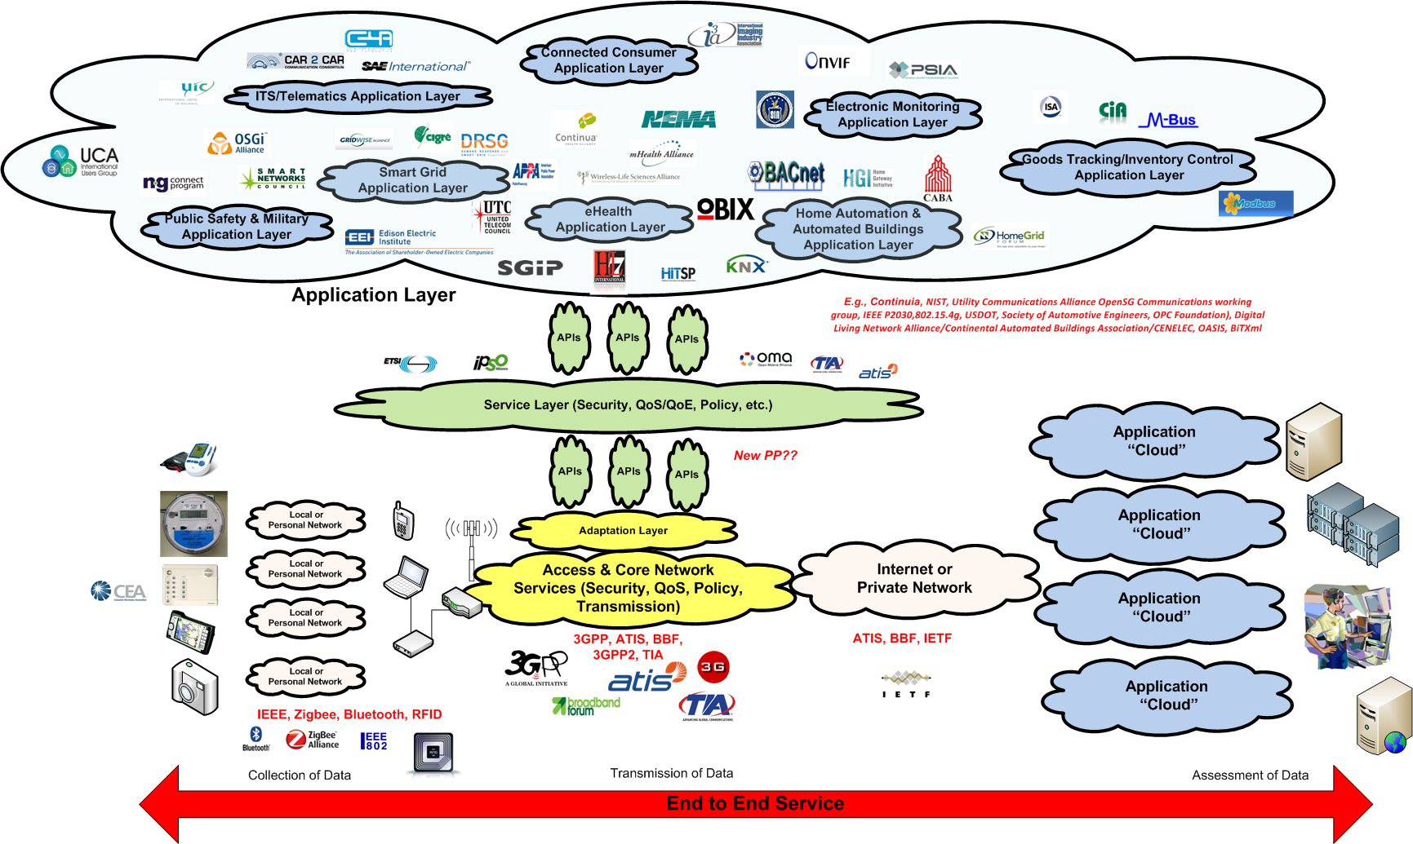
Seek “WIDE Spectrum” representation: Broad Regional & Industry Balance
Vertical w/Broad Regional “coverage” & Industry Balance
Vertical w/Regional “coverage”
Vertical w/Narrow “coverage”
3
3

Slide 4
Thresholds!
Vertical Participation Threshold Elements:
Agreement for equal participation, rights and position for VMPs
Balance among industries represented by the VMPs is required (whether regional or global)
The ratio of regions represented by the VMPs is preferred to approximately reflect the ratios represented in M2M-Cons01(11)17
Each regions should identify their candidate VMPs since each region has different focus, participation level, numbers of verticals, etc.

