Slide 1
4.3 [4] Technical Scope of M2M Consolidation
Brian Daly – Member of ATIS Delegation (AT&T Director, Core Network & Government/Regulatory Standards)
Meeting of Potential M2M Consolidation Partners #2
August 17-18, 2011
Washington, DC
M2MCons02_09r1

Slide 2
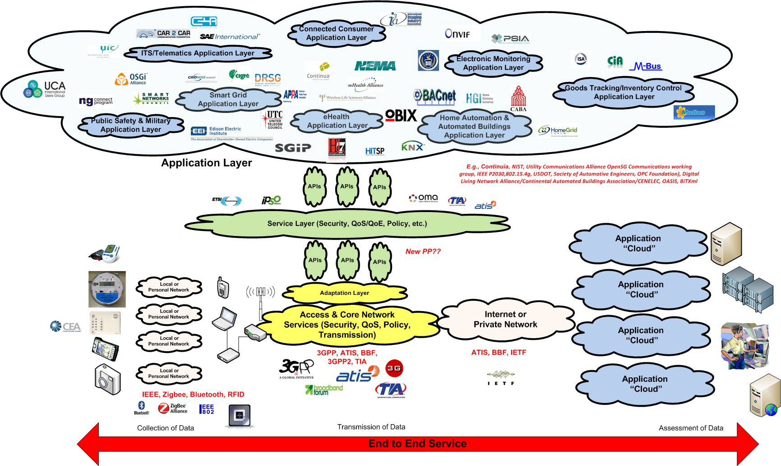
Technical Scope of M2M Consolidation
Service layer aspects
As highlighted in the ATIS diagram presented in meeting #1
Harmonized use cases and requirements
Defining the common set across verticals as well as regions
Development of a common service layer architecture
Supporting the harmonized set of requirements & use cases
Include security aspects within the architecture
Develop protocols/APIs/standard objects based on this architecture
Open interfaces and protocols allowing for any vertical application to access the service
Identification of services required in lower layers
Development of APIs/adaptation layer to request/support lower layer services
Testing specifications for the service architecture & APIs
Conformance specifications

Slide 3
Technical Scope of M2M Consolidation
Should not address aspects which fall outside the service layer which are being handled in other fora:
Network aspects
M2M consolidation effort should not disrupt existing ongoing standards work at the local access or network layers
E.g. optimization and adaptation functions in 3GPP should proceed unaffected by the service layer consolidation
Understanding is needed of ongoing optimization and adaptation function standards work in other fora such as BBF
Consolidation effort should liaise with access and network standards groups to identify service needs from lower layers

Slide 4
Technical Scope of M2M Consolidation
Terminal aspects
In general M2M applications are downloaded onto existing devices, thus no need for additional device requirements
Avoid Device Management (DM) fragmentation
E.g., OMA Device Management is access-independent and is supporting the provisioning of many services (email, location, presence…) and can be extended to support M2M services
Continue to address Universal Integrated Circuit Card (UICC) service aspects under existing SDOs
UICC specifications under 3GPP CT6, ETSI SCP
Subscriber equipment comprises the device and UICC
If M2M consolidation effort includes devices, then they have to cover the UICC too, as there is a tight coupling between the two
In general, device requirements are addressed only if specific hardware is needed
E.g., Near Field Communications – NFC - Forum is addressing only the NFC access and interface related requirements

Slide 5
Technical Scope of M2M Consolidation
Application Layer aspects
Vertical segments are already addressing application layers
Vertical applications have diverse requirements to meet application needs and are better developed in application-centric fora

