Slide 1
4.4 Timeline for M2M Consolidation
Susan Miller
ATIS Head of Delegation
Meeting of Potential M2M Consolidation Partners #2
Washington, D.C.
August 17-18, 2011
M2MCons02_10

Slide 2
Timeline for M2M Consolidation: Recap of Korea Discussions
The timeline for M2M consolidation was not broadly addressed in Korea. Comments ranged from:
Thresholds must be met before consolidation occurs - (e.g., minimum set of verticals required, clearly articulated and agreed upon mission and scope, etc.) . . . to
Timing is an open matter still needing discussion.
ETSI presented a timeline:
Consistent with internal meeting schedule and project plan – Release 2 extensions.
“small window of opportunity for success”
No broad objective or event identified to dictate or define a timeline.
There was no consensus on a timeline for consolidation.

Slide 3
Timeline Factors for M2M Consolidation
The timeline must address and balance a number of factors:
Verticals must have the opportunity to define and help shape any M2M consolidation.
Opening vertical dialogue should answer key questions and define verticals’ requirements;
The dialogue should educate on M2M objectives and opportunities to be achieved if consolidation were to occur; and
The SDOs’ consolidation views should be presented as initial and early thinking, a starting point for the verticals’ consideration and open discussion.
Vertical outreach and dialogue will not be fruitful without some initial SDO alignment on key elements.
This is the purpose of current SDO discussions.

Slide 4
Timeline Factors for M2M Consolidation
The timeline must address and balance a number of factors:
Minimum set of verticals must commit to consolidation – a minimum of three global markets or three markets with representation across global regions.
Balance is essential amongst the markets and across the regions to learn if there is an agreed upon path forward.
Ultimately, the verticals must manifest an intent and commitment to M2M consolidation for success.

Slide 5
Proposed Timeline for M2M Consolidation
July 21st in Seoul, Korea – First Discussion
All work activity and views put on the table.
Only consensus – criticality of including vertical markets.
August 17th - 18th in Washington, D.C. – Second Discussion
Objective: Further development and discussion of the agenda items put on the table in Korea.
Find points of consensus, identify differences /challenges and begin to address them;
Full agenda on significant items – not likely to complete discussion and reach consensus on all items.

Slide 6
Proposed Timeline for M2M Consolidation
Third Meeting –Tentative Date Proposals By HoDs:
Proposal #1: October 29-30 (Saturday/Sunday)– in front of GSC Meeting in Halifax
Proposal #2 – November 3-4 (Thursday/Friday) – after GSC Meeting in Halifax
Considerations:
Many representatives in the M2M discussions are the same representatives as in attendance at the GSC ;
Reflects expense/challenge of global travel in current economy at end of budget year; and
October global calendar is already set and very full.

Slide 7
Proposed Timeline for M2M Consolidation
ATIS Supports November 3-4 as the next meeting date.
Provides more time for interim SDO discussions and development of path forward, including regional vertical outreach and feedback.
Progress, regional outreach to verticals, SDO discussions, and key work can and should continue in the interim and post-Halifax meeting.
ATIS does not believe inviting verticals to November, Halifax meeting is well-timed:
Likely to need more SDO discussion on key elements to stabilize initial consensus framework – many open issues;
October calendar is extremely full to plan appropriately – likely already full calendar for verticals too;
Halifax is not optimum location for meeting invitation; and
Timing is off –already late for invitation to Halifax.

Slide 8
Proposed Timeline for M2M Consolidation
Planning forward – Timeline to Involve Verticals
SDO discussions should continue via virtual meetings and conference calls both leading up to November and beyond.
Virtual meeting tools/conference calls commonly used by all SDOs;
Allows work to keep moving and progress faster e.g. (easier to schedule; and
Balances opportunity for quality regional outreach to verticals with keeping the work moving.
Target international Consumer Electronics Show (CES) as first collective SDO/vertical markets meeting – January 7-13 in Las Vegas, Nevada.
Many vertical markets and their respective organizations already in attendance; and
January date allows for ample time to plan now, extend invitations, and support optimum calendaring and attendance.

Slide 9
Proposed Timeline for M2M Consolidation
Proposed Schedule to Involve Verticals:
August 17 – 18 Meeting in Washington, D.C.
Between August 17 – 18 and November 3 – 4:
One early to mid-September and mid-October Virtual Meeting/Conference Call (2 hours each):
Regional SDOs launch regional vertical outreach with opportunity for shared early feedback on SDO conference calls.
Continue discussion on those areas where further consolidation work is needed – focus calls on short list of topics.
Start details of planning for CES meeting – January, 2012 – now.
Small SDO planning group to create initial proposal
Invitations to be extended no later than October 1st.

Slide 10
Proposed Timeline for M2M Consolidation
Proposed Schedule to Involve Verticals:
Post November 3-4 Meeting in Halifax
Two Virtual Meetings/Conference Calls – Early December and week before CES meeting.
Addresses continued work effort and finalizes planning for January meeting during CES.
Creates “check points” along the way for factoring in regional SDO interface with verticals and allows adjustments to SDOs’ initial thinking.
Activity and dialogue keeps moving.
If successful, and M2M consolidation is deemed desirable as output from January meeting, verticals and SDOs can work together to quickly realize the structure, process, and supporting details.

Slide 11
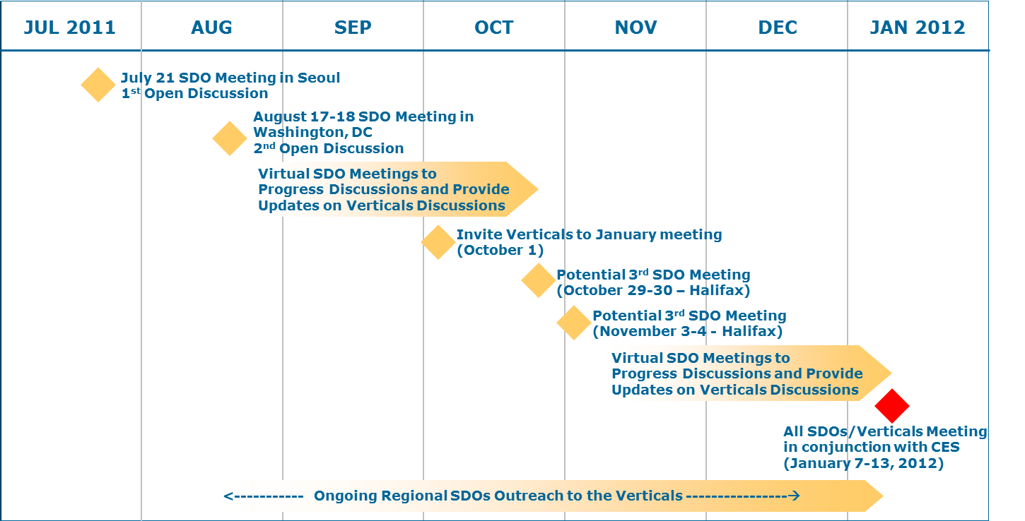
Proposed Timeline for M2M Consolidation
If key thresholds and target milestones are met, consolidation launch and
work could begin in earnest at the end of 1Q 2012.

Slide 12
Proposed Timeline for M2M Consolidation
It is important to move forward with both deliberateness and a realistic M2M consolidation plan that can be embraced by all SDOs and the verticals.
It is equally, if not more important, to position the opportunity for success.
This is best done with careful planning, open dialogue, and the appropriate outreach/homework.
Taking these six weeks (discounting the year-end holiday period)will enhance and advance the likelihood of success.

