Slide 1
Broadband Forum
Machine-to-Machine (M2M) Solutions
Robin Mersh, CEO
rmersh@broadband-forum.org
The information in this presentation is public

Slide 2
Broadband Forum
Engineering smarter & faster connections
Architecting a connected lifestyle
  Defining best practices for global networks
  Enabling multi-service and content delivery
  Establishing technology migration strategies
  Engineering critical device & service management tools
  Redefining Broadband
Who are we?
  Industry consortium made up of approximately 200 service providers, vendors, consultants, academia and test labs
  Predominant broadband industry forum since 1994
  Engineer technology solutions to help service providers achieve standards based, economical and effective broadband deployments
Notes:
Re-defining Broadband

Slide 3
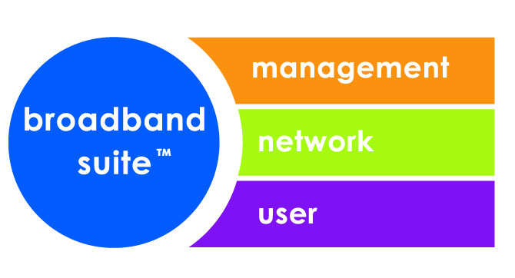
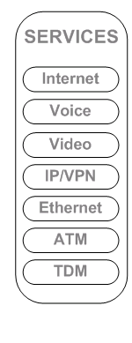








Broadband Forum Scope
PARTNER
APPLICATION
FUNCTION
Management
Quality of Experience
TR-069 (CWMP)
Identity, Accounting and Policy
Operations and Network Management
DSL Quality Management
IDENTITY
TR-069 ACS
BILLING
PARTNER
CONTROL
FUNCTION
TR-126 IPTV
Quality of Experience
TR-176 DSL
Profiles for IPTV
OSS
CWMP
TR-069
Network
TR-144 Multi Service Requirements
User
Multi-Service Core
Edge
Aggregation
Access
Connected
Home & Office
VoD
TV
SIP
Content Network
P2P E-FTTx
TR-101, TR-156
Ethernet
Aggregation
GPON
IP/MPLS
EPON
Customer Premise Device Management
DSL
Residential Gateway Management
Mobile Network
BSC
RNC
SGW
Smart Grid
Home Networking Protocols
Multi Service Architecture & Requirements Certification, Test and Interoperability

Slide 4
Broadband Home – Device Management
  TR-069 – CPE Wan Management Protocol (CWMP)
Industry leading device management solution.
Evolving TR-069 family of extensive and modular manageable ‘objects’ covering wide range of devices and functionality.
Referenced by many industry bodies such as 3GPP, ATIS, ETSI and ITU-T.
    Approved as a European standard in 2010 by ETSI.
    Currently referenced in ETSI M2M architecture as a protocol for device management that runs over the “mId” reference point.
    Ongoing work between the Broadband Forum and ETSI M2M to develop new Object model work.
Well over 147 Million devices connected (reported by Ovum).
Ratified by DSL (now Broadband) Forum in May 2004, amended in 2006 and 2007 and recent M2M driven amendments amendment 3 and 4 in 2011.

Slide 5

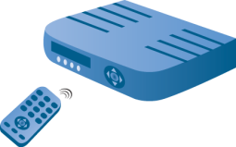
Remote Management of non-TR-069 Devices
TR-069 amendment 4
CWMP RPC to Proxy Service on TR-069 Device
Local Protocol command to non-TR-069 Device
TR-069 “Proxying” Managed Device
Non-TR-069 “Proxied” Managed Device
CWMP RPC Response
Local Protocol Success Response
ACS
Proxy management agnostic to the local protocol, supporting all vertical M2M devices.
  UPnP DM/DLNA, Zwave, ZigBee etc.
  Layer 2 protocols (e.g. HomePlug OAM, etc.)
  Any proprietary local protocols known by the proxying device
TR-069 accesses proxied devices through TR-069 embedded and virtual managed objects
  ACS sends management commands to proxying device
  TR-069 device converts TR-069 commands to local protocol
  Once proxied device has successfully executed commands, TR-069 device sends CWMP messages to ACS

Slide 6
M2M Activity – ETSI M2M TR-069 Models
  Collaborative work effort between the BBF’s Home working group and the ETSI M2M working group 5
Developed a TR-181 model for administration ETSI M2M G/DSCLs
  Model is published within BBF as part of the TR-181 specification as well as within ETSI as ETSI TS 103 093 (BBF TR-069 compatible Management Objects for ETSI M2M)
Defined device capabilities within existing TR-181 models that would be useful for management of M2M devices.
  Published within ETSI in Annex E of ETSI TS 102 921 (mIa, dIa and mId interfaces)

Slide 7
M2M Activity – Control Signaling & Data Abstraction (CSDA) Proposed Draft
Control Signaling & Device Abstraction
  Horizontal (single) solution to provide access to all vertical (independent end technologies, Zwave, ZigBee etc.) devices using common communication and common objects, enabling a seamless extensible ecosystem.
  Provide technology agnostic access by embedded and cloud applications.
  Not management plane – “Instant / real time” command communications.
  Builds on work and integration points in ETSI M2M Release 1.
Builds on recent BBF TR-069 work to enable services that utilize M2M devices in the Smart Home.
  Software Module Management in an Execution Environment.
  Follow Architectural model of Proxy Management enhancements.
Builds on the Broadband Forum competency and leadership in large scale device communication solutions.
  Communication with 20+ SDOs to solicit interest in M2M solutions.

Slide 8
Thank you

