Slide 1
oneM2M-OIC Interworking Technical Comparison
ARC-2015-2138-oneM2M-OIC_Interworking_Technical_Comparison
Group Name: WG2 ARC #19
Source: Sung-Chan Choi, Jaeho Kim, Minu Ryu KETI, csc@keti.re.kr
Jieun Keum, Samsung Electronics, je.keum@samsung.com
Seonhyang Kim, DT&C, shkim@dtnc.net
Bahareh Sadeghi, Intel, bahareh.sadeghi@intel.com
Lionel Florit, Cisco, lflorit@cisco.com
Meeting Date: <2015-09-07>
Agenda Item: oneM2M & OIC Interworking (WI-0044)

Slide 2
Overview
Overview of oneM2M vs. OIC Framework
RESTful Architecture
oneM2M-OIC Technical Comparison
New proposed text in TR-0023
Technical Comparison
Resource Representation
Communication Model

Slide 3
oneM2M vs. OIC Framework
Smart
Home
Industry
…
…
Application profile
Smart
Home
Industry
…
…
Common Service Entity
OIC Core Framework
Identification
CRUDN
Security
Resource Model
Core Framework
Identification
CRUDN
Security
Resource Model
Discovery
Messaging
Registration
Location
Discovery
Messaging
Streaming
Device
Management
Group
Management
Network Exposure
Device
Management
Group
Management
Protocol Bridge
CoAP
HTTP
MQTT
CoAP
HTTP
Network
Network
Connectivity & messaging
Connectivity
Connectivity

Slide 4
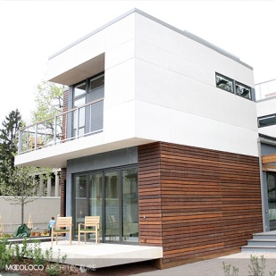
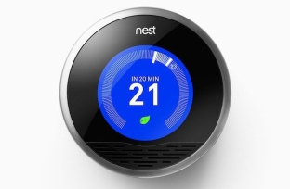
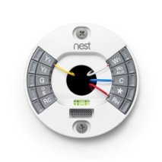
Resource-oriented Architecture
Entity handler
Client
Server
Entity
Request
{
"n": “MyRoomTemperature",
"rt": "oic.r.temperature",
"if": "oic.if.a",
"id": "temp_TF38_3",
"unit": “Celcius",
“Current_value": 18,
“Set_value": 25
}
Response
CRUD & N operation
Resource (representation)
OIC Architecture is based on Resource-oriented Architecture
Resources are addressable and Services are exposed using CRUD&N operations

Slide 5
oneM2M vs. OIC Resources
Both oneM2M and OIC adopt ROA (resource-oriented architecture) model where services are exposed through resource representation
oneM2M exposes M2M Common Service functionalities through various resources, e.g., AE, remoteCSE, container, group, node, delivery, etc.
OIC’s resources are mainly related with device representation and its status/control information
Including device type property (mandatory) which describes OIC device type (e.g., fan, light, thermostat, air conditioner, etc.) as well as device specific application data
Comparing with OIC, oneM2M uses <container>, <contentInstance> resources for the device specific application data
Each OIC device usually keeps only its own application data

Slide 6
oneM2M Resource Model
Common Service Functions
CSF | oneM2M Resource Type
REG | <CSEBase>, <remoteCSE>, <AE>
DMR | <container>, <contentInstance>
SUB | <subscription>
GMG | <group>, <fanOutPoint>
LOC | <locationPolicy>
SEC | <accessControlPolicy>
DIS | <Annc>
DMG | <mgmtObj>,<mgmtCmd>, <execInstances>, <execInstance>, <parameters>, <node>
CMDH | <delivery>, <request>
NSSE | <schedule>, <cmdhNwAccessRule>
SCA | <statsConfig>, <statsCollect>
Registration
Discovery
Security
Group
Management
Data Mgmt. & Repository
Subscription & Notification
Device Management
Application & Service Mgmt.
Communication Management
Network Service Exposure
Location
Service Charging & Accounting

Slide 7
OIC Resource Model
OIC Device
Core resources + Device specific resources
Core resources (with fixed URI)
oic/res: core resource with device type
oic/d: core resource for device discovery
Device specific resources (with free URI)
For example, light device shall have “binary switch” Device specific resource
/oic/res
oic/res
* oic core resource with fixed URI
/oic/d
oic/d (with “rt”=“oic.d.<device type>”
* oic core resource with fixed URI
Link relationship
/resource1URI
Resource1
* Device specific resource with free URI
/resource2URI
Resource2
* Device specific resource with free URI

Slide 8
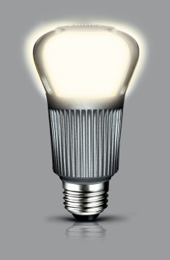
Light Bulb Resource Example
Example overview
Smart light device with i) binary switch & ii) brightness resource
Device type: Light device (oic.d.light)
Associated resources
Core resources
① oic/res, ② oic/d
Device specific resources
③ Binary switch (oic.r.switch.binary), ④ Brightness resource (oic.r.light.brightness)
Example: Smart light device with 4 resources
Device Title | Device Type | Associated Resource Type | M/O
Light | oic.d.light | oic/res (oic.wk.core) | M
 |  | oic/d (oic.d.light) | M
 |  | Binary switch (oic.r.swtich.binary) | M
 |  | Brightness (oic.r.light.brightness) | O
oic/res
oic/d
Binary switch
Brightness

Slide 9
Light Bulb Resource Example
Set of links in oic/res resource
/oic/res
[{
"di": "example_device_id",
"links": [
{ "href": "/oic/d",
"rt": "oic.d.light",
"if": "oic.if.r",
"rel": "hosts"},
{ "href": "/myLightSwitch",
"rt": "oic.r.switch.binary",
"if": "oic.if.a",
"rel": "hosts"},
{ "href": "/myLightBrigtness",
"rt": "oic.r.light.brightness",
"if": "oic.if.a",
"rel": "hosts"}
]
}]
/oic/d
{
"n": "myRoomLightDevice",
"rt": “oic.d.light",
"if": "oic.if.r",
“di": "example_device_id“,
"icv": "oic.1.5"
}
/myLightSwitch
{
"n": MyRoomLightSwitch",
"rt": "oic.r.switch.binary",
"if": "oic.if.a",
"id": "b.switch_TF38_3",
"value": "true"
}
/myLightBrightness
{
"n": MyRoomLightBrightness",
"rt": "oic.r.light.brightness",
"if": "oic.if.a",
"id": “light_brightenss_TF38_3",
"value": 30
}

Slide 10
oneM2M vs. OIC Communication
oneM2M CSE/AE shall perform registration with another CSE to be able to use M2M Services offered by the CSE
Registration establishes a relationship between CSEs/AE allowing them to exchange information. Therefore, data delivery path mainly occurred along with the registration-based relationship configuration
OIC devices mainly support peer-to-peer communication in local area network (home, industry)
OIC supports remote access using a connection broker server
OIC does not have a concept of data collection yet as in oneM2M <container> which could be related with its registered devices’ application data

Slide 11
oneM2M Registration
IN
AE
Registration
CSE
IN-AE
Registration
MN
Registration
AE
Registration
Registration
CSE
Registration
Registration
AE
AE
AE
AE
Registration
ADN
Registration
CSE
ADN
CSE
ASN
ASN

Slide 12
oneM2M Communication
Originator
Registrar CSE = Transit CSE
Transit CSE
Hosting CSE
Registration
Registration
Registration
AE1
CSE1
CSE2
CSE3
Request(op=UPDATE,
to=/{CSE3}/c01, fr=AE1, ri=01, cn, rt=blockingRequest)
Internal processing
(forwarding to CSE2)
Request(op=UPDATE,
to=/{CSE3}/c01, fr=AE1, ri=01, cn, rt=blockingRequest)
Internal processing
(forwarding to CSE3)
Request(op=UPDATE,
to=/{CSE3}/c01, fr=AE1, ri=01, cn, rt=blockingRequest)
Internal processing
(hosting CSE)
Response(“successfully updated”)
Response(“successfully updated”)
Response(“successfully updated”)

Slide 13
OIC Communication
OIC Device
OIC Device
OIC Connection Broker
OIC Server/Client
OIC Server/Client
Remote Access Connection
Peer-to-peer
OIC Server/Client
OIC Server/Client
OIC Device
Local (LAN)
OIC Device
Remote (WAN)

Slide 14
OIC Communication
Client
(OIC Smartphone)
Server
(OIC Light Bulb)
GET(oic/res)
Response (list{res uri, rt, if})
GET(/light)
n=bedlight
of=false
Response (content)
POST(/light, {of=true})
Response (Success/ Failure)
n=bedlight
of=true

Slide 15
Conclusion
Both oneM2M and OIC architecture are based on ROA (resource-oriented architecture) model
OIC resources represent Device Specific Characteristics
But, oneM2M focuses on Common Service Functionalities
oneM2M and OIC communication models are different
Peer-to-Peer (plus remote access feature) vs. Registration-oriented data delivery (hop by hop)
TR-0023 Proposed text
oneM2M-OIC technical comparison

