Slide 1
OIC Interworking Operation Procedure for Subscription & Notification
Group Name: Architecture WG
Source: Jieun Keum, Samsung Electronics, je.keum@samsung.com
Kiran Vedula, Samsung Electronics, kiran.vedula@samsung.com
Jinhyeock Choi, Samsung Electronics, jinchoe@samsung.com
Sungchan Choi, KETI, sungchan.keti@gmail.com
SeonHyang Kim, DT&C, shkim@dtnc.net
Meeting Date: <2015-10-20>
Agenda Item: <WI 44: oneM2M-OIC interworking >
Notes:
Other suggested titles:
“Benefits of oneM2M Standardization”

Slide 2
Introduction
This presentation introduces possible interworking procedure of Subscription and Notification for oneM2M OIC Interworking

Slide 3
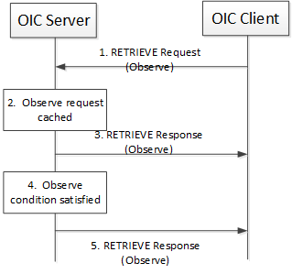
General principle
oneM2M Subscription and Notification function can be mapped to OIC observe scheme.
In observe mechanism the OIC Client utilizes the RETRIEVE operation to require the OIC Server for updates in case of OIC Resource state changes
<OIC operation for observe mechanism>

Slide 4
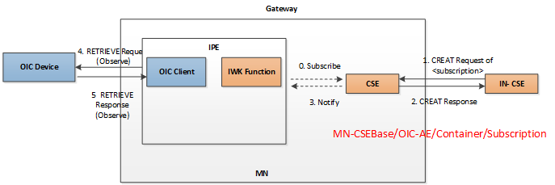
Subscription
0 Assume that IPE already subscribe to <container> resource at CES for notifying of creating request of <subscription>
IN-CSE CREATE Request of <subscription> resource targeting to the <container> resource under OIC AE
MN-CSE send CREATE Response message to IN CSE
CSE send Notify message to IPE of creating <subscription>
OIC Client send OIC Retrieve Request message to OIC Device
OIC Device send OIC Retrieve Response message to OIC Client

Slide 5
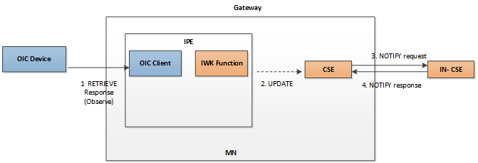
Notification
OIC Device send OIC Retrieve Response message to OIC Client with the modified resource representation
IPE send oneM2M UPDATE message to MN-CSE
MN- CSE send oneM2M NOTIFY request message
IN- CSE send oneM2M NOTIFY response message

Slide 6
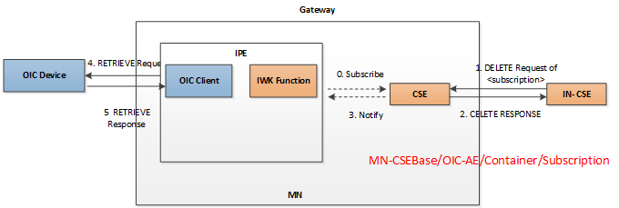
Cancel of Subscription
0. Assume that IPE already subscribe to container resource hosted at CES for notifying of DELETE request of <subscription>
IN-CSE send DELETE request of <subscription> resource.
MN-CSE send DELETE response message
CES notify to IPE the DELETE of <subscription>
OIC Client send OIC Retrieve request message without observation indication to OIC Device
OIC Device send OIC Retrieve response message

