Slide 1
Discussion ON Action Triggering
Group Name: oneM2M ARC#32
Source: Sungchan Choi (csc@keti.re.kr)
Meeting Date: 2017-11-16
Agenda Item: TBD

Slide 2
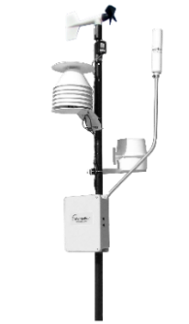
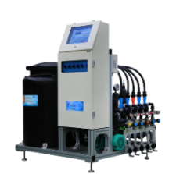
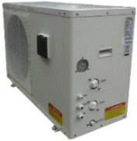
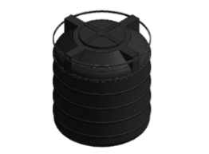
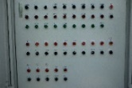
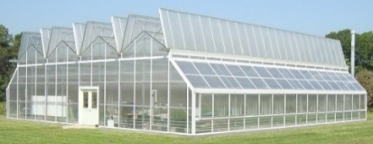
Knowledge-based System
Plant Factory case in Korea
Big Data
Complex Rule based
Automatic Control system
CROP Encyclopedia
Empirical Knowledge

Slide 3
Intelligent System
Decision Trees
If (A == true) then Yes
else if (B==true and C==true) then Yes
else No..
A
True
False
Priority 1
Yes
B
False
True
No
C
False
True
No
Yes
Priority 2

Slide 4
Intelligent System
Action Triggering condition
To use a complex decision tree with priority order
Event
Given Humidity 40
Humidity
> 30
Humidity
< 50
False
True
False
True
No
Degree
> 20
No
UV <3
True
False
True
False
No
Dust < 10
No
True
Blind Close
False
Conflict
No
Blind Open

Slide 5
Current Approach
Action Triggering condition
Combining a filter condition with multiple dependencies
Dependencies
Dependencies
Dependencies
Filter Condition
②
Subject Resource
①
Operation
(CRUDN)
④
Object Resource
③
⑤
Input Resource
Output Resource

Slide 6
Current Approach
Subject
Resource
Update
Action1
Target1
Action2
Target2
Action3
Independent handling
Action4
…

Slide 7
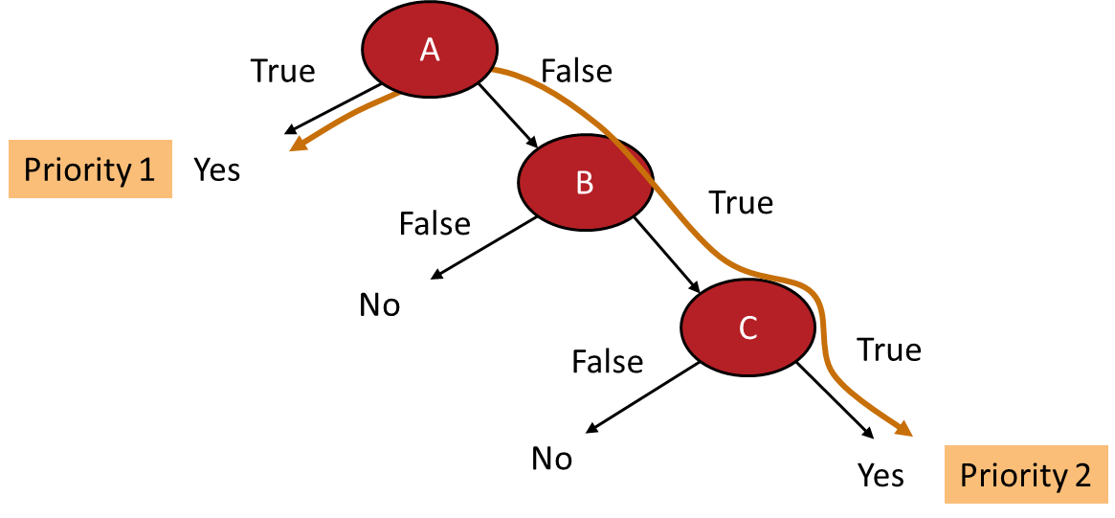
Potential Solution
Subject
Resource
Update
1
Action1
2
Action2
Target1
Action3
Target2
Grouping or
sequential handling
3
Action4
…

