Slide 1
How to know supported flexContainer type
Group Name: ARC
Source: Hiroyuki Maeomichi – maeomichi.hiroyuki@lab.ntt.co.jp, Kei Harada – harada.kei@lab.ntt.co.jp
Meeting Date: 2018-03-12

Slide 2
Introduction
Flexibility of <flexContainer> is convenient but it could be a cause of less interoperability.
This Input Contribution discuss identified issues.

Slide 3
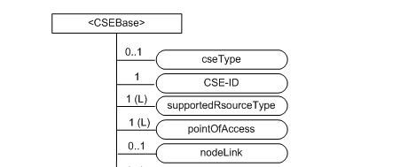
Current <CSEBase>
<CSEBase> provides supportedResourceType attribute for exposing supported range.

Slide 4
Problems for expressing <flexContainer>
Outer AE and CSE cannot know what containerDefinition are supported by registered <flexContainer>
Currently there is no attribute like supportedResourceType
Relationship between URI for containerDefinition and actual XSD files is unclear.
Even if you know containerDefinition URI, you could not retrieve implied XSD files.

Slide 5
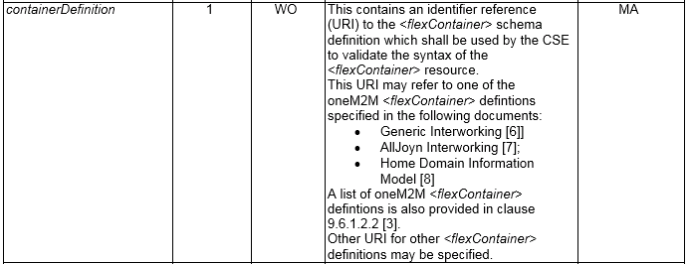
Current containerDefinition
TS-0001 9.6.35

Slide 6
Current containerDefinition
Generic IWK (TS-0030 7.2)
we must look at & have a <contentInstance>

Slide 7
Current containerDefinition
HAIM (TS-0023 6.4)
using only this information,
we cannot retrieve any XSD file.

Slide 8
Possible Solutions
Option 1: add new attribute of <CSEBase> for expressing supported containerDefinition.
like “supportedContainerDefinition”
Option 2: add more Information to option 1
providing URL where client can download related XSD files.
Option 3: add more information to option 1 or 2 giving more developer friendly information
like “customAttributeNames” which expresses a list of supporting [customAttribute]s as string.

Slide 9
Appendix

Slide 10
Example
Option 1: add new attribute of <CSEBase> for expressing supported containerDefinition.
Option 2: add more Information to option 1
Option 3: add more information to option 1 or 2 giving more developer friendly information
supportedContainerDefinition | containerDefinitionURI (parameter of supportedContainerDefinition) | downloadableURL (parameter of supportedContainerDefinition) | customAttribute Name (parameter of supportedContainerDefinition)
containerDefinition HAIM | https://aaaaaaaaa | https://bbbbbbbb | HeartRate, rr…(List of String)
containerDefinition AllJoyn | https://xxxxxxxxxx | https://yyyyyyyyy | objectpath, enabled…(List of String)
Option 1
Option 2
Option 3

Slide 11
Discussion 1
<flexContainer> supporting =
all contentDefinition supporting
<flexContainer> speciallizations can be created freely? or only what oneM2M has decided?

Slide 12
Discussion 2
Do we allow vendor specific / domain specific <flexContainer> or not?
Should we handle version of XSDs?

