Slide 1
Location Request
Preeti Rani (preetir@cdot.in)
C-DOT
10 May 2018

Slide 2
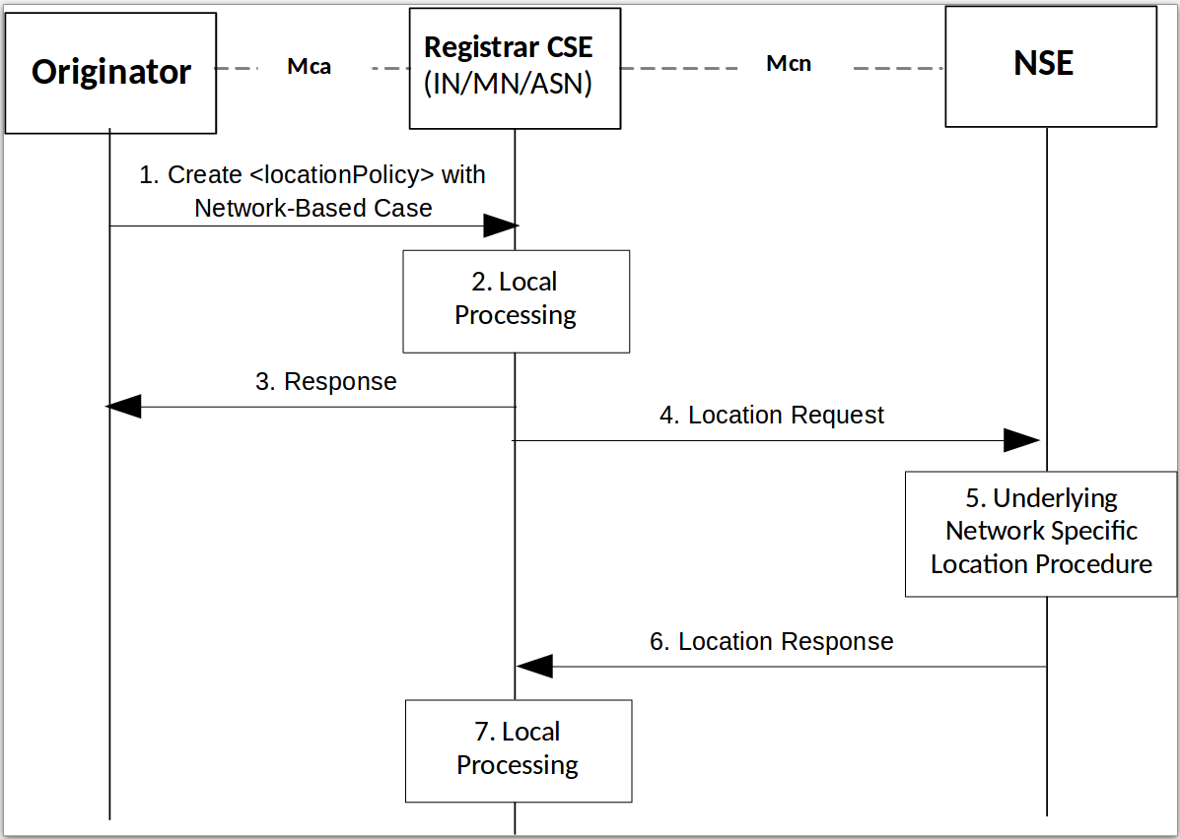
TS-0001 - 8.3.4

Slide 3
Types
Protocols
OMA RESTful NetAPI for Terminal Location
OMA Mobile Location Protocol
Location Request
Positioning Procedure by CSE
Positioning Procedure by NSE
CSE makes location request to location Server periodically and gets Location
CSE creates one time periodic subscription at NSE. NSE sends location notifications to CSE periodically.

Slide 4
Case 2: Positioning Procedure by NSE
Originator
Mca
Registrar CSE
(IN/MN/ASN)
Mcn
NSE
1. Create <locationPolicy> with Network-Based Case
Valid locationUpdatePeriod >0
2. Local Processing
3. Create Subscription on Location Server
4. Success Response with subscriptionID
Timer set = LUP
5. <locationPolicy> Response Primitive
Timer expiration reset timer = LUP
7. Local Processing
6. Periodic location info
Timer expiration reset timer = LUP
Periodic location info
Local Processing

Slide 5
Impacts
TS-0001 Section 8.3.4 - Location Request
TS-0001 Section 10.2.9.2 Location Management - Create <locationPolicy>

Slide 6
Thanks for your listening!
Q & A

