Slide 1
A sketch of the oneM2M Base Ontology - interworking aspects
MAS-2015-0516R01
Joerg Swetina
NEC Europe Ltd.
Joerg.swetina@neclab.eu
© NEC Europe Ltd. 2014

Slide 2
Interworking oneM2M and devices in Area Network
Area Network (e.g. KNX)
oneM2M compliant Solution
“proxied” Devices in own oneM2M System technology
real Devices in Area Network
Inter working
Proxy Entity
oneM2M Device

Slide 3
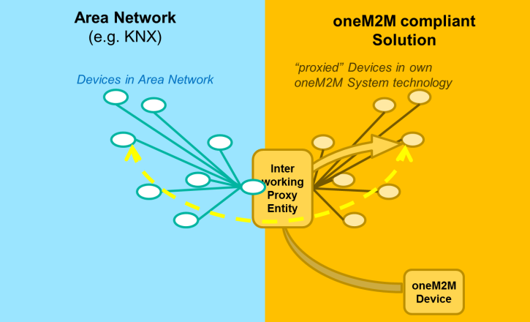
How do the “proxied” devices behave?
Interworking Proxy Entity (IPE) creates virtual, “proxied” devices as resources in the own, oneM2M compliant Solution. The IPE translates changes of resources in “proxied” devices into Area Nwk specific commands to the real devices - and vice versa.
“proxied” devices can be accessed through the mechanisms of the oneM2M System (RESTful access to oneM2M Resources)
“proxied” devices still exhibit their original information model. E.g.
If the device in the original system (KNX) publishes a boolean-, a 3-byte-, and an integer value every 30 minutes then also the proxy does the same
oneM2M Device accessing the proxy needs to know the original (KNX) information model !
The original (KNX) information model is provided through a (KNX) specific specialization of the oneM2M Base Ontology

Slide 4
The oneM2M base ontology: proposed Concepts
Network/Data view
Functionality view
Washing_Machine
TemperatureSensor
DoorSwitch
EnergyMeter
LightSwitch
SmokeSensor
Device
offers
accomplishes
WashingFunction
DryingFunction
TemperatureReading
TemperatureEvent- Reporting
LightControl
SmokeAlarming
WashCycleService
Standby
SmokeAlarmService
Service
represents (at least one)
Function
Steers / is steered though
has Operation
Control-Interface
Monitoring-Interface
implements
Interface
Operation
SetWashTemperature
StartWashing
(continuously-) display-Temperature
ToggleLightSwitch
CloseDoor

Slide 5
Description of concepts (stateful)
[non-oneM2M] Device
A device is a tangible object designed to accomplish a particular task. In order to accomplish this task, the device performs one or more functions. For example, a washing machine is designed to wash (task) and to accomplish this task it performs a washing-cycle- and a drying-cycle function.
Function (functionality view)
A Function represents the functionality necessary to accomplish the task for which a Device is designed. A device can be designed to perform more than one function. A Function can have a State – e.g. washing colored laundry at 60 degrees.
Service (network/data view)
A service is a representation of a function in an [Area] network that makes the function discoverable, registerable, remotely controllable by other devices in the network. A service can represent one or more functions. A Service is offered by a device that wants (a certain set of) its function(s) to be discoverable, registerable, remotely controllable by other devices in the network. A Service must specify the device that is offering the service, the function(s) to be represented, and the Interfaces (input and output data exchange) necessary to operate the service.

Slide 6
proposed oneM2M Concepts - statefulness
Network/Data view
Functionality view
Washing_Machine
TemperatureSensor
DoorSwitch
EnergyMeter
LightSwitch
SmokeSensor
Device
Stateful
(multiple states possible)
offers
accomplishes
WashingFunction
DryingFunction
TemperatureReading
TemperatureEvent- Reporting
LightControl
SmokeAlarming
WashCycleService
Standby
SmokeAlarmService
Service
represents (at least one)
Function
Steers / is steered though
hasOperation
No State
(‚atomic‘ action)
Control-Interface
Monitoring-Interface
implements
Interface
Operation
SetWashTemperature
StartWashing
display-Temperature
ToggleLightSwitch
CloseDoor

Slide 7
Description of concepts (non - stateful)
Operation (functionality view)
An Operation is
a directive that a influences the behavior (and possibly state) a certain Function – e.g. set washing temperature to xxx degrees
Information provided by the Function – e.g. „current washing temperature“, or indication: „wash-cycle finished“
An Operation has no state.
Note: “Operation” is approximately equivalent to “Command” in SAREF (Smart Appliances REFerence ontology)
Interface (network/data view)
An Interface specifies within a network the input and output data exchange necessary to operate the service. It is a implements in that network some Operation. An Interface is either
An IO-Primitive
or
a Method
Note: “Interface” is approximately equivalent to “property or state” in SAREF (Smart Appliances REFerence ontology)

Slide 8
related SAREF Concepts
Network/Data view
Functionality view
Washing_Machine
TemperatureSensor
EnergyMeter
Device
offers
accomplishes
Service
represents (at least one)
Function
StartPauseFunction
SensingFunction
EventFunction
OpenCloseFunction
LevelControlFunction
SwitchOnService
hasInputParameter
hasOutputParameter
hasCommand (at least one)
Energy
Average enegy
Hot water energy
Maximun energy
Total energy
Humidity
Temperature
Property
Command
oneM2M: Interface
oneM2M: Operation
OnCommand
ToggleCommand
GetCommand
SetLevelCommand
( SetAbsoluteLevel
or SetRelativeLevel)
StepUpCommand

Slide 9
proposed oneM2M Concepts - additions
Network/Data view
Functionality view
Washing_Machine
TemperatureSensor
DoorSwitch
EnergyMeter
LightSwitch
SmokeSensor
Device
offers
accomplishes
WashingFunction
DryingFunction
TemperatureReading
TemperatureEvent- Reporting
LightControl
SmokeAlarming
WashCycleService
Standby
SmokeAlarmService
Service
represents (at least one)
Function
Steers / is steered though
hasOperation
Control-Interface
Monitoring-Interface
implements
Interface
Operation
Fixed set consisting of:
In-Binary
In-Toggle
Out-Analogue
Out-Multistate
In-NextState
In-BLOB (binary obj.)
In-NULL (no data)
...
SetWashTemperature
StartWashing
(continuously-) display-Temperature
ToggleLightSwitch
CloseDoor
Is either of a
provides
IO-Primitive
Method
Is identified by
Name/ID
Other meta- information
(e.g. latest update..)
(for IO-Primitives and Methods)
IO-Primitive
hasUnit
Unit

Slide 10
More on IO-Primitives and Methods
IO-Primitive is a description of data transport to a device or from a device
has a direction: ToDevice or FromDevice
has a Name/ID
may have a data value and a related data type
Example: Name/ID = „desired washing temperature“, direction: „ToDevice“, data value: 40, data type: integer
Example (of a device-initiated event): Name/ID = „finished washing!“, direction: „FromDevice“, no data value
Method is a description of transaction with the device
has is either invoked_in_the_device or invoked_by_the_device
has a Name/ID
may have IO-Promitives (which again have direction: ToDevice or FromDevice)
Example: Name/ID = „Reboot“, direction: „ invoked_in_the device“, no IO-Primitive
Note: if a Method is invoked_in_the_device and has IO-Primitives then
first all data of IO-Primitives ToDevice are sent to the device as parameters of the Method
then all data of IO-Primitives FromDevice are created as result of the execution of the Method
(comprising a transaction at transport level)
Example: Name/ID = „GET“, direction: „ invoked_in_the device“
IO-Primitive ToDevice: Name/ID = „remaining_time“, direction: „ToDevice“, no data value
IO-Primitive FromDevice: Name/ID = „remaining_time“, direction: „FromDevice“, data value = 90, data type: integer

Slide 11
Examples of types of IO-Primitives (details tbd)
ToDevice
TD_Binary
TD_Integer
TD_Analogue
TD_ByteArray
TD_String
TD_NULL (no data)
TD_MultiState
...
FromDevice
FD_Binary
FD_Integer
FD_Analogue
FD_ByteArray
FD_String
FD_MultiState
...

Slide 12
Network/Data view
Device
address
Can be reached in network via a
Device
offers
State
has zero or more
Service
Steers / is steered though
Interface
Is identified by
Is either of a
Is identified by
Name/ID
IO-Primitive
Method
Name/ID
Is either of
contains 0 .. n
IO-Prim
ToDevice
IO-Prim
FromDevice
IO-Primitive

Slide 13
Network/Data view (IPE, Area NW and NW Bus)
For interworking purposes an IPE does not need to be part of the ontology
Interworking Proxy [Application] Entity
a Network Bus is a special (non- physical) device
Interworks with 1..n
M2M Area Network
Serves 0 .. x
Serves 0 ...k
Network Bus
Device
offers
Bus Service

Slide 14
Notes:
NEC's brand statement, "Empowered by Innovation," expresses our commitment to empowering people and society through continuous innovation in every area of our businesses, fueled by our infinite passion for innovation and our customer-focused spirit of collaboration.

