Slide 1
Ontology Resource Discussion
Group Name: MAS#19
Source: InterDigital
Contact: Catalina.Mladin@InterDigital.com
Meeting Date: 2015-09-06 Agenda Item: TBD

Slide 2
Discussion Context
Ontology repository (MAS-2015-0528
NEC proposal)
Supports Management of ontologies
Supports CRUD, SPARQL query on ontology (as special retrieve)
Q: What is the representation of the individual ontology resources in this picture (e.g. oneM2M Base, SSN)
Following: “Unstructured” and “Structured” approaches to the representation question

Slide 3
Goal 1: Make local and imported Ontologies available for Annotation
Functionality | No | Requirement
Ontology | 2 | The M2M System shall support modelling semantic descriptions of Things (including relationships among them) by using ontologies.
Ontology | 32 | The M2M system shall be able to model devices based on ontologies which may be available outside the M2M system (e.g. HGI device template).
Ontology | 19 | The M2M System shall be able to re-use common ontologies (e.g., location, time ontologies, etc.) which are commonly used in M2M Applications.
Ontology | 23 | The M2M system shall be able to support mechanisms to import external ontologies into the M2M system.
Ontology | 7 | The M2M System shall provide the capability to retrieve semantic descriptions and ontologies stored outside of the M2M System.
Ontology | 33 | The M2M System shall support storage, management and discovery of ontologies.
Ontology | 24 | The M2M System shall be able to support update of ontologies.
Ontology | 22 | The M2M system shall provide the capability for making ontology available in the M2M System, e.g. through announcement.

Slide 4
Goal 2: Make Ontologies flexible enough for enhanced functionality
Functionality | No | Requirement
Ontology | 18 | The M2M System shall be able to use ontologies that contain concepts representing aspects (e.g. a room) that are not represented by resources of the M2M System.
Ontology | 17 | The M2M System shall be able to support extending ontologies in the M2M system.
Ontology | 5 | The M2M System should be able to provide translation capabilities from different modeling languages for ontologies to the language adopted by oneM2M if the expressiveness of the imported ontology allows.
Ontology | 16 | The M2M System shall provide support for linking ontologies defined in the context of the M2M system with ontologies defined outside this context.
Ontology | 29 | The M2M System shall enable functions for data conversion based on ontologies.
Reasoning | 21 | The M2M system shall be able to update ontologies as a result of the ontology reasoning.
Reasoning | 25 | The M2M System shall be able to support semantic reasoning e.g. ontology reasoning or semantic rule-based reasoning.
Reasoning | 26 | The M2M System shall be able to support adding and updating semantic information based on semantic reasoning.

Slide 5
Unstructured Approach
Ontology to be accessed directly from specialized format file e.g. OWL
Questions:
Should both local content storage (file as resource content) and external (IRI) be supported?
If supporting IRI, are multiple allowed?
Is “internal” vs. “external” designation needed, and if yes how to fully define?
Anything else needed?

Slide 6
Unstructured Approach example
contentFormat may indicate that content is IRI or file, as well as indicating file format e.g. OWL
description is rather generic, but may be useful in categorizing by verticals, etc.

Slide 7
Structured Approach
Previous proposals: MAS-2015-0603
Ontology resource with <class> and <relationship> child resources
Ontology
Name
Topic
1
..
1
n
..
n
IsSubjectOf
Use several individual attributes to maintain class and relationship information
<
class
>
1
..
n
IsObjectOf
0
..
n
hasSubclass
0
..
n
isSubclassOf
0
..
n
equivalentTo
0
..
n
1
..
<
n
relationship
>
relationshipCategory
1
..
n
hasSubject
1
..
n
hasObject
0
..
<
n
subscription
>
restriction

Slide 8
<class> Resource example
isSubjectOf | 1..n | RW | URI(s) of a <relationship> resource for which the class is a subject E.g. for oneM2M Base class <Service> this attribute may be the URI of: <hasOperation>, <consistsOf>,
isObjectOf | 1..n | RW | URI(s) of a <relationship> resource for which the class is an object E.g. for oneM2M Base class <Service> this attribute may be the URI of: <hasService>, <isExposedBy>
hasSubclass | 0..n | RW | URI to another class which is a subclass of the one being defined E.g. for oneM2M Base class <thing> this attribute may be the URI of <device>
isSubclassOf | 0..n | RW | URI to another class resource which is a superclass of the one being defined E.g. for oneM2M Base class <device> this attribute may be the URI of <thing>
equivalentTo | 0..n | RW | URI to another class resource which is the equivalent of this class.

Slide 9
<relationship> Resource example
relationshipCategory | 0..n | RW | Optional, describes the relationship type, e.g. Synonymy, Antonymy, Hyponymy, Meronymy, Holonymy.
hasSubject | 1..n | RW | URI(s) of a <class> reource who is a subject for this relationship
hasObject | 1.. n | RW | For Object relationships/properties, a URI(s) to a class which is the object for this relationship. For Data properties it would contain a data type
restriction | 0..n | RW | Restrictions posed by this relationship, as they map to the OWL use of restriction

Slide 10
Analysis/ PROs & CONs
Unstructured (OWL)
+ “Existing” approach
==? Parsing
+ One retrieve needed
==? Caching
==? Availability without external connection
Structured:
+ Enables inter-ontology mapping within the platform
+ Enables ontology extensions
- Many retrieves? (+one can retrieve the whole resource, same as OWL file)
+ Enables easier to identify partial updates of ontology, which may result in semantic annotation updates
+ Enables use of ontology sections (i.e. from SSN)
+ Enables reasoning-related features, as each class/ relationship is addressable
Why not supporting both?
Both approaches allow support of multiple ontologies such that they can be discovered and re-used by the M2M system
Both approaches enable ontology use for semantic annotation

Slide 11
Dual Approach Support

Slide 12
Reference material from TS-0012: oneM2M Base Ontology

Slide 13
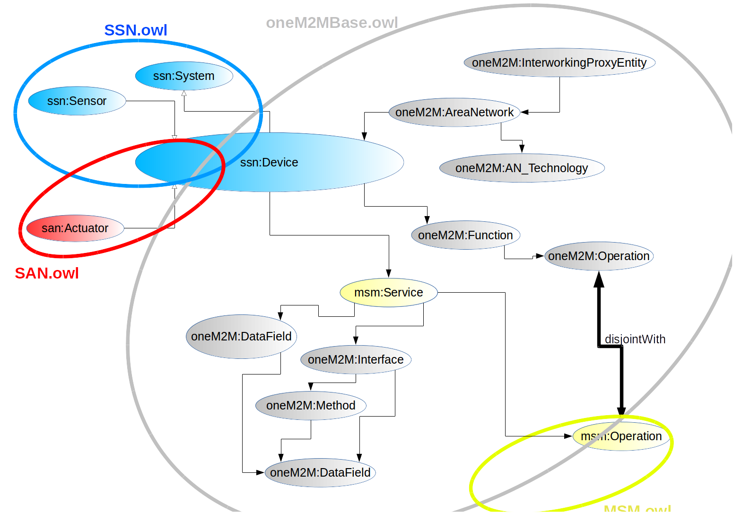
Reference material from MAS-2015-0551R01

