Slide 1
oneM2M Sustainability Case Study
10/20/2021
Dale Seed
Convida Wireless

Slide 2
Outline
Review of oneM2M specifications to identify aspects/features that are already well-aligned with IoT sustainability and that can provide value-add sustainability.
E.g., Aspects/features that can make IoT deployments more sustainable
E.g., Aspects/features that can help society reach sustainability goals
Review of oneM2M specifications to identify aspects/features where there may be opportunities for further improvements / enhancements to enable implementations of the standard to be deployed more sustainably or to enable the standard to further help society meet its sustainability goals.

Slide 3
oneM2M features that enable more sustainable IoT deployments

Slide 4
Streamlining IoT Message Sizes
Service layer can help streamline the size of messages that IoT devices need to generate and send without losing information. Service layer can apply a message profile to enrich messages it receives from IoT devices with additional metadata. This can reduce overhead on devices and networks while not sacrificing info that is useful to the apps that consume this data.
Registration
Service Layer
Registration
Communication Management
Security
Discovery
Data Management & Repository
Semantics
Device Management
Subscription & Notification
Group Management
Application & Service Management
Location
Service Charging & Accounting
Network Service Exposure
Transaction Management
Time
Management
Session
Management
Process
Management

Slide 5
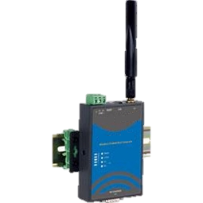
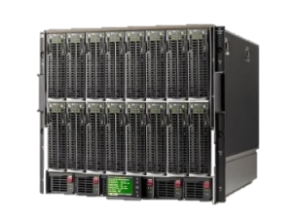
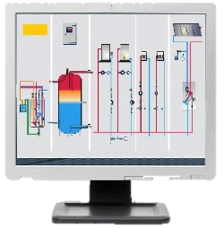
IoT Message Streamlining Example
Only bare minimal amount of info needed in request (i.e. just the sensor reading)
3) Request to Retrieve contentInstance
temp
1) Request to create contentInstance resource
[content = 32]
4) Response
[labels = temperature, creator = AE-1,
contentInfo = application/xml:1, content=32]
AE-1
AE-2
CSE
CSE
2) CSE uses Message Primitive Profile to add additional useful metadata to message
4) Rich set of information needed by AE-2 included in response
CSEBase
AE-1
A Message Primitive Profile is used by a CSE to add, modify and delete attributes of messages flowing to/from constrained IoT devices. This helps minimize size of messages without sacrificing useful info needed by apps interacting with these devices
primitiveProfile
resourceTypes = contentInstance
operations = CREATE
additions =
labels=temperature,
creator=AE-1, contentInfo=application/xml:1 …
container
contentInstance
labels = temperature
creator = AE-1
contentInfo = application/xml:1 …
content=32
AE: Application Entity
CSE: Common Services Entity

Slide 6
Offloading processes from apps to service layer
Registration
Service Layer
Registration
Communication Management
Security
Discovery
Data Management & Repository
Semantics
Device Management
Subscription & Notification
Group Management
Application & Service Management
Location
Service Charging & Accounting
Network Service Exposure
Transaction Management
Time
Management
Session
Management
Process
Management
Service layer can help streamline the complexity of IoT devices by offloading the burden of keeping the device’s time synchronized with other entities in the system. The service layer can detect time synchronization offset issues with devices and compensate for this offset without burdening the devices. This helps keep devices simple and streamlined such that they consume less energy.

Slide 7
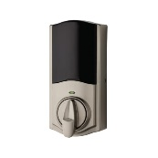
Offloading Processes Example
1. Create <processManagement>,
<state>, <action> resources
5. Unlock Door
AE-2
CSE
AE-1
CSEBase
An AE can offload to a CSE a process that the CSE performs on the AE’s behalf.
3. CSE monitors start/stop conditions to determine if/when to perform the process
processManagement
state-1
4. While performing the process, CSE transitions to individual process states based on transition criteria and performs actions defined for each state if/when specified conditions have been met.
5. While performing the process, CSE transitions to individual process states based on transition criteria and performs actions defined for each state.
5. While performing the process, CSE transitions to individual process states based on transition criteria and performs actions defined for each state.
action-1
2. A process consists of a set of states and actions much like a state machine
state-2
…
AE: Application Entity
CSE: Common Services Entity
…

Slide 8
Alleviate time synchronization burden from IoT devices
Registration
Service Layer
Registration
Communication Management
Security
Discovery
Data Management & Repository
Semantics
Device Management
Subscription & Notification
Group Management
Application & Service Management
Location
Service Charging & Accounting
Network Service Exposure
Transaction Management
Time
Management
Session
Management
Process
Management
Service layer can help streamline the complexity of apps by offloading app-defined processes to the service layer to perform. This can reduce the amount of network traffic flowing between the apps and service layer. For example, app no longer needs to pull data from service layer and process it. Instead, service layer is instructed by app on which operations to perform on the locally stored data and when to perform these operations.

Slide 9
Time Management Example
1) Request to create timeSeriesInstance resource
[Originating Timestamp = 20201003T112432,
Data Generation Time = 20201003T112405
content = 32, …]
4) Request to Retrieve timeSeriesInstance resource
[Originating Timestamp = 20201003T161349]
temp
6) Response
[Data Generation Time = 20201003T113555
content = 32, …]
AE-1
AE-2
CSE
CSE
2) Based on AE-1’s Originating Timestamp value, CSE detects time synchronization offset of +7mins 35secs
CSE compensates for time offset by adjusting Data Generation Time by 11mins 50secs
5) Based on AE-2’s Originating Timestamp value, CSE detects time synchronization offset of +4mins 15secs and adjusts Data Generation Time to compensate for offset when responding to AE-2
CSEBase
AE-1
timeSeries
timeSeriesInstance1
dataGenerationTime = 20201003T113140,
content = 32
3) CSE compensates for time offset by adjusting Data Generation Time by 7mins 35secs
AE: Application Entity
CSE: Common Services Entity
.
.
.

Slide 10
Support for sleepy IoT devices
Service layer can store-and-forward requests to devices based on device reachability status and schedules
Service layer can host a digital twin representation of device such that device can be allowed to sleep but its information can still be accessed while it sleeps
Registration
Service Layer
Registration
Communication Management
Security
Discovery
Data Management & Repository
Semantics
Devices can share their reachability status and schedules with service layer
Device Management
Subscription & Notification
Group Management
Application & Service Management
Location
Service Charging & Accounting
Network Service Exposure
Transaction Management
Time
Management
Session
Management
Process
Management
Service layer can trigger a device to wake up and reconnect to receive a high priority request if it is not reachable
Service layer subscriptions and notifications provide a modular, loosely coupled and secure means for apps and devices to communicate with one another. This makes IoT deployments more sustainable and robust to changes in devices and apps.

Slide 11
Digital Twin Example
1) Register to CSE
5) Retrieve contentInstance or flexInstance
temp
2) Create container or flexContainer
AE-1
7) Response (temp = 32 F, location = New York
3) Create contentInstance or flexInstance
AE-2
CSE
CSE
6) CSE services request without needing to wake and interact with device. CSE uses local oneM2M resources (i.e., digital twin of device) to service request.
4) Device goes to sleep
CSEBase
AE-1
oneM2M resources are used to represent digital twin of the device
container or flexContainer
contentInstance or flexInstance
temp = 32 F
location = New York
AE: Application Entity
CSE: Common Services Entity

Slide 12
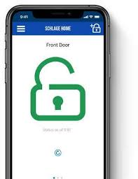
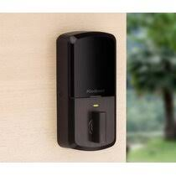
Subscriptions & Notifications
1) Register to CSE [reachability schedule]
2) Create flexContainer for door lock
4) Subscribe to door lock status updates
3) Subscribe to door lock control attribute
5) Request to unlock door
AE-1
8) Notification that door is unlocked
6) Notification of request to unlock door
CSE
AE-2
CSE
7) Update door lock status as unlocked
Subscriptions and notifications provide a modular, loosely coupled and secure means for apps and devices to communicate with one another. This makes IoT deployments more sustainable and robust to additions, removals, and changes to devices and apps in the system.
CSEBase
AE-1
flexContainer for door lock
status = locked
control = unlock
flexContainer for door lock
status = locked
control = lock
flexContainer for door lock
status = unlocked
control = unlock
subscription to control
AE: Application Entity
CSE: Common Services Entity
subscription to status

Slide 13
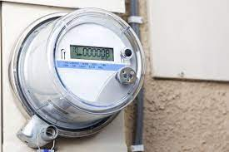
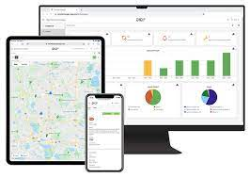
Device Triggering
1) Register to CSE [reachability schedule]
2) Create node and software for smart meter
4) Subscribe to smart meter software status
3) Subscribe to software install attribute
5) Request to install software
AE-1
9) Notification software has been installed
7) Notification to install software
CSE
AE-2
CSE
8) Update software install status
CSEBase
node (smart meter)
3GPP Network
software
install = TRUE
…
software
software
installStatus = installed
…
subscription to control
6) Service layer detects if/when device is not connected to the 3GPP network and sends a trigger request to have the 3GPP network trigger the device to re-establish a network connection to the service layer.
subscription to status
AE: Application Entity
CSE: Common Services Entity

Slide 14
Shortcomings / opportunities for further improvements and enhancements to oneM2M that could enable more sustainable IoT deployments

Slide 15
Next Steps
Collaborate with others to continue to identify additional oneM2M features well-aligned with IoT sustainability
E.g., Interworking, SDT, semantics, etc.
Start to identify shortcomings / opportunities for further improvements and enhancements to oneM2M that could enable more sustainable IoT deployments

