Slide 1
IoT Done Sustainably Leveraging oneM2M
Dale Seed
11/10/2022
Notes:
S1 - Hello everyone, again my name is Dale Seed and it’s a pleasure to have the opportunity to speak with you today and provide you with some insight into how IoT deployments can be made more sustainable leveraging the oneM2M standard.

Slide 2
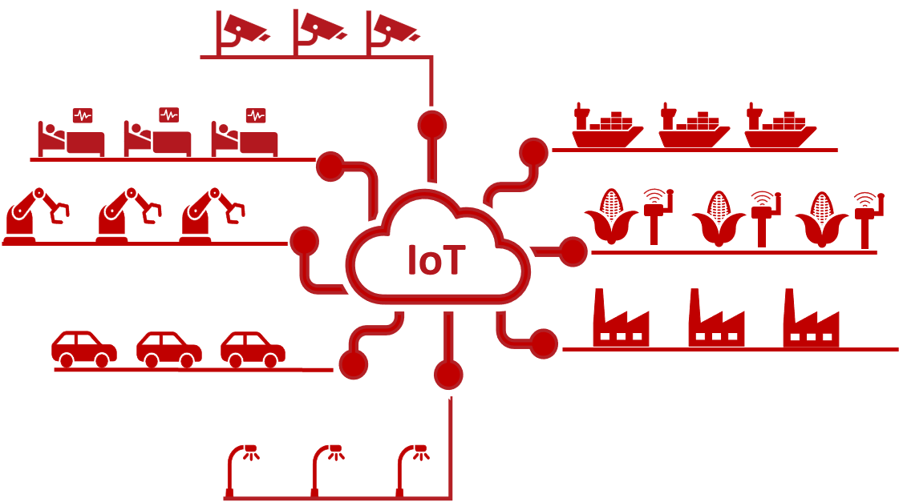
The Importance of IoT
IoT is a very important and well positioned technology to help reduce environmental impact and inefficiencies for many use cases.
E.g., smart farming, smart energy production, smart supply chain management, etc.
However, what’s often overlooked is IoT technologies have their own carbon footprint which can undermine their benefits if not deployed responsibly.
Notes:
S2 - Given this is an IoT conference and most of you have a good bit of experience and appreciation for IoT technologies, I probably don't have to spend a lot of time convincing you of the important role that IoT has in helping society reduce the environmental impact and inefficiencies of many of our everyday use cases such as industrial, healthcare and shipping to name a few.
For example, if we look at smart agriculture, IoT technologies are helping us reduce the water consumption and amount of chemicals and fertilizers being used to grow crops
However, what's often overlooked is the fact that IoT technologies themselves have their own carbon footprint which can undermine and negate some of their benefits if not deployed responsibly.

Slide 3
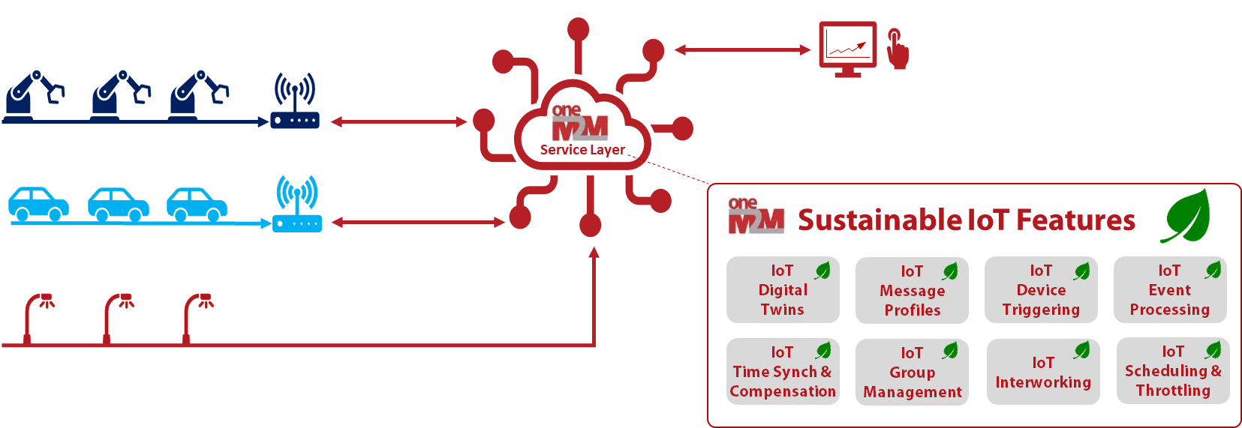
oneM2M Sustainable IoT Features
The oneM2M standard provides several key features enabling more sustainable IoT deployments
These features can help reduce the energy consumption and carbon footprint of IoT deployments
Notes:
S3 - This brings me to the focus of my talk today - Which is to provide you with some insight into how IoT deployments can be made more sustainable through the use of the oneM2M standard.
I plan to introduce you to some of the key features supported by the standardized oneM2M service layer and hopefully provide you with a better appreciation of the sustainability benefits of these features.
By using these features, IoT deployments can reduce their own energy consumption as well as their carbon footprints.

Slide 4
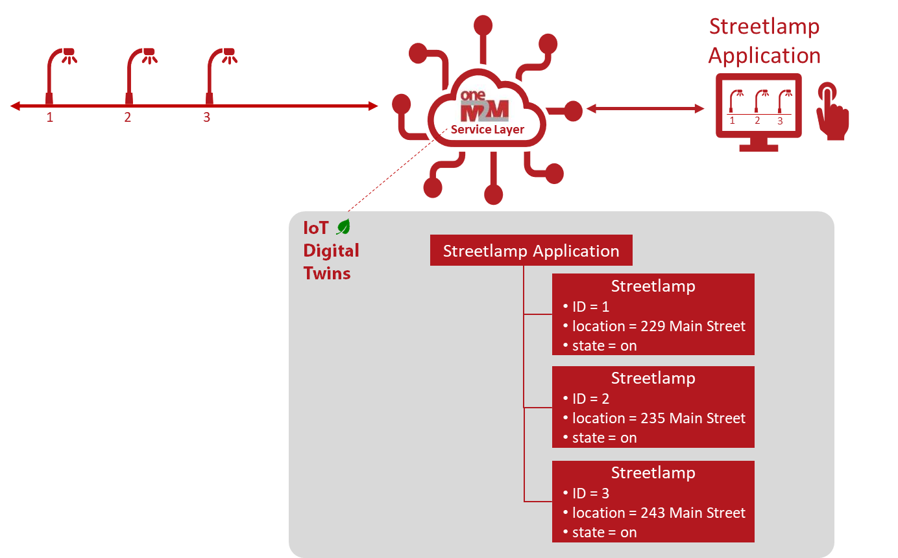
IoT Digital Twins
Use of IoT digital twin technology provides a huge power consumption benefit for IoT devices:
Allows IoT devices to disconnect, power down and sleep for longer durations of time,
Allows network applications to access device data while IoT devices are sleeping,
Reduces load on devices - devices only need to interact with their digital twins and not all the applications interested in their data.
oneM2M defines a standardized and extensible framework for IoT digital twins. It provides developers with flexible options for representing their devices and applications as digital counterparts in the oneM2M service layer.
Notes:
S4 - So with that intro, let me jump right into the first feature I'd like to discuss with you and that is IoT Digital Twins
This is a well-known feature being used by many IoT deployments which I’m sure many of you are familiar with.
However, when it comes to sustainable IoT deployments it’s a very important feature and deserves some attention in my talk today.
From an IoT perspective, a digital twin provides a representation of physical IoT devices in the digital world which are stored off device typically within the cloud and/or on a gateway.
For example, I’m showing streetlamp digital twins here on this slide.
Why digital representations of devices are so important from a sustainability perspective, is they allow physical IoT devices to disconnect, power down and sleep for long durations of time while their digital twins remain accessible to applications to access.
Using digital twins, applications can access sensor readings from the device even while the device is sleeping and powered down.
This can have huge sustainability benefits since it reduces energy consumption of devices and in turn increases battery life and overall deployment lifetime of devices.
Digital twins also reduce the carbon footprint of devices by reducing the frequency of having to swap out or recharge batteries.
When it comes to the oneM2M standard, it supports a standardized as well as an extensible framework for IoT digital twins.
It provides developers with flexible options for representing their devices and applications as digital counterparts in the oneM2M service layer
oneM2M supports various types of digital twin resources, information models and ontologies standardized by oneM2M as well as other standards bodies which oneM2M collaborates with such as ETSI SAREF.

Slide 5
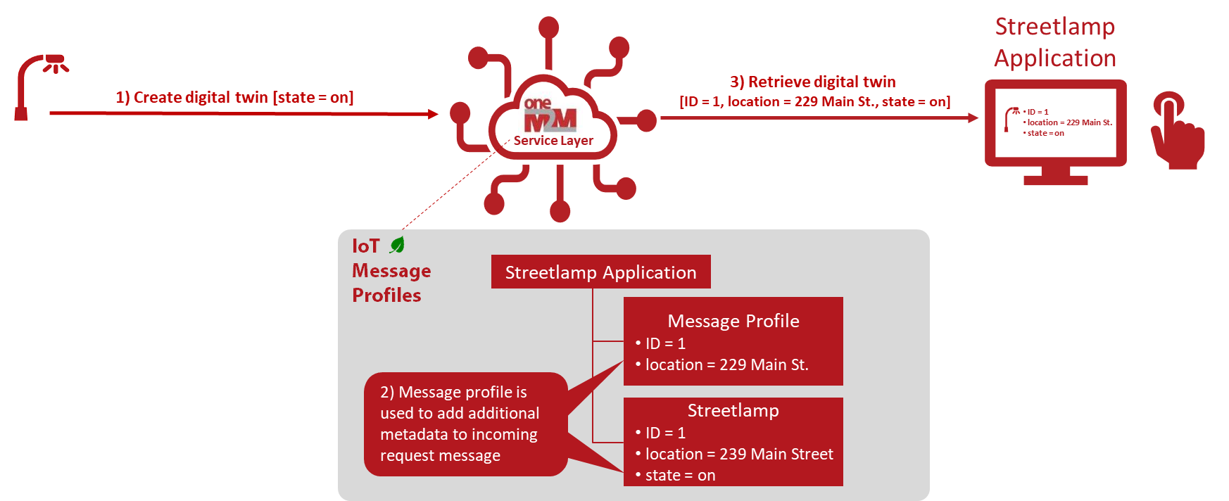
IoT Message Profiles
The number of bytes included within each message a device sends or receives has a major impact on its battery life and the amount of congestion and overhead introduced into the network.
In many IoT use cases, there is a certain amount of static and repetitive data present in sensor readings (e.g., device description or location).
oneM2M defines message profiles to help streamline message sizes.
Devices send only the bare minimum amount of data that is dynamically changing.
oneM2M then enriches messages with static information using message profiles.
Notes:
S5 - The next feature I'd like to cover is IoT Message Profiles
The number of bytes included within each message a device sends or receives has a major impact on the time a device needs to stay connected to the network and how long the device needs to keep its transceiver powered
This can greatly impact the battery life of the device.
The number of bytes also contributes to the amount of congestion and overhead an IoT device introduces into the network, especially as the number IoT devices scales out to large numbers.
In many IoT use cases, there is a certain amount of static and repetitive data present in each and every IoT message.
For example, it is not uncommon for IoT message payloads to include a device identifier or location which seldom if ever changes.
To address this inefficiency, oneM2M defines message profiles to help streamline message sizes.
The oneM2M service layer can be configured with a message profile which includes information the service layer uses to enrich messages it receives from IoT devices
Devices send only the bare minimum amount of data that is dynamically changing to the oneM2M service layer.
The service layer then enriches messages with static information using the message profiles.
These enriched messages are then consumed by backend applications which benefit from the additional information

Slide 6
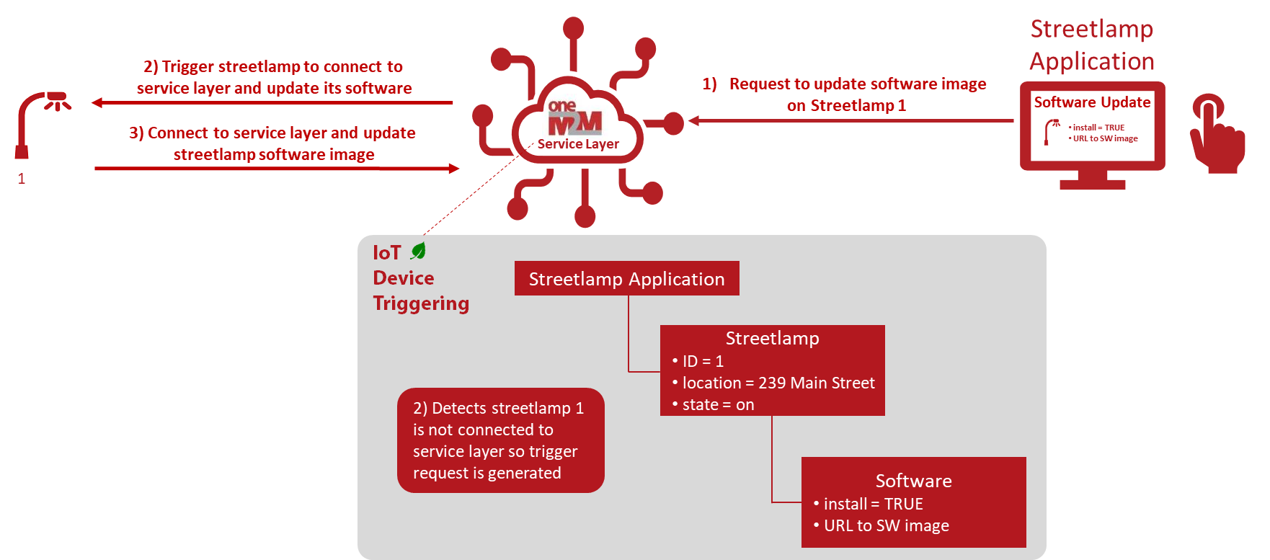
IoT Device Triggering
oneM2M device triggering enables an IoT device to “sleep” for long periods of time when not in use, and intelligently “wake up” when applications need to interact with the device.
oneM2M triggers devices in an on-demand fashion via control plane of underlying communication network (e.g., 3GPP).
When device receives the trigger, it fully powers-up, re-connects to the oneM2M service layer and receives application messages.
Notes:
S6 - The next feature I'm going to cover is IoT Device Triggering
oneM2M supports device triggering which enables an IoT device to “sleep” for long periods of time when not in use, and be woken up by the service layer in an on-demand fashion if/when applications need to interact with the device.
For example, if/when a device requires a software update, the oneM2M service layer can trigger a device to have the device to wake-up and reconnect to the oneM2M service layer.
oneM2M does this via its support for interworking with underlying networks like 3GPP to send messages to devices to trigger them to wake-up and reconnect
When a device receives the trigger, it fully powers-up, re-connects to the network and receives the software update messages.
Once finished, the device can return to a sleep state and conserve power until the next time it needs to wakes up

Slide 7
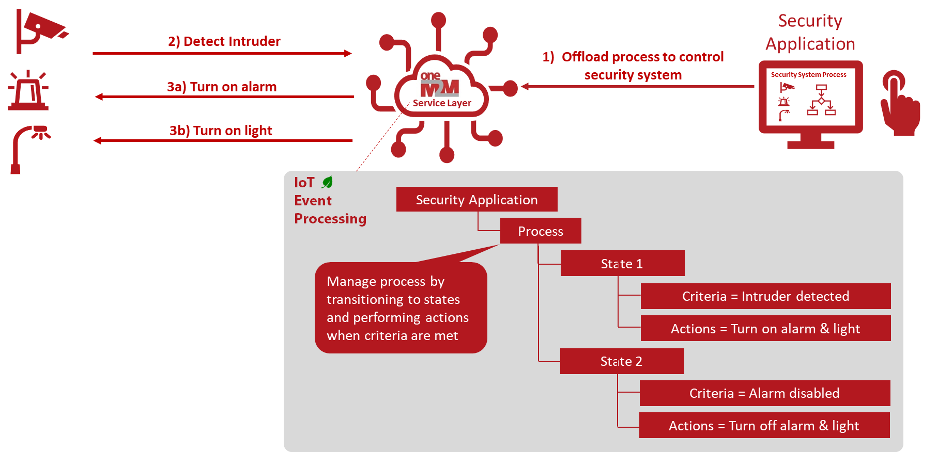
IoT Event Processing
oneM2M supports offloading event detection and processing from devices and applications to the oneM2M service layer.
E.g., checking if sensor readings have crossed a certain threshold and performing actions such as switching an actuator on/off.
This offloading to the oneM2M service layer greatly reduces the amount of messaging and data exchanged in the system.
Notes:
S7 - The next feature is IoT Event Processing
oneM2M supports the capability for offloading event detection and processing from devices and applications to the oneM2M service layer.
This offloading of processes to the oneM2M service layer greatly reduces the amount of messaging and data exchanged in the system.
For example, the oneM2M service layer can be configured with events of interests to an application (e.g., an intruder alert from a security camera)
The service layer can also be configured to perform one or more actions if/when the event occurs (e.g., enabling a security alarm and turning on lights).
This can all be configured to be performed within service layer rather than the application having to fetch and analyze data from the service layer and issue commands to perform actions on devices if when events occur. Hence this can greatly reduce the amount of messaging in the overall system.
It can also enable the reuse and sharing of data stored within the service layer across multiple processes and applications. E.g. data from the same device can be shared efficiently between applications.

Slide 8
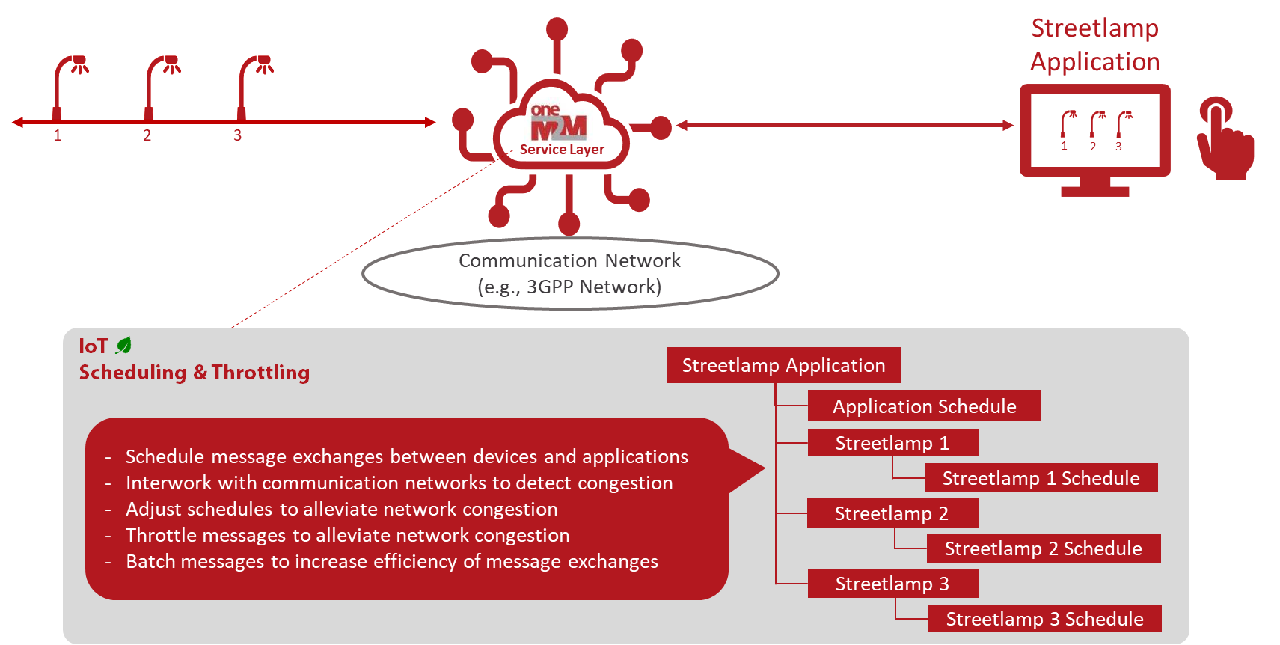
IoT Scheduling and Throttling
By managing peak demands on communication networks, network operators can optimize the amount of network equipment (e.g., switches, routers, servers, cell towers and base stations) required to meet their customer demands. This can significantly reduce the energy consumption and carbon footprints of their networks.
oneM2M supports several scheduling and throttling features to help network operators minimize the peak demand on their communication networks.
Notes:
S8 - The next feature is IoT Scheduling and Throttling of Messages
By managing peak demands on communication networks, network operators can optimize the amount of network equipment (e.g., switches, routers, servers, cell towers and base stations) required to meet their customer demands. This can significantly reduce the energy consumption and carbon footprints of their networks and equipment.
oneM2M supports several scheduling and throttling features to help network operators minimize the peak demand on their communication networks. For example, the oneM2M service layer supports
Scheduling message exchanges between devices and applications based on schedule input from underlying networks
Interworking with communication networks to detect congestion
Adjusting schedules of devices and applications to alleviate network congestion
Throttling messages to also alleviate network congestion
Batching messages to increase efficiency of message exchanges
oneM2M also supports the capability to notify applications and devices of congestion such that the devices and applications themselves can take action, such as reducing the frequency or size of messages that they exchange

Slide 9
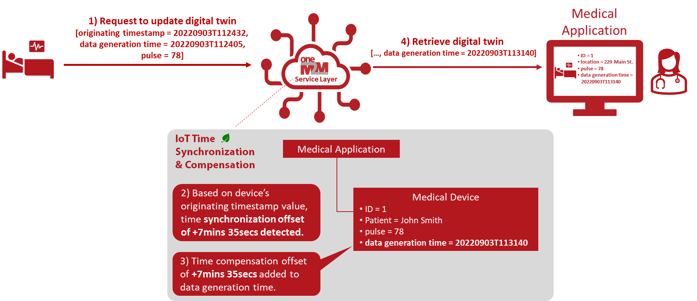
IoT Time Synchronization & Compensation
Many resource constrained devices lack the capability to keep their local time synchronized with other devices in the network using traditional technologies such as GPS and Network Time Protocol (NTP).
oneM2M supports low-overhead time synchronization capabilities for IoT devices.
E.g., when messages containing timestamp information are received from devices, the oneM2M service layer can adjust the timestamps to compensate for any detected time offsets.
Notes:
S9 - The next feature is Time Synchronization and Compensation
Many resource constrained devices lack the capability to keep their local time synchronized with other devices in the network which typically require the use of heavy weight time synchronization protocols and technologies such as the Network Time Protocol (NTP).
oneM2M supports time synchronization capabilities specifically targeted for resource constrained IoT devices.
E.g., when messages containing timestamp information are received from devices, the oneM2M service layer can detect if/when the time of the device is not synchronized with the rest of the system
It does this by comparing and detecting any offset between a device’s local time reference and the service layer's local time reference using oneM2M timestamp fields within the messages.
If the service layer detects that time compensation is required, the service layer can compute a time offset and then adjust any timestamp related metadata that is contained within the received message.
For example, the oneM2M service layer can adjust the data generation time to compensate for any time synchronization offset as shown in this example
This can simplify devices and allow them to consume less energy by offloading them from the burden of having to maintain time synchronization with the rest of the system which requires frequent wake-ups and the sending and receiving of time sync protocol messages.

Slide 10
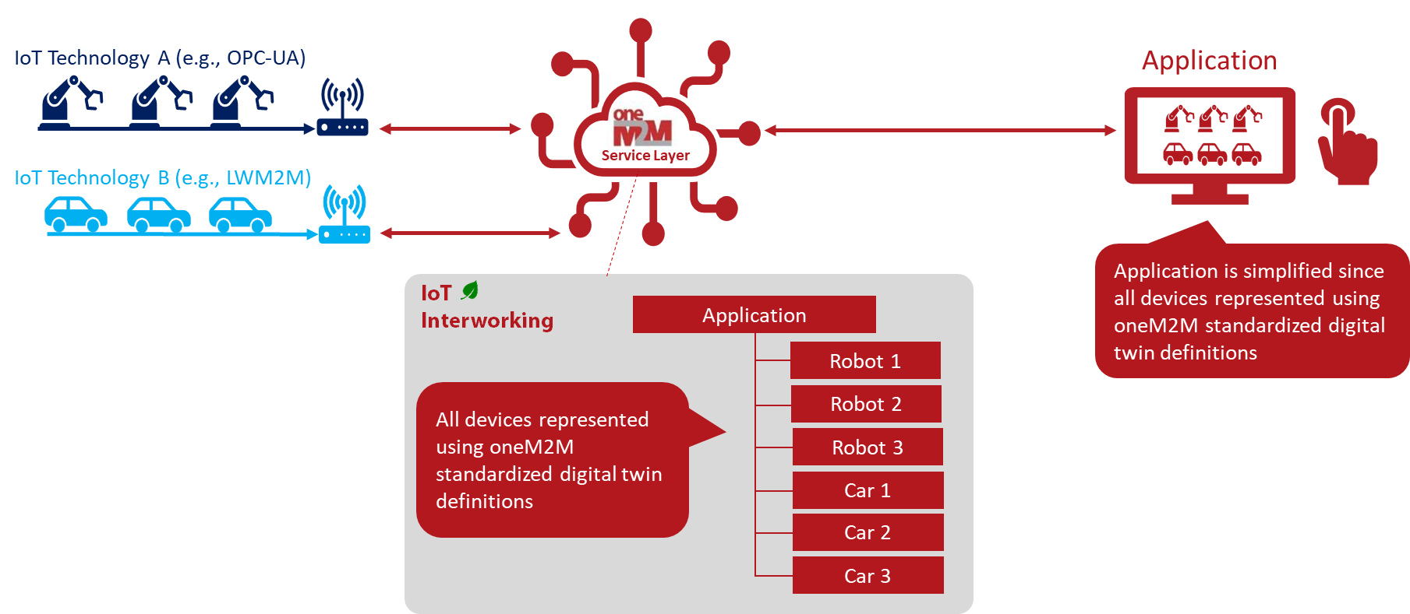
IoT Interworking
Interworking different IoT platforms together with one another can be challenging, especially newer and older platforms.
This typically requires developing complex and costly custom over-the-top application code to glue these platforms together.
This can lead to frustration and frequent swapping out and replacing of older platforms with new ones.
This is problematic from a sustainability perspective since frequent refreshing of older platforms with newer ones generates a significant amount of e-waste
oneM2M can help extend the life of IoT deployments by standardizing and simplifying how IoT platforms are interworked with one another.
Notes:
S10 - IoT Interworking
Interworking different IoT platforms together with one another can be challenging, especially newer and older platforms.
This typically requires developing complex and costly custom over-the-top application code to glue these platforms together.
This can lead to frustration which in turn can lead to frequent swapping out and replacing of older platforms with new ones.
This is problematic from a sustainability perspective since frequent refreshing of older platforms with newer ones can generate a significant amount of e-waste
oneM2M helps extend the life of IoT deployments by standardizing and simplifying how IoT platforms are interworked with one another.
For example, oneM2M has standardized interworking proxies to popular IoT technologies as well as supports an extensible framework which can be used to build additional interworking proxies with less time, less cost and less complexity.

Slide 11
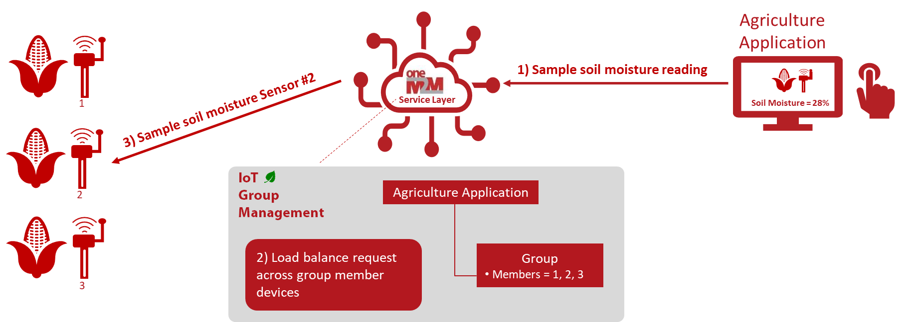
IoT Group Management
Deploying IoT devices in groups can extend overall lifetime of an IoT deployment and reduce its carbon footprint.
oneM2M supports load balancing requests across a group of functionally equivalent devices.
This can extend the battery lifetime of individual devices as well as extend the overall IoT system deployment lifetime.
Notes:
S11 - IoT Group Management
Deploying IoT devices in groups can extend overall lifetime of an IoT deployment and reduce its carbon footprint.
For example, deploying the same type of device in proximity to one another provides the opportunity to split the load between the devices
This allows devices to sleep for longer durations and extend their battery lifetime which in turn extends the service time of the IoT deployment before maintenance such as battery swaps are needed.
oneM2M supports the formation and management of groups of IoT devices and also supports the load balancing of requests across a group devices.
For example, in the smart agricultural use case I’m showing here, monitoring the soil moisture level can be achieved by doing a round-robin sampling of a group of sensors which extends the lifetime of the individual sensors as well as the time between maintenance such as battery replacements.

Slide 12
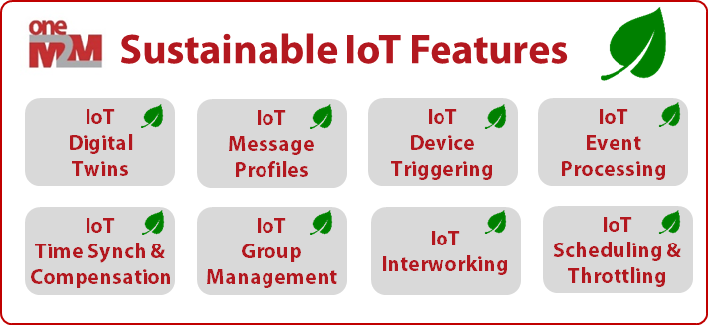
Takeaways
IoT deployments have their own carbon footprint which can undermine their sustainability benefits.
oneM2M provides several key features that enable more sustainable IoT deployments
These feature can reduce energy consumption, increase system longevity, and minimize the amount of e-waste of IoT deployments
Link to oneM2M Sustainability White Paper
http://www.oneM2M.org
12
Notes:
S12 - So let me wrap-up here and leave you with a few takeaways
First off, it's important for us all to realize that IoT deployments themselves have their own carbon footprint, which if not optimized, can undermine and chip away at the sustainability benefits of an IoT deployment.
Secondly, oneM2M provides several key features that can enable more sustainable IoT deployments.
Lastly, these standardized oneM2M features can reduce energy consumption, maximize deployment lifetime, and minimize the amount of e-waste of IoT deployments
I'm including a link here to the latest oneM2M sustainability white paper that was just published and where you can find additional information expanding further upon the features and information I presented today.

Slide 13
Thank You!
Dale Seed
oneM2M Technical Plenary Vice Chair
oneM2M Sustainability Sub-Committee Convenor
Principal Engineer, InterDigital / Convida Wireless
dale.seed@interdigital.com
Notes:
S13 - And finally I'd like to say thank you to the ETSI IoT Week organizers for the invite and the time to share my presentation with you today.
If you would like to reach out to me for further discussion, I'm also providing my contact info here for you.

