Slide 1
HGI Proposal for OneM2M re: WI-0017 (v2.0.0) “Home Domain Abstraction Information Model"
input to oneM2M TP-2015-0640 / MAS-2015-0542
Date: 2015-03-20 DMS#: HGI09999 CoAuthors: L. Giacomello, H-W. Bitzer, D. Bees, L. Frost, P. Martigne, T. Yamazaki
Company: HGI (PT2) For working group: OneM2M TP and WG5

Slide 2
Contents
HGI abstraction layer including the Smart Device Template
HGI’s SDT 1.0 principles
Relation to oneM2M WI-0017
Result from HGI inter-alliance meeting (Febr.2015)
input to oneM2M TP-2015-0640 / MAS-2015-0542

Slide 3
Recap
HGI has been a Partner Type 2 of OneM2M since early 2014
HGI is developing a smart home architecture that builds on service provider assets in the home
The service enabled Home Gateway is at the core
Defined reference points within and external to the home
Easier integration among applications, smart devices, home networks, and cloud located logic is very important . This is addressed in HGI via an abstraction layer that hides the heterogeneity of underlying technologies.
A key element of the abstraction layer, and the main topic of this presentation, is a HGI’s work on Smart Device Template (SDT)
The SDT approach needs participation and buy-in by a cross-section of organisations, including oneM2M
input to oneM2M TP-2015-0640 / MAS-2015-0542

Slide 4
Some Smart Home milestones Collaborative Approaches have been consistently used
2015
Industry wide effort:
Reference
Implementations,
Tools,
Testing
Specification of key components and technologies for a platform and eco system approach
i.e. a software execution environment, related management protocol, test suite; and logo program
Cross-reference to other organizations
Service Provider’s requirements for wireless home area networks supporting smart home services
In cooperation with organizations like Zigbee, EnOcean and ULE Alliances.
Smart Home Reference Architecture introducing an abstraction layer
Smart Device Template; to enable unification of device model semantics and provide unified APIs for application developers
Open
Plattform 2.0
(SWEX)
WHAN
Requirements
SDT
vorto
Smart Device Template
input to oneM2M TP-2015-0640 / MAS-2015-0542

Slide 5
Smart Device Template
Key: SDT envisioned as collaborative work from the start & first step in a process/tool chain
Ideally, to be accepted by key participating organizations (HGI, OneM2M, OSGi-A, BBF …)
Template has an informal (text) and a formal section (machine-readable, probably XML based)
The machine readable part shall be automatically and dynamically translatable into any API system (Java, REST, iOS, Android etc.)
Template must be instantiated for specific devices by domain specific organizations
Wide industry acceptance is crucial to attract adopters and application developers
Template may also be instantiated by vendors, even for proprietary models
oneM2M : TP-2015-0640 / MAS-2015-0542
5

Slide 6
Feb 2015, Torino Inter-Alliances Seminar on Device Modelling
Participants from 12+ organizations (including AllSeen Alliance, Eclipse Smart Home, Eclipse openHAB, Eclipse Vorto, Energy@Home, ETSI SmartM2M, SAREF ontology, HGI, OSGi Alliance, oneM2M, ULE Alliance)
Desire for collaboration towards common models is clear
still several options to consider
A common wish to leverage the SAREF ontology as a guide/roadmap towards convergence.
Next steps = share use of SDT on "typical" devices such as:
(1) dimmer-switch, (2) thermometer-sensor, (3) magnet-contact (uni-directional and battery powered), (4) energy-plug, (5) on/off switch, (6) washing machine, (7) multi-socket electrical-extension-block
input to oneM2M TP-2015-0640 / MAS-2015-0542

Slide 7
HGI and OneM2M working together
Key: HGI is a strong supporter of OneM2M approach; opportunity to work even more closely together for the Smart Home benefit
Previous activities to keep OneM2M up to date
Presentations to OneM2M technical plenary in 2013 and 2014
Participation of OneM2M at HGI’s Paris Symposium (Dec 2014)
Technical presentation at OneM2M showcase conference (Nice, Dec 2014)
Participation of OneM2M at HGI’s Torino inter-alliances Seminar (Feb 2015)
HGI views OneM2M as the reference SDO to align the verticals in IOT
The international participation, plus multi-vertical scope, are important
HGI alignment with allied groups, including oneM2M PT1
HGI has worked closely with ETSI SmartM2M as one of the regional OneM2M, in preparing the SDT proposal
OSGi Alliance‘s Device Abstraction Layer is directly mapped to HGI‘s SDT
SDT is closely linked to the EU Ontology project and SAREF mapping is planned
HGI would now like to propose the HGI SDT as a basis for abstraction modelling of the smart home within the OneM2M generic standard
input to oneM2M TP-2015-0640 / MAS-2015-0542

Slide 8
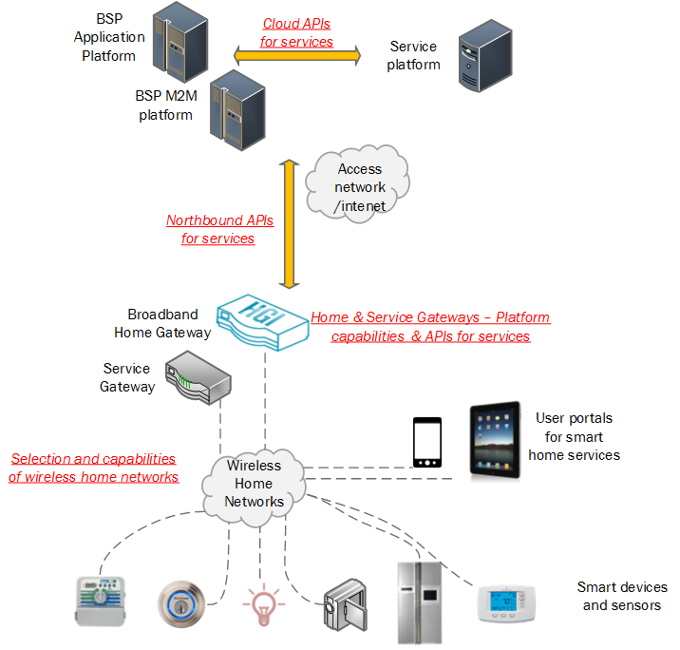
Broadband Service Providers Introducing Smart Home Services –
Challenges addressed by HGI
Key: HGI Smart Home overview

Slide 9
HGI Approach to Abstraction
Key: more detailed intro
We define a Smart Device Template (SDT)
SDT enables application access to devices using a set of standardized modules
The modules combine to create devices
The modules are agnostic to technology
The modules are defined not just by HGI, but by industry stakeholders, through a process of clearing
input to oneM2M TP-2015-0640 / MAS-2015-0542

Slide 10
Ordered goals of the abstraction layer
Provide unified APIs for application developers to command, control and query home appliances
Independence of underlying HAN technologies so that an application developer doesn’t need to know anything about Zigbee, Z-Wave, wireless m-bus etc.
Enable applications to be portable across different “SDT compliant devices”
Enable extendibility of the system with additional HAN technology support without service interruption
Applications should be able to use a pass-through mechanism to use technology-specific functions
input to oneM2M TP-2015-0640 / MAS-2015-0542
10

Slide 11
View from application
Home Automation Application
Application is portable if base modules are used
API at RP1
Zigbee extensions to basic
(if needed)
ABSTRACTION
LAYER
Dimmer Basic
Dimmer Basic
Echonet extensions to basic
(if needed)
Washing Machine Basic
Washing Machine Basic
Washing Machine
Dimmer
Washing Machine
Dimmer
input to oneM2M TP-2015-0640 / MAS-2015-0542

Slide 12
Smart Home : HGI Topics & Current Drafts
RPx
S_HGI02362R05.docx
Remote Access Middleware
USE CASES
SH_HGI02314R01.docx
DEVICE MODEL OVERVIEW GWD042
RP4
ARCHITECTURE
RWD036
HOME GATEWAY
Remote Access Agent
App 1
App N
SH_HGI02029R32.docx
…
RP1
Abstraction Layer
RP2
SDT: (Apache 2.0) DEVICE MODELS RWD050
SH_HGI02593.pdf
D1
D2
D3
Dx
WHAN
WIRELESS HOME AREA NETWORK
RD039 published
12
Notes:
Include for context, only take 10 seconds

Slide 13
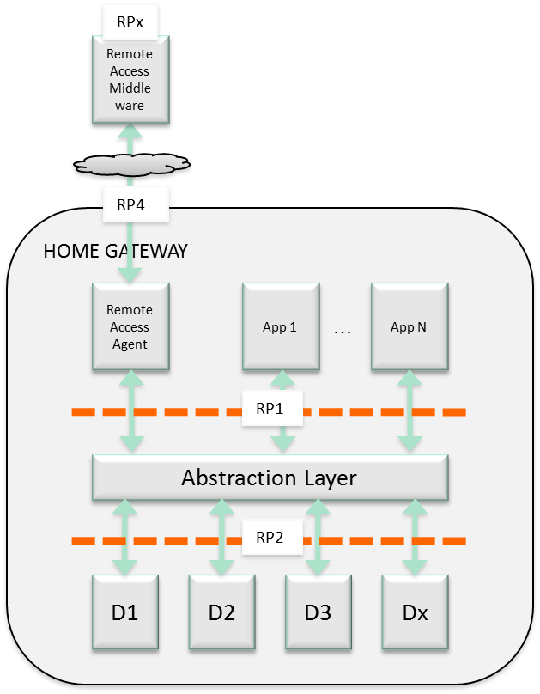
Example of Mapping to OneM2M Architecture
example of Home Energy Management System (NTT Use Case already presented in oneM2M)
The components for HEMS can be mapped onto the architecture of oneM2M.
M2M platform can provide services with HEMS data through APIs.
APIs can be defined based on HEMS abstract information.
Application
Application
Application
Application
APIs
Server
Access Network
GW
oneM2M
Infrastructure
GW
GW
Power network in the home
HEMS
HEMS
HEMS
HEMS
HEMS
Smart Meter
Power Sensor
wired
wireless
input to oneM2M TP-2015-0640 / MAS-2015-0542

Slide 14
HGI SDT Specifics
input to oneM2M TP-2015-0640 / MAS-2015-0542

Slide 15
Some Guiding Principles
Device description is in XML
Try to avoid becoming too complex
Mechanism for referencing other definitions required
Rely on standard XML semantics
Description should be a valid XML document
Do not introduce additional semantics (e.g. <import-device id="…"/>)
Use of standard XML tools (parser, XSLT) should be possible
Identify unit of re-use and abstraction
Not addressed: Standard dictionary for terms such as power, light, etc.
input to oneM2M TP-2015-0640 / MAS-2015-0542
15

Slide 16
Smart Home Device Template (SDT)
The SDT comprises
An XML schema (XSD). This tells us the agreed syntax for the XML device models
This is the part released for comment
A set of ModuleClasses
Building blocks for the device models
Can be instantiated and/or extended as needed to handle technology-specific extensions
Some examples are available
input to oneM2M TP-2015-0640 / MAS-2015-0542

Slide 17
The basis set of Modules
Set of ModuleClasses is used to construct models for complex devices across the domains of interest
Perhaps 20 to 80 different ModuleClasses could be sufficient to represent most common appliances. Which functions? e.g.:
Doc – optional text describing the device model
BooleanState - read/writable true/false state
DataPoint – read-only sensor data
Examples of models constructed from ModuleClasses
Washing Machine Basic – sets out the XML parameters of a non-technology specific washing machine
Dimmable Lamp Basic - combines "set % value" and on/off attributes
Technology-specific instantiation inherit the generic one, and may include technology-specific extensions if required
input to oneM2M TP-2015-0640 / MAS-2015-0542

Slide 18
Way of working on SDT
For SDT, HGI is using an open-source development process under Apache 2.0
Contributions made to SDT must follow this license, ensuring that SDT is not encumbered by commercial license factors
HGI can accept comments from allied organisations under this license
HGI can contribute the SDT result to OneM2M
input to oneM2M TP-2015-0640 / MAS-2015-0542

Slide 19
HGI Proposes
HGI and OneM2M relevant working groups exchange detailed comments
Overall approach
Fit of HGI SDT within OneM2M architecture
Conference call mid April
OneM2M, or member companies of OneM2M who are HGI member companies, consider to provide detailed comments on SDT, under Apache 2.0 terms
HGI aims to continue to publish updates of SDT as progress is made
input to oneM2M TP-2015-0640 / MAS-2015-0542

Slide 20
SDT 1.0 Detailed explanation, & feedbacks from the inter-alliances seminar for next steps of the SDT
for discussions in oneM2M WG5 and/or in joint sessions WG2/WG5…
input to oneM2M TP-2015-0640 / MAS-2015-0542

Slide 21
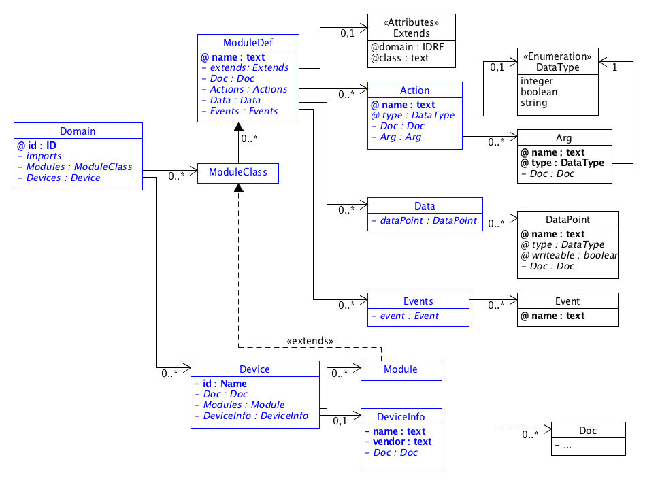
UML Overview of the SDT
input to oneM2M TP-2015-0640 / MAS-2015-0542

Slide 22
Summary of the contribution
let us work on abstraction/modelling together, so there will be one relevant result out in the industry
There should be one effort to determine common device models that the smart home industry can coalesce around
HGI welcomes the oneM2M WI-0017 v2.0.0 to assist this effort, and proposes SDT as a starting point (from the smart home vertical P.O.V.). This takes advantage of a great deal of alliance outreach on the SDT approach in past 2 years.
SAREF provides guidance and HGI is committed to helping to further develop this approach
HGI proposes joint conf call with oneM2M in near future (mid-April).
input to oneM2M TP-2015-0640 / MAS-2015-0542

Slide 23
BACK-UP MATERIAL

Slide 24
Namespace Declarations
Schema
<xs:schema targetNamespace="http://hgi.org/xml/dal/1.0"
xmlns="http://hgi.org/xml/dal/1.0"
xmlns:xs="http://www.w3.org/2001/XMLSchema"
elementFormDefault="qualified">
<xs:import namespace="http://www.w3.org/XML/1998/namespace" schemaLocation="http://www.w3.org/2001/03/xml.xsd"/>
An XML Schema
Using some standard XML elements
Needed for imports
24

Slide 25
Domains
Multiple device descriptions are collected in a Domain
Schema
<xs:element name="Domain">
<xs:complexType>
<xs:sequence>
<xs:group ref="Imports"/>
<xs:element minOccurs="0" name="Modules">
<xs:complexType>
<xs:sequence>
<xs:element minOccurs="0" maxOccurs="unbounded" ref="ModuleClass"/>
</xs:sequence>
</xs:complexType>
</xs:element>
<xs:element minOccurs="0" ref="Devices"/>
</xs:sequence>
<xs:attribute ref="xml:base"/>
<xs:attribute name="id"
use="required" type="xs:ID"/>
</xs:complexType>
</xs:element>
Domain has a unique id and consists of:
Imports section
Modules section containing ModuleClasses
Devices section
xml:base tag needed for compatibility with xincludes
25

Slide 26
Example Domain Declaration
Device Descriptions are XML Domain Documents
Document
<?xml version="1.0" encoding="iso-8859-1"?>
<Domain xmlns:xi="http://www.w3.org/2001/XInclude"
xmlns="http://hgi.org/xml/dal/1.0"
id="com.telekom”>
<Imports>
<xi:include href=”http://hgi.org/dal-core.xml" parse="xml" />
</Imports>
...
The default namespace is bound to the HGI-DAL Schema
The Domain defines a unique id
Imports are realised using standard XML includes
Namespace for XML Includes must also be declared
Domain documents can be included in the Imports section
Modern standard XML tools are xinclude aware
26

Slide 27
Imports
Ideally the descriptions build on standard definitions
Schema
<xs:group name="Imports">
<xs:sequence>
<xs:element minOccurs="0" ref="Imports"/>
</xs:sequence>
</xs:group>
<xs:element name="Imports">
<xs:complexType>
<xs:sequence>
<xs:element minOccurs="0" maxOccurs="unbounded" ref="Domain"/>
</xs:sequence>
</xs:complexType>
</xs:element>
Schema provides Imports tag for importing one or more Domain definitions
Imported Domain is part of document – not merely a reference
27

Slide 28
Documentation
Small HTML-style tag-set for documenting the defintion
Schema
<xs:element name="Doc">
<xs:complexType mixed="true">
<xs:choice>
<xs:group ref="DocText"/>
<xs:choice minOccurs="0” maxOccurs="unbounded">
<xs:element ref="p"/>
<xs:element ref="img"/>
</xs:choice>
</xs:choice>
</xs:complexType>
</xs:element>
<xs:element name="p">
<xs:complexType mixed="true">
<xs:group ref="DocText"/>
</xs:complexType>
</xs:element>
Consists of paragraphs and images
DocText group provides mark-up for emphasis etc.
If there is only one paragraph the tag can be omitted
28

Slide 29
Domain Modules
Reusable elements are declared in the Modules section
Schema
<xs:element name="ModuleClass" type="ModuleDef"/> <xs:complexType name="ModuleDef">
<xs:sequence>
<xs:element minOccurs="0" ref="extends"/>
<xs:group ref="Doc"/>
<xs:element minOccurs="0" ref="Actions"/>
<xs:element minOccurs="0" ref="Events"/>
</xs:sequence>
<xs:attribute name="name" use="required"/>
</xs:complexType>
<xs:element name="extends">
<xs:complexType>
<xs:attribute name="domain" use="required" type="xs:IDREF"/>
<xs:attribute name="class" use="required"/>
</xs:complexType>
</xs:element>
ModuleClass consists of:
Name – unique in the Domain
Actions section
Events section
Can extend another module referenced by
Domain id (must be included)
ModuleClass name
Do not use globally unique identifiers for module classes – Domain should act as a scope.
29

Slide 30
Domain Devices
Now have all the elements to define a device
Schema
<xs:element name="Device">
<xs:complexType>
<xs:sequence>
<xs:element ref="DeviceInfo"/>
<xs:group ref="Doc"/>
<xs:element minOccurs="0" ref="Modules"/>
</xs:sequence>
<xs:attribute name="id" use="required" type="xs:Name"/>
</xs:complexType>
</xs:element>
<xs:element name="DeviceInfo">
<xs:complexType>
<xs:all>
<xs:element ref="Name"/>
<xs:element ref="Vendor"/>
</xs:all>
</xs:complexType>
</xs:element>
<xs:element name="Name" type="xs:string"/>
<xs:element name="Vendor" type="xs:string"/>
Consists of
Some meta-info
Vendor
Model
etc
Modules section
Contains Modules
Not ModuleClasses
30

Slide 31
Example Device
A device with a power switch defined by DTAG ...
Document
<?xml version="1.0" encoding="iso-8859-1"?>
<Domain xmlns="http://hgi.org/xml/dal/1.0" xmlns:xi="http://www.w3.org/2001/XInclude" id="com.telekom"> <Imports>
<xi:include parse="xml" href="http://hgi.org/dal-core.xml"/>
</Imports>
<Devices>
<Device id="switch.power">
<DeviceInfo>
<Name>PowerSwitch</Name>
<Vendor>Telekom Laboratories</Vendor>
</DeviceInfo>
<Modules>
see previous slide
</Modules>
</Device>
</Devices>
</Domain>
Details of device discovery to be determined, but device can be used by applications understanding:
power
BooleanState
31

Slide 32
Devices Modules
Device Modules essentially the same a ModuleClasses
Schema
<xs:element name="Modules">
<xs:complexType>
<xs:sequence>
<xs:element minOccurs="0" maxOccurs="unbounded" ref="Module"/>
</xs:sequence>
</xs:complexType>
</xs:element>
<xs:element name="Module" type="ModuleDef"/>
Can extend a ModuleClasse
Cannot be extended
The ModuleClass is the unit of re-use
Hence the basis of abstraction
Device Modules can extend standard ModuleClasses
ModuleClasses can be imported from other domains
Modules cannot
32

Slide 33
Example Device Modules
Power – candidate for BooleanState
Document
<Modules>
<Module name="proprietaryPower">
<Actions>
<Action name="on"/>
<Action name="off"/>
<Action name="state" type="string"/>
</Actions> </Module>
<Module name="power">
<extends domain="hgi.dal.core" class="BooleanState"/> </Module>
</Modules>
Vendor can define „inline“ proprietary modules
Simpler – reduces definition effort
But little abstraction
Use ModuleClasses to abstract within the domain
Use standard ModuleClasses to abstract across domains
Only need hgi-core domain to use power module
33

Slide 34
A <DataPoint> tag could slim down modeling
Document
Easy modeling of data model based technologies (e.g. Echonet)
Only 1 entry per data point
Transformations to APIs can still use object oriented approach
No reverse engineering of data points for data model driven target systems
Con: Different options to model data points needs more work in clearing process
<ModuleClass name="BooleanState">
<Data>
<DataPoint name=“status” type=“boolean”
writable=“true”>
</DataPoint>
</Data>
</ModuleClass>

Slide 35
Example Module Class
BooleanState for modelling underlying binary state
Document
<ModuleClass name="BooleanState">
<Doc>…</Doc>
<Actions>
<Action name="get" type="boolean"> <Doc> Obtain the current associated state. </Doc>
</Action>
<Action name="setTarget">
<Doc> Obtain the current associated state. </Doc>
<Arg name="value" type="boolean"> <Doc> Desired value of the associated state. </Doc> </Arg>
</Action>
</Actions>
</ModuleClass>
Provides operations for reading and setting the state
35

Slide 36
(sample) “Home Air Conditioner” in the Echonet domain
This sample shows a XML description to describe “Home Air Conditioner” class.
We suppose DMT should be defined for every device type in a format as shown in this sample.
<Domain xmlns="http://hgi.org/xml/dal"
name="jp.gr.echonet">
<Device abstract="true">
<DeviceInfo>
<Name>Home Air Conditioner</Name>
<Vendor>Fujitsu</Vendor>
</DeviceInfo>
<Modules
import="jp.gr.echonet.common">
<Module name="Operation mode setting"
mandatory="true"
notify="true“ />
<Action name="Automatic"/>
<Action name="Cooling"/>
<Action name="Heating"/>
<Action name="Dehumidification"/>
<Action name="Air circulator"/>
<Action name="Other"/>
</Module>
<Module name="Automatic temperature control setting"
extends=“org.hgi.core.BooleanState” />
<Module name="Normal/high-speed/silent-operation setting“ />

Slide 37
Using SDT to model data points
Contents are mapped as follows:
2 state values with the value 0x30 and 0x31 are represented as boolean
Numeric values are represented as integer (even if they’re typed as “char” in the source)
Numeric values as named states should be represented as <xs:enumeration>
Properties that are “Get” access rule only must not be represented without “writable” attribute
Properties that a “Get” access rule and an optional or mandatory “Set” access rule must be represented with a “writable” attribute set to “true”
Properties that are “Set” only, and do only have 1 possible value, are represented as actions, with an adapted name according to its function
Properties containing more than 1 value have to split to multiple data points

