Slide 1

Presentation for OIC
July 20th 2015
Nicolas Damour
Senior Manager, Business and Innovation at SIERRA WIRELESS
Chairman of the Architecture Working Group (WG2 – ARC) at ONEM2M
ndamour@sierrawireless.com , www.oneM2M.org

Slide 2














The oneM2M Partnership Project
Over 200 member organizations in oneM2M

Slide 3
Purpose, Work & Deliverables
Purpose
To specify and promote an
M2M Common Service Layer
Work
Six physical 1-week meetings per year with ~100 attendees
200+ documents produced and discussed at each meeting
3800 docs in 2013 4400 docs in 2014
Deliverables
Technical Reports (TRs) and Technical Specifications (TSs)
Release 1 published in January 2015 – 10 TSs + 5 TRs
Work on Release 2 just started (2016?)

Slide 4

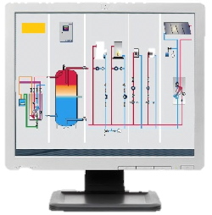

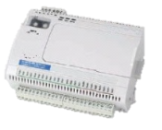

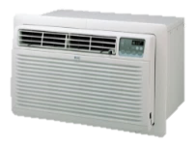
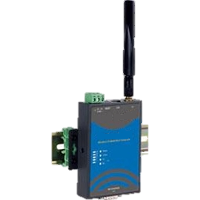


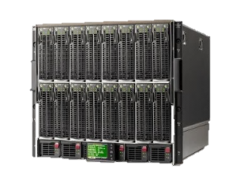


Use Case 1
temp
flow
I/O
heat
A/C
valve
pump

Slide 5
Use Case 1
temp
flow
I/O
heat
A/C
valve
pump
LAN
WWAN
WAN

Slide 6
Use Case 1
temp
App
App
App
App
App
App
heat
I/O
heat
I/O
A/C
flow
A/C
valve
pump
LAN
WWAN
WAN

Slide 7
Use Case 1
temp
App
App
App
App
App
App
heat
I/O
heat
I/O
A/C
flow
A/C
valve
MW
MW
pump
LAN
WWAN
WAN

Slide 8
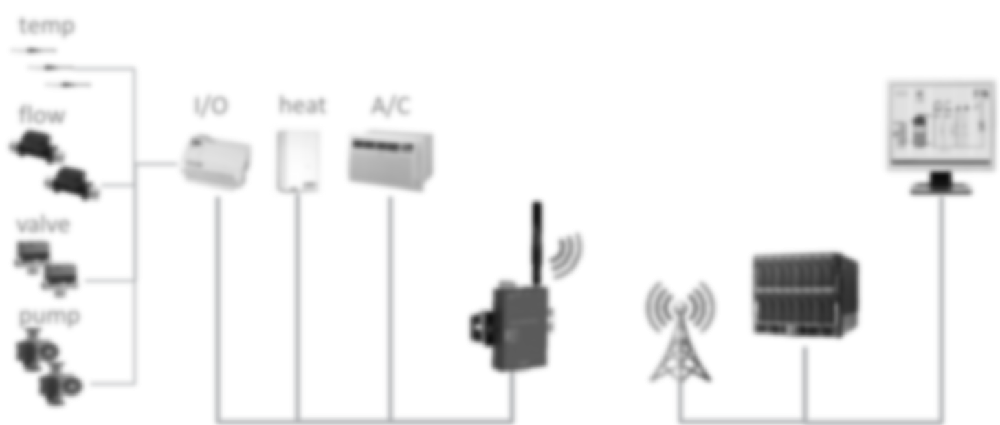
Use Case 1
App
App
App
App
App
App
I/O
heat
A/C
MW
MW
LAN
WWAN
WAN

Slide 9
Use Case 1
App
App
App
App
App
App
I/O
heat
A/C
MW
MW
Communication Network(s)

Slide 10
Use Case 1
App
App
App
App
App
App
I/O
heat
A/C
MW
MW
Communication Network(s)

Slide 11







Use Case 2
Doctor

Slide 12
Use Case 2
Doctor
WLAN
WAN

Slide 13
Use Case 2
App
App
App
App
App
I/O
heat
A/C
Doctor
WLAN
WAN

Slide 14
Use Case 2
App
App
App
App
App
I/O
heat
A/C
Doctor
MW
MW
WLAN
WAN

Slide 15
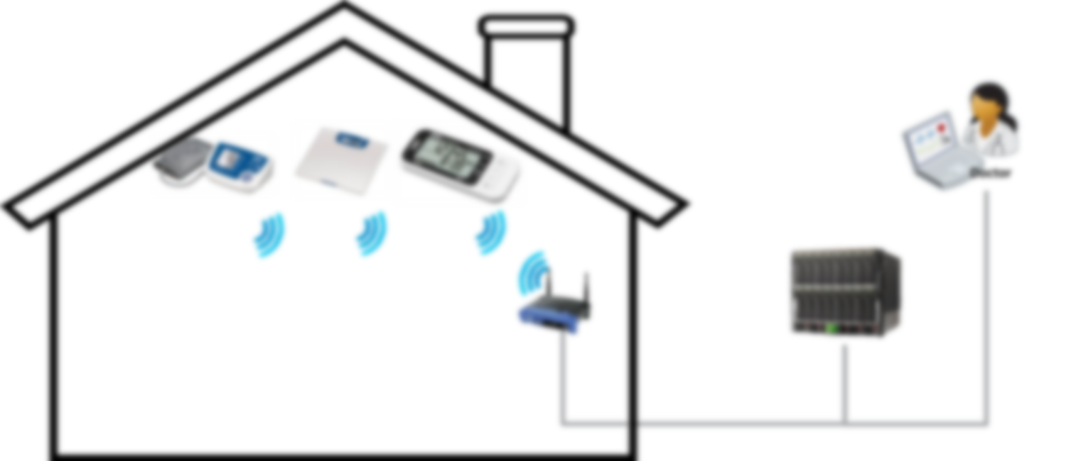
Use Case 2
App
App
App
App
App
I/O
heat
A/C
MW
MW
WLAN
WAN

Slide 16
Use Case 2
App
App
App
App
App
I/O
heat
A/C
MW
MW
Communication Network(s)

Slide 17
Use Case 2
App
App
App
App
App
I/O
heat
A/C
MW
MW
Communication Network(s)

Slide 18
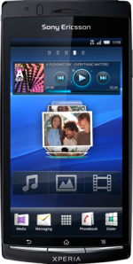
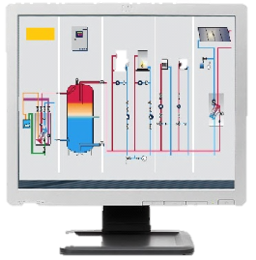
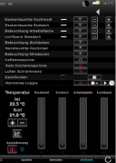





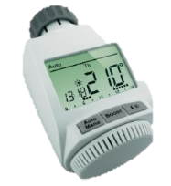
Use Case 3

Slide 19
Use Case 3
LAN/WLAN
WAN

Slide 20
Use Case 3
App
App
App
App
App
App
App
I/O
heat
A/C
LAN/WLAN
WAN

Slide 21
Use Case 3
App
App
App
App
App
App
App
I/O
heat
A/C
MW
MW
LAN/WLAN
WAN

Slide 22
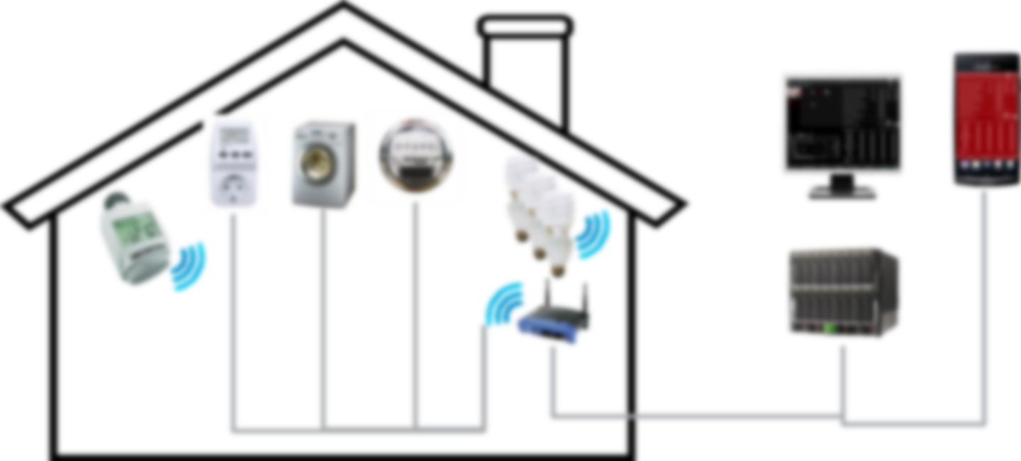
Use Case 3
App
App
App
App
App
App
App
I/O
heat
A/C
MW
MW
LAN/WLAN
WAN

Slide 23
Use Case 3
App
App
App
App
App
App
App
I/O
heat
A/C
MW
MW
Communication Network(s)

Slide 24
Use Case 4
App
App
App
App
App
App
I/O
A/C
MW
MW
Communication Network(s)

Slide 25
Use Case 4
App
App
App
App
App
heat
MW
MW
Communication Network(s)

Slide 26
Use Case 5
App
App
App
App
App
A/C
MW
MW
Communication Network(s)

Slide 27
Use Case n
App
App
App
App
MW
MW
Communication Network(s)

Slide 28
oneM2M
Application Layer
AE
AE
AE
AE
AE
I/O
heat
A/C
Service Layer
CSE
CSE
CSE
Network Layer
Communication Network(s)
AE: Application Entity
CSE: Common Services Entity

Slide 29
oneM2M
It is Software/Middleware
It sits between applications and
data processing & communication HW
Integrated into devices/gateways/servers
e.g. sensors, actors, things, routers, cloud
Connects data producers and consumers
in secure manner
Hides complexity of NW usage from apps
Controls when communication happens
Increases efficiency of data transport
Stores and shares data
Supports access control
Notifies about events
Talks to groups of things
Manages devices on large scale
Application Layer
Service Layer
Network Layer

Slide 30
oneM2M
…
HAV Apps
Home Apps
Asset Apps
eHealth Apps
Simple APIs via Standardized Reference Points
Service Layer
Data Processing Resources & Protocols (selection) & Communication HW
Communication Network(s)
Horizontal layer of functions commonly needed across different segments
Similar: Generic OS versus use case-specific application

Slide 31
Interworking
Home Apps
eHealth Apps
…
HAV Apps
Standard X
Asset Apps
Standard Y
Simple APIs via Standardized Reference Points & Interworking
Service Layer
Data Processing Resources & Protocols (selection) & Communication HW
Communication Network(s)
Horizontal layer of functions commonly needed across different segments
Similar: Generic OS versus use case-specific application

Slide 32
Common Service Functions
Registration
Discovery
Security
Group Management
Data Management & Repository
Subscription & Notification
Device Management
Application & Service Management
Communication Management
Network Service Exposure
Location
Service Charging & Accounting

Slide 33
Technical Specifications
Requirements
TS-0002
(WI-0001)
Functional
Architecture
TS-0001
(WI-0002)
Definitions
& Acronyms
TS-0011
(WI-0003)
Service Layer
Core Protocols
TS-0004
(WI-0009)
HTTP Protocol
Binding
TS-0009
(WI-0013)
CoAP Protocol
Binding
TS-0008
(WI-0012)
Management
Enabl^{nt} - OMA
TS-0005
(WI-0010)
Management
Enabl^{nt} - BBF
TS-0006
(WI-0010)
MQTT Protocol
Binding
TS-0010
(WI-0014)
Security
Solutions
TS-0003
(WI-0007)
(Release 1)

Slide 34
Technical Reports
Architecture
Analysis 1
TR-0002
(WI-0002)
Use
Cases
TR-0001
(WI-0001)
Architecture
Analysis 2
TR-0003
(WI-0002)
Protocol
Analysis
TR-0009
(WI-0008)
Study of Mgt
Capab. Enabl^{nt}
TR-0006
(WI-0004)
Abstraction &
Semantics
TR-0007
(WI-0005)
Security
Analysis
TR-0008
(WI-0007)
Roles &
Focus Areas
TR-0005
(WI-0003)
Use
Cases v2
TR-0011
(WI-0014)
E2E Security &
Group Authent.
TR-0012
(WI-0011)
And many others…

Slide 35








Architecture
Application Entity Provides application logic for the end-to-end M2M solutions
Network Services Entity Provides services to the CSEs besides the pure data transport
Node Logical equivalent of a physical (or possibly virtualized, especially on the server side) device
Application
Layer
AE
AE
AE
Underlying
Network
Underlying
Network
Network
Layer
NSE
NSE
NSE
NSE
Application Service Node
Middle Node
Infrastructure Node

Slide 36
Architecture
Reference Point One or more interfaces - Mca, Mcn, Mcc and Mcc’ (between 2 service providers)
Common Services Entity Provides the set of "service functions" that are common to the M2M environments
Application Entity Provides application logic for the end-to-end M2M solutions
Network Services Entity Provides services to the CSEs besides the pure data transport
Node Logical equivalent of a physical (or possibly virtualized, especially on the server side) device
Application
Layer
AE
AE
AE
Mca
Mca
Mca
Service
Layer
CSE
CSE
CSE
CSE
Mcn
Mcc
Mcn
Mcn
Mcc
Mcn
Mcc’
Underlying
Network
Underlying
Network
Network
Layer
NSE
NSE
NSE
NSE
Application Service Node
Middle Node
Infrastructure Node
Inf. Node

Slide 37
Topologies
AE
AE
AE
Infrastructure Node
IN-CSE
Middle Node
Middle Node
CSE
CSE
Middle Node
Application
Dedicated
Node
CSE
AE
AE
Application
Dedicated
Node
Application
Service
Node
AE
AE
Application
Dedicated
Node
CSE
AE
CSE

Slide 38
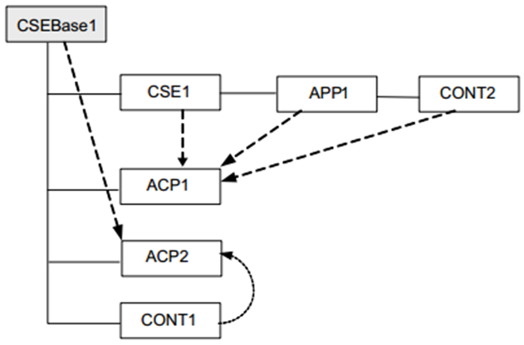
Information Modelling
Resource-based information model
Information is stored in the system as Resources
A given Resource can be identified with a Uniform Resource Identifier
  A given Resource is of one of the defined Resource Types
  The Resource Type determines the semantics of the information in the Resource
  Resources can be Created, Read, Updated or Deleted to manipulate the information
  Resources are organized in a tree-like structure and connected by links
  Links either as the tree hierarchy or to another part or the tree

Slide 39
Resource oriented approach
REST = Representational State Transfer
Dissertation by Thomas Roy Fielding, 2000 {HTTP contributor}
Architectural style for distributed applications
State information is residing in hosted resources only
  Interfaces between entities use stateless communication
  Requests can be processed based on resource state and request itself => idempotent
State transition is done by manipulation of resources
Simple and uniform interfaces are used to access resources
  Create, Retrieve, Update, Delete
All services offered via addressable resources with access control
Idempotency is key for scalability (caches, proxies, drops, repetitions)
oneM2M not strictly REST but RESTful / resource oriented
  Also added notifications

Slide 40
Resource Types & Flows
Defined resource types
The System (nodes, CSEs, AEs…): node, CSEBase, AE, mgmtObj…
M2M Service subscriptions: m2mServiceSubscriptionProfile…
Security: accessControlPolicy…
Entity groups and memberships: group, members…
Application data: container, contentInstance…
Information dispatch and flows: subscription, delivery, request, schedule…
Location services: locationPolicy…
Service charging & accounting: statsConfig, eventConfig, statsCollect…
Defined communication schemes
Direct communication and subscriptions/notifications
Synchronous (blocking or non-blocking with regular polling) communications
Asynchronous (non-blocking, with callback) communications

Slide 41
Request / Response Paradigm
Entities communicate with each other via pairs of requests and responses
A request-message triggers a response message
  Request/Response pattern allows for robust data transport when needed
  Request/Response pattern allows for subscribe/notify mechanisms
  Request / Response pattern is quite flexible as it can be used to accommodate other message passing patterns as well.
Originators: AEs or CSEs
Receivers: CSEs, AE (optional)

Slide 42
Simplified Event Flow
Secure Remote Provisioning
  Supports legacy Device Management protocols
  Roll-out of Security Credentials, Registration Targets, Entity-IDs etc.
Establish Secure Communication *
  Hop by hop between neighboring oneM2M entities
Data Sharing governed by Access Control *
  Discovery of resources (special form of Retrieve)
  CRUD access to data sharing resources (e.g. containers, groups)
  Establishment of subscriptions
  Execution of Notifications when subscriptions trigger
  Policy-driven communications
    CMDH: Communication Management and Delivery Handling
Device Management
  Application life cycle management, diagnostics etc.
* Some more details on following slides

Slide 43
10,000 foot view
1
2
3
4
M2M Service
Activation &
Initial Device Provisioning
Secure M2M
Communication &
M2M Service
Registration
‘Normal’
M2M Service Operation,
CRUD & N
exchanges
Device Management Actions

Slide 44
Communication Protocols
  Reuse IP-based existing protocols
Service Layer
Core Protocols
TS-0004
CoAP Binding
TS-0008
HTTP Binding
TS-0009
MQTT Binding
TS-0010
  XML or JSON Content serialization
  HTTP Example
REQUEST
GET http://provider.net/home/temperature/la HTTP/1.1
Host: provider.net
X-Orig: /CSE-1234/WeatherApp42
X-M2M-RI: 56398096
Accept: application/vnd.onem2m-res+json
RESPONSE
HTTP/1.1 200 OK
X-M2M-RI: 56398096
Content-Type: application/vnd.onem2m-res+json
Content-Length: 94
{"ri":"28375964","cnf":"application/json:0",
"con":"{'timestamp':1413405177000,'value':25.32}"}

Slide 45
Security
  Reuse existing mechanisms
Security
Solutions
TS-0003
Enrolment
Provisioning/Configuration of the M2M System (Devices, Applications…)
Secure communications
Protocols (TLS/DTLS), credentials and authentication (PSK/PKI/MAF)
Access Control
Defined in accessControlPolicy resources
Which SUBJECT can perform which ACTIONS
on which OBJECT under which CIRCUMSTANCES
  More details
  in the oneM2M webinar#3
  November 14th 2014

Slide 46
Secure Communication
From “Facing the Challenges of M2M Security and Privacy” Webinar by Phil Hawkes
Hop-by-Hop
TLS/DTLS v1.2
AE-CSE
  AE: TLS Client (C)
  CSE: TLS Server (S)
CSE-CSE
  CSE1: TLS Client (C)
  CSE2: TLS Server (S)
Field Domain
Sensor
Gateway
C
S
AE1
CSE1
C
S
C
S
AE2
CSE2
M2M SP’s Server
Web App
Server
Infrastructure
Domain
Check out : https://www.brighttalk.com/webcast/11949/133367
for details on authentication options etc.

Slide 47


Interworking – Dev. Mgt
  Reuse existing Device Management technologies
Application Entity
Mca
OMA DM 1.3
OMA DM 2.0
OMA LWM2M
oneM2M
Domain
IN-CSE
DM
Domain
BBF TR-069
BBF Server
DM Server
BBF CPE
  More details
  in the oneM2M webinar#4
  November 27th 2014
BBF Device
DM Client

Slide 48






Interworking – General Case
Interworking
Proxy Entity
AE
AE
IPE
Mca
Mca
Mca
CSE
CSE
Mcc
et cetera

Slide 49
Next steps in oneM2M
The Work Program for Rel. 2 of oneM2M Specifications includes the following areas:
Architecture enhancements
  Advanced interworking with other systems:
  AllJoyn interworking, OMA LWM2M interworking, hopefully with OIC
  Improvement of communications efficiency
  Optimized group-based operations
  API description for programmers
  Support of Time Series Data, Support of Event Descriptors / Conditional Action Triggers
  Interworking with 3GPP Rel-13 MTC features
Protocol enhancements
  New binding: Support of Websockets as a transport
Abstraction and Semantics
  Analysis of device and data models used in Home and Industrial Domains
  Development of semantic support for M2M data: E.g. Ontologies for smart appliances
Continued on the next page…

Slide 50
Next steps in oneM2M
…Continued from the previous page…
Security enhancements
  Securing communication traversing multiple oneM2M hops
  Authorization enhancements: Distributed authorization functions, dynamic authorization with tokens
  Enhancements to remote configuration of security parameters
  Secure Environment Abstraction: Access functions in secure environments using a common API.
Interoperability and Conformance Testing
  Development of interoperability and conformance testing methodologies and test specifications
A public mailing-list for technical Q&A is being setup in July 2015
oneM2M_TechQuestions@list.onem2m.org
Possibly also an online forum soon

Slide 51
Where to find info?
Main Web Site
http://www.oneM2M.org
YouTube Channel
http://www.youtube.com/c/onem2morg
Webinars
http://www.onem2m.org/technical/webinars
Published Specifications
http://www.onem2m.org/technical/published-documents
Events
http://www.onem2m.org/news-events/events
Documents developed in oneM2M: TRs, candidate TSs, ratified TSs
    http://ftp.onem2m.org/Work Programme/
Meeting documents & contributions
    http://ftp.onem2m.org/Meetings

Slide 52
Thank You!
Q&A

