Slide 1
HGI Message to oneM2M Technical Plenary
www.homegateway.org
Hans Werner bitzer, deutsche telekom
Vice Chair, Hgi
Onem2m Tp#19, sophia antipols, france

Slide 2
“HGI to conclude its work by 2016”
10 Years of collaborative work on business perspectives, guidelines, requirements & technical specifications, testing
Focus extended beyond the Broadband Access & Triple Play Gateway itself to the Connected Home Infrastructure and Smart Home Services
Some factors for HGI‘s decision
original mission completed, lifetime already extended two times
Need for consolidation in a fragmented standards and consortia landscape
New technologies and paradigms (also promoted by HGI itself – software modularity) that need to be addressed cross vertical
Increasing importance of open source developments
“Overall, we decided the controlled closure of HGI following the accelerated completion of its current work was the most sensible option.”
Notes:
NFV, SDN, Industial Internet, Smart Cities, …

Slide 3
HGI‘s role in the ecosystem and relation to oneM2M
The residential gateway remains the key architectural component in the home
An operator driven collaborative approach to specify requirements from a business and service perspective
Concrete results with relevance for the industry through close cooperation with complementary organisations (e.g. OSGi Alliance, BBF, DECT Forum, UPnP, …)
First contact in Berlin Dec 2011 – oneM2M forming phase
HGI was invited as “vertical industry representative”
And became a member type 2

Slide 4
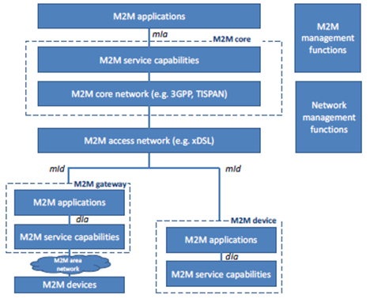
The Home Gateway as an instantiation of an M2M Gateway for the Home
Presented at Berlin
“oneM2M2” meeting Dec 2011
Notes:
Home Network, most advanced and discussed environment with complex/multi service M2M scenario → middle to big size gateway → analogies to other verticals (e.g. industrie, shopfloor), relevance ins Smart City concepta..

Slide 5
The HGI way to smart home Collaborative Approaches
2012
2014
2015
Industry wide effort:
Reference
Implementations,
Tools,
Testing
Specification of key components and technologies for a platform and eco system approach
i.e. a software execution environment, related management protocol, test suite; and logo program
Cross-reference to other organizations
Service Provider’s requirements for wireless home area networks supporting smart home services
In cooperation with organizations like Zigbee, EnOcean and ULE Alliances.
Smart Home Reference Architecture introducing an abstraction layer
Smart Device Template; to enable unification of device model semantics and provide unified APIs for application developers
Open
Plattform 2.0
(SWEX)
WHAN
Requirements
SDT
vorto
Smart Device Template

Slide 6
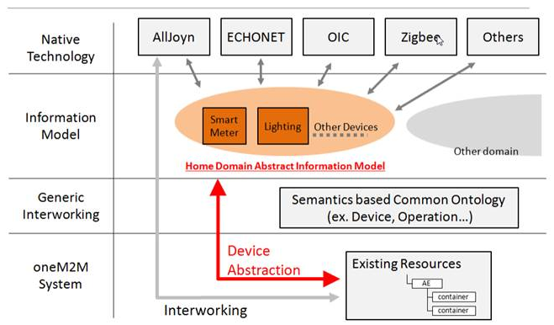
HGI topics at TP#19 and way forward
HGI Deliverables | Relation to oneM2M | Status of HGI deliverable
HGI-RWD036 SH Architecture | 1. Abstraction layer | Publication : Q3-2015 liaised to oneM2M
 | 2. Reference Points, APIs | MAS-2015-0637-HGI-RWD036_-_Smart_Home_Architechture ….
SDT Smart Device Template | 3. Home Domain Abstract Information Model | SDT 2.0 available on GitHub; SDT 3.0 planned for Nov. ’15 MAS-2015-0635-HGI_oneM2M_Presentation_SDT
Related documents and work items:
Generic
TS-0002 Requirements (WG1 lead)
TS-0001 Functional Architecture (WG2 lead)
TS-0004 oneM2M Core protocol (WG3 lead)
TR-0007 Abstraction & Semantic (WG5 lead)
Smart Home domain
TR-0013 Home Domain enablement (WG1 lead)
TR-0017 Home Information Abstract Model (WG5 lead)
TR-0022 Continuation & Integration of HGI SH activities
TS-00xx Home Appliance Information Model and Mapping
WI-0017: Home Domain Enablement WI-0043: Continuation & Integration of HGI Smart Home activities
TS-0012 oneM2M Ontology (WG5 lead)

Slide 7
HGI topics at TP#19 and way forward
HGI Deliverables | IPR Regime | Hosted
HGI-RWD036 SH Architecture | HGI FRAND licence scheme | HGI document server
SDT Smart Device Template | Apache 2.0 open source licence | Github
Finalisation of SDT 3.0 - ready before TP#20
SDT – open source licence chosen to enable joint development and usage of template
Close interaction with Eclipse IoT projects „Eclipse Smart Home“, „Vorto“ and the OSGi Alliance‘s IoT Expert Group

Slide 8
March

Slide 9
Thank you!

