Slide 1
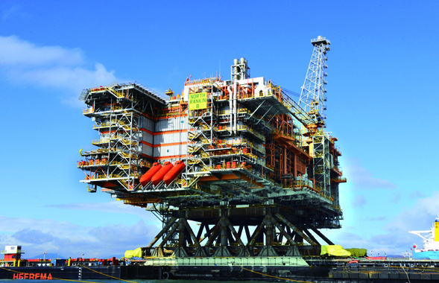
Technical Plenary #22
- Introduction of DDS Binding -
Jun-Kwon Jung and
Sung-Chan Choi

Slide 2
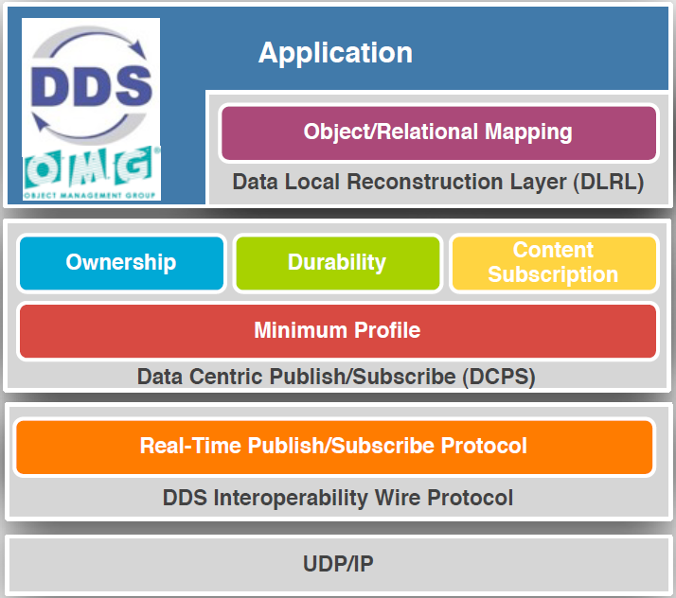
What is DDS?
Data Distribution Service
Real-Time and High-Performance Data Communication Service
Publish/Subscribe Model
Various QoS Support
No Essential Broker
3

Slide 3
What is DDS?
Using Area
category | Appliance
National Defense | US Navy LPD-17 Ship-Wide Area Network US Navy Sea Slice US Navy E2-C Hawkeye Lockheed Martin US Navy Aegis Open Architecture Weapon System Boeing Secure Distributed Computing platform AWACS Radar System Upgrade B1-B tactical Systems Upgrade Insitu’s Unmanned Air Vehicle Advanced Cockpit Ground Control Station Raytheon SSDS(Ship Self-Defence System) Boeing Future Combat Systems Littoral Combat System(LCS) NavDDS Shipboard Navigation System FFX-1 Naval Combat System
Flight | EU Air Traffic Management US Air Traffic Management NASA Constellation Launch Control System European Southern Observatory, very Large Telescope
Energy | Siemens Wind Power, LocalGrid MicroGrids, GC Dam
Finance | ATD/Citigroup: Market Data Feed Pimco : Compliance Architecture InfoDyne : Market Data
3

Slide 4
What is DDS?
Using Area
category | Appliance
Transport | Wi-tronix: High-value Mobile Asset Tracking Highway Traffic Monitoring in Tokyo Train Communications system in US Volkswagen Driver Assistance and Integrated Safety System Audi Hardware-in-the-Loop Simulation NAV Canada – Air Navigation Service Provider
Medical | Varian MRI and NMR Product Exelis C4i Command and Control Systems, Agilent MRI Systems DLR Minimally Invasive Robotic Surgery Systems Still Rivers’s PBRT (Proton Beam Radiation Therapy), Cancer Treatment
Modeling | USA National Advanced Driving Somulator CAE Filght Simulator Nextel (Simulation and Information Systems) Force Technology (Ship Simulator)
Industry | Schnieder Integrates PLC and IT Systems Harmonic Transmission and Video Switching KuKa Robotics
Communication | Accom (digital video control) Tekelc (Network Test equipment) IPC, Infinera (Telecomm equipment)
3

Slide 5
Why DDS?
DDS Everywhere
Embedded OS
Android
DDS
Other Communication Protocol
Enterprise OS
Reference : OpenSplice DDS Intro http://www.omg.org/hot-topics/documents/dds/Prismtech_Slideshow.pdf
2

Slide 6
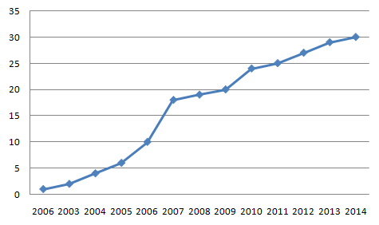
Why DDS?
DDS Usage
3

