Slide 1
Call to Action
To increase market adoption of oneM2M, more publically available CSEs, AEs, tools and guides are needed for developers and systems integrators to reference and test their implementations against

Slide 2


Answering the Call!
an InterDigital Solution
IN-CSE
MN-CSE
AEs
Tools
Publicly accessible to reference and test against

Slide 3
CSEs and AEs
an InterDigital Solution

Slide 4
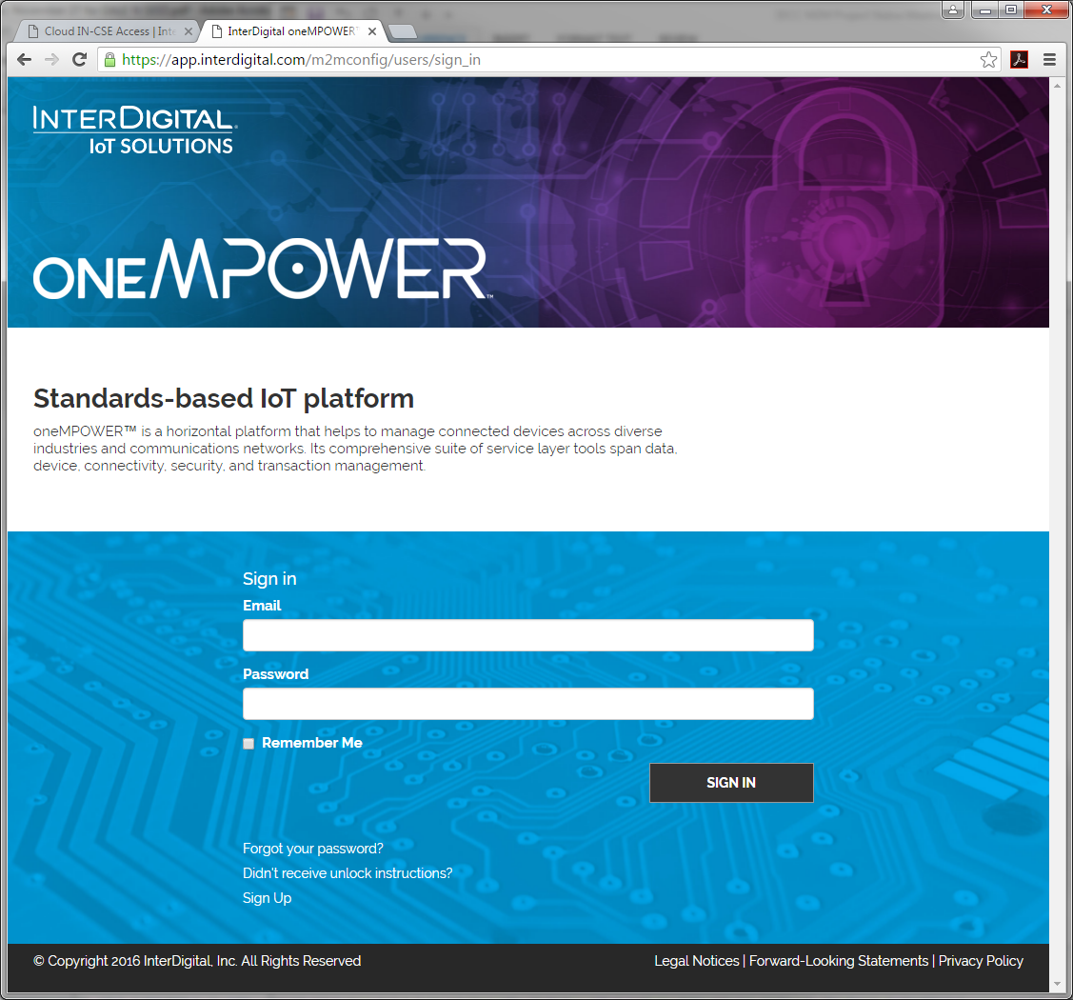
How do I get access?
Go to InterDigital’s Developer Portal and sign up for a oneMPOWER account
https://app.interdigital.com/m2mconfig/users/sign_in

Slide 5
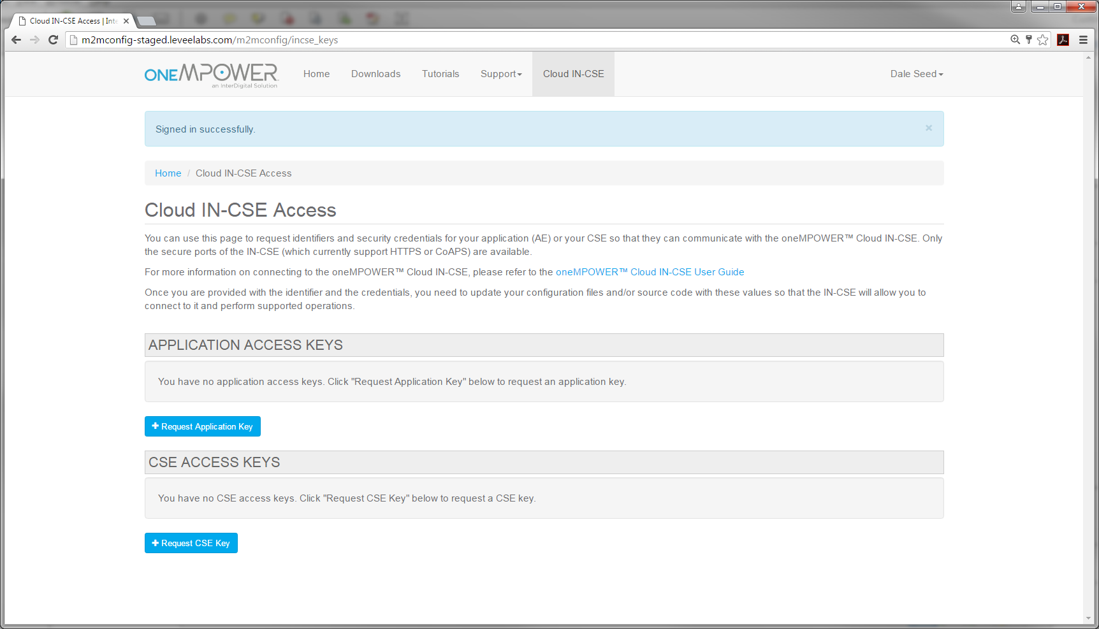
How do I get access to IN-CSE?
IN-CSE is hosted in the Cloud
No SW Install Required!
Ideal for folks that want to quickly test without installing a CSE locally
Submit a request for AE-ID or CSE-ID and PSK Credentials via InterDigital’s Website
Register your AE or CSE to IN-CSE via PSK-based secured Mca or Mcc
(HTTPs or CoAPs)
IN-CSE Contact Information:
FQDN: cse.onem2mpub.wot.io
IP Address: 137.116.117.137
HTTPs Port: 9013
CoAPs Port: 9012

Slide 6
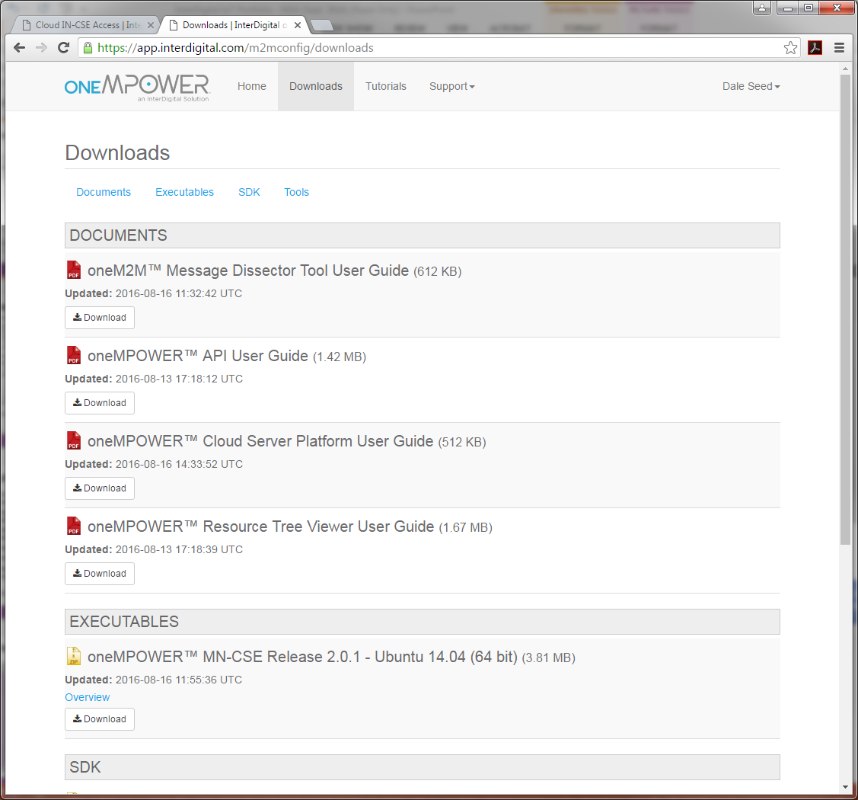
How do I get access to MN-CSE?
MN-CSE is available for download from InterDigital’s Website
Ideal for folks that want to run locally in their own environments
Simply download, configure and run MN-CSE
Register your AE or CSE to MN-CSE via Mca or Mcc
(HTTP or CoAP)

Slide 7
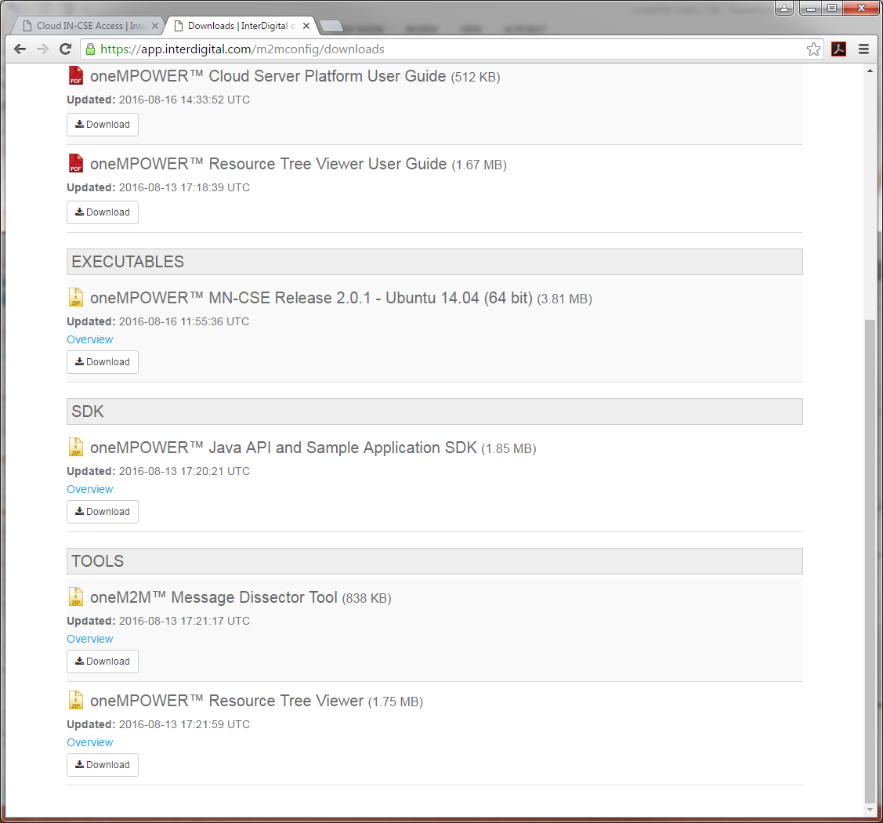
How do I get access to AEs?
InterDigital has sample AEs available for download from InterDigital’s Website
These AEs are based on InterDigital’s oneM2M programmatic API library
Simply download and try them out
These AEs can be run with InterDigital’s IN-CSE, MN-CSE or your own CSE

Slide 8
Tools
an InterDigital Solution

Slide 9
Tools for Developers and SIs
InterDigital has several useful tools for oneM2M developers
oneM2M Wireshark Dissector
oneM2M Primitive Exerciser
oneM2M curl scripts
oneM2M test tools

Slide 10

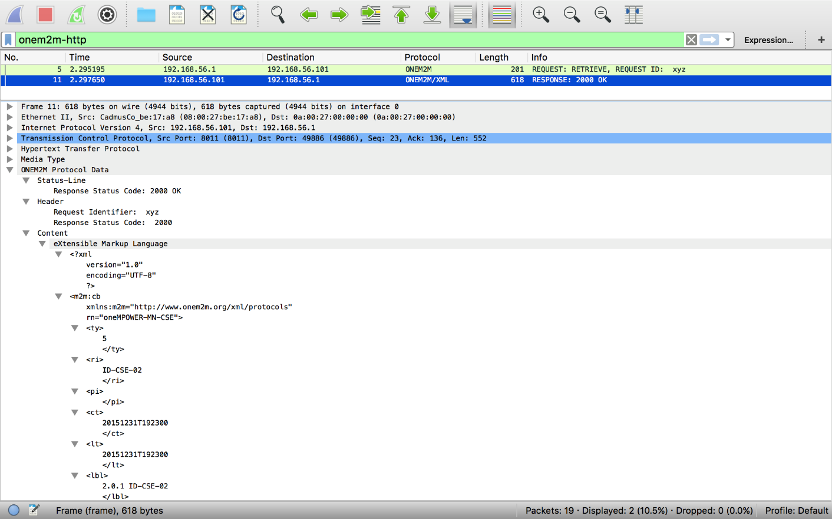
oneM2M Message Dissector
View and decode oneM2M protocol in Wireshark!
Dissector can be downloaded from
http://www.interdigital.com/downloads/onem2m-wireshark-dissector
Currently Supports
HTTP and CoAP oneM2M bindings
(MQTT under development)
Selectively capture or filter on oneM2M traffic
Dissects and displays oneM2M request and response parameters
Dissector is implemented as a Wireshark plug-in that can be easily installed
Dissects and displays oneM2M content

Slide 11
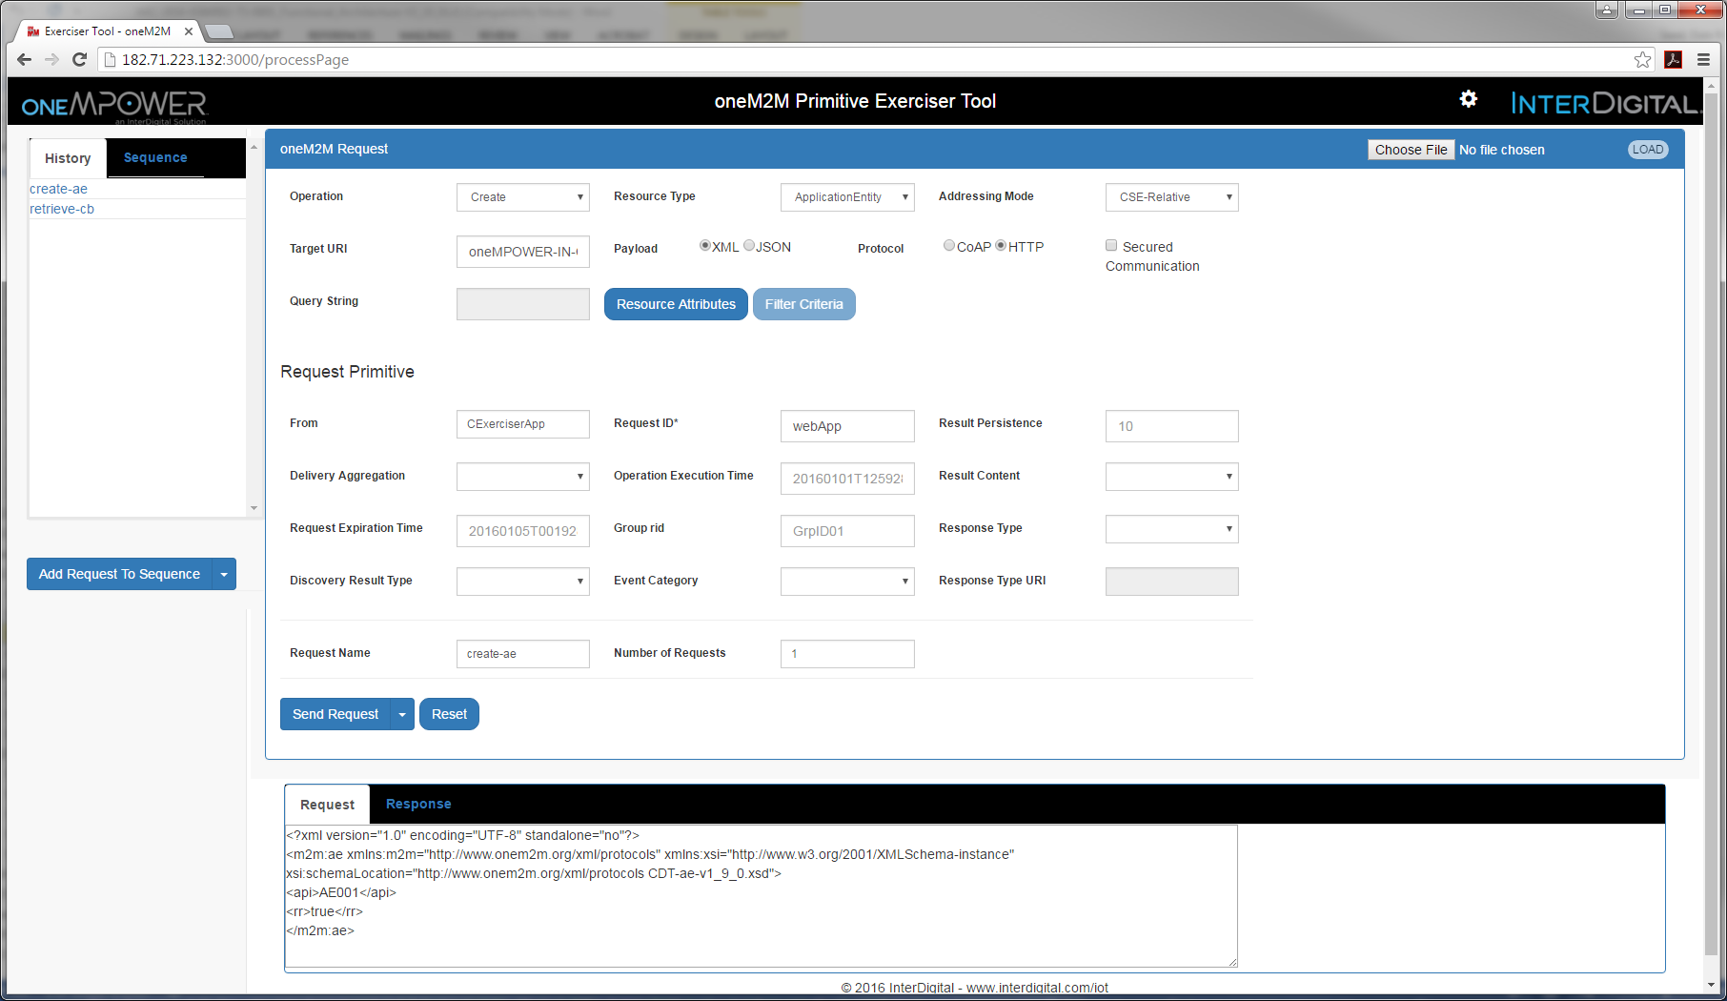
oneM2M Primitive Exerciser
Tool is hosted in the Cloud
No SW Install Required!
URL – TBD
Username: oneM2M
Password: oneM2MForEveryone
Currently supports
HTTP and CoAP oneM2M bindings
(MQTT under development)
The oneM2M Primitive Exerciser is a handy tool to generate oneM2M requests (e.g. to send to a CSE)
Think of it as Postman on steroids ☺
Tool provides a history of issued requests that can be re-issued
(similar to Postman)
The tool is oneM2M aware and provides a nice GUI for developers to build oneM2M requests and decode responses
Tool supports a sequence generator that can be used to create sequences of requests that can be issued sequentially
Tool supports saving requests to file that can be re-loaded into the tool and re-issued
The tool also allows developers to see protocol binding and serialization level details for requests it generates and responses it receives

Slide 12
oneM2M curl scripts
####################################################
# Create AE resource using HTTP binding and JSON serialization
####################################################
curl -v -X POST -H 'X-M2M-RI: xyz2' -H 'X-M2M-Origin: CAE001' -H 'Content-Type: application/vnd.onem2m-res+json; ty=2' -H 'Accept: application/vnd.onem2m-res+json' -d @payloadAe.json http://127.0.0.1:9011/oneMPOWER-IN-CSE
> POST /oneMPOWER-IN-CSE HTTP/1.1
> User-Agent: curl/7.32.0
> Host: 127.0.0.1:9011
> X-M2M-RI: xyz2
> X-M2M-Origin: CAE001
> Content-Type: application/vnd.onem2m-res+json; ty=2
> Accept: application/vnd.onem2m-res+json
> Content-Length: 96
>
{
"m2m:ae": {
"rn": "TestAE_JSON",
"api": "myAppId",
"rr": "true"
}
}
< HTTP/1.1 201 Created
< Content-Type: application/vnd.onem2m-res+json
< X-M2M-RI: xyz2
< X-M2M-RSC: 2001
< Content-Location: /ID-CSE-01/CAE001
< Content-Length: 154
<
{
"m2m:ae":{
"aei":"CAE001",
"ct":"20160608T103559",
"et":"20160611T215559",
"lt":"20160608T103559",
"pi":"ID-CSE-01",
"ri":"CAE001",
"rn":"TestAE_JSON",
"ty":2
}
}
curl is a popular open source command line tool used for issuing HTTP client requests. It ships with most operating systems
curl is used by many hard core developers preferring a command line interface
(Yes, you know who you are ☺)
InterDigital maintains a library of curl scripts that provide working examples of different types oneM2M requests
Curl scripts can be downloaded from:
http://TBD

Slide 13
oneM2M test tools
InterDigital has developed several test tools and test suites for the purposes of interop and conformance testing
These tools and test suites have been used to test InterDigital’s oneMPOWER solution as well as oneM2M solutions from other parties.
At this time, InterDigital is not making these tools publically available. For more information regarding these tools please contact us

