Slide 1
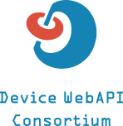
Introduction to OMA GotAPI and Device WebAPI Consortium
specs
implementation
Takashi Yoshikawa
NTT DOCOMO, Inc.
Device WebAPI Consortium

Slide 2
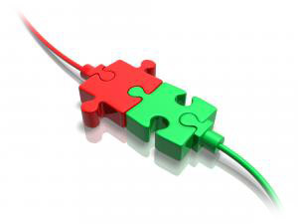
Issues facing IoT
Explosion & growth of data
Interoperability
Security
Big data analysis
Etc…
discussing!!

Slide 3
Interconnectivity ??
Dev. Skills
App.
Developer
There are too many standards to development software.
Dev Tools(SDKs, Libs)
Programming languages
Increasing dev costs and time.
Flooding specs ≒ result of innovation??
Android
App Dev
iOS App
Developer
Scripts language
Developer
Web App.
Developer
…
OS / Exec env.
OS / Dev Env.
Native App.
Hybrid App.
Web App./Web Browser
…
Understanding
SDKs/Libs
…
Android
iPhone
Windows
Constructing
Dev. environments
Standards
SDK of Light
for Android
SDK of Light
for iOS
API of Cam
for iOS
Lib. of grasses
for iOS/Win
…
Stick to protocols
Comm. Protocols
WiFi
Bluetooth
BLE
USB
…
Devices
Smart
Lights
Smart
Watches
Remote
Cameras
Health
Meters
Smart
Grasses
…
Unchangeable…

Slide 4
What is OMA GotAPI?
Regardless of programming languages
App.
Developer
Facilitates innovation through OMA GotAPI
Developer can use any programming languages, any application execution environments.
RESTful Web API
Device is represented as a set of functions
Android
App Dev
iOS App
Developer
Scripts language
Developer
Web App.
Developer
…
Run in any exec env.
OS / Dev Env.
Native App.
Hybrid App.
Web App./Web Browser
…
…
GotAPI
REST
Android
iPhone
Windows
Standards
Can access via
RESTful API (HTTP/HTTPS)
SDK of Light
for Android
SDK of Light
for iOS
API of Cam
for iOS
Lib. of grasses
for iOS/Win
…
Comm. Protocols
WiFi
Bluetooth
BLE
USB
…
Represent each device as a set of functions.
Device 1
Device 2
Device 3
Devices
Smart
Lights
Smart
Watches
Remote
Cameras
Health
Meters
Smart
Grasses
…
canvas
light
canvas
camera
Heart rate
light
notification
acceleration
vibration

Slide 5
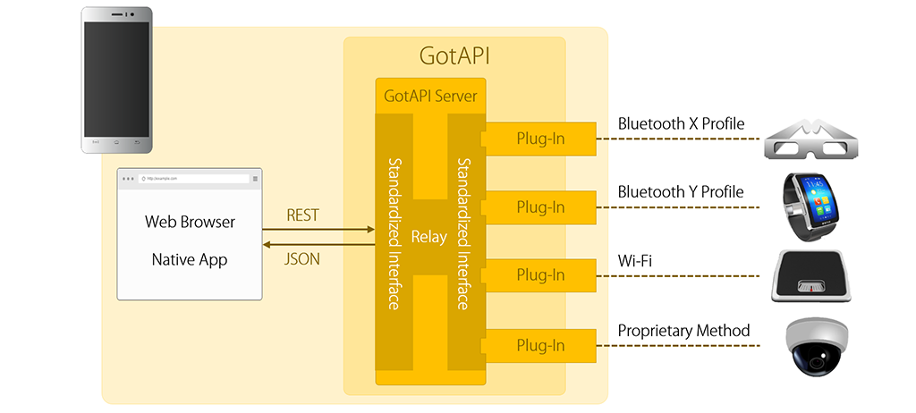
Architecture of Device WebAPI
Device WebAPI is an implementation of OMA GotAPI
Exec web server on the smartphone
localhost or IP addr:4035

Slide 6
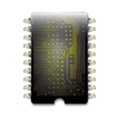
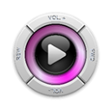
API for device access
* these are an example
ServiceDiscovery
Discover connected devices
Authorization
Authenticate applications
ServiceInformation
Device information
HeartRates
Get heart beat rates
Thermometer
Get body temperature
BloodPressure
Get blood pressure data
Proximity
Proximity detection
DeviceOrientation
Orientation of devices
Temperature
Temperature detection
Media Player
Replay control of music and videos
MediaStreamRecording
Record videos, audios and photos
Canvas
Draw images on the screen
Battery
Battery level, etc.
Vibration
Control vibration
Light
Turn on/off lights
EchonetLite
Control home appliances
AllJoyn
Control home appliances
IRKit
Control IR remote controllers

Slide 7
Device WebAPI Consortium
121members (2016/12/7)
114 Corporate members
8 Individual members
Outline
Share: By sharing information of standardization and specification, deepen the understanding of trends of IoT and wearables.
Expand: Discussing and examine how the new architecture should look like.
Contribute: Supporting web API specification of device functions based on the GotAPI specification, contribute to the development of convenience and connectivity.
Open Source
https://github.com/DeviceConnect
URL:
http://en.device-webapi.org/index.html
©2016 NTT DOCOMO, INC. All Rights Reserved.

Slide 8
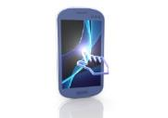
oneM2M × OMA GotAPI
Potential collaboration area: Smart Home
oneM2M IN-CSE
Local Control Apps
Native
App
Web
App
Smart phone / HomeGW
REST API
GotAPI
Plug_ins layer
Remote Control Apps
Devices

Slide 9
Thanks.

