Slide 1
Deutsche Telekom and Orange CloudAPI Demonstrator
Group Name: TP
Source: Andreas Kraft et al, a.kraft@telekom.de
Saïd Gharout et al, said.gharout@orange.com
Meeting Date: 2017-11-15

Slide 2
Overview
The demonstrator (presented at EclipseCon Europe and ETSI IoT Week) shows an Elderly Care Application developed by a 3rd Party using the common set of CloudAPIs, so it could run unchanged with Orange’s Smart Home and DT’s QIVICON platform.
The demonstrator is based on jointly developed requirements, architecture and API specifications, and resulted in tool and code contributions to the respective Eclipse open source projects.
Orange exposes the APIs for experimental use on their IoT Platform “Datavenue”: https://onem2m.cfapps.io/swagger-ui.html

Slide 3
Why oneM2M?
Be attractive to everyone
Use a standard backed by a large organisation and set of partners.
Scale up
Leverage available open source implementations and communities.
Go fast
Capitalise on available specifications covering all technical aspects

Slide 4
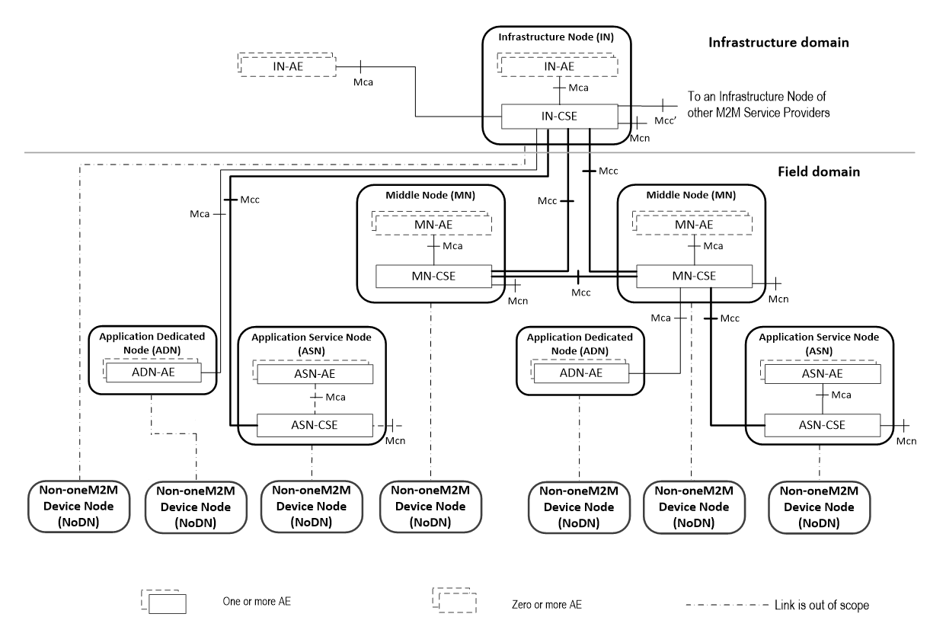
Current Scope

Slide 5
Showcase
Make oneM2M applications run simultaneously with both operator platforms without any code change.
Partners’ apps, e.g.,
oneM2M Home cloud APIs
Datavenue / eclipse OM2M
oneM2M Home cloud APIs
Qivicon / eclipse OM2M
Deutsche Telekom Speedport or home base
Orange LiveBox
Soft@Home
with oneM2M data models
Qivicon
with eclipse OM2M
and eclipse SmartHome
Virtual and local devices
Virtual and local devices

Slide 6
DT Interworking Target Architecture
Expose ESH Items/Things
as OSGi DAL Services
Utilize the REST / SSE API
to connect to the ESH Runtime
Abstract oneM2M
Devices & ModuleClasses
Manage, control, and convert ESH Items/Things
oneM2M
Infrastructure
Eclipse SmartHome Runtime
Map OSGi DAL to oneM2M Resources

Slide 7
Contributions to the Community Beyond the Demo
Open source contributions to Eclipse OM2M project
oneM2M implementation available on Eclipse OM2M git repository.
With ‘SDT Viewer’ tool, applications and Java connectors for various devices.
An online oneM2M Smart Home platform for experiments
Orange Data Share is exposed in a oneM2M version for experimental purposes.
Developers can connect devices (e.g., Philips, OSRAM, NetAtmo devices) and play with a live infrastructure.
APIs are described with Swagger documents.

Slide 8
om2m Web UI - Resource Tree
oneM2M third-party Application
Swagger UI

Slide 9
DT,Orange & oneM2M @ ECE 2017

Slide 10
Press Releases
Below please find links to the Press Release and pictures of the mixed teams (QIVICON, T-Labs, Orange) on premise:
https://www.orange.com/en/Press-Room/press-releases/press-releases-2017/New-Eclipse-Member-Orange-and-Deutsche-Telekom-demonstrate-joint-initiative-on-oneM2M-based-cloud-APIs-for-Smart-Home-and-consumer-IoT
https://smarthome.telekom.net/new-eclipse-member-orange-deutsche-telekom-demonstrate-joint-initiative-onem2m-based-cloud-apis-smart-home-consumer-iot/

Slide 11
Thank You!

