Slide 1
Definition of a Pilot test plan for cooperation of Agriculture equipment with oneM2M and C-ITS
ETSI STF 542
Presented by Michelle Wetterwald for oneM2M Technical Plenary
Sophia Antipolis, 22 of May, 2018

Slide 2
Outline
Motivation
From a standardization point of view
From a road safety point of view
Presentation of STF 542
Objective
Project description
Description of the use case
Main scenario
Alternative scenario using infrastructure
Main challenges
Summary

Slide 3
Motivation : Standardization interoperability
AEF: Agricultural Industry Electronics Foundation
Main objective of AEF is the interoperability of communication between manufacturer’s equipment via common standards
ISOBUS standard (ISO 11783) is a family of 14 standards
for the communication taking place between tractors and implements
enabling every combination of tractor and implements
full compatibility of data transfer between the mobile systems and the office software used on the farm
already consolidated between manufacturers for 15 years (certification)
From [1]

Slide 4
Motivation : Standardization interoperability
oneM2M is a global standards initiative for Machine to Machine Communications and the Internet of Things
Partnership project including ETSI
Objective of oneM2M is to address the need for a common M2M Service Layer that can be readily embedded within various hardware and software
oneM2M covers telematics and intelligent transportation, healthcare, utilities, industrial automation, smart homes, etc…

Slide 5
Motivation for selected use case : Traffic Safety
Risk of tractors in road traffic
Accidents with Motorized Agricultural Vehicles (MAVs) are not very common, but 75% involve personal injuries or fatalities *
Two-thirds occur outside (rural) of built-up areas.
Accidents happening in the hours of darkness are more severe for the persons involved: the proportion of fatalities and serious injuries is above-average
Insurance companies have requested the equipment manufacturers to improve the issue of lateral collision due to lack of visibility
=> Radio communications and cooperative ITS can play a major role to prevent this hazard
* From [3]

Slide 6
STF 542: Objective
Provide the necessary input (parameters, measurements methods, guidelines) for a pilot testing event to validate the possible cooperation between the oneM2M platform and AEF ISOBUS standards
Define interfaces / inter-working between oneM2M and ISO 11783 standards & oneM2M and C-ITS
=> enable interoperability between vertical domains using oneM2M
=> benefit from IoT architecture as normalized interfaces and protocols at service layer
Target use case:
Dissemination of a warning message to vehicles passing-by, after an agriculture equipment from the fields has been detected to exit on the road

Slide 7
STF542: Project Description
Deliverable : ETSI TR 103 545: Smart M2M; Pilot test definition and guidelines for testing cooperation between oneM2M and Ag equipment standards (ETSI WI: DTR/SmartM2M-103545)
Experts
AEF (Manuel Gorius); Netellany (Michelle Wetterwald, STF Leader)
External contributors: Christophe Gossard (John Deere), Laurent Velez and Alexandre Bergé (ETSI CTI)
Schedule

Slide 8
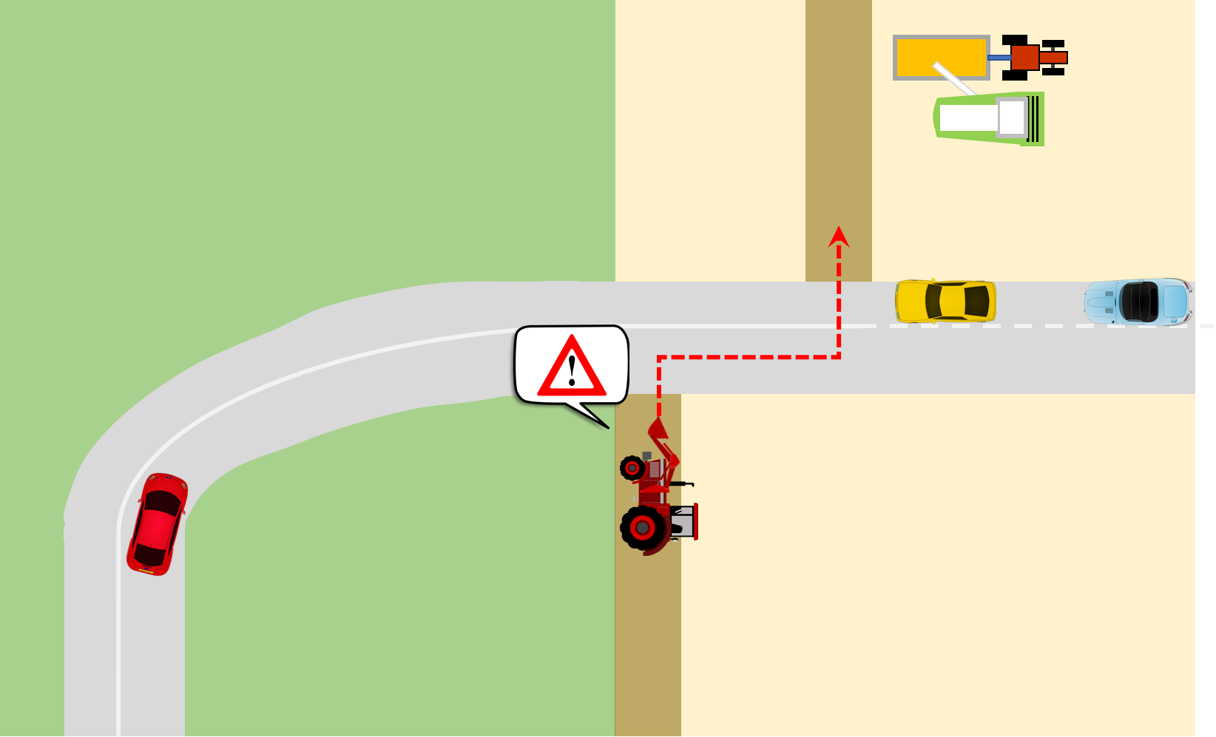
Description of the Use Case

Slide 9
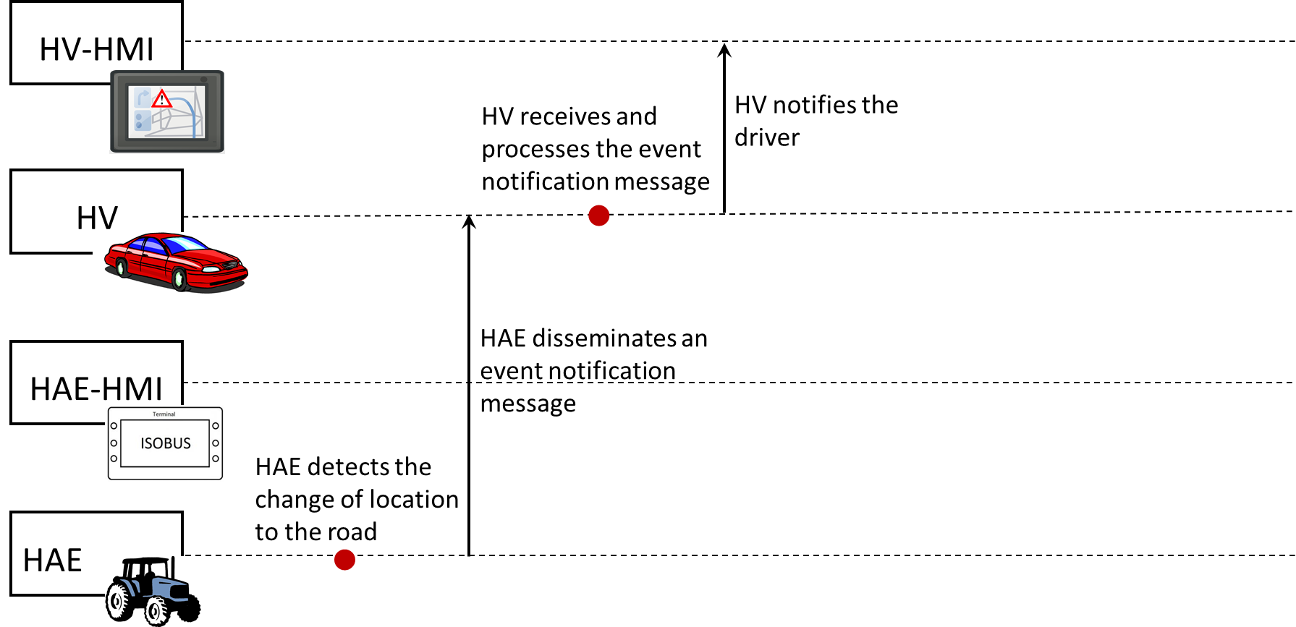
Main Scenario
DENM

Slide 10
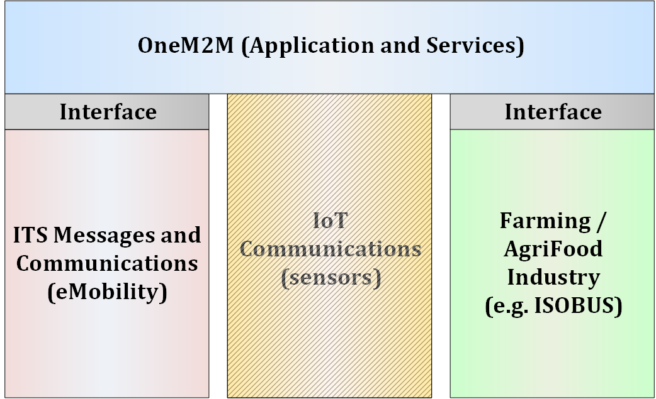
Main Challenges
Trigger reliably the event while avoiding false positive
HAE not in working condition (implement deployed)
Knowledge of position : when on (or entering)-road/in the field (maybe no road map in the agriculture equipment)
Map ISO 11783 data to C-ITS data
oneM2M standards for „inter-domain“ communication on the vehicle: ISO 11783 ← oneM2M → C-ITS
AE manufacturers prefer to avoid
Define interworking / semantic interoperability
Maintain security and trust in sensors, cross-system interfaces

Slide 11
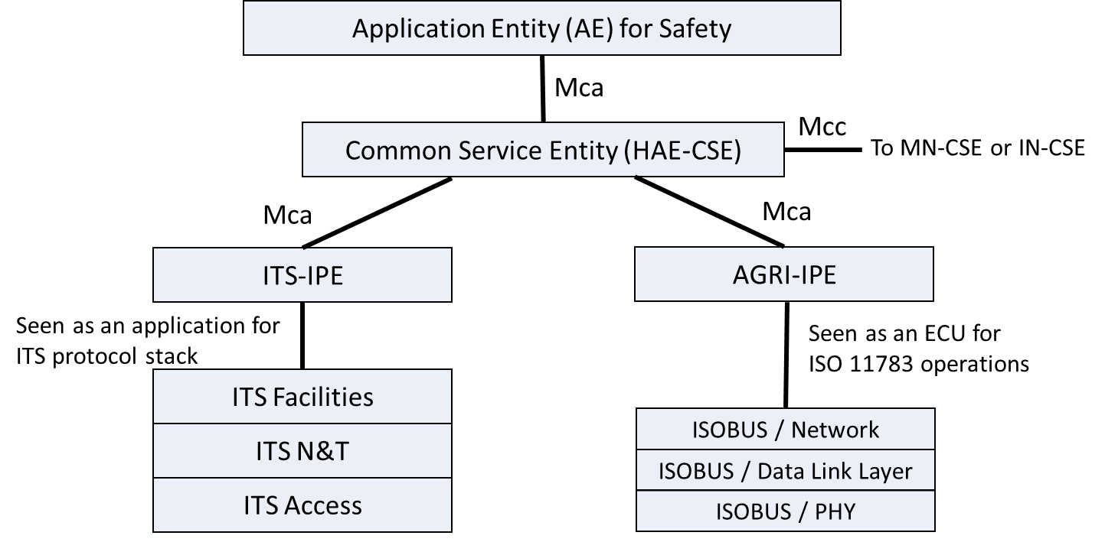
Interworking Reference Model in the HAE

Slide 12
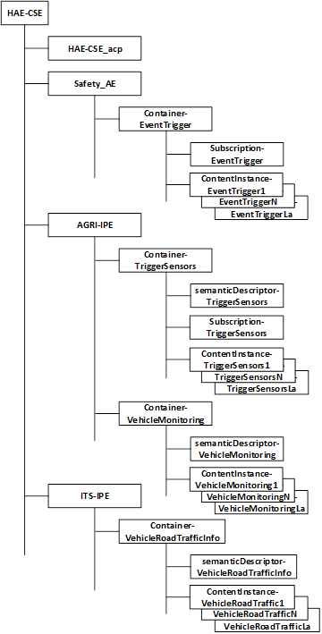
HAE-CSE resource structure
Data have been split into four groups
Parameters read from ISO 11783 and involved in the triggering (Container-TriggerSensors)
Parameters read from ISO 11783 and not involved in the triggering (Container-VehicleMonitoring)
ITS specific parameters (Container-VehicleRoadTrafficInfo)
Parameters used internally (Container-EventTrigger)

Slide 13
Data management for the exchange of information

Slide 14
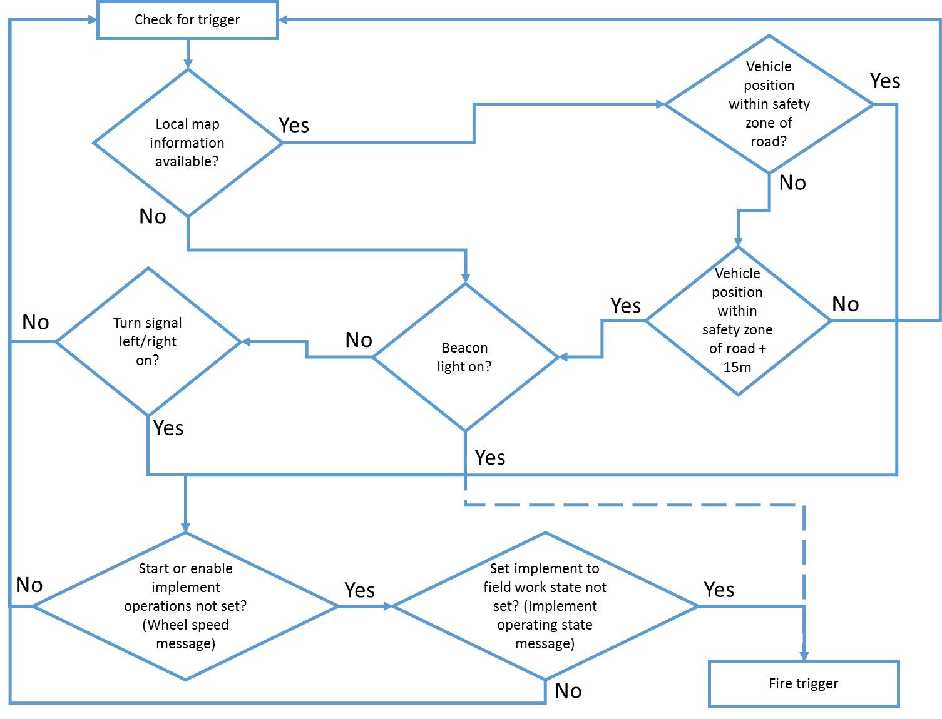
Triggering conditions

Slide 15
Next steps
Introduce semantics (based on oneM2M and SAREF)
Finalize the description of information exchange
including main fields of primitives
Describe configuration parameters for the pilot test
Refine the test procedures

Slide 16
Summary
ETSI STF 542 is defining a pilot test for cooperation of agriculture equipment with oneM2M and C-ITS
Addresses the scenario of an agriculture equipment entering a road from the field
Road Safety – Lack of visibility
Main objective is to demonstrate interoperability through a pilot test of vertical domains: Smart Agriculture + Smart Mobility using the oneM2M platform
horizontal service layer
Cooperation of C-ITS with the IoT world
Technical Report to be approved by ETSI TC SmartM2M in August 2018

Slide 17
References
AEF Brochure, ISOBUS in Functionalities, 180-1-D/EN 10/2015, October 2015
Omar Elloumi, oneM2M Update, Zoom ON Release 3, ETSI IoT Week 2017, Sophia Antipolis, France, October 2017
'Risk of tractors in road traffic', study by German Insurance Association, Study n.21, January 2011, available at https://udv.de/en/publications/compact-accident-research
AEF, http://www.aef-online.org
oneM2m, http://www.onem2m.org/

Slide 18
STF 542
Michelle Wetterwald
NETELLANY
Sophia Antipolis, France
michelle.wetterwald@gmail.com
Thank you for your attention!
STF 542 Homepage: https://portal.etsi.org/STF/stfs/STFHomePages/STF542

