Slide 1
Open Source IoT (OS-IoT)
Josef Blanz Iain Sharp
Principal Engineer Principal Technologist
Qualcomm ATIS
September 10, 2018

Slide 2
Background
The global oneM2M partnership is defining standards for interoperable IoT systems:
oneM2M standards could improve the openness and robustness of IoT applications including industrial automation, Smart Cities, eHealth, and Smart Grid
As a founding Partner of oneM2M, ATIS recognized that Open Source implementations of the standards would complement oneM2M specifications, drive adoption, and enhance commercial value
In 2017, ATIS initiated work on OS-IoT to deliver an open source library for lightweight oneM2M clients:
For example for application in wearables, low-cost environmental monitors, home appliances and smart metering
OS-IoT has a unique place in the ecosystem as the only open source project that is focused on clients as opposed to servers.

Slide 3
OS-IoT Participation
Group led by Farooq Bari (AT&T) and Farrokh Khatibi (Qualcomm).
Open to both ATIS members, and approved non-member companies with suitable technical contributions.
Recent participants:
AT&T, Deutsche Telekom, Huawei, InterDigital, KDDI, Linaro, Qualcomm
Contributors provide a wide-range of expertise on oneM2M standards, client chipsets, and open-client ecosystems.

Slide 4
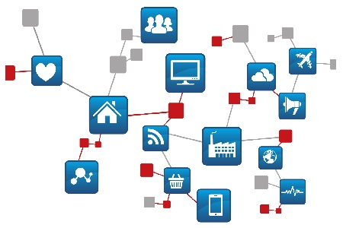
OS-IoT Library, Architectural Overview
oneM2M Infrastructure
Custom IoT Application
Physical sensors and actuators
Resource
Oriented API
Library
Parsing, Serialization and Protocols
Interoperability tested with
JSON
XML
HTTP/HTTPS
Mca
Mobius
Operating System
oneM2M Client Device
HW Platform
IoTDM

Slide 5
Key Features
Open Source
OS-IoT is Open Source, BSD-licensed, for community and commercial application.
oneM2M v2 Compliant
OS-IoT supports oneM2M version 2 compliant Application Entity (AE) capabilities.
Platform Independent
OS-IoT provides a high degree of platform independence and potential to support constrained devices.
Simple API
OS-IoT provides a simple, resource-oriented API to interact with oneM2M ecosystems.
Interoperable
OS-IoT is interoperable with other oneM2M ecosystem components.

Slide 6
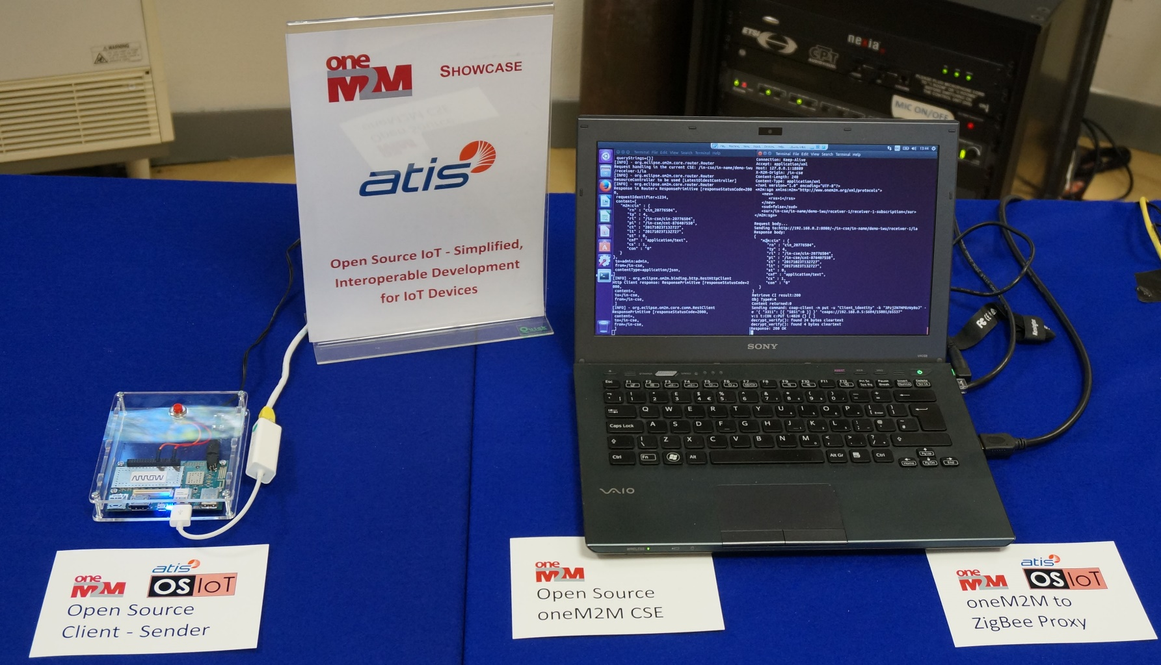
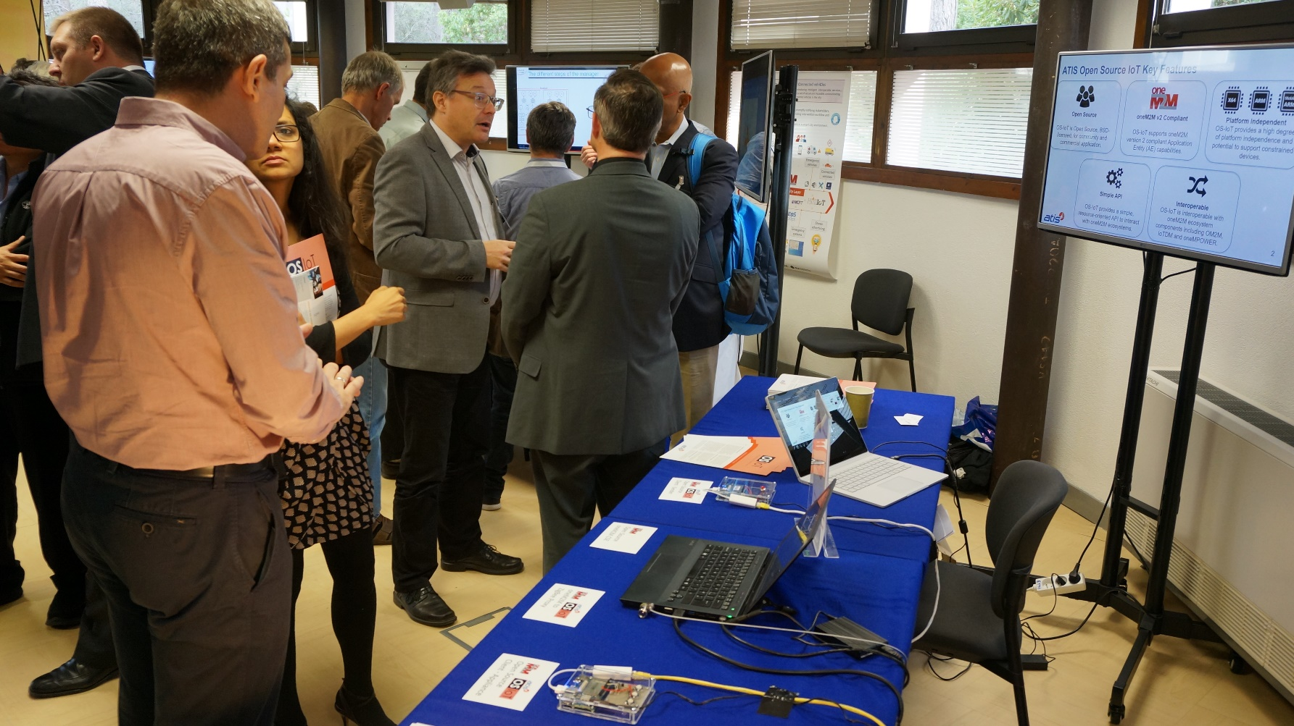
Initial Release – September 2017
Core set of oneM2M Application Entity (AE) features:
CRUD operations for main oneM2M resources
Subscribe/Notify
Live demo of OS-IoT example applications:
oneM2M standards compliant smart lighting application
Interworking between oneM2M and commercial ZigBee Light Link system
Platform portability between X64 and ARM
Demonstrated the concept of an open, interoperable oneM2M client library.

Slide 7
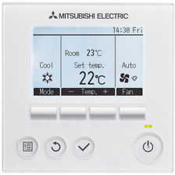
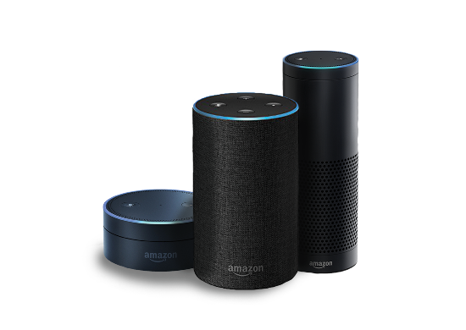
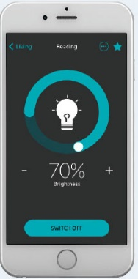
OS-IoT Library, Initial Release and Expanded Capabilities
Multiple follow-up releases with feature additions, e.g.:
oneM2M Home Appliance Information Model (HAIM) resource type support
HAIM provides standard representations of common home appliances
Support of HAIM will allow clients using OS-IoT to seamlessly integrate with other HAIM appliances and appliance controllers (e.g., apps)
Using HAIM also allows OS-IoT to be used in interworking bridges that connect different appliance-centric IoT standards
oneM2M compliant HTTPS protocol security to support access to public cloud CSEs
Resource discovery
Interoperability improvements with CSEs
New

Slide 8
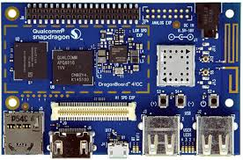
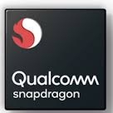
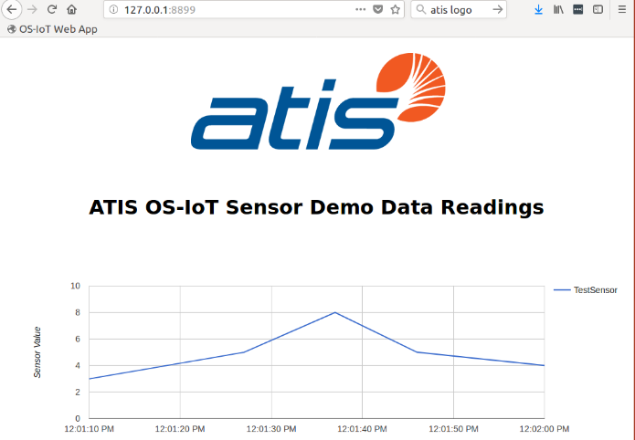
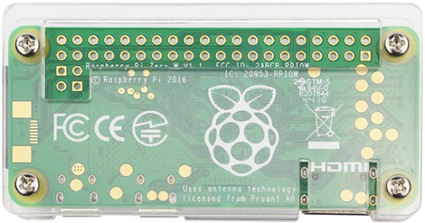
Cloud Demo and OS-IoT over LTE
DragonBoard Sensor
Web Browser
Shows how oneM2M standards and OS-IoT can support real-time monitoring of environmental sensors.
Uses public cloud-based CSE server.
Tested with US (AT&T) and UK LTE networks.
https://www.youtube.com/watch?v=hQN-YeM-mSY
Write Resources
LTE Adaptor
Additional Sensors
(Example)
Web Server App
Mca
Discover & Read Resources
Shows oneM2M deployment with real-world characteristics.
Resource Tree
(Example)
Cloud CSE

Slide 9
Open Connectivity Foundation (OCF) Interworking
OCF is a standard for proximal IoT interoperability at the appliance level, including a suite of Smart Home applications.
OCF/ATIS agreement to collaborate in developing a demo of seamless interoperability
OS-IoT has developed a demo of an Interworking Proxy Entity (IPE) that maps OCF devices in to the oneM2M HAIM ecosystem
IPE was demonstrated at OCF Technical Face to Face meeting
OCF responded to this work by advancing their standard on OCF/oneM2M interworking to an earlier release and enabling this kind of asymmetric IPE
Next steps for OCF to oneM2M IPE demo:
Demo video using separate physical devices for each functional element
Provide detailed installation and user guide
Add reverse direction (oneM2M device to OCF)
OCF Device Lights
New
Interworking Proxy Entity (IPE)
oneM2M CSE
oneM2M HAIM Representation of OCF Resources

Slide 10
Bridge Network Architecture
OCF/oneM2M Bridge/IPE
C++ Bridge App
oneM2M
CSE
OCF Client
oneM2M AE
OCF server lightdevice
e.g. Eclipse OM2M
oneM2M Controller AE
IoTivity C++ Library
Simulated OCF device from OCF deviceBuilder application
Library
osiotcmd command-line tool
Mca
Mca

Slide 11
HAIM Support Resource Structure
RN = “ocfBridge”
AE for bridge
RN = <Name of OCF lightDevice>
HAIM deviceLight
powerState: 0 or 1
HAIM binarySwitch
HAIM toggle resource is omitted
Subscription

Slide 12
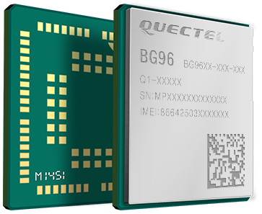
OS-IoT on Embedded Cellular Devices – work in progress
Conventional Closed Cellular Module
Cellular Module
e.g. AT Commands/PPP over Virtual Serial
Application CPU
Peripheral interface
e.g. I2C, GPIO, ADC
Sensor and Actuator Hardware
Custom IoT Application
Library
Real-Time OS (RTOS)
Application OS
Cost-optimized, Open Cellular IoT Module
Cellular Module
Peripheral interface
e.g. I2C, GPIO, ADC
Sensor and Actuator Hardware
Custom IoT Application
Library
Real-Time OS (RTOS)
Integrated cellular IoT modems with accessible application SDKs and support for NB-IoT and LTE-Cat M1 are now available:
Goal is to show OS-IoT using cellular IoT on a live network (AT&T)
OS-IoT aims to port the OS-IoT library to the Quectel BG96 module based on the Qualcomm 9206 chipset

Slide 13
OS-IoT Community Outreach
Site: www.os-iot.org
Full source code and test suites
Example applications
Documentation
Press release and video distributed for OS-IoT over LTE operation.
OS-IoT event participation
oneM2M interoperability event at ATIS-hosted oneM2M Technical Plenary in Washington DC.
OCF face to face, Malaga.
oneM2M industry day.
Technical support for university projects involving OS-IoT and oneM2M sponsored by participating companies.

