Slide 1
SDS Status Report to TP40
Group Name: oneM2M SDS
Source: Dale Seed, Peter Niblett, SeungMyeong Jeong, Wei Zhou
Meeting Date: 2019-05-20 to 2019-05-24

Slide 2
Summary
Objectives for SDS
Progress Rel-4 work items
Reduce number of open actions
Closed – 15, Remain Open - 14
Rel 2/3 Maintenance
Status details
27 Input contributions agreed towards Rel-4 TRs
TR-0024, TR-0026, TR-0043, TR-0050, TR-0052, TR-0053, TR-0054, TR-0055, TR-0059, TR-0060
11 Input contributions agreed towards Rel-4 TSs
TS-0001, TS-0026
33 Maintenance CRs agreed towards TSs (Mostly Rel-2 / Rel-3)
TS-0001, TS-0004, TS-0026, TS-0008, TS-0009, TS-0034
~15 Contributions pushed to teleconference calls due to lack of meeting time

Slide 3
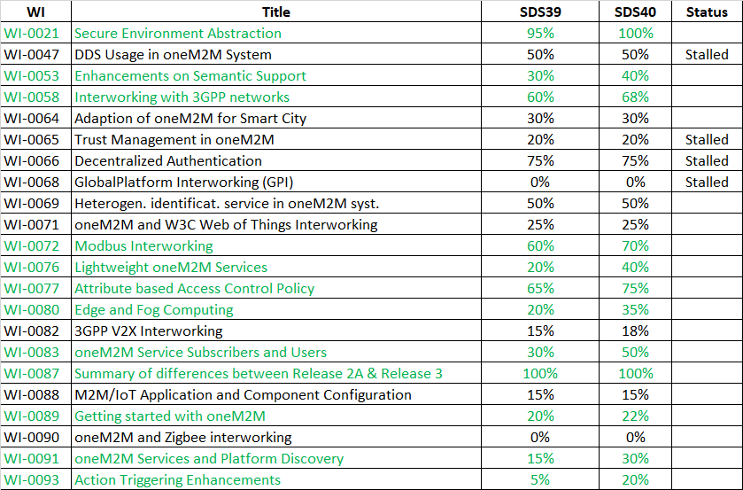
SDS40 WI Activity

Slide 4
CR Trends

Slide 5
Items for Decision
CR Packs:
TS-0001 – TP-2019-0083 – 6-R2, 9-R3, 9-R4
TS-0004 – TP-2019-0084 – 5-R2, 5-R3, 0-R4
TS-0005 – TP-2019-0104 – 0-R2, 1-R3, 0-R4
TS-0006 – TP-2019-0105 – 0-R2, 1-R3, 0-R4
TS-0026 – TP-2019-0085 – 0-R2, 1-R3, 2-R4
TS-0034 – TP-2019-0086 – 0-R2, 1-R3, 0-R4
TS-0008 – TP-2019-0087 – 1-R2, 1-R3, 0-R4
TS-0009 – TP-2019-0088 – 1-R2, 1-R3, 0-R4

Slide 6
Conference Calls
Meeting | Date | Time (UTC)
SDS 40.1 | Thurs 6-Jun-2019 | 12:30 – 14:00
SDS 40.2 | Thurs 13-Jun-2019 | 12:30 – 14:00
SDS 40.3 | Thurs 20-Jun-2019 | 12:30 – 14:00
SDS 40.4 | Thurs 27-Jun-2019 | 12:30 – 14:00

