Slide 1
ICA Thing Model Introduction
ICA Connectivity Alliance
2019.6

Slide 2
Background
Global organizations which provide similar data model
Standard semantic for IoT device digitalization
Clear and unified definition of device functions
Better data interworking between IoT devices
Loose coupling of IoT software and hardware

Slide 3
Definition
{
"properties": [
{
"identifier": "LightSwitch",
"dataType": {
"type": "bool"
}
}
],
"events": [
{
"outputData": [
{
"identifier": "ErrorCode",
"dataType": {
"type": "enum"
}
}
],
"identifier": "Error",
"type": "error"
}
]
}
Status:
Status
Online/Offline, Active/Deactive
Profile:
Profile
Static description
Service
Functionality
Property: Run-time status
Property
Event
Service: Action, command
Event: Information, warning and fault
Thing Abstract Model
Things Specification Language
(JSON Schema)

Slide 4
Model Construction Example
Resource Module Library
Wi-Fi Connectivity Module
Basic Property
SNR
RSSI
Channel
BSSID
Band
…
Product based on Thing Model
BT Connectivity Module
Thing Model: Light
Basic Resource Library
OTA Module
Property
…
Color
On/Off
Darkness
Basic Property
Event
Temperature
Color
On/Off
…
Fault report
Basic Service
volume adjust
Count down
…
Wi-Fi Connectivity Module
Basic Event
OTA Module
Tumeout
High temperature
…
Basic Resource
Resource Module
Thing Model

Slide 5
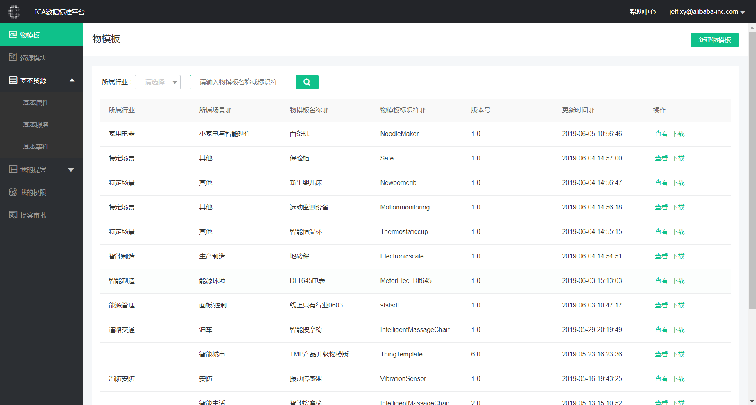
ICA Data Standard Platform ( IDSP )
Tag:
Create
Thing Model
View
Resource Module
Download
Basic Resource
My proposal
My Permission
Proposal Approval
IDSP : Online tool for the co-creating and sharing of ICA Thing Model
https://www.ica-alliance.org/dataindex

Slide 6
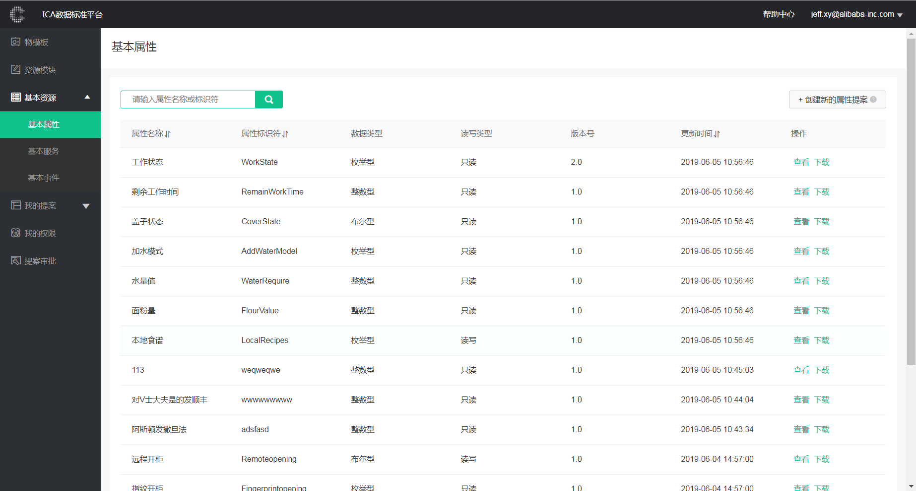
Lifecycle
IoT Market
On sale
Partners
Things binding
IoT Link P/F
ICA WG
Definition
Submission
Thing model
Thing model
Data service
ICA Data STD P/F (IDSP)
① Interworking between STD P/F and Link P/F
③ Base → Inheritance, Thing Model → Space/Scenario Model
② On-line "Crowdfunding”for thing models

Slide 7
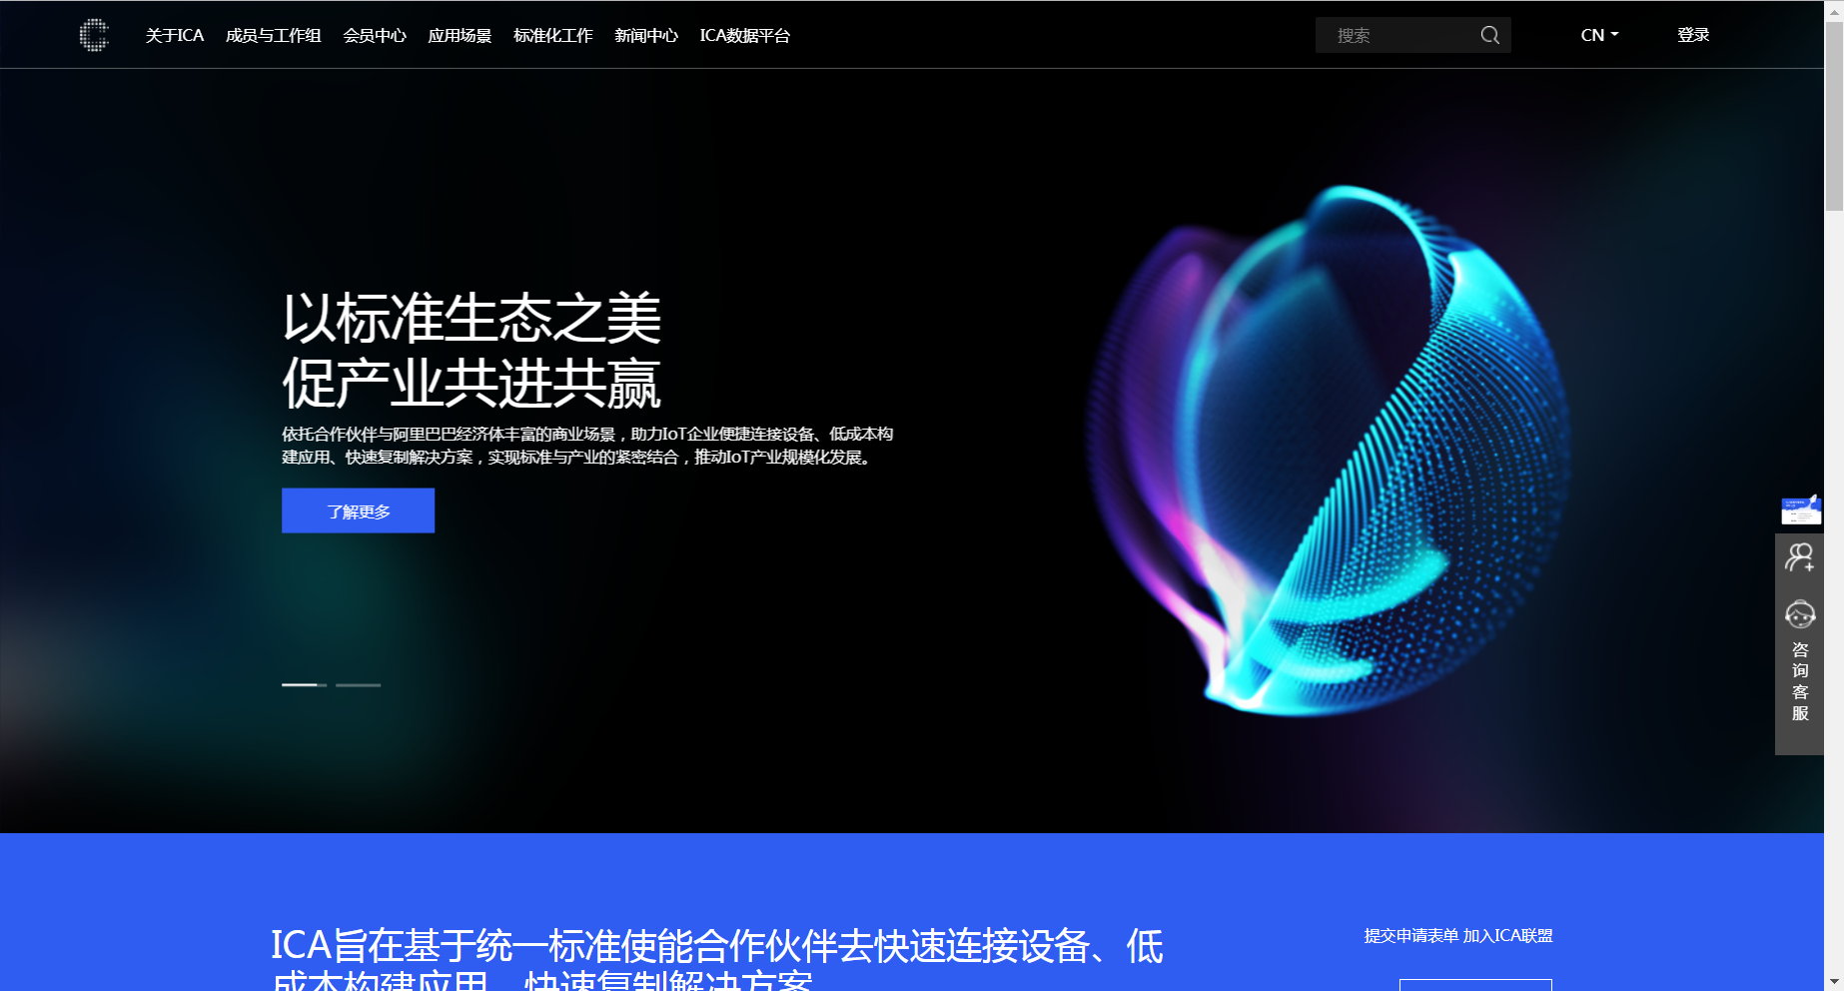
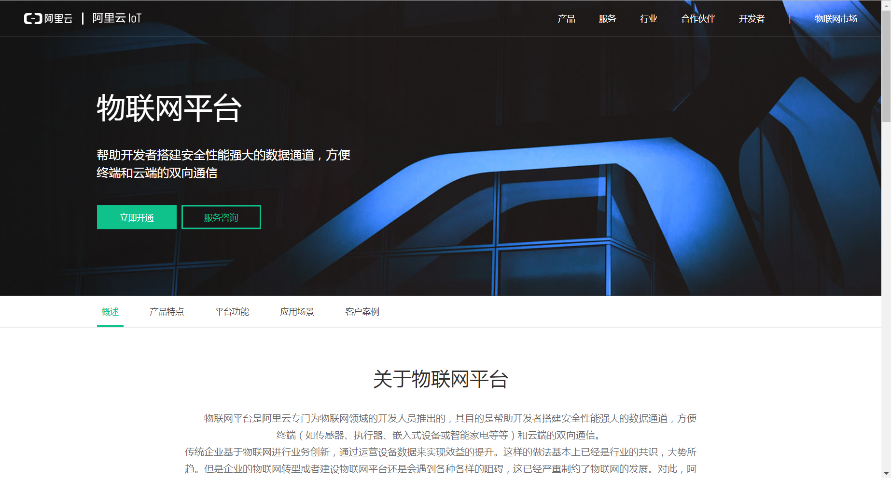
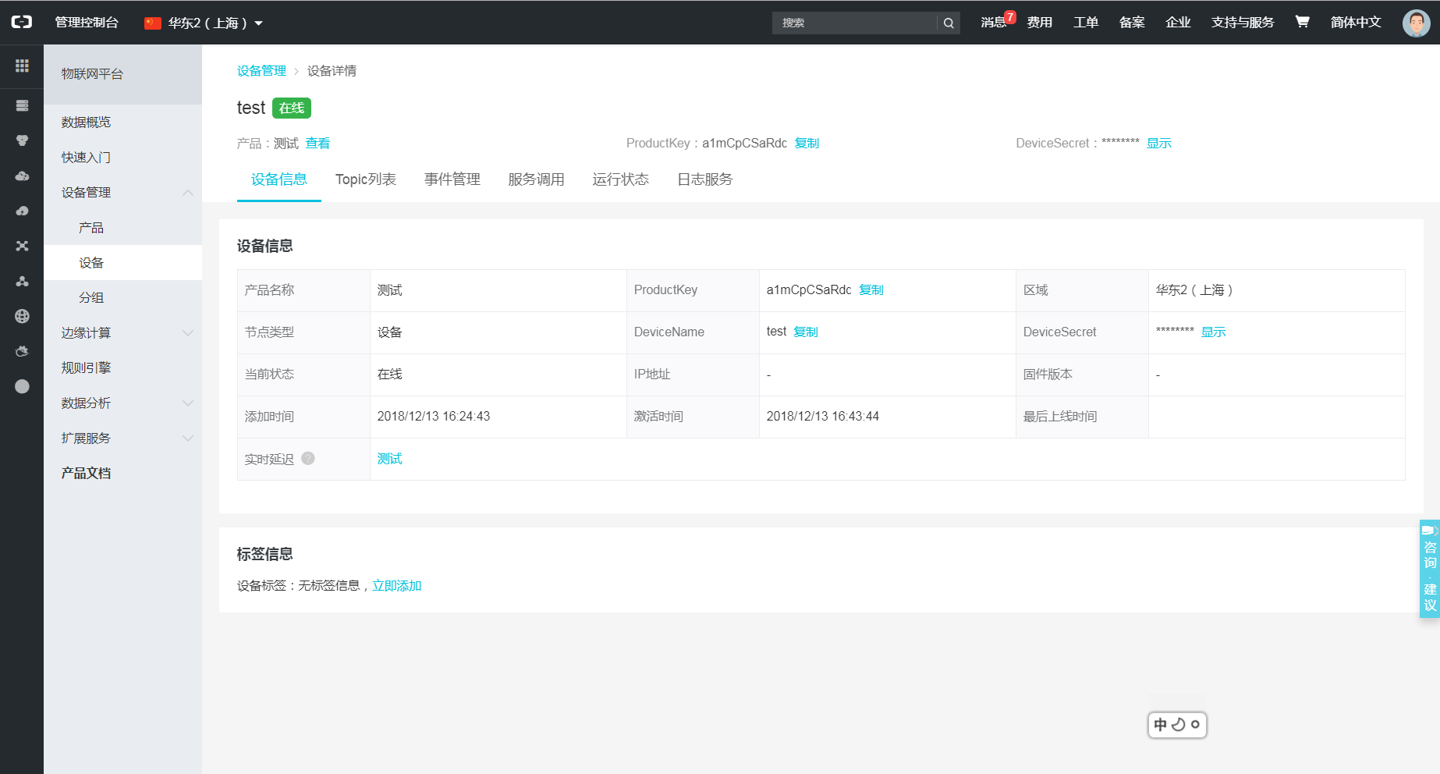
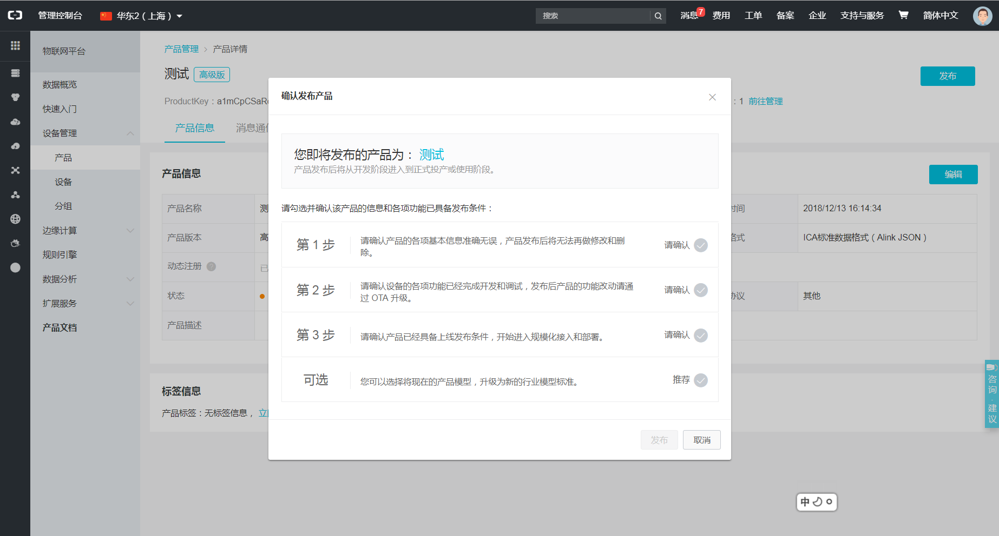
Process
Step 1
Step 2
Step 3
Step 4
Define thing model in IDSP, submit and sync to Alibaba Cloud P/F
Easily create product or device based on thing model
Deploy device full-lifecycle MGT. based on Thing model capability
Publish product and head for commercialization
IDSP: https://www.ica-alliance.org/dataindex
Alibaba cloud P/F: https://iot.aliyun.com/products/linkplatform
Demo video: http://cloud.video.taobao.com/play/u/2663106983/p/1/e/6/t/1/218971778705.mp4

Slide 8
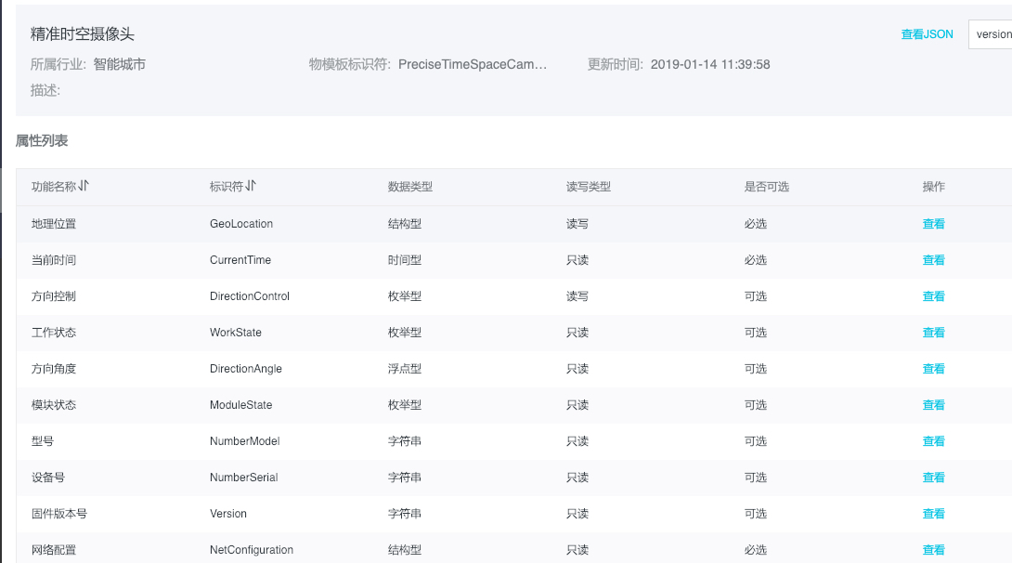
Example: PreciseTimeSpaceCamera

Slide 9
Capability
Service
Hub device connection and Smart living interoperability
Internet content/service integration (GIS, BIM etc.)
Drag-and-drop dev.
and visual management
Alibaba Cloud Product Matrix
Alibaba Cloud Market (app, API…)
Alibaba Group Economy (Tmall…)
ICA Ecosystem
Open P/F
Capability
Thing virtualization
Thing communication
Thing searching
Protocol and STD.
Thing Data repository
Thing data computing
Thing relationship
HW certification
Thing identification
Thing shadow
Device driver
Firmware updating

Slide 10
ICA Thing Index
Based on Thing Model statistics, provide more product and business insight services for partners
Device
Device shipment
Brand awareness
Utilization status
ISV & SI heat list
Thing Model
Application
Model heat map
Model awareness
Coverage rate
Industry tag
Connection
Scenario
Business
Technology
Chipset & Moduile
Connectivity ratio
Trend of new model
Trend of new app.
Command & Event
Reusability
Innovation
Functionality
City level coverage
Biz opportunity
Region

Slide 11
Ecosystem Overview
Standard access to mask IoT HW differences, tools to accelerate development on thing-model-based VAS
BI
Board
ICA
Thing
Model
Index
Thing model based VAS
(e.g. Digital Twins)
Smart Living
Smart City
Smart Manufacturing
Cloud side
Inheritance or Mapping
Thing Model Base Pool (Parent Template)
Thing Model VAS Tools
(Data storage/search/display/analysis etc. )
3rd –Party Models
Publish and Approval
End side
Alibaba IoT HW pool
(Tmall, DingTalk, Cainiao…)
HW ecosystem

Slide 12
Current state
5,000+
Cooperative Partners
1000+
Thing Models
8+
Vertical Industries
Notes:
Co-creation

Slide 13
THANK YOU

