Slide 1
C-DOT & oneM2M Activities
Aurindam Bhattacharya
Centre for Development of Telematics
www.cdot.in

Slide 2
Why is essential for
cross-sector standardization
of
IoT and ICT in India

Slide 3
Challenges faced by the City Authorities
Interoperability: Due to non-standardised proprietary implementations the devices and applications do not interoperate; giving rise to higher TCO
Data Sharing: Siloed Nature of the Applications make sharing of data amongst divergent applications very difficult and controlled by the Application Provider(s)
Vendor Lock-In: All the applications are deployed and controlled by a single vendor. New Application onboarding difficult
Security- Device Security, Authentication, Communication Security, Data Integrity, Data Privacy, Lawful Interception
Device Ownership: Ownership of the devices communicating, KYC/KYM
No Contextualisation of IoT and Non-IoT Data

Slide 4
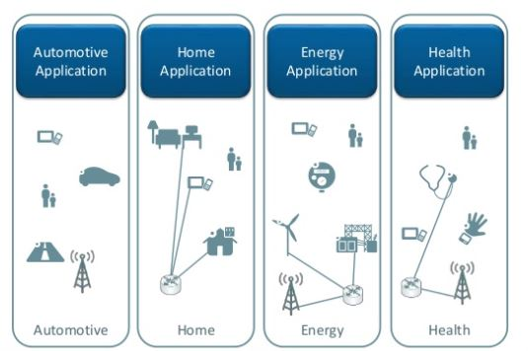
Current Landscape of IoT/M2M Applications
Management App
Proprietary Platforms (Smart City )
Proprietary APIs
Other Services and Departments
vertical Centric Siloed Ecosystem
IN ORDER TO SHARE DATA AMONG ALL THESE SILOED (PROPRIETARY) APPLICATIONS ANOTHER LAYER WOULD HAVE TO BE CREATED WHICH CAN EXTRACT DATA FROM THESE APPLICATIONS

Slide 5
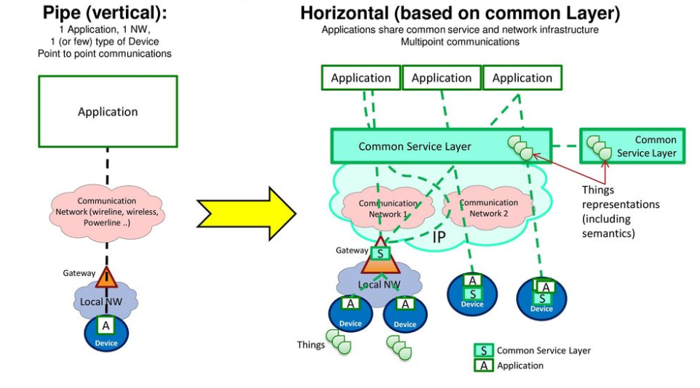
OneM2M Architecture Approach

Slide 6
oneM2M Breaks Down the Silos
Horizontal
Information Flow
Smart
Emergency
Services
Smart
Transportation
Smart
Infrastructure
Vertical
Information Flow
Vertical
Information Flow
Vertical
Information Flow
Smart
Emergency
Services
Smart
Transportation
Smart
Infrastructure
…
…
Service Layer
…
Standardized architecture
Streamlines onboarding of new applications and devices
Manages information in a unified, secure, and flexible end-to-end system
Support various use cases, devices vendors, connectivities and protocols
Multi-purpose, multi tenant, collaborative applications across various industries

Slide 7
Need for horizontal IoT platform connecting the ”things”
Smart Cities
Other Data Sources
Connected Car
Smart Home
Smart Agriculture
Horizontal Information flow
Courtesy Hewlett Packard Enterprise 2018
7

Slide 8
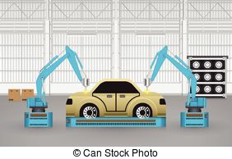
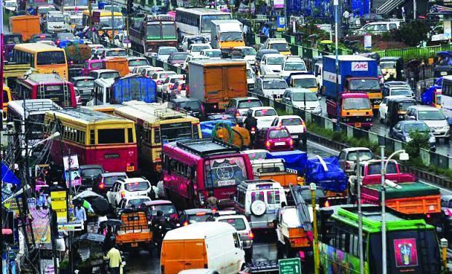
Horizontal Approach for the IoT Applications
Management Layer
Management App
Application1
Application2
Application3
Application4
Standardised interface
Common Service Layer
Management App
Communication Devices and Hardware
Communication Technologies and Protocols
Communication Networks
Car Manufacturer
Insurance Provider
Maintenance Provider
Traffic Police
Other Applications
A Common Service Layer, being and integral part of the IoT/M2M Platform, obliterates the need of a management layer to be created on top of all the applications besides adding values like interoperability, security, data management etc.
8

Slide 9
Ongoing Collaborations
Collaboration is important to reach common understanding, avoid overlap and build interoperable IoT ecosystems globally.
Sharing/Reference
(Liaison, workshop, …)
P2413
MIoT
ref. arch, OHTP
Certification
Interworking
SCP, SmartM2M
JTC1 WG10
OCF
SG20
OSGi/DAL
Endorsement
(adoption)
SCEF/CIoT
WoT
WG3
TR-069/ TR-181
AllJoyn
DDS
OPC-UA
OMA DM/ LWM2M
HTTP/ CoAP/
(D)TLS/
WebSocket
MQTT
Partnership
Source: Huawei

Slide 10
Conceptual Architecture View
Application Dedicated Node
Infrastructure Node
Middle Node
AE
AE
AE
Things:
Sensors,
Devices
AE
Mca
Apps Cloud Services,
BSS
Application Service Node
CSE
Mca
CSE
AE
Mca
CSE
Gateways
Network
AE: Application Entity CSE: Common Services Entity NSE: Network Services Entity
NSE
NSE
NSE
Sensor Areas
Cloud

Slide 11
In a Smart City, the potential for IoT use cases is vast
Smart water
Smart lighting
Smart traffic
Smart parking
Make more informed decisions, protect city’s water supply and prevent water waste
Save time for maintenance crews and save fuel costs–
from driving around town to find and replace broken bulbs
Optimize traffic flow using traffic signals, the number of vehicles and pedestrians
Better utilization of assets, including parking spaces and enforcement staff, by providing real-time parking availability info
Smart industry
Smart buildings
Smart environment
Location/context based services
Enable easier tracking of transport and logistics flows, not only for one industry, but multi-industry (e.g., retail, oil, shipping, etc.)
Optimize building electricity usage with motion sensor lights which can dim or shut off when a room is empty
Monitor air quality, pollution and other weather conditions such as temperature and humidity
Provide real-time city event info; leverage GPS locations and combine with the user profiles to find a suitable parking spot
© Copyright Hewlett Packard Enterprise 2018
Notes:
Cities have to consider four priorities in their transformation into smart cities:
transferring to a hybrid infrastructure,
protecting digital assets,
empowering a data-driven organisation and t
he increased mobility and engagement of their citizens.”

Slide 12
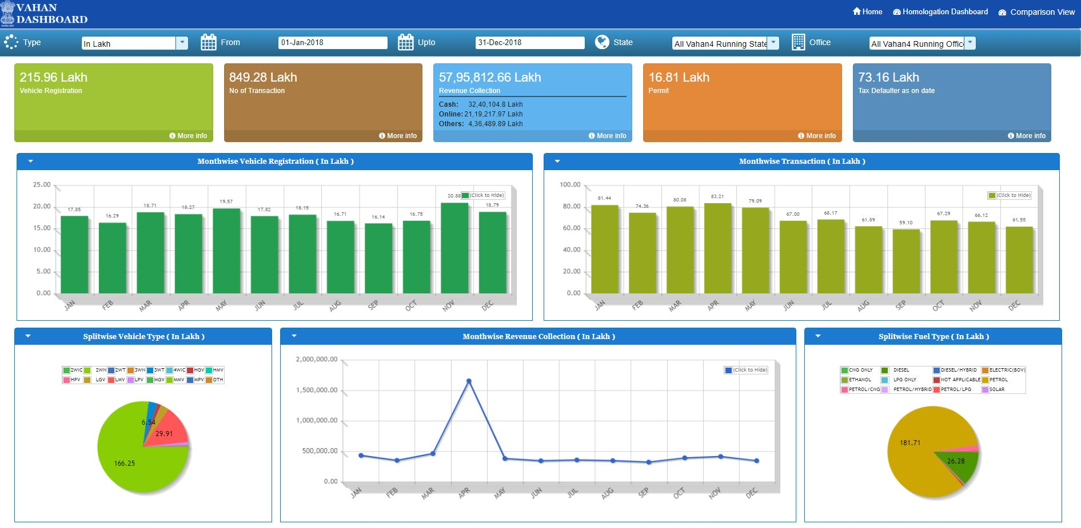
Certain Figures which make Indian Smart Cities Unique
Total number of vehicles registered in India in 2018=21.6 million

Slide 13
The India Aspect - Continues
Total number of vehicles registered in Delhi in 2018=729,000

Slide 14
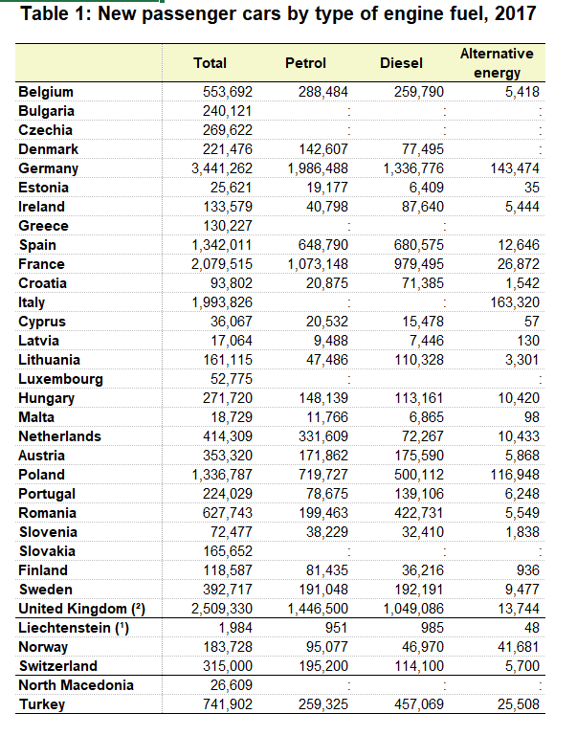
Total No. of Vehicles added in 2017 in entire Europe : 18,566,398 ≈18.6 million

Slide 15
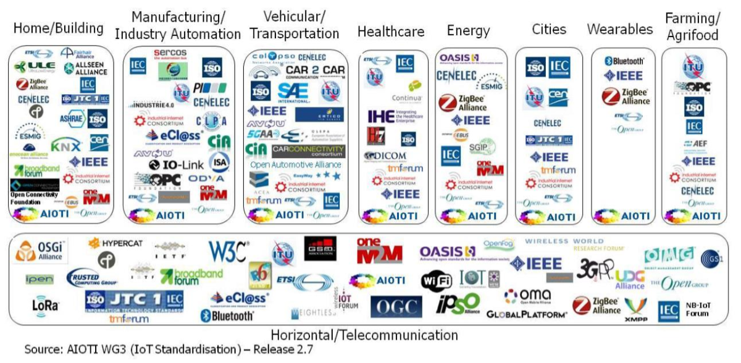
The issue with IoT interoperability is diversity

Slide 16
The Common Service Functions in Horizontal Service Layer Architecture
Registration
Discovery
Security
Group Management
HTTP(S)
Devices/ Sensors
Data Management & Repository
Subscription & Notification
Device Management
Application & Service Management
CoAP
MQTT
Communication Management and Delivery Handling
Network Service Exposure
Location
Service Charging & Accounting
Applications in the Cloud
WebSocket
Transaction Management
Semantics
CSE

Slide 18
Standards Compliant Smart City Architecture: IoT Technology Perspective
Application Infrastructure Platform
Appl. Layer
BUSINESS APPLICATIONS
CAPACITY MGMT.
RESOURCE ABSTRACTION
COMMAND & CONTROL
BUSINESS SUPPORT
Infrastructure Node
Network Layers
2 G
3 G
4 G
5 G
Broadband
Optical/Copper
Satellite
WiFi
Others
IP
COMMON SERVICE
LAYER
ASN
MN
Field Domain Devices
Personal Area/Home Area/Sensor Network & Gateways
ADN
Sensing Layers
6LoWPAN
ZigBEE
ZWave
LoRa
RFID
Wi-Fi
CAR END
Blutooth
Others

Slide 19
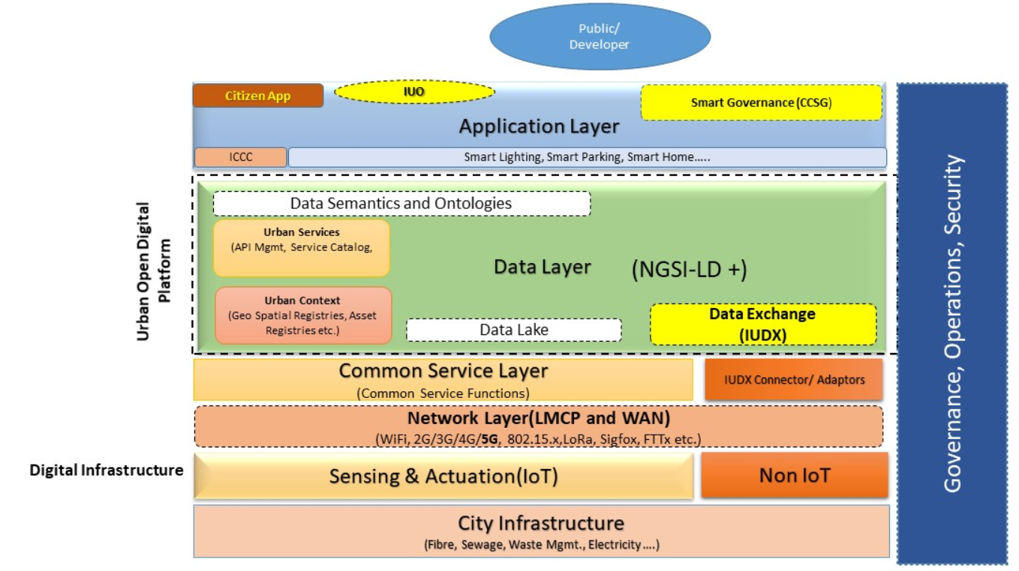
Unified Smart City Architecture:IoT + Non-IoT
Pillars of Service
Applications
Physical
Social
Economic
Institutional

Slide 20
What happens if oneM2M is not Adopted
Interoperability: Device, Network and Application Level Interoperability can not be achieved. Universal pluggability can not be achieved
Security: We would not be able to prevent deployment of unauthorized and unauthenticated devices and applications in the network which may be a serious threat to the entire ecosystem(and to the mankind)
Due to non-standardized implementation, security (including lawful interception) can not be ensured
Benefits to Local Entrepreneurs: Startup community would not be able to bring innovations as proprietary interfaces make application development time-consuming, difficult and expensive
Regulations: Implementation of KYC norms would be extremely difficult. No control over unregulated proliferation of devices and applications
Monetization: Monetization of the M2M Service Provider, Application Service Provider, Device Manufacturers would not be structured and clear
Licensing: Low-touch-licensing would become no-touch-licensing
Transparency: Obtaining details and statistics about the devices, applications and services would be extremely difficult .

Slide 21
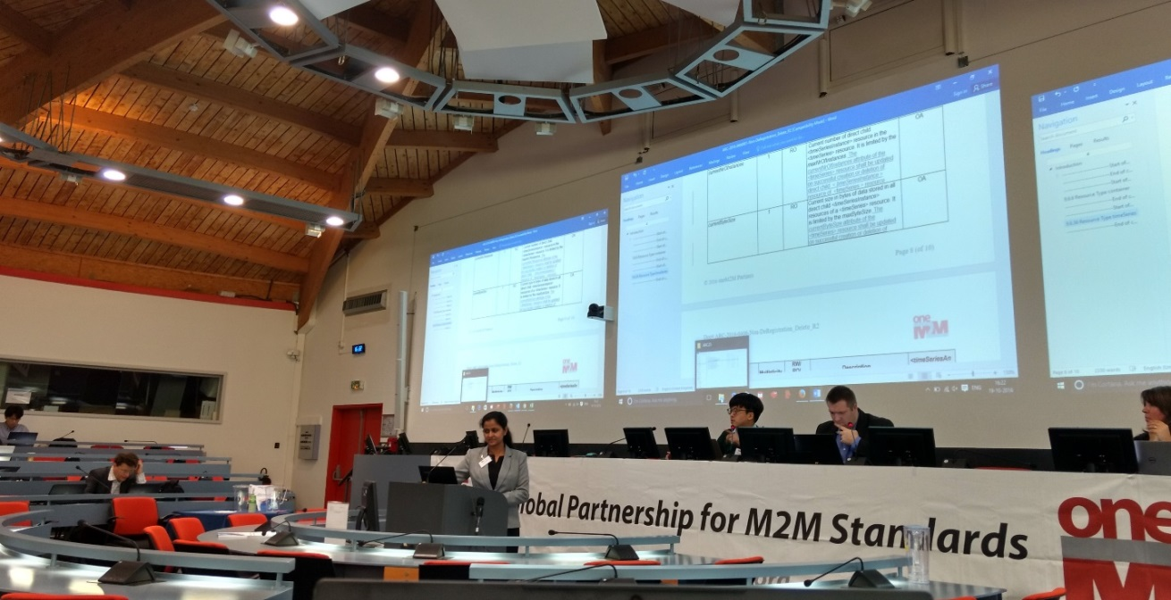
Participation in oneM2M Technical Plenary
C-DOT has been contributing in the M2M standardization process by actively participating in oneM2M discussions. C-DOT recently participated in the oneM2M Technical Plenary and made contributions in Architecture and Protocol working groups.

Slide 22
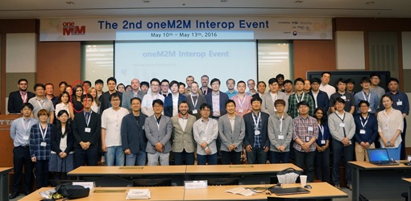
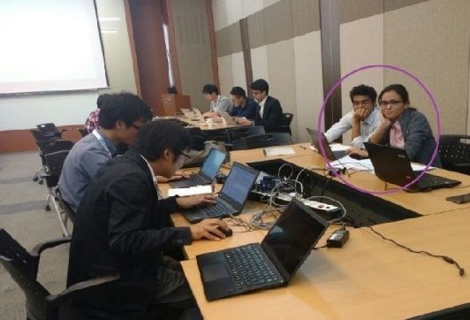
Interoperability Test event participation
C-DOT participated in oneM2M Interop Events
2nd Interop Event held in South Korea
3rd Interop Event Held in Kobe, Japan
4th Interop Event held in Taipei, Taiwan
5th Interop Event held in South Korea

Slide 23
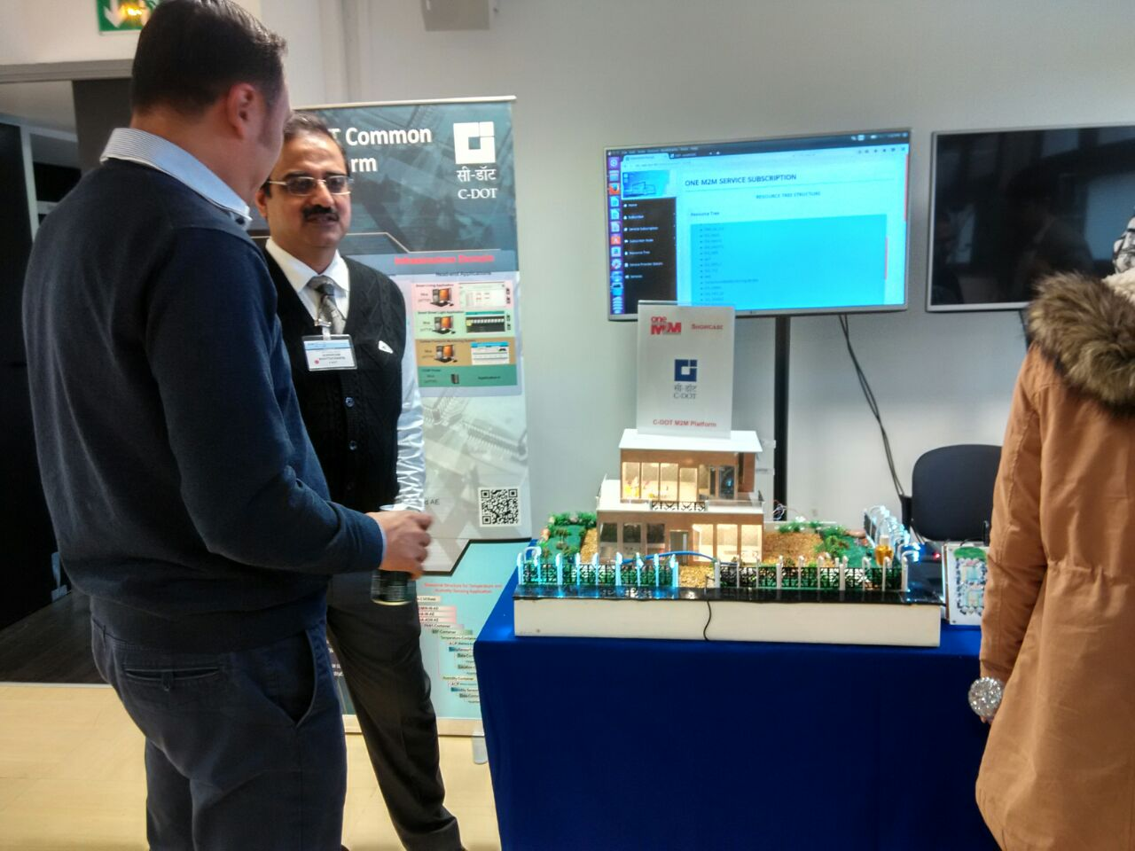
Participated in ETSI IoT/M2M workshop 2016 featuring the smart world.
Showcase event was held in Sophia Antipolis, France
C-DOT displayed its ADNs and IN in a smart city solution based on oneM2M standard .

Slide 24
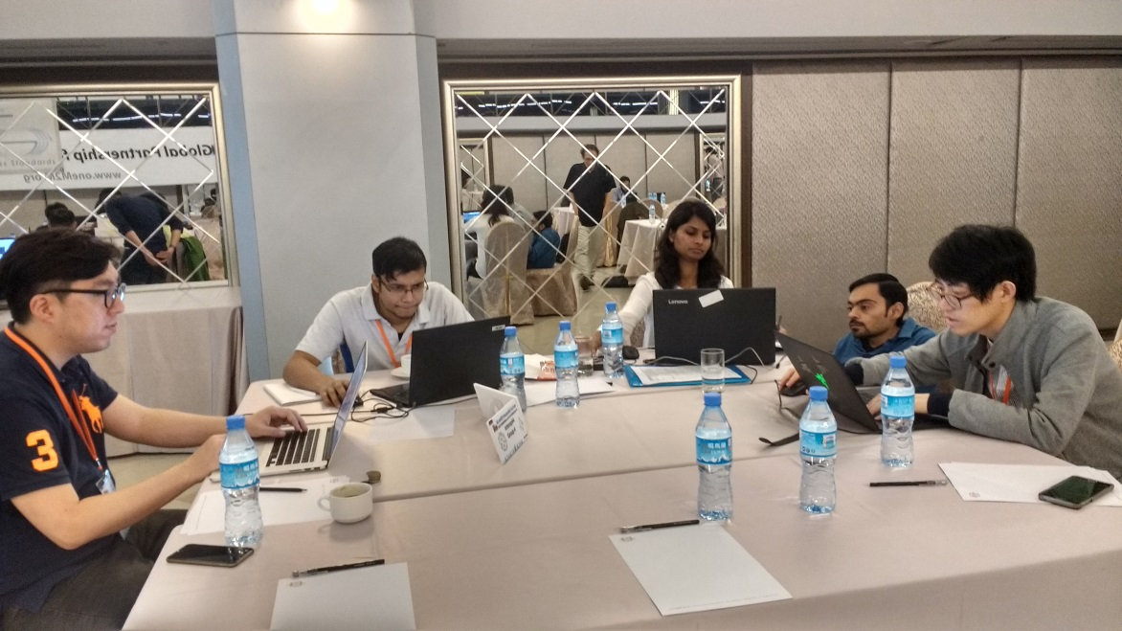
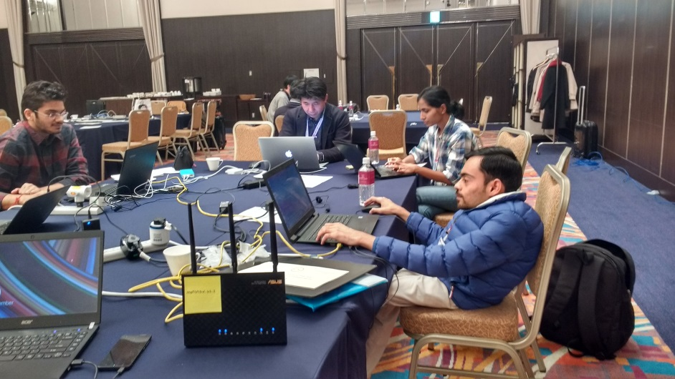
Interoperability Test event participation
CCSP Interoperability testing was held with
Interdigital
LAAS-CRNS, France
HPE
NTT – Japan
KETI, Korea
DEKRA - Germany
III – Institute for Information Industry
Sejong University
Conformance testing of CCSP
with ETSI was with ETSI

Slide 25
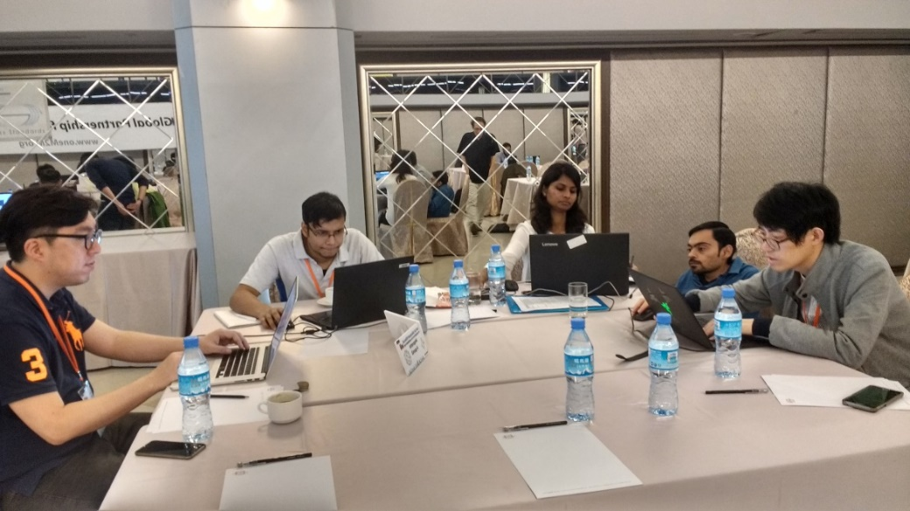
oneM2M Interop Test Event 4 held in Taiwan
C-DOT participated in Interop Test Event 4 held in Taiwan from 16 to 19th May 2017

Slide 26
oneM2M Interop Test Event 5 held in South Korea in Dec 2017

Slide 27
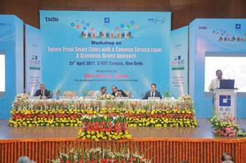
Iot in Smart Cities event held in Apr 2017
India-EU Partnership Project on Cooperation for ICT Standardization
An international conference on “Future Proof Smart Cities with a Common Service Layer: a standards driven approach” was organised by the Project in CDOT, New Delhi on 21 April, 2017. Need for standards based deployments in Smart Cities was emphasised by the Govt., users and solution providers alike.

Slide 28
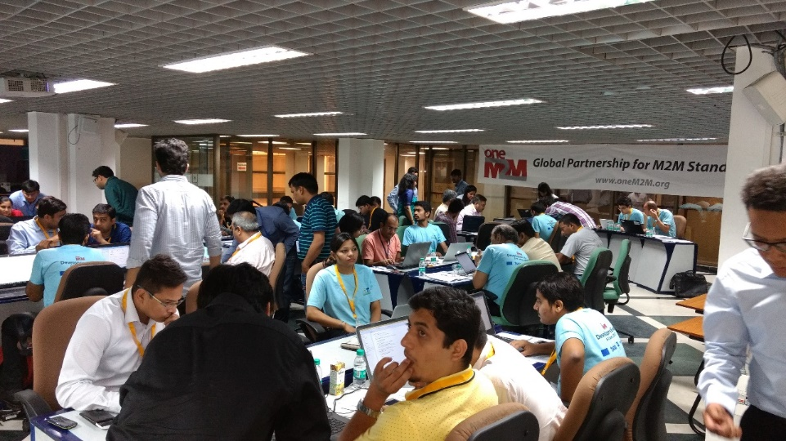
oneM2M Developer Event held in C-DOT June 2017
In June 2017 –C-DOT also held a oneM2M developer Event where persons from industry and academia participated and learnt how to write oneM2M based applications .

Slide 29
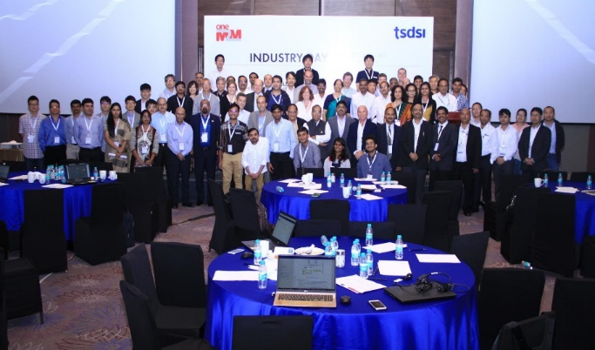
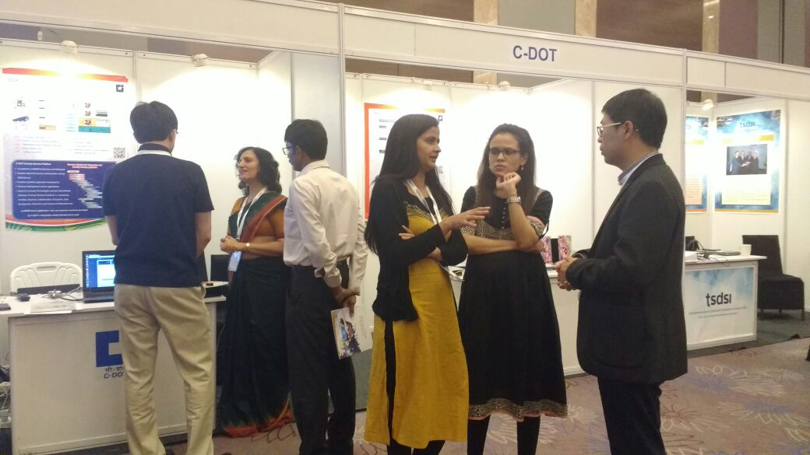
oneM2M Technical Plenary 31 and Industry Day held in Bangalore (17th to 21Sep 2017)
C-DOT is also a very active participant in various oneM2M technical Plenaries and Web conference calls for the standardization of the M2M specifications.
C-DOT has around 230 AGREED contributions in Architecture, Protocol, Security specifications of oneM2M standards .

Slide 30
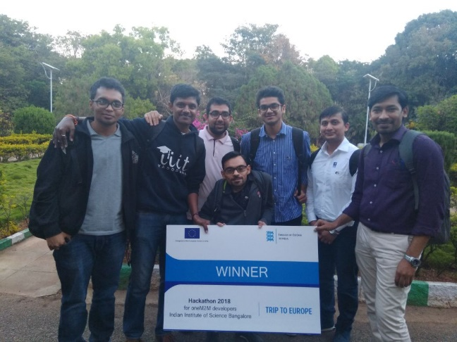
India EU ICT Standards Collaboration Project - Developers Tutorial and Hackathon Feb 2018
A multi city developer tutorial using open source implementation of oneM2M, developed by a French research lab, LAAS – CNRS was organised by India EU ICT Standards Collaboration Project.
C-DOT participated in the Hackathon held in Bengaluru and mentored the groups to help them develop the applications .

Slide 31
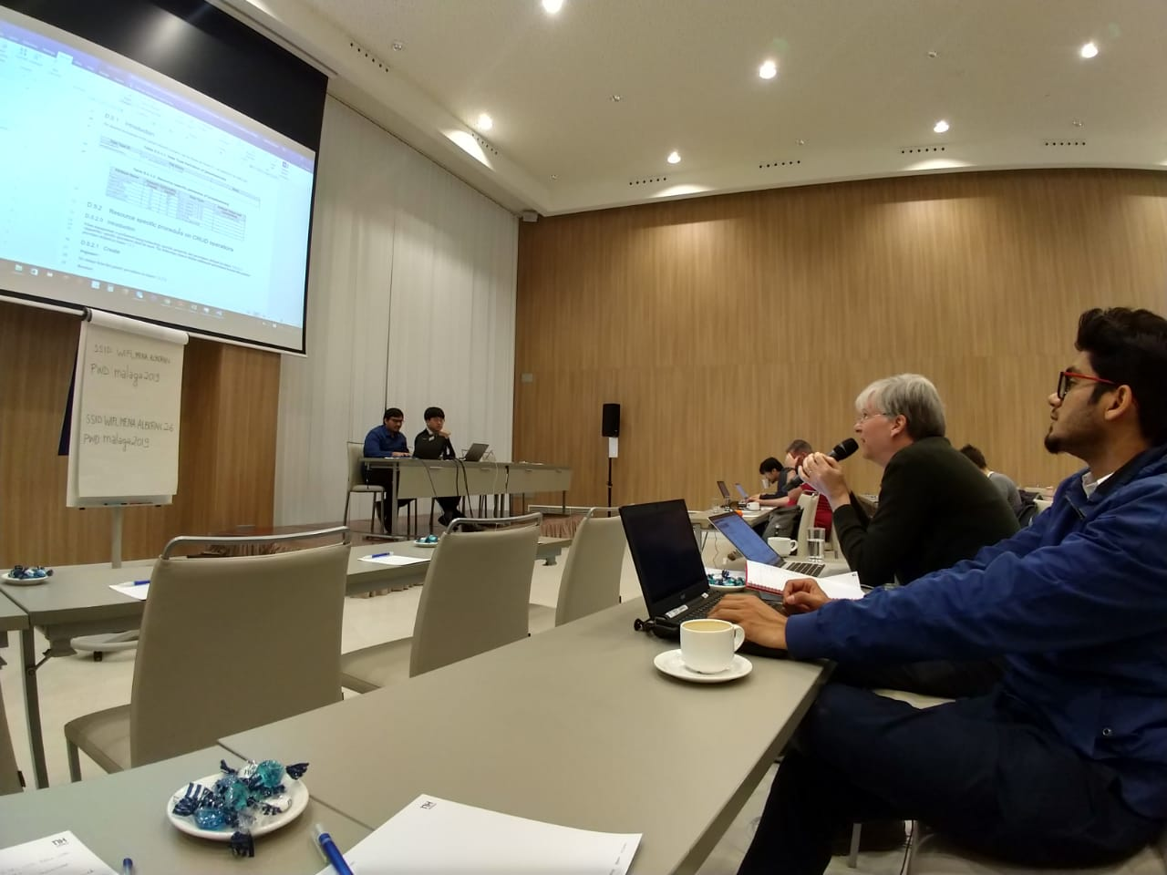
oneM2M Technical Plenary 39 held in Spain (Feb 2019)
C-DOT participated in oneM2M Technical Plenary held in Spain in Feb 2019.
C-DOT made contributions in oneM2M specification .
28 Change requests of C-DOT were AGREED in this TP taking the total tally to 235.

Slide 32
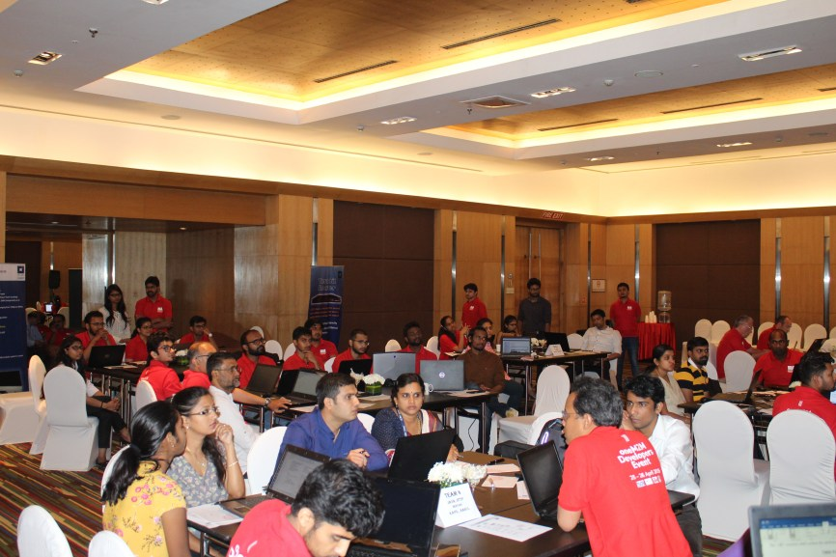
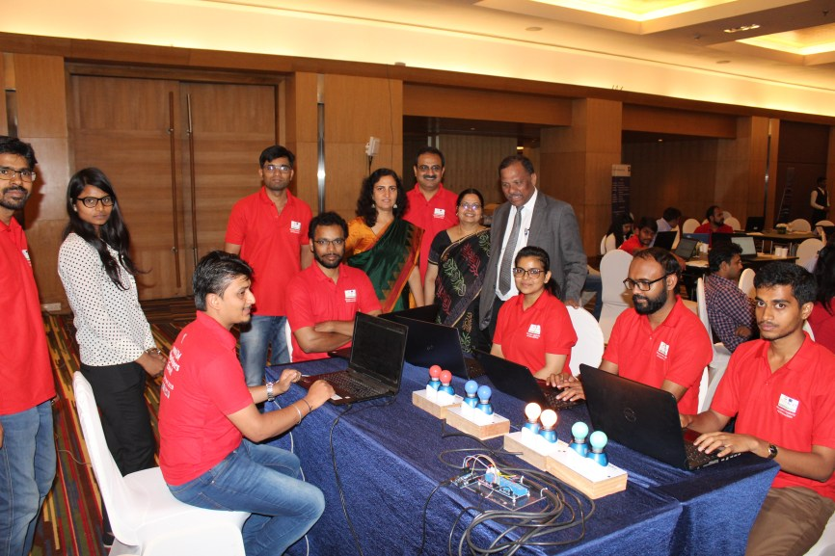
oneM2M Developer Event 2 held on 25th and 26th May 2019 at Bengaluru
About 25 S/W companies comprising of C-DAC and BEL participated in the 2nd oneM2M Developer event.
It was organised by India EU ICT Standards Collaboration Project.

Slide 33
oneM2M Conference during C-DOT Foundation Day
26th and 27th August 2019 at Delhi

Slide 34
Other Contributions
The Common Service Layer Standard P Draft was released in BIS LITD/28
Submitted recommendations for Standardisation as part of the Intelligent Transportation Committee in Niti Aayog.
Contributions in various technical Reports released from TEC
Gateway and Architecture
13 digit numbering plan for M2M communication
Communication Technologies in M2M / IoT domain
Recommendations for IoT / M2M Security
Currently Contributing in the following in TEC
Finalising IoT standards for Smart Cities
Adoption of oneM2M as National standard
IoT Experience Centre in TEC
Security by design principle and National Trust Centre for IoT

Slide 35
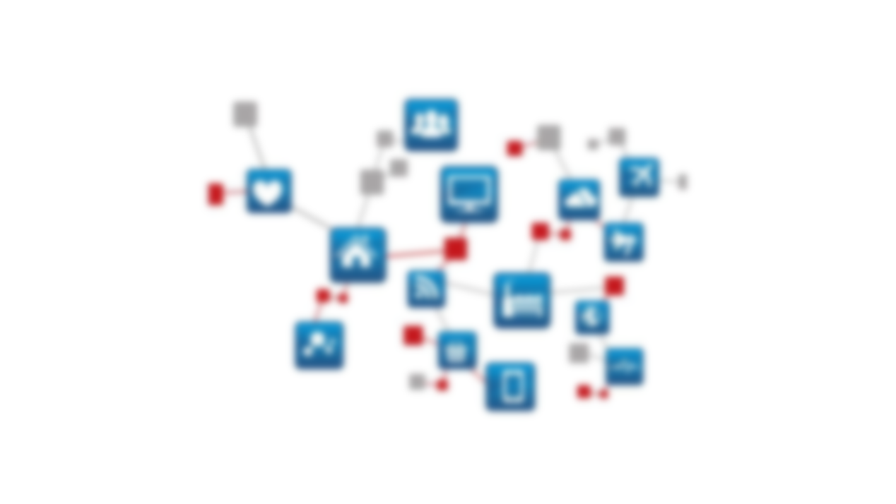
Thank You
Aurindam bhattacharya
GL, C-DOT
aurindam@cdot.in

