Slide 1
Web-site Guidance to Assist oneM2M Users
Discussion at TP#43
Ken Figueredo
4 December 2019

Slide 2
Context
Update to oneM2M.org web site scheduled for Q1-2020 represents an opportunity to refresh support provided to oneM2M users
Provide relevant oneM2M information for different audiences
Proposed Approach: Use oneM2M.org to explain oneM2M and to provide navigation links to existing resources on external sites

Slide 3
Draft of new landing page (1)

Slide 4
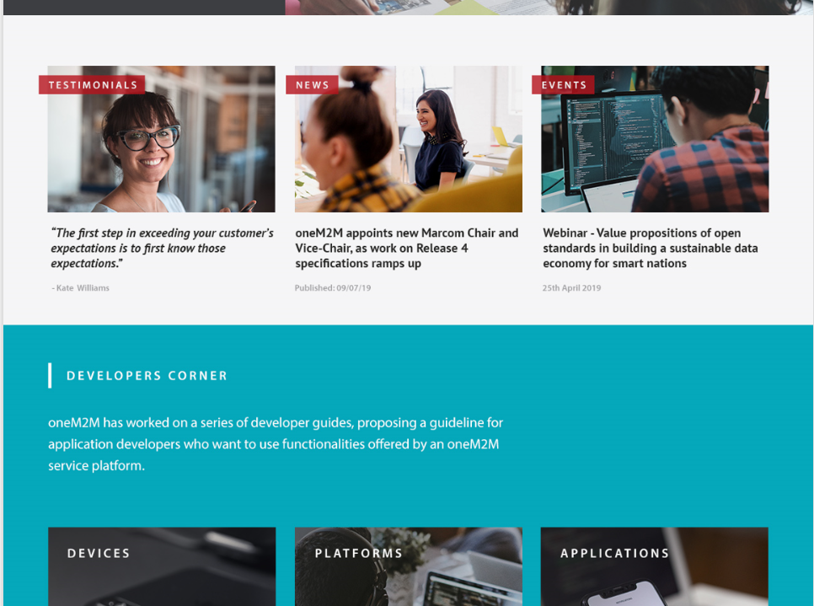
Draft of new landing page (2)

Slide 5
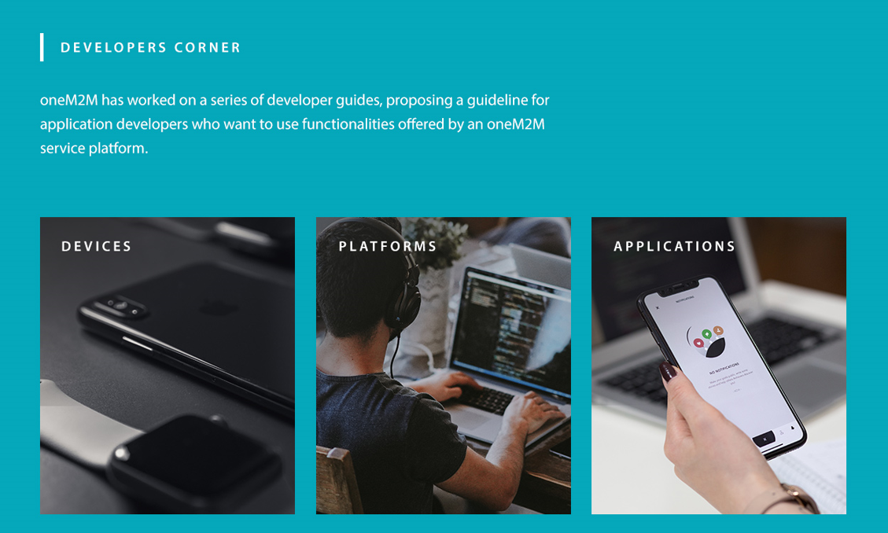
Launch point for ‘users’ (draft)

Slide 6
Information decision tree (1)
oneM2M.org
BUSINESS & PRODUCT MANAGERS
IMPLEMENTERS
USERS/APP DEVELOPERS
STANDARIZATION STAFF
I want to learn about oneM2M
I want to implement with oneM2M specifications
I want to consume oneM2M services
I want to contribute to oneM2M standardization

Slide 7
Information decision tree (2)
oneM2M.org
BUSINESS & PRODUCT MANAGERS
IMPLEMENTERS
USERS/APP DEVELOPERS
STANDARIZATION STAFF
I want to learn about oneM2M
I want to implement with oneM2M specifications
I want to consume oneM2M services
I want to contribute to oneM2M standardization
High level overview
Horizontal architecture
Animation of end-to-end use of oneM2M (Josef)
Devices community (OS-IOT.org, OCEAN CUBE etc.)
Platform community (ECLIPSE OM2M, OCEAN MOBIUS et.)
Provide scripts and access to CSE for testing e.g. Jupyter Hub (ETSI)
Example applications e.g. oneTRANSPORT.io developer guides
Direct to section on membership, specifications and events (TP calendar)

Slide 8
Information decision tree (3)
oneM2M.org
BUSINESS & PRODUCT MANAGERS
IMPLEMENTERS
USERS/APP DEVELOPERS
STANDARIZATION STAFF
I want to learn about oneM2M
I want to implement with oneM2M specifications
I want to consume oneM2M services
I want to contribute to oneM2M standardization
High level overview
Horizontal architecture
Animation of end-to-end use of oneM2M (Josef)
Devices community (OS-IOT.org, OCEAN CUBE etc.)
Platform community (ECLIPSE OM2M, OCEAN MOBIUS etc.)
Provide scripts and access to CSE for testing e.g. Jupyter Hub (ETSI)
Example applications e.g. oneTRANSPORT.io developer guides
Direct to section on membership, specifications and events (TP calendar)
Link to..
Stack Overflow using #oneM2M
OCEAN Developers
Other?

Slide 9
Other Resources to Integrate
oneM2M Developer Guides - http://www.onem2m.org/developer-guides
Jupyter Hub (Laurent and Andreas)
KETI - https://onem2m-cookbook.readthedocs.io
ATIS – Open Source IoT
CSEs - Open source and Chordant trial versions (others?)
StackOverflow (Andreas Kraft)
OCEAN – code and tools
ECLIPSE OM2M
WiKipedia - https://en.wikipedia.org/wiki/OneM2M
Others?
Need to complete this list and identify points of contact

Slide 10
Communications Channels
oneM2M.org web site
oneM2M on WiKipedia
ATIS os-iot.org
YouTube channel (SeungMyeong)
Stack Overflow
Others?
Need to complete this list and identify points of contact

Slide 11
Potential Contributors (to be confirmed)
ETSI – Laurent Velez and team
KETI – SeungMyeong Jeong
DT – Andreas Kraft
Orange (t.b.d.)
TIM – Enrico Scarrone
Sensinov (t.b.d.)
C-DOT
Chordant – Bob Flynn
LAAS/CNRS – Eclipse team (t.b.d.)
Others?

Slide 12
Next steps
Near term planning to meet web site relaunch goal of end Q1-2020
Agree on ‘decision tree’ details and coordinate with oneM2M MARCOMs on web site layout
Gather inventory of external resources
Contribute web site text and assist in reviews with MARCOMs

