Slide 1
A way forward for Zigbee Interworking
TP-2020-0010-A_way_forward_for_Zigbee_interworking
Group Name: TP#44
Source: JaeSeung Song and Sherzod Elamanov, KETI
Meeting Date: February 18, 2020

Slide 2
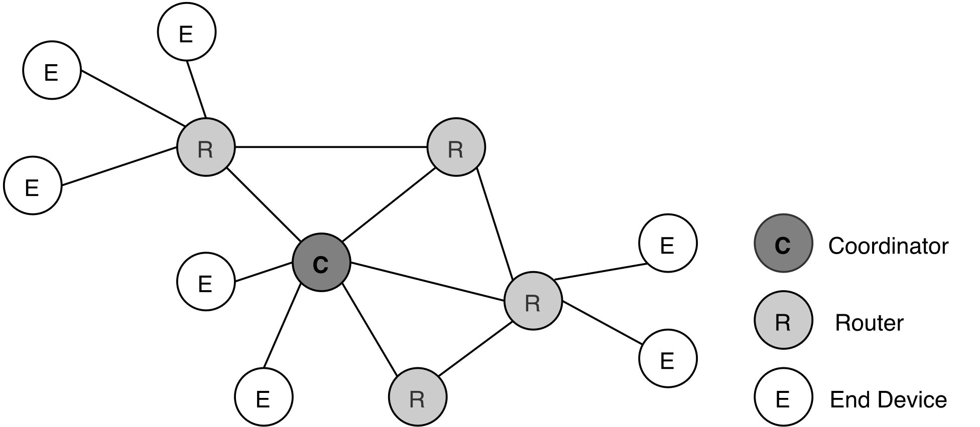
Zigbee
What is Zigbee?
A low-power, low data rate, and close proximity wireless ad-hoc network
Mainly applied in home automation
What kinds of Zigbee devices?
End Device (e.g. sensors, switches)
suitable choice for battery operated devices
has only one parent
Router (e.g. lights, smart plug)
routes traffic between different nodes
not a suitable choice for battery operated devices
Coordinator (e.g. Xiaomi gateway 3)
core node in the network
Starts the network and registers devices

Slide 3
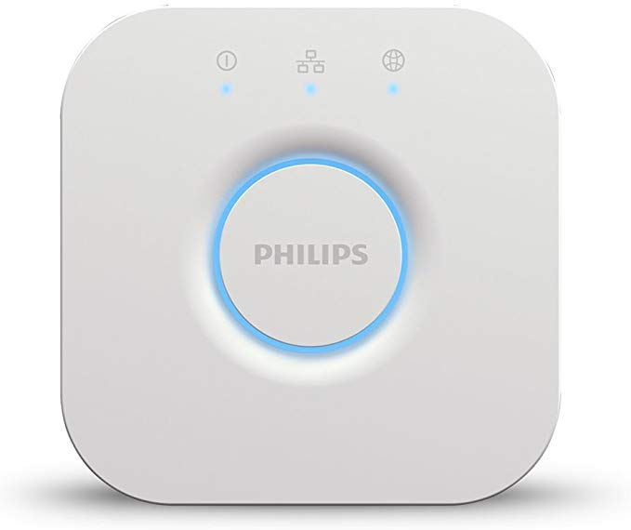
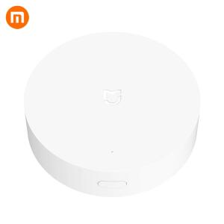
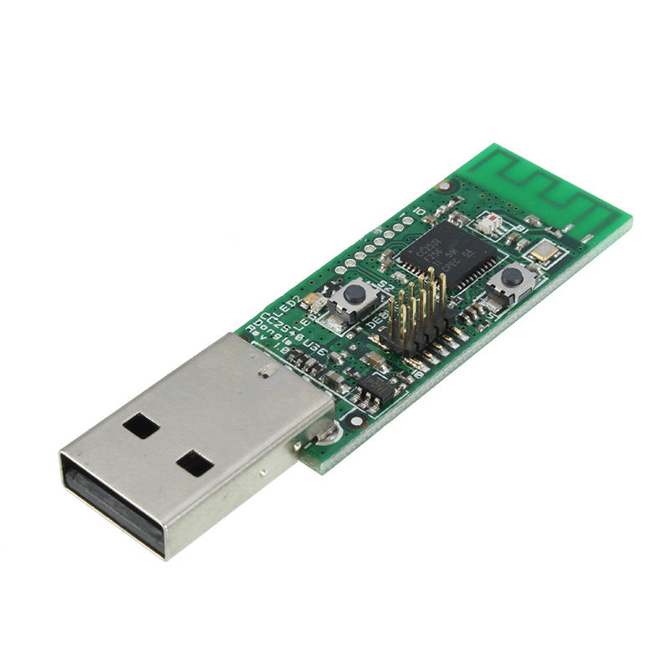
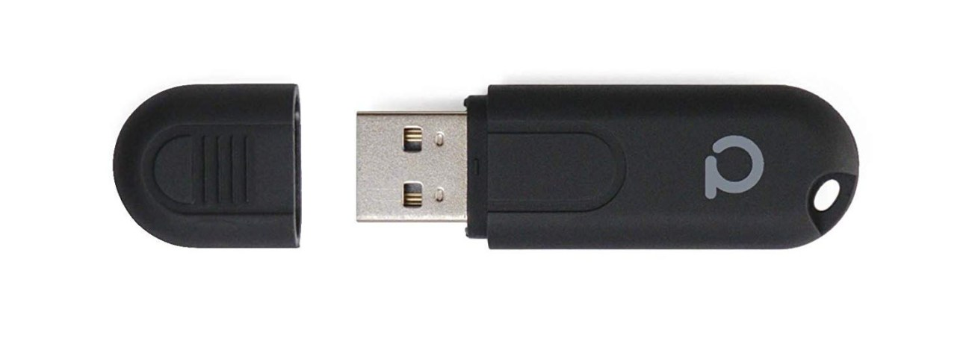
Zigbee gateway
Along with devices manufactures sell their own gateway (coordinator)
Devices can not connect to other vendors’ gateway
Custom Zigbee gateways can be used to make Zigbee devices of different vendors interoperable
Can be connected to a bigger IoT network or platform (e.g., oneM2M CSE)
Custom Zigbee gateway consists of:
Raspberry Pi
Zigbee adapter (e.g. Conbee II, CC2531)

Slide 4
How to add a Zigbee device to the network
Pairing:
A Zigbee device joins the network.
The coordinator identifies the type of the device and registers it in the database
Binding:
Allowing devices directly control each other
e.g. bind a switch to a bulb
Running:
Accessing a device through the coordinator API
e.g., control the lights from mobile application

Slide 5
Possible Zigbee interworking architecture

Slide 6
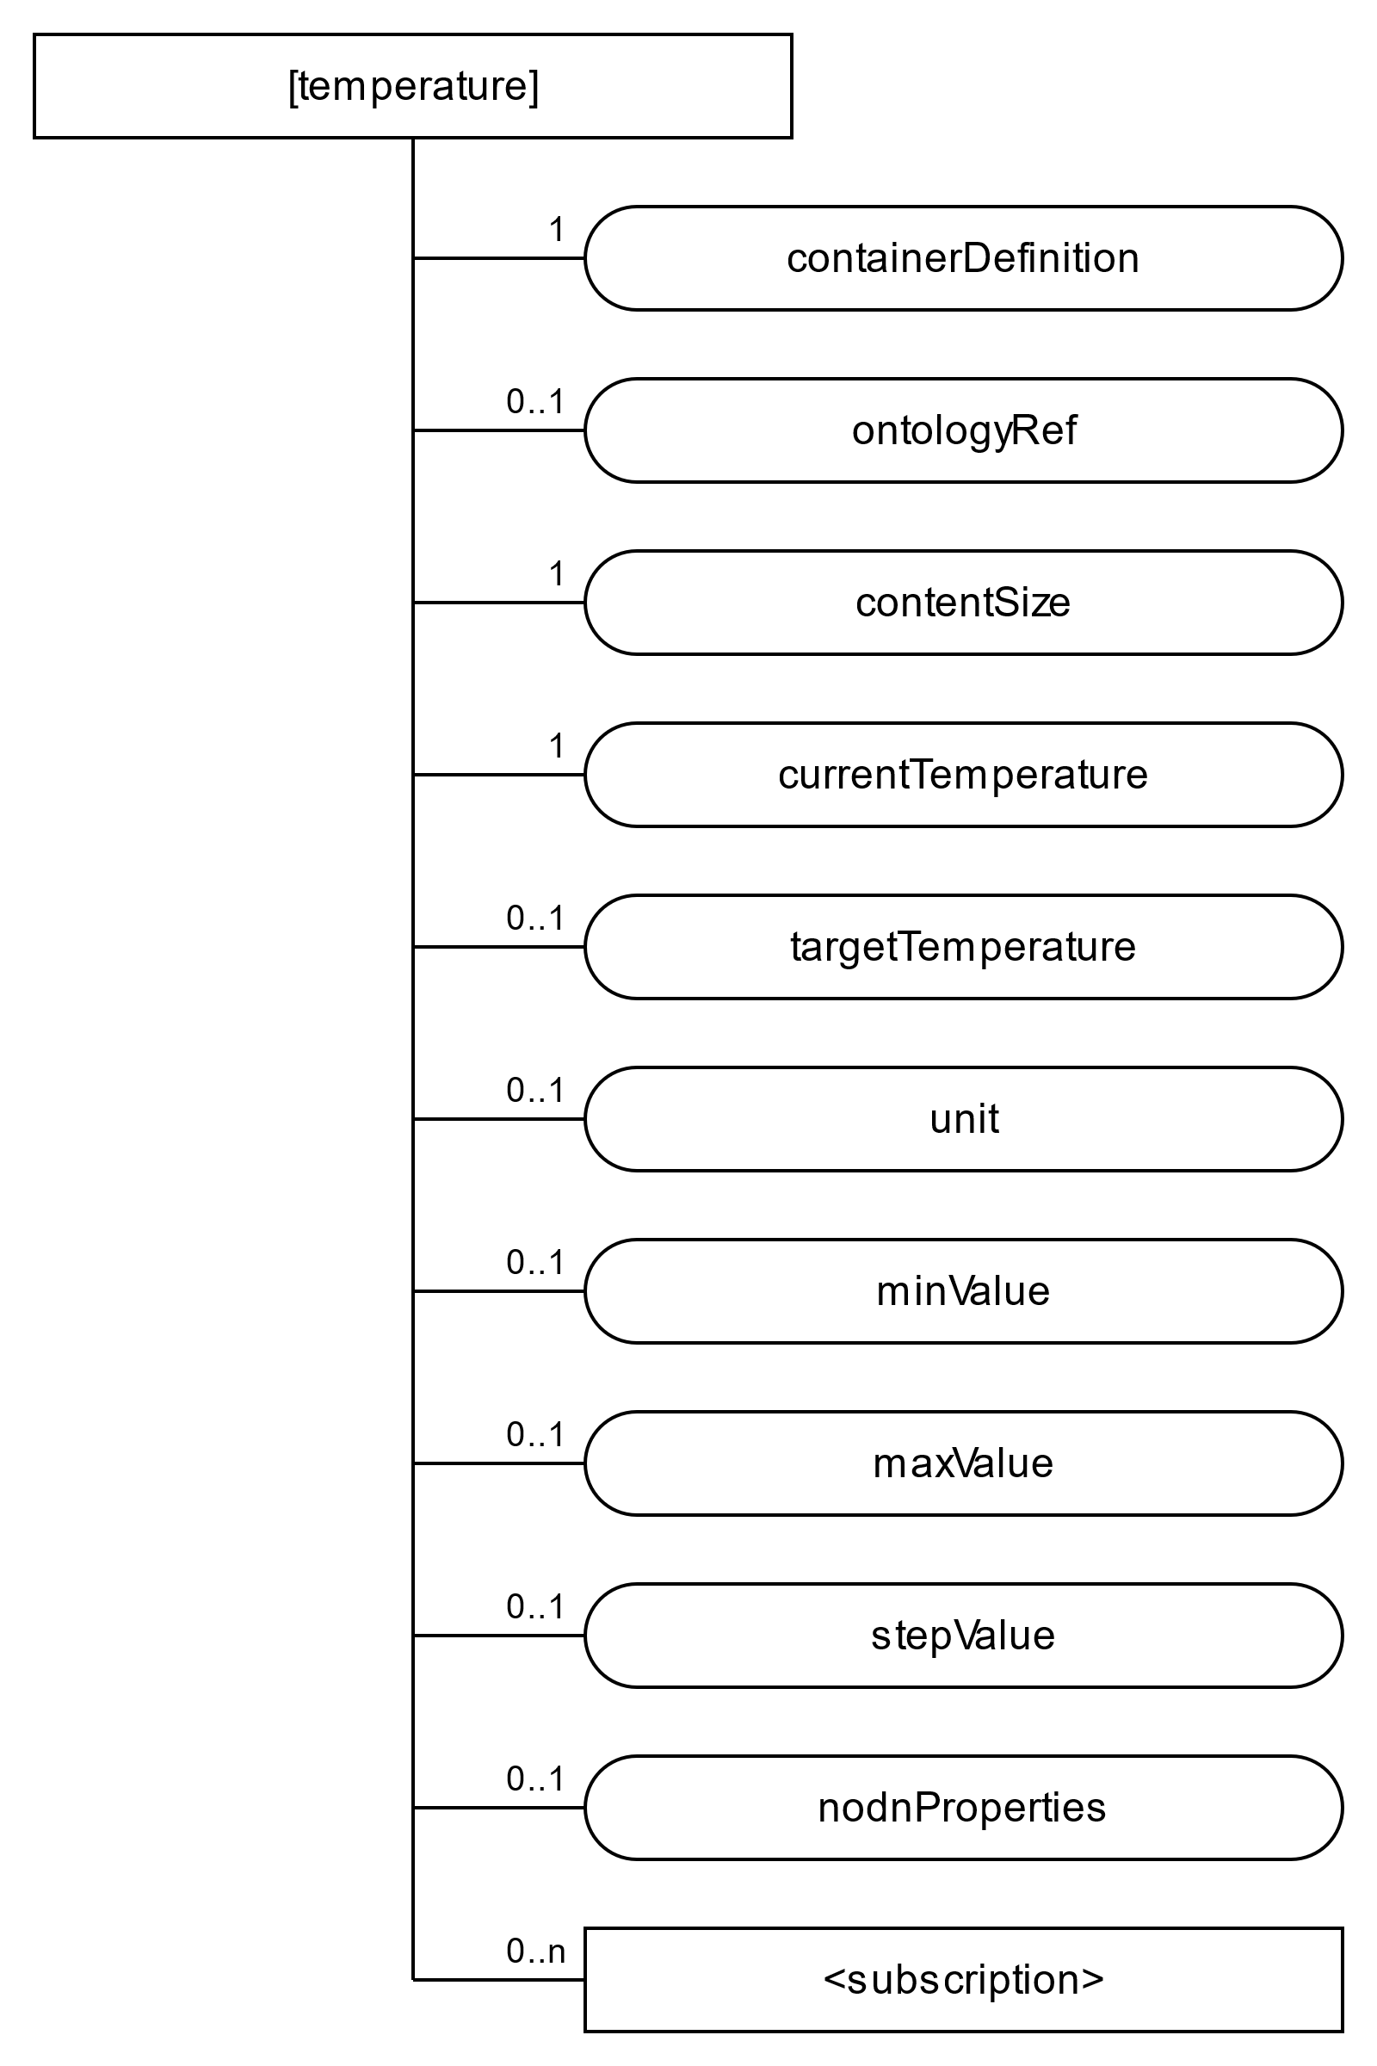
oneM2M and SDT
Zigbee Interworking can be similar to Modbus Interworking
The oneM2M resource structure can be built using Smart Device Template (SDT)
nodnProperties is an extra flexContainer attribute that stores Zigbee interworking information
i.e., mapping between attributes and corresponding Zigbee data

Slide 7
Plans for the Technical Report
Create a detailed report based on interworking of real Zigbee devices and oneM2M (something like developer’s tutorial).
Use case:
A mini smart home environment
The use case configuration includes following Zigbee devices:
Light
Switch
A temperature & humidity sensor

Slide 8
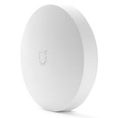
A possible demo configuration
Needs alibrary that provides a simple MQTT interface to interact with Zigbee devices through a custom gateway → Zigbee2mqtt library
Runs on the custom gateway (Raspberry Pi)
Supports a wide range of devices from different vendors
Can be connected to oneM2M CSE through MQTT broker
Zigbee
Zigbee IPE (Raspberry Pi)
oneM2M
IN-CSE
Zigbee2mqtt
MQTT broker
oneM2M AE
mca
Zigbee

Slide 9
Plans for the Technical Report
Functional capabilities of ADN-AE user application to be created:
Managing network (e.g. ON/OFF access for new devices join)
Binding devices (e.g. interconnecting bulb & switch)
Reading from a device
Writing to a device
The report shall include:
Use case configuration
Resource structure
IPE working principle
Mapping of oneM2M to Zigbee2mqtt library
Procedures for ADN-AE user application to interact with the system

