Slide 1
Smart Home and Project Connected Home over IP
Honoré Ventures
InDiCo Project Team
July 24th. 2020

Slide 2
Smart Home Market: a huge opportunity
Smart Home is the second largest market in the TMT Industry after wireless data
Expected to reach $150B in 2023 from $100B in 2019 (11% CAGR)
Geography split: North America (40%), APAC (30%) and EU (20%)
Larger than other major consumer digital segments: OTT Video, Digital Music, Digital Games, Pay TV
Revenue split: 70% from devices and 30% from services

Slide 3
Smart Home market segments
Security and Safety (7.1% penetration rate in the US):
  IP Cameras (indoor/outdoor/doorbell), Sensor (doors/windows), Smart locks
Utilities Management (5.3% penetration rate in the US)
  Thermostat, Lights (Switch and bulbs), Power outlets, Various sensors for leak detections (water, gas)
Smart Appliances (1.8% penetration rate in the US)
  Kitchen: Cookware, Fridge, Dishwasher, Laundry room: Washer/Dryer, vacuum cleaner, Bathroom: smart scale, smart mirrors, connected toothbrush
  Source: Mc Kinsey Connected Home Study

Slide 4
Current status of the smart home market
The smart home market remains stuck in the early adopter phase of the product life cycle.
Market is very fragmented with inconsistent performance
Many competing technologies which are mostly incompatible
Customers struggle with what choice to make when choosing a product and it creates a lot of frustrations

Slide 5
Smart Speakers: becoming the Smart Home hub
Only true smart home mass market device: 147 million units sold in 2019 (+70% vs, 2018)
Smart Speakers coupled with AI-Assistants are rapidly becoming the smart home hub from where you can control all your connected devices with a simple voice command
Amazon’s Echo Dot is the leader with 25% market share in 2019. Google Nest speakers 20% and Apple’s Homepod 4% market share.
Chinese vendors remain dominant in China: Baidu, Alibaba and Xiaomi
Other AI Assistants include: Samsung Bixby, Microsoft Cortana, Telefonica’s Aura (leader in Spain).
Smart Speakers bring AI into the home positioning tech giants at the cornerstone of the future smart home market
Source: Strategy Analytics

Slide 6
AI-assistants
Application program that understand natural language voice commands and complete tasks for the user.
Smart conversational AI is becoming the preferred UI for smart home
Besides controlling the smart home devices through voice, AI-Assistants can provide a wide variety of services: provide weather, facts from the web, set an alarm or a time, make to-do lists or shopping lists, play music from streaming services (ex: Spotify/Pandora/apple/Amazon) or radio stations, read audio books, play video, TV shows, movies from streaming services (Ex: Netflix/Amazon Video).

Slide 7






Recent market trends for smart speakers
AI-assistants are being increasingly integrated into third party speaker devices. Category leaders for Bluetooth Speakers (Bose, Logitech, JBL,…) are now able to compete head-to-head with Amazon and Google devices.
At the same time, Multiple AI-assistant are being integrated on the same speaker and used interchangeably (example: Sonos One speaker with Alexa and Google Assistant)
  Differentiation will be less through devices and more through AI-based services
  Large potential for future AI-based services based on personalization: face recognition, emotion/mood recognition, AI assistant acting as a friend, health monitoring, help to manage household bills,etc…

Slide 8
Summary smart home communication protocols

Slide 9
Existing Smart Home situation is a challenge !
Numerous technologies for wireless connectivity at all levels of the network stack
Each major platform provider (Amazon, Apple and Google) have implemented different approaches that are incompatible
Device manufacturers and application developers incurs significant cost and overhead as they have to choose which platform to work with.
Consumers struggle with what choice to make when purchasing a smart home product. Fragmentation, inconsistent performance and interoperability issues creates lots of frustration
Does not benefit consumers and not conducive to optimal market growth

Slide 10
What is Project Connected Home over IP ?
Project CHIP was announced in December 2019 in a joint release by Amazon, Apple, Google, and the Zigbee Alliance
It is a new working group within the Zigbee Alliance that is committed to create a new universal application layer for the smart home ecosystem
An open-source & royalty free approach to increase compatibility among smart home products with security as a fundamental design tenet
It is built on IP and designed to enable smart home devices, mobile apps and cloud services to communicate seamlessly
The goal is to unify and possibly in time replace homegrown application layers like Amazon’s Alexa Home, Apple’s Homekit, Google’s Weave or Dotdot for the Zigbee Alliance.

Slide 11
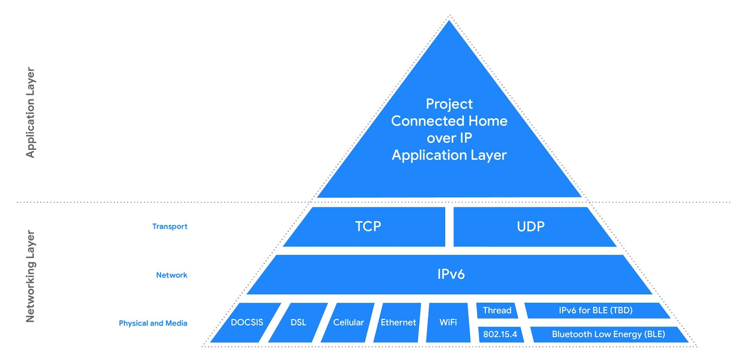
Where is CHIP in the OSI model ?
Source: Google Developers

Slide 12
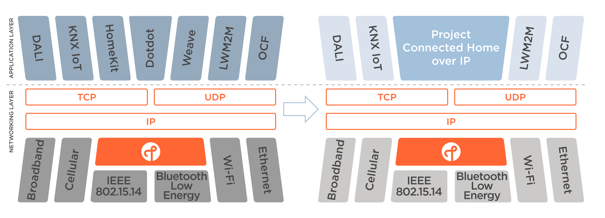
Thread and Project CHIP
Source: The Thread Group

Slide 13
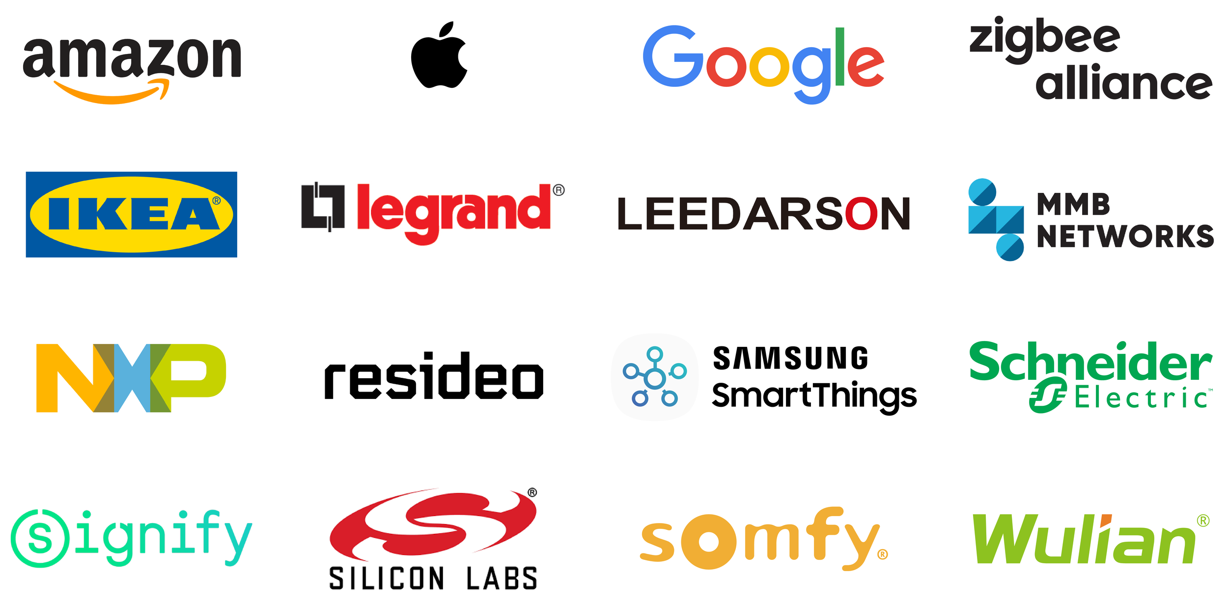
Companies participating in the Project Connected Home over IP (CHIP)

Slide 14
What are the benefits of CHIP ?
Project CHIP is expected to bring the following benefits to the Smart Home ecosystem (device manufacturers, application developers and consumers).
Unified product out of the box experience
The goal is to have a platform and ecosystem agnostic technology (any device, any ecosystem): the consumer device of choice will work in their home with the ability to do setup and control from their preferred system.
Use of IPv6 for scalability. Each device will have its own IP address and able to connect directly with standardized networking equipment.
CHIP will make it easier for developer to build a device that is compatible with most smart home services such as Amazon Alexa, Apple Siri and Google Assistant and others
CHIP will create a unified data model for the rest of the industry to possibly adopt

Slide 15
Smart Home in 2023 if CHIP succeeds
Device manufacturers build single SKU devices that give a plug-and-play experience right out of the box independent from the network and applications used
Consumers select devices based on features and quality without worrying about network and application compatibility
Consumers have the choice at any time to use Alexa, Siri, Google Assistant or other compatible applications to control any of their devices. Full portability of AI-Assistants.
Price of devices drops as manufacturers build fewer SKUs at higher volumes
Special hubs and gateways are no longer needed since every device is addressable directly through IPv6

Slide 16
Can CHIP standardization efforts succeed ?
Past standardization efforts to unify the application layer have had little success
Why is CHIP different ?
  Backed by a critical mass of very large companies: Amazon, Apple, Google
  Build on market proven radio protocols (initially 802.15.4/WiFi/IP-based Bluetooth) with a very rich chipset manufacturer ecosystem
  Based on market proven IPv6/TCP/UDP network and transport protocols
  Amazon, Apple and Google are officializing a strategic transition to an open ecosystem (open source/royalty free). Putting in common their proprietary application layers (Homekit/Alexa Home/Weave) to build the new universal application layer (yet to be named)

Slide 17
Conclusion
Smart Home is one of the largest opportunity in the digital consumer market but still in the early adoption stage.
Smart speaker is the only is mass market device with 30+% penetration rates in the US/Western Europe and becoming the smart home hub quickening the transition to an AI-driven smart home and positioning tech giants like Amazon, Apple and Google at the cornerstone of the smart home market
Smart home vendors will deepen differentiation through AI-services.
In this context, Project Connected Home over IP aims at unifying the application layer while relying on existing radio technologies (starting with IEEE802.15.4/WiFi/ Bluetooth) and IP protocols at the network and transport layers (IPv6 and TCP/UDP).
The application Layer is the last frontier that if properly unified through the right protocols & standardizations could remove the last friction for a true mass market adoption of smart home technologies.

