Slide 1
ETSI & 3GPP Collaborative Drafting Platform (New Working Methods Project)
NWM Team
oneM2M
30.11.2021

Slide 2
The motivation behind NWM
  By taking advantage of modern collaboration and drafting approaches NWM hopes to achieve the following:
    To help ETSI & 3GPP committees to draft and maintain standards as efficiently as possible;
    To ensure the highest editorial and technical quality of our Deliverables;
    To facilitate closer integration with Member working practices;
    To give an added value for end-users;
    To enable increased throughput by the ETSI Secretariat;
    To be attractive to the next generation of standardizers.

Slide 3
Key Features of NWM
  Collaboratively writing, reviewing, approving and updating (standardization) documents
    Private drafting of proposals for change, sharing, reviewing, revising, approving and integration into base document
    Automated integration of agreed changes
  Support for discussion & consensus-building
  Separate style from content
  Configurable workflows and document lifecycles
  Validation of document contents against a set of quality rules
  Flexible output formats
  Full traceability of all changes to documents

Slide 4

NWM - in a nutshell
STF Leader
Share
Chair
Delegates
EditHelp
Technical Officers
Rapporteur

Slide 5
Various drafting scenarios
Only meeting based
Quality
Start
Approval
Meeting based with significant interim drafting
Quality
NWM concept allows for
  24/7 collaboration – drafting, discussion and consensus building
  Continuous (automated) integration of variants
  Automated Quality
  Full transparency
  Added value
  ……
Start
Approval
Continuous drafting - no meetings except formal approval
Quality
Start
Approval
Continuous drafting with heavy parallelism
Quality
Start
Approval

Slide 6
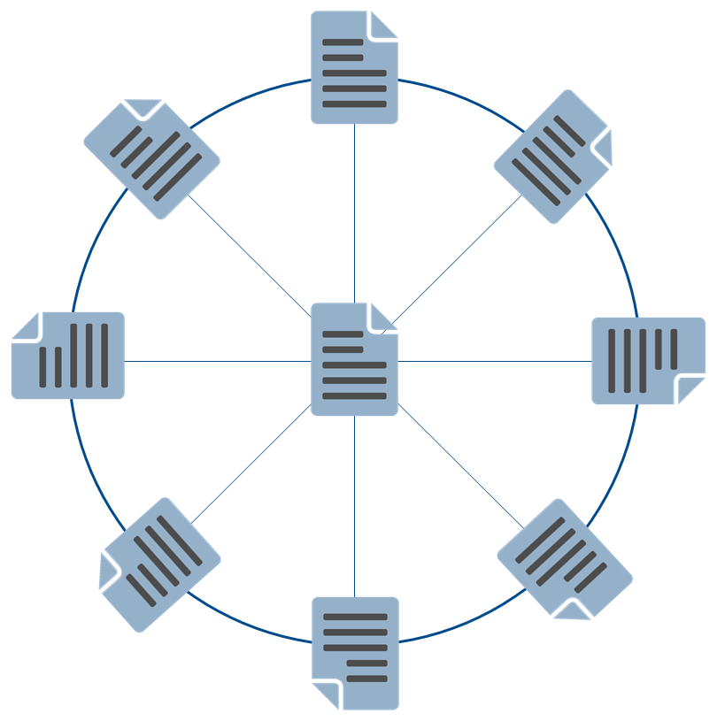
In-Document User Experience
User Tagging
Identification of Requirements,
Features, Capabilities and more
Personal Annotations
Publishing
Various publication formats
Customized rendering
Continuous Quality & Integration
Check and application of EDR rules
Conflict detection
Assisted CR Integration
Customizable Processes
Configurable workflows
Editing modes depending on drafting groups
Context related User Actions
Traceability & Data Mining
Document History
Metrics
Assisted building of agendas, meeting minutes and work plans
24/7 Collaboration
Embedded discussion threads
Navigation between variants
Identification of overlapping variants
Highlight of changes
Decisions
Linked Document Elements
Consistent References, Abbreviations, Terms
Cross document navigation
Accessibility
Accessible standards
Accessible platform
ETSI 301 549

Slide 7
Current Focus:
3GPP

Slide 8
NWM Trial Version
Trial version of NWM available
Access it at: https://nwm-trial.etsi.org
  User ETSI Portal or 3GU username/password to log in
Help files & documentation: https://nwmwiki.etsi.org/docs
Report an issue or suggest a new feature: https://etsinwm.ideas.aha.io/

Slide 9
Near-term Project Focus
2021 focus on support for 3GPP online discussions
  Improve workflow, save time and trial NWM functionality in less critical scenarios
  Get full buy-in from members, from design to deployment of each application case
Two use cases arise:
  Discussion Summary Documents as used in RAN WGs and RAN Plenary
  Alternative to e-mail discussions for other committees
2022: Consolidate and extend functionality
Document describing two use-cases & proposed solutions
  Document on NWM: https://nwm-trial.etsi.org/#/documents/556

Slide 10
Use Case 1: RAN Discussion Summary Documents
Some committees develop Word documents as Discussion Summary Documents
  Common in RAN WGs and RAN plenary
  Moderator prepares a discussion summary document in Inbox folder
    Could be based on e-mail discussion or on Tdoc or CR contributions
  Each member updates file with their comments/position & saves in Inbox folder with new name
  Parallel updates result in multiple copies of each file with incomplete sets of comments
  10s of files for 100+ discussions each meeting
  No requirement to retain documents – only in Inbox folder.
    Outcome may be submitted as Tdoc

Slide 11
Use Case 2: Alternative to e-mail discussions
  Discussions take place by e-mail & need to be summarised
  1000s of e-mails during meeting weeks
  Delegates have difficulty following multiple discussions
    Some receive e-mail with delays
  Moderators have difficulty trawling through e-mails to generate a summary

Slide 12
Solutions proposed
Use Case 1 solution: ‘Feedback Form’ to be added to a document in NWM, allowing members to provide feedback or opinion
  One or more forms per document, each can be locked individually
  PDF Export format required – easily imported into Word
  Delegates blocked from changing content other than providing their feedback
    This can be re-enabled later
Use Case 2 will be supported through collaborative drafting functionality with complete change management workflow
  Use NWM to collaboratively build documents (e.g. Tdoc) rather than build consensus via e-mail discussions

Slide 13
NWM project management Wiki
https://nwmwiki.etsi.org/projectwiki
  Log in with ETSI EOL account
Project Steering Committee area: https://nwmwiki.etsi.org/projectwiki/index.php?title=Project_Oversight_Committee
Technical Steering Committee area: https://nwmwiki.etsi.org/projectwiki/index.php?title=Technical_Steering_Committee
About NWM: https://nwmwiki.etsi.org/projectwiki/index.php?title=About_NWM
Project Roadmap: https://nwmwiki.etsi.org/projectwiki/index.php?title=Project_Roadmap

