Slide 1
Report on 2021 oneM2M International Hackathon
oneM2M TP#52
SeungMyeong Jeong (KETI), Il-Yeup Ahn (KETI)

Slide 2
Hackathon organizers & supporters
The InDiCo project is funded by the European Union

Slide 3
Challenges
For the teams participating, the goal will be to build an IoT Solution that can help citizens, solve major environmental and society issues.
The solution must use any of the oneM2M Platforms.
To help participants build their solution, a budget is allocated per team for purchasing any HW with sensors, actuators and microcontroller
- Sponsored by KETI celebrating its 30th Anniversary

Slide 4
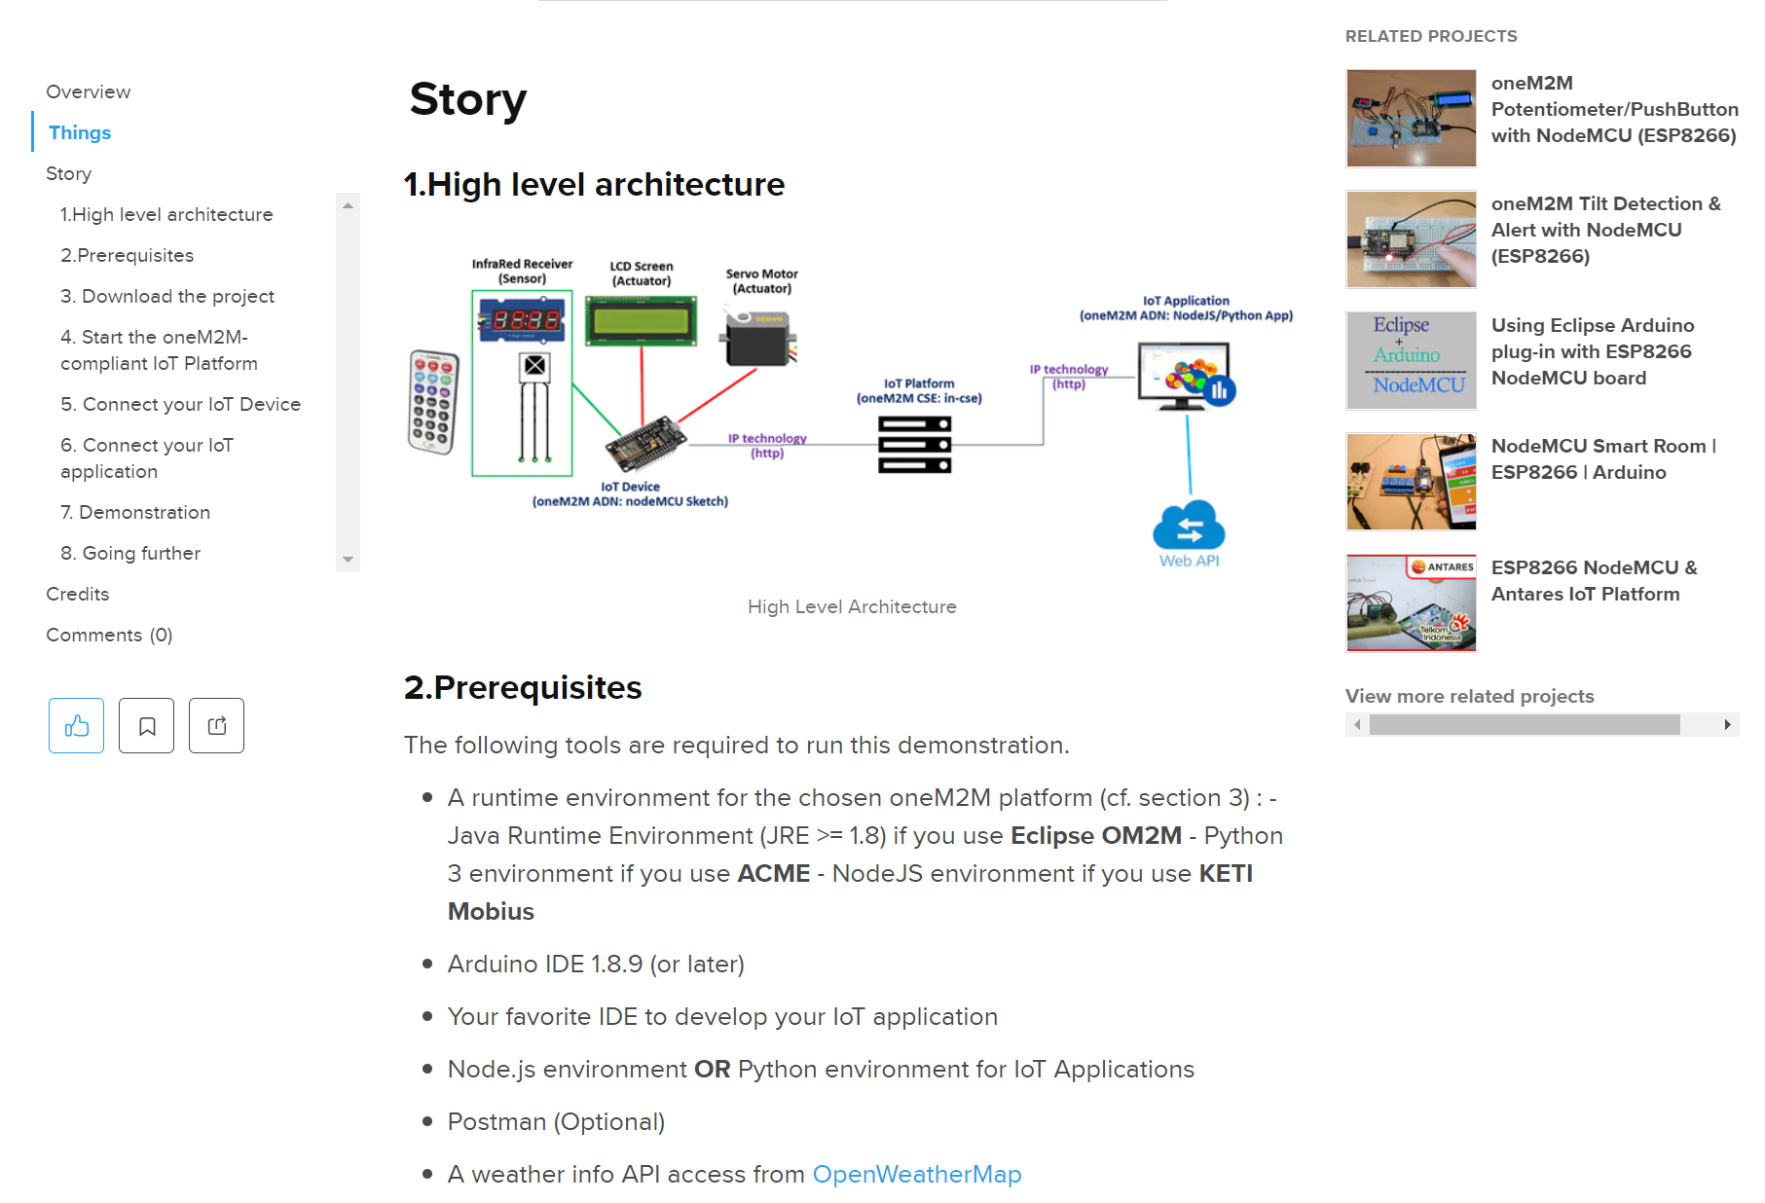
Deliverables of the projects
Each team produces :
a hackster.io project describing step by step how to build the IoT solution
Description of the issue and how the project solves it
Detailed technical description of the IoT solution
HW and SW components used
Step by step user guide
A short video (< 5 min) showing the solution in action

Slide 5
Communications
Microsoft TEAMS Workspace to exchange information
A Microsoft account (from university or personal) is required
TEAMS Chat as preferable way to contact the organizers
Private channels are possible
Each team will get his/her own private repo. for sharing documents or codes

Slide 6
Teaching materials
oneM2M advanced tutorial 2020 (LoRa, dashboard, etc)
https://www.youtube.com/playlist?list=PLDd4EJmw5gUlIXL0oek7RicHC5iFGfh1Z
Hyderabad university tutorial
https://mooc.indiaeu-ictstandards.in/courses/onem2m/
Additional materials will be given via the TEAMS channel

Slide 7
Getting started with oneM2M – TR-0057
Draft Guide (under development) : https://member.onem2m.org/Application/documentapp/downloadLatestRevision/default.aspx?docID=33407
This work will provide high level descriptions of the main functionalities and features of the oneM2M service platform.
It should be considered as an “entry point” before going more deeply to the standards.

Slide 8
Developer resources
Hackster.io https://www.hackster.io/onem2m
oneM2M tutorial (with virtual SW devices, Luminosity detector): https://www.hackster.io/benalayamahdi/onem2m-tutorial-8c87e5
oneM2M Tilt Detection & Alert with NodeMCU (ESP8266) (with HW kit): https://www.hackster.io/samir-medjiah/onem2m-tilt-detection-alert-with-nodemcu-esp8266-7a5223
oneM2M demo (with HW kit: Luminosity detector): https://www.hackster.io/onem2m/onem2m-demo-57022e
oneM2M Potentiometer/PushButton/LCD with NodeMCU (ESP8266) : https://www.hackster.io/samir-medjiah/onem2m-potentiometer-pushbutton-lcd-with-nodemcu-esp8266-1ea20a
oneM2M RemoteControler/ServoMotor with NodeMCU (ESP8266) : https://www.hackster.io/samir-medjiah/onem2m-remotecontroler-servomotor-with-nodemcu-esp8266-db4be3

Slide 9
Developer resources
https://github.com/oneM2M-Tutorials
oneM2M-IoT-Dashboard
oneM2M-IoT-Device-Simulator
oneM2M-IoT-Application
oneM2M-IoT-Device

Slide 10
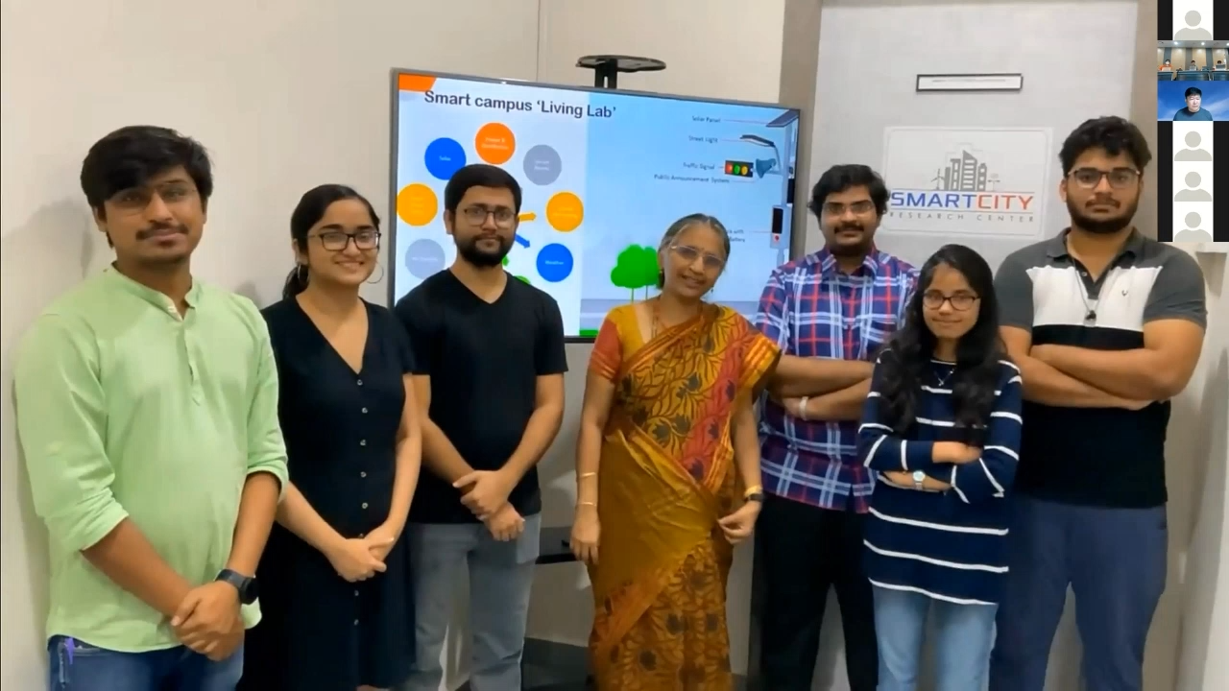
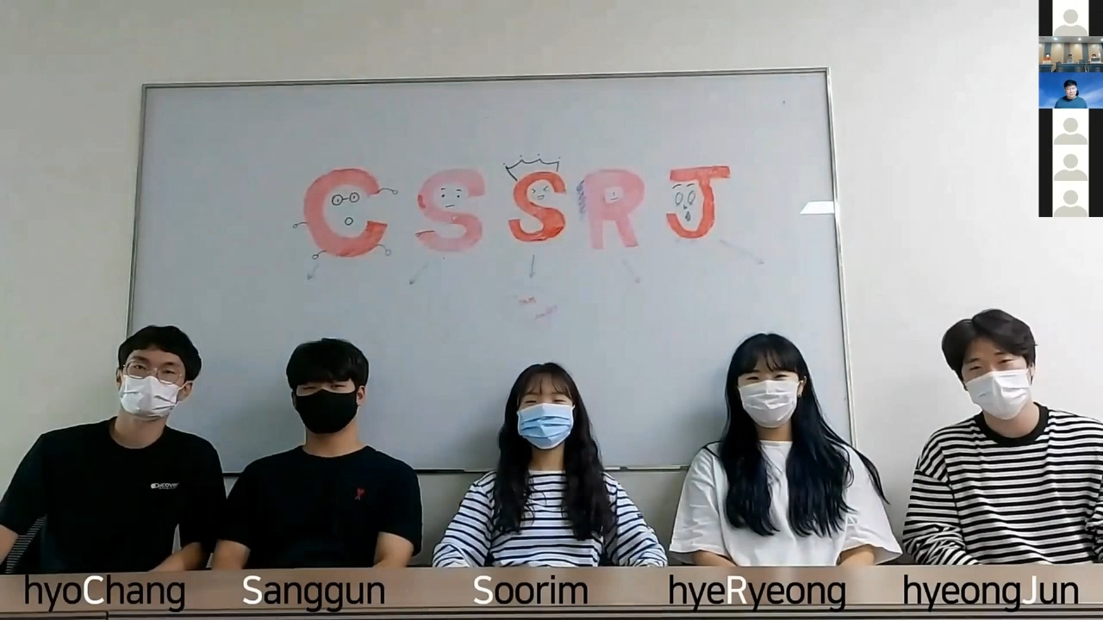
Milestones
Kick-off
30th September (8am UTC), zoom
Deliverable Submission
12th November (8am UTC), hackster.io
Closing Ceremony
17th November (8am UTC), zoom

Slide 11
Projects from the hackathon
26 projects from 6 countries
Organization | Team | Project | Deliverable
Hansung University (KR) | Mobi-Hero | Smart Working Environment Monitoring | https://www.hackster.io/mobi-hero/smart-working-environment-monitoring-with-nano-33-iot-board-3f624f
Sejong University (KR) | Byunggeon | SmartShoppingCart | https://www.hackster.io/byunggeon/smartshoppingcart-2035a5
 | Meta express bus | Virtual Store using digital twin | https://www.hackster.io/meta-express-bus/virtual-store-using-digital-twin-22d0ac
 | CSSRJ | oneM2M Autonomous cooperative smart delivery system | https://www.hackster.io/cssrj/onem2m-autonomous-cooperative-smart-delivery-system-7040d6
Shinjung Tech Consulting (KR) | echsquare | AI Recycling Machine | https://www.hackster.io/techsquare/ai-recycling-machine-22e0ef
Sooncheonhyang University (KR) | Talking Potatoes | Edu Farm | https://www.hackster.io/talking_potatoes/talking-potatoes-5e0357
 | JINDOGE | Smart pet helper | https://www.hackster.io/jindoge/mobius-int-developer-competition-60bb21
Gwangju Software Meister High School (KR) | BOEM | Birds protection with oneM2M | https://www.hackster.io/boseoggim08/saeboda-4d4671
Qilu University (CN) | QLU_1 | A smart automatic pet feeder based on OM2M | https://www.hackster.io/qlu_1/a-smart-automatic-pet-feeder-based-on-om2m-1c1a73
 | QLU_2 (No Error No Waring) | Succulent Care System based on oneM2M | https://www.hackster.io/no-error-no-waring/noerror-qlu-edu-d85749
 | QLU_3 (we love bug) | Water quality monitoring system | https://www.hackster.io/we-love-bug/onem2m-we-love-bug-2624d0
Penn State (US) | PENN_1 | Cellular IoT Irrigation System | https://www.hackster.io/psu-capstone-pj3c/cellular-iot-irrigation-system-for-onem2m-nordic-thingy-91-5cfc14

Slide 12
Projects from the hackathon
Organization | Team | Project | Deliverable
INSA Toulouse (FR) | INSA_ 1 (HAKA) | smart crop monitoring and growth management | https://www.hackster.io/haka/keti-hackathon-smart-crop-monitoring-and-growth-management-877d14
 | INSA_ 2 (AJATA) | Safe city for cyclists | https://www.hackster.io/ajata/safe-city-for-cyclists-8f49dc
 | INSA_ 3 (INGE-CONNECTES) | Wearable wristband for the monitoring of elderly healthcare | https://www.hackster.io/inge-connectes-engineers-of-things/wearable-wristband-for-the-monitoring-of-elderly-healthcare-933229?
 | INSA_ 4 (Smart home monitoring) | Monitoring toxic gases with OM2M | https://www.hackster.io/smart-home-monitoring-insa-toulouse/monitoring-toxic-gases-with-om2m-397c26
 | INSA_ 5 | Smart home for reduced mobility people | https://www.hackster.io/432509/smart-home-for-reduced-mobility-people-with-onem2m-esp8266-d41ec5
 | INSA_ 6 (Rubber Ducks) | Vehicloud - Monitoring our city | https://www.hackster.io/rubber-ducks/vehicloud-monitoring-our-city-339c02
ISEN YNCREA (FR) | ISEN_1 | Trash tracker | https://www.hackster.io/431035/trash-tracker-2021-international-onem2m-hackathon-8c5852
IUT Toulouse - University Paul Sabatier (FR) | FranC++ | oneM2M Smart Crossroad with NodeMCU | https://www.hackster.io/franc/onem2m-smart-crossroad-with-nodemcu-esp8266-8a4029
 | Tekyl | COVID BOX oneM2M | https://www.hackster.io/tekyl/covid-box-onem2m-1b2245
University Cote d’Azur side – Institute of technology (FR) | IOTIA 2 | Hephaestus :OneM2M infrastructure for fire Detection & Alarm | https://www.hackster.io/iotia-2/hephaestus-onem2m-infrastructure-for-fire-detection-alarm-d10365
 | IOTIA 1 | Hephaestus : OneM2M infrastructure for fire prevention | https://www.hackster.io/iotia-1/hephaestus-onem2m-infrastructure-for-fire-prevention-d5195f
IIIT Hyderabad (IN) | IIIT_1 | oneM2M based Smart Campus IoT system ​ | https://www.hackster.io/team-1_iiith/onem2m-based-smart-campus-iot-system-b6a75e
 | IIIT_2 | ECO-oneM2M | https://www.hackster.io/team2_iiit-h/eco-onem2m-170628
University Malaga (ES) | WSW | Smart Building using oneM2M protocol | https://www.hackster.io/wsw/smart-building-using-onem2m-protocol-c2e7a9

Slide 13
Awards

Slide 14
Awards – 1st Prize

Slide 15
Awards – Ceremony
https://youtu.be/WZw-Xb0NwNA

