Slide 1
SDS Status Report to TP52
Group Name: oneM2M SDS
Source: Peter Niblett, Poornima Shandilya, SeungMyeong Jeong, Wei Zhou
Meeting Date: 2021-11-29 to 2021-12-02

Slide 2
Summary
A total of 53 SDS contributions were submitted
Priority was Rel-4 Stage 3 contributions
One missing new feature was discovered
45 contributions were treated
32 Agreed (+ 1 more from SDS 51.x calls)
12 Noted (8 with revisions expected)
Issue tracking system now being used
Allows minor editorial changes without needing CRs
ITU-T feedback on TS-0003
Detailed CRs are not yet ready

Slide 3
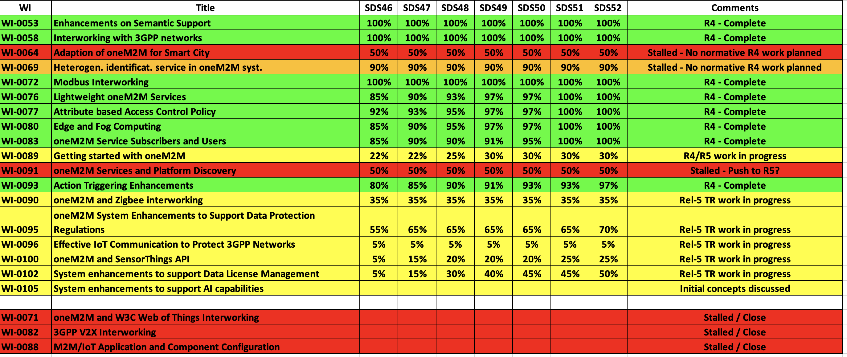
SDS WI Status
Complete
On track
Running behind schedule
Work has stalled

Slide 4
Rel-4 Progress
Majority of SDS 52 meeting time was spent on Rel-4 Stage 3 work
Stage 3 work complete for nearly all Rel-4 features
PollingChannelURI aggregation is remaining Various maintenance/corrections needed before R4 is complete.
Final review of TS-0004 against TS-0001 is needed to check that there are no further missing pieces
Agreed to rename some attribute names in TS-0023 and TS-0032 to avoid name clashes.
Rel-4 XSDs also need to be generated
Rel-2/3 TS-0004 XSD (long names) are up to date
Rel-4 started

Slide 5
Rel-5 Progress
Treated contributions for the following TRs
TR-0033 (agreed)
TR-0062
TR-0063
TR-0066
Five contributions for R5 TS’s were agreed
Will be added to a CR pack when the new versions of the TSs are started.

Slide 6
Items for Decision
CR Packs:
TS-0001 – TP-2021-0109 – 01-R2, 01-R3, 03-R4 = 5
TS-0004 – TP-2021-0110 – 04-R2, 04-R3, 05-R4 = 13
TS-0008 – TP-2021-0111 – 01-R2, 01-R3, 01-R4 = 3
TS-0009 – TP-2021-0112 – 02-R2, 02-R3, 02-R4 = 6

Slide 7
Conference Calls
Meeting | Date | Time (UTC)
SDS 52.1 | Tue 14-Dec-2021 | 12:00 – 13:30
SDS 52.2 | Wed 12-Jan-2022 | 12:00 – 13:30
SDS 52.3 | Wed 26-Jan-2022 | 12:00 – 13:30
Dates subject to confirmation

