Slide 1
SDS Status Report to TP53
Group Name: oneM2M SDS
Source: Peter Niblett, Poornima Shandilya, SeungMyeong Jeong, Wei Zhou
Meeting Date: 2022-02-08 to 2021-02-16

Slide 2
Summary
A total of 15 SDS contributions were agreed
Priority was Rel-4 Stage 3 contributions
Issue tracking system now being used
63 issues currently open, 27 have been closed
Recommend we start R5 TSs at SDS 54
Ready to register URN namespace at IANA
ITU-T feedback on TS-0003
2 CRs approved on TS-0003 R2, addressing 8 of the questions
Editorial changes that would conflict with oneM2M drafting rules to be handled in ITU-T transposition not in the oneM2M version

Slide 3
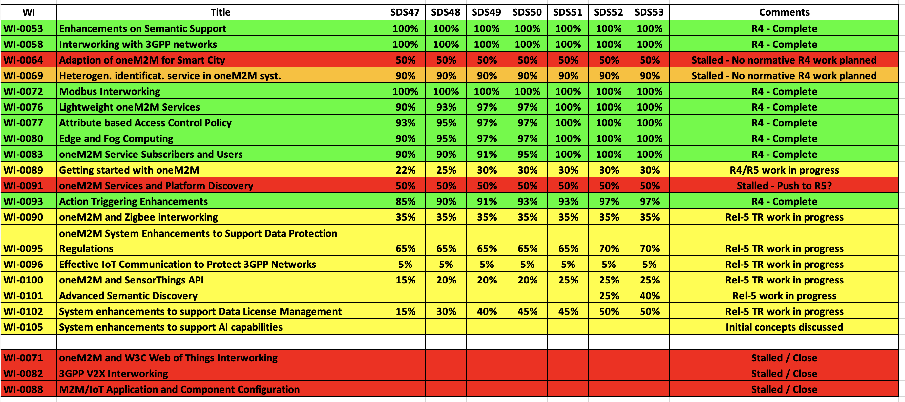
SDS WI Status
Complete
On track
Running behind schedule
Work has stalled

Slide 4
Rel-4 Progress
Stage 3 work complete for nearly all Rel-4 features
PollingChannelURI aggregation needs to be finalised
Various maintenance/corrections needed before R4 is complete.
Final review of TS-0004 against TS-0001 is needed to check that there are no further missing pieces
Some attributes in TS-0023 and TS-0032 have been renamed to avoid clashes.
Rel-4 XSDs also need to be generated
Rel-2/3 TS-0004 XSD (long names) are up to date
Rel-4 started

Slide 5
Rel-5 Progress
WI-101 (Advanced Semantic Discovery) was progressed at SDS 53
Discussions on other areas
CMDH
Management Objects
Eight contributions for R5 TS’s have now been agreed
Will be added to a CR pack when the new versions of the TSs are started.
Recommend that we start R5 TSs at TP54.

Slide 6
Items for Decision
CR Packs:
TS-0001 – TP-2021-0012 – 01-R2, 01-R3, 03-R4 = 5
TS-0003 – TP-2021-0013 – 02-R2, 00-R3, 00-R4 = 2
TS-0004 – TP-2021-0014 – 00-R2, 00-R3, 01-R4 = 1
TS-0008 – TP-2021-0015 – 00-R2, 00-R3, 01-R4 = 1
TS-0022 – TP-2021-0016 – 01-R1, 01-R3, 01-R4 = 3
TS-0032 – TP-2021-0017 – 01-R2, 01-R3, 00-R4 = 2

Slide 7
Conference Calls
Meeting | Date | Time (UTC)
SDS 53.1 | Mon 28-Feb-2022 | 12:00 – 13:30
SDS 53.2 | Wed 09-Mar-2022 | 12:00 – 13:30
SDS 53.3 | Wed 23-Mar-2022 | 12:00 – 13:30
SDS 53.4 | Wed 13-Apr-2022 | 12:00 – 13:30

