Slide 1
Cross-domain data usability of IoT devices for humans and machines STF 601
Presented by: Bob Flynn
Meeting Date: 2022-05-11

Slide 2
Summary
Started: 3 February 2021
Completed: (planned) 11 July 2022
Objective: Address usability of data and services that IoT Devices and platforms deliver
Deliverables:
TR 103 778: SmartM2M; Use cases for cross-domain data usability of IoT devices
TS 103 779: SmartM2M; Requirements and Guidelines for cross-domain data usability of IoT devices

Slide 3
TR 103 778: SmartM2M; Use cases for cross-domain data usability of IoT devices
Collection of use cases in the following domains
Healthcare (disabilities, environment, elderly, pandemic); Industry and manufacturing; ICT networks management (ISG ENI); Agriculture, farming; Mobility (transportation); Energy; Public and Emergency services; Building; Retail (vending machines, supply chain); Large events; Smart lift; Smart Cities
Total number of use cases: 33
External organization solicited for input:
TC SmartM2M: oneM2M RDM, AIOTI WG03, ETSI TC HF, TC SmartBAN, EP eHEALTH, ISG E4P, 3GPP SA1, SC USER, ISG ENI, TC CYBER, TC ITS, TC ATTM, ISG OEU.
Included inputs from the 8 external groups that responded
Use case structure: aligned very well with the structure used in oneM2M

Slide 4
TR 103 778: SmartM2M; Use cases for cross-domain data usability of IoT devices
Category | Description
Setup | Easy way for sensor data to be directed to a user (human or ML algorithm).
Setup | describe data format such that it can be used without ambiguity by its intended user (human or ML algorithm).
Configuration | transform data, if necessary, for a ML algorithm input or human user installation
Configuration | describe the sensor data quality, or suitability to use in different scenarios
ML output | capture classification of ML algorithms along with the data of interest that generated the classification
ML output | terms used for output: ontology for ML results.
ML output | organize output in a manner that is easy to find and understand “important” data without any ambiguity.
ML output | data duplication should be avoided, if possible, e.g. image from a camera is provided. Then it is “analysed” by an ML algorithm. A classification is determined. The image and classification are stored again (based on #7) but this should be avoided as it will create multiple instances of the same data (raw image) Just store the “classifications”.
ML output | identify the ML module used to provide a classification (traceability).
IoT system operation | timestamp and geolocate the data when necessary
IoT system operation | ensure that data accessibility is enabled to all authorized users.
IoT system operation | ensure that data interoperability is enabled if data should be shared between different IoT systems.
IoT system operation | ensure that the system is properly maintained and default components can be easily identified.
 | Protect against privacy, security and data integrity breaches
Analysis of use cases
Characterize actors that are Machine or Human
Identify Data consumer
Identify how “data” can “compromise data usability”
Summary of analysis identified 14 common themes to address:

Slide 5
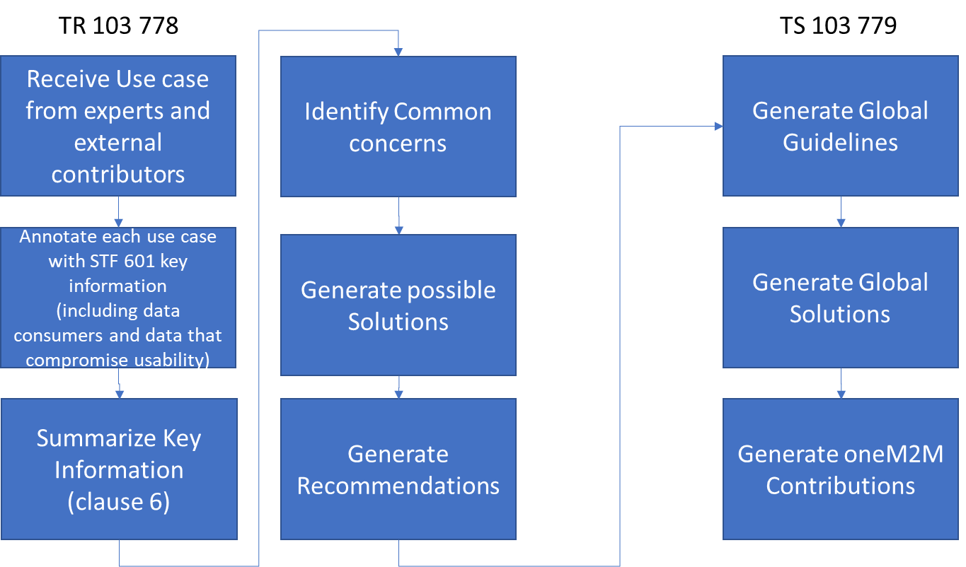
Process to determine recommendations

Slide 6
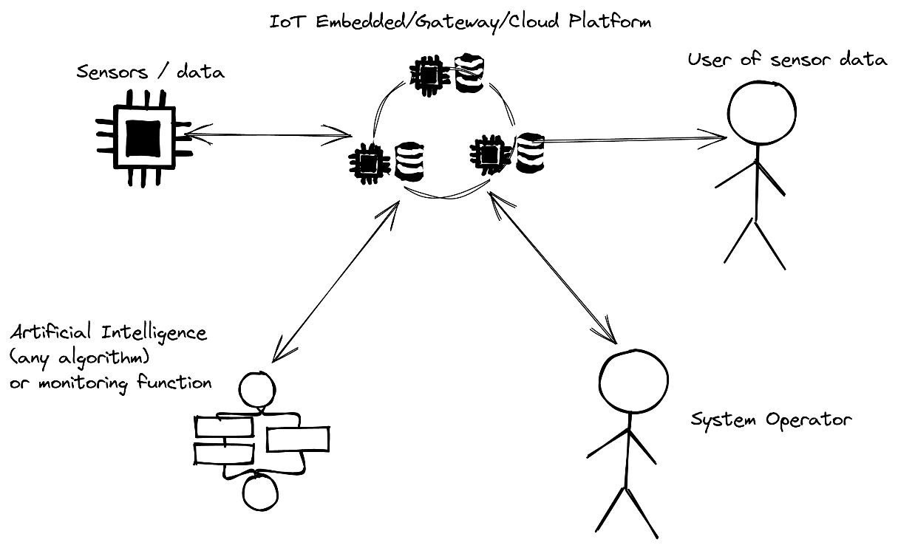
TS 103 779: SmartM2M; Requirements and Guidelines for cross-domain data usability of IoT devices
Requirements and guidelines for preserving data usability
Service requirements and Operational requirements
Subcategories for
Sensor/data sources
IoT Platform
AI/ML or monitoring function
Operator of system
Data users
Annex A: In-depth analysis and summary of research literature that were related to these topics
Interoperability
Collecting data from sensors
Granularity
Traceability

Slide 7
Inputs to oneM2M
WI-0105: System enhancements to support AI capabilities; (TR-0068)
Included a selection of the use cases into TR-0068 from ETSI: TR 103 778
Will contribute requirements from ETSI: TS 103 779

Slide 8
STF Team
Michelle Wetterwald, Netellany SASU (STF Leader)
Mauro Dragoni, Fondazione Bruno Kessler
Bob Flynn, Exacta Global Smart Solutions
Jumoke Olumide, EX2 Management

