Slide 1
Sustainability Sub-Committee(SSC) Update
5/9/2022
Dale Seed
SSC Convenor
Convida Wireless

Slide 2
Overview of oneM2M Sustainability Sub-committee
Objectives
Advocate the role that IoT and the oneM2M standard have with respect to sustainability
Create a market-responsive forum to promote the oneM2M standard externally
Recruit new participants to oneM2M activities, going beyond standardization experts
Identify requirements that may feed into oneM2M working group activities
Approach
Demonstrate a strategic commitment to sustainability via a dedicated oneM2M sub-committee
Sub-committee will generate various content (webinars, articles, blogs, tweets, videos, etc.):
the role of IoT in enabling sustainability, leveraging oneM2M deployment examples
oneM2M capabilities that enable sustainability (network resource management, messaging scheduling for efficient communications etc.)

Slide 3
2022 SSC Plans
Sustainability case study of the oneM2M standard
Increase awareness of the standard’s current set of features that can enable more sustainable IoT deployments
Identify opportunities to further enhance and improve the oneM2M standard with sustainability minded features.
Sustainability case studies of real-world IoT deployments
Evaluate both oneM2M and non-oneM2M based IoT deployments to identify sustainability strengths and weaknesses
Share case study findings with the oneM2M TP as well as externally via white paper, webinar, articles and speaking engagement opportunities

Slide 4
oneM2M standard case study
Aspect #1 – Review of oneM2M specifications to identify aspects/features that are already well-aligned with IoT sustainability and that can provide value-add sustainability.
E.g., Aspects/features that can make IoT deployments more sustainable
E.g., Aspects/features that can help society reach sustainability goals
Aspect #2 - Review of oneM2M specifications to identify aspects/features where there may be opportunities for further improvements / enhancements to enable implementations of the standard to be deployed more sustainably or to enable the standard to further help society meet its sustainability goals.
Latest version of case study – SSC-2022-0002R01
Point-of-Contact – Dale Seed <dale.seed@interdigtial.com>

Slide 5
Real-world IoT deployment case study
TCS IoT centric solutions:
Energy management solution – TCS Clever Energy - (link)
Elderly care – Shine Senior – (link, link)
Fleet management solution – (link)
Point-of-Contact - ANAND SAMPATHRAMAN <sampathraman.anand@tcs.com>

Slide 6
Come join us!
Looking for folks interested in making a sustainability impact
real-world IoT deployments case study participants
Both oneM2M and non-oneM2M deployments are encouraged and welcome
Participation is open to oneM2M and non-oneM2M members
SSC email list - ONEM2M_SSC@LIST.ONEM2M.ORG
2022 Meeting Schedule
Thurs Feb 24 – 1-2pm UTC
Thurs Apr 28 - 1-2pm UTC
Thurs Jun 23 - 1-2pm UTC
Thurs Aug 18 - 1-2pm UTC
Thurs Oct 20 - 1-2pm UTC
Thurs Dec 15 - 1-2pm UTC

Slide 7
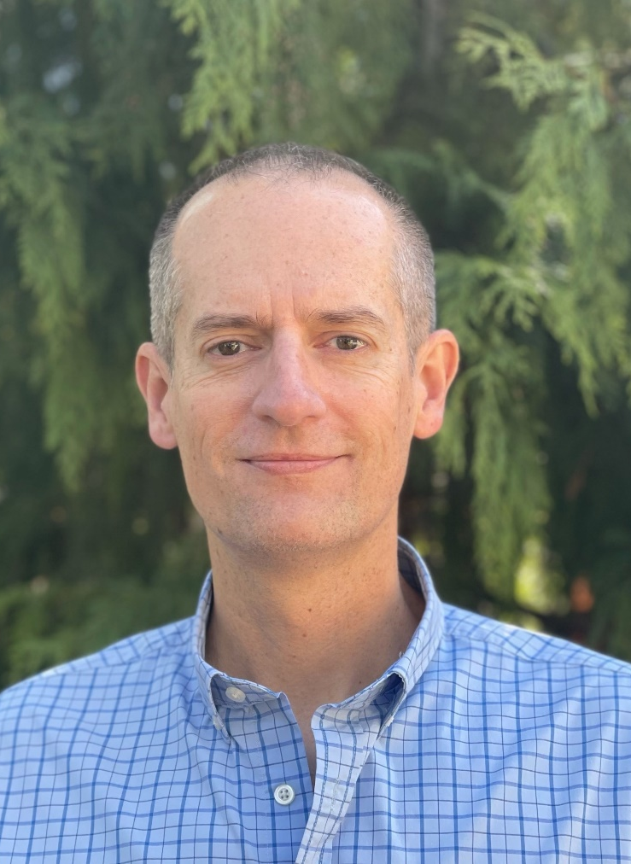
Dale Seed
oneM2M Technical Plenary Vice Chair
oneM2M Sustainability Sub-Committee Convenor
Principal Engineer, InterDigital / Convida Wireless
dale.seed@interdigital.com

