Slide 1
Voting in oneM2M
TP-2022-0033-Voting in oneM2M
Roland Hechwartner, TP Chair
Karen Hughes, ETSI
2022-05-11

Slide 2
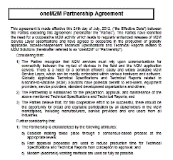
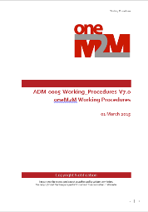
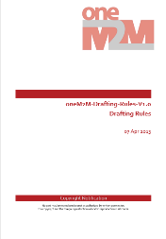
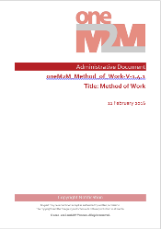
Rules and Procedures (I)
source: https://member.onem2m.org/website/Procs.aspx

Slide 3
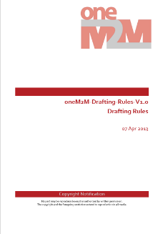
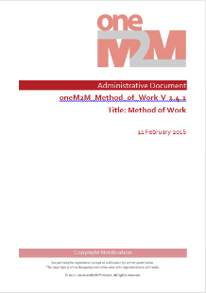
Rules and Procedures (II)
Steering Committee – Methods and Processes Committee
oneM2M Partnership Agreement ADM-0002-oneM2M Partnership Agreement V3.0
Purpose, Scope, Objectives, Intellectual Property Rights and Copyright Ownership
undertakings and rights to participate in the collaboration
Working Procedures ADM-0005-Working Procedures V8.0
Structure, SC, TP, WGs, Work Programme and Technical Coordination, deliverables, external relations, guidance on meeting organization, voting …
oneM2M Drafting Rules ADM-0003-oneM2M Drafting Rules V1.0
applicable to Technical Specifications and Technical Reports that are delivered to the Partners Type 1 for potential transposition
Use of normative language Shall, May, Should
Technical Plenary – Method of Work Committee
Method of Work ADM-0004-Method of Work V1.4.1
Handling Deliverables, Deliverables and Release Management, conducting a meeting, Work Items and CR through Releases: Guidelines, Test Event Requirements, Technical Forum on the oneM2M website, Meeting Guidelines, Annex A - Rapporteurs Checklist for Draft Deliverables

Slide 4
Voting List
The TP shall maintain a voting list for ordinary meetings:
a list of Members eligible to vote in TP. The voting list shall be published and made available to the members at least 7 days in advance of each meeting.
How does an organization get added to the voting list? (Article 26)
A Member or Partners Type 2 shall be added to the voting list at the end of the second consecutive meeting at which that Member or Partners Type 2 is represented.
When is an organization removed from the voting list? (Article 26)
A Member or Partners Type 2 shall be removed from the voting list if they are not represented at three consecutive meetings. The removal shall take place at the end of the third consecutive meeting at which that Member or Partner Type 2 has not been represented.
Role of the Secretariat (Article 20)
The Secretariat shall be responsible for the voting process and shall ensure that confidentiality is maintained.
Source: ADM-0005-Working Procedures V8.0

Slide 5
Who is eligible to vote?
Only organizations on the voting list may cast a single vote
See latest voting list in VotingList TP54
One person per eligible organization may cast a vote
There is no concept of ‘official voting contact’
First come – first served
A person can only vote for the organization and partner that they have registered with
This can not be changed after signing in for the meeting
A ballot paper will only be given out when the meeting badge is shown
Source: ADM-0005-Working Procedures V8.0

Slide 6
How does it work?
Election Result (Article 20)
If no candidate obtains 71% or more of the votes cast in the first ballot, a second ballot shall be held between the two candidates who have obtained the highest number of votes in the first ballot.
The candidate obtaining the higher number of votes in the second ballot is elected.
For multiple positions, the above process is applied sequentially for each position to be filled.
Quorum
is established if the number of Members and Partners Type 2 present exceeds 50% of the number of Members and Partners Type 2 on the voting list.
Source: ADM-0005-Working Procedures V8.0

