Slide 1
SDS Status Report to TP54
Group Name: oneM2M SDS
Source: Peter Niblett, Poornima Shandilya, SeungMyeong Jeong, Wei Zhou
Meeting Date: 2022-05-09 to 2021-05-13

Slide 2
Summary
26 SDS contributions have been agreed against Rel-2,3,4
8 contributions to date have been agreed against Rel-5
Recommend we start R5 TSs at SDS 55
ITU-T feedback on TS-0003
More CRs have been agreed on TS-0003 R2, with mirrors for R3 and R4
Propose to remove resource mapping rules from TS-0001 rel 4
See slide 6
Issue tracking system is being used
77 issues currently open, 37 have been closed
10 issues were discussed during this TP

Slide 3
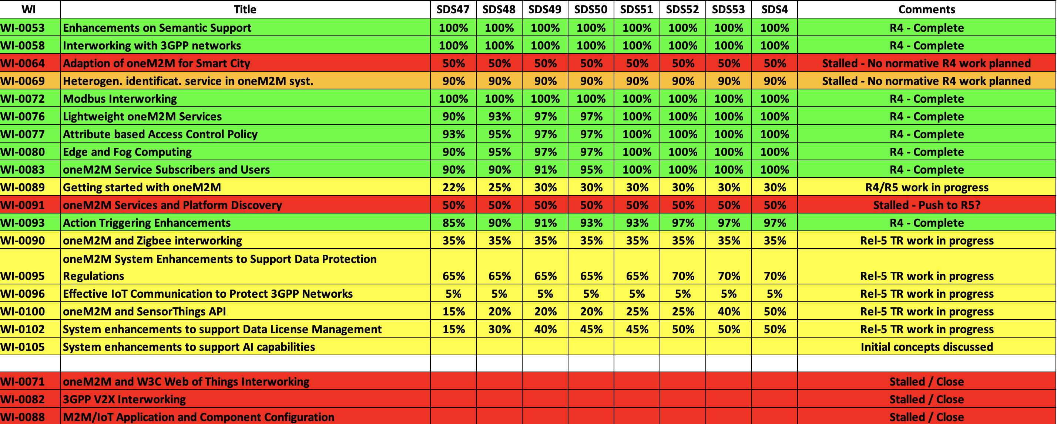
SDS WI Status
Complete
On track
Running behind schedule
Work has stalled

Slide 4
Rel-4 Progress
Stage 3 work complete for nearly all Rel-4 features
PollingChannelURI aggregation is now finalised
Various maintenance/corrections needed before R4 is complete.
Final review of TS-0004 against TS-0001 is needed to check that there are no further missing pieces
Propose to remove resource mapping rules from TS-0001 rel 4 (see slide 6)
Rel-4 XSDs also need to be generated
Rel-2/3 TS-0004 XSD (long names) are up to date
Rel-4 started

Slide 5
Rel-5 Progress
WI-101 (Advanced Semantic Discovery) was progressed at SDS 53.x
Progress on other areas
IPE/SDT-based Device Management
Eight contributions for R5 TS’s have now been agreed
Will be added to a CR pack when the new versions of the TSs are started.
Recommend that we start R5 TSs at TP55.

Slide 6
Items for Decision
CR Packs:
TS-0001 – TP-2022-0034R01 – 00-R2, 02-R3, 03-R4 = 5
TS-0003 – TP-2022-0035 – 02-R2, 03-R3, 03-R4 = 8
TS-0004 – TP-2022-0036R01 – 00-R2, 04-R3, 07-R4 = 11
TS-0008 – TP-2022-0037 – 01-R2, 01-R3, 00-R4 = 2
Request to remove SDS-2019-0476R05-Retarget_via_resourceMappingRules_for_TS0001 from TS-0001 Rel 4.
TS-0001 resourceMapping function is not complete
No corresponding TS-0004 contributions
Propose deferring to Rel 5.

