Slide 1
oneM2M Turns 10!!!
MARCOM Committee

Slide 2
oneM2M@10

Slide 3
oneM2M@10
Dedicated oneM2M@10 page

Slide 4
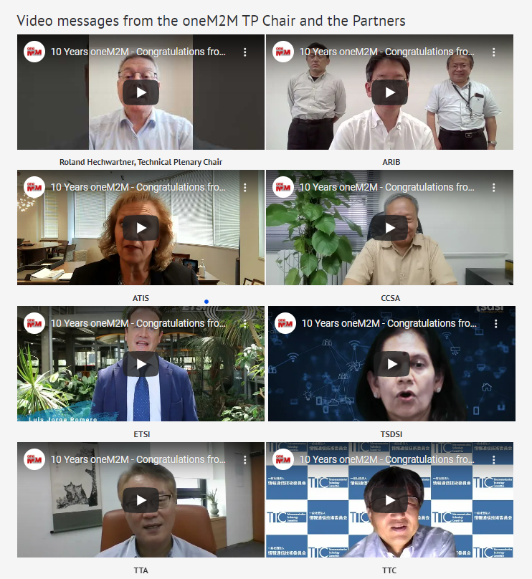
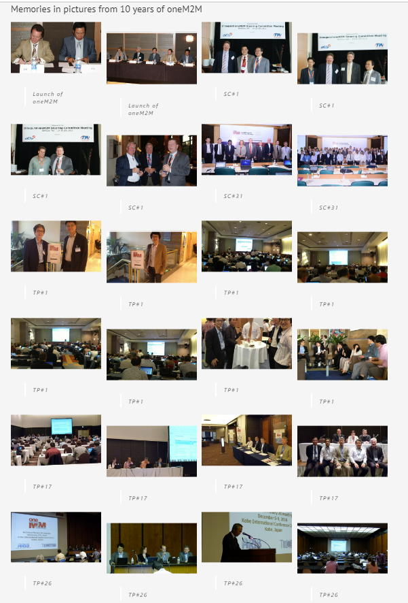
Congratulatory Messages & Memories

Slide 5
SC Leaders

Slide 6
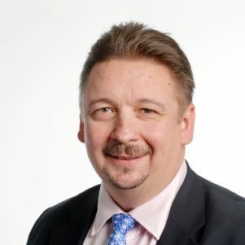
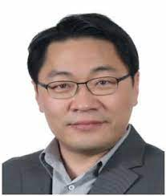
SC Chairs
Luis Jorge Romero
Fran O'Brien
Enrico Scarrone
Jonas Sundborg
Yong Chang

Slide 7
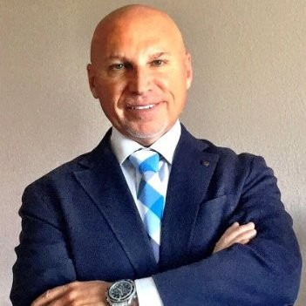
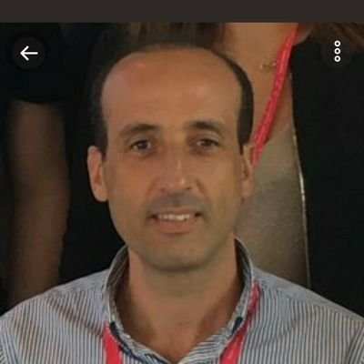
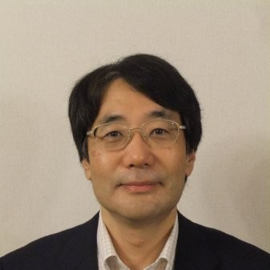
SC Vice Chairs
David Foote
Ed Tiedemann
Cheryl Blum
Uday Desai
Rouzbeh Farhoumand
Thomas Li
Omar Elloumi
Puneet Jain
Nick Yamasaki

Slide 8
TP Leaders

Slide 9
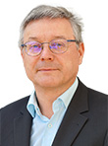
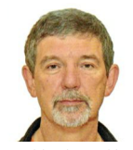
TP Chairs
Omar Elloumi
Jonas Sundborg
Roland Hechwartner
Peter W Nurse
Yong Chang

Slide 10
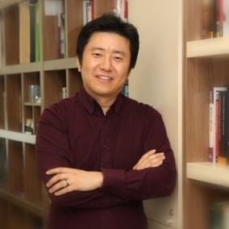
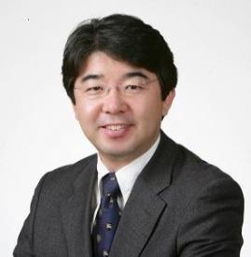
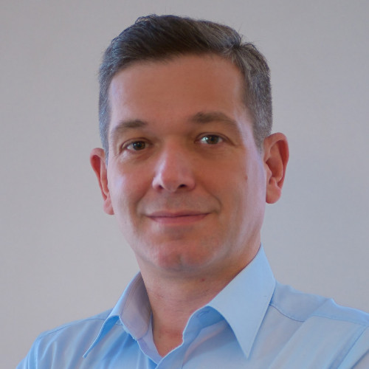
TP Vice Chairs
Dale Seed
JaeSeung Song
Ki Young Kim
Nick Yamasaki
Josef Blanz

Slide 11
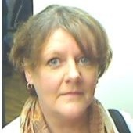
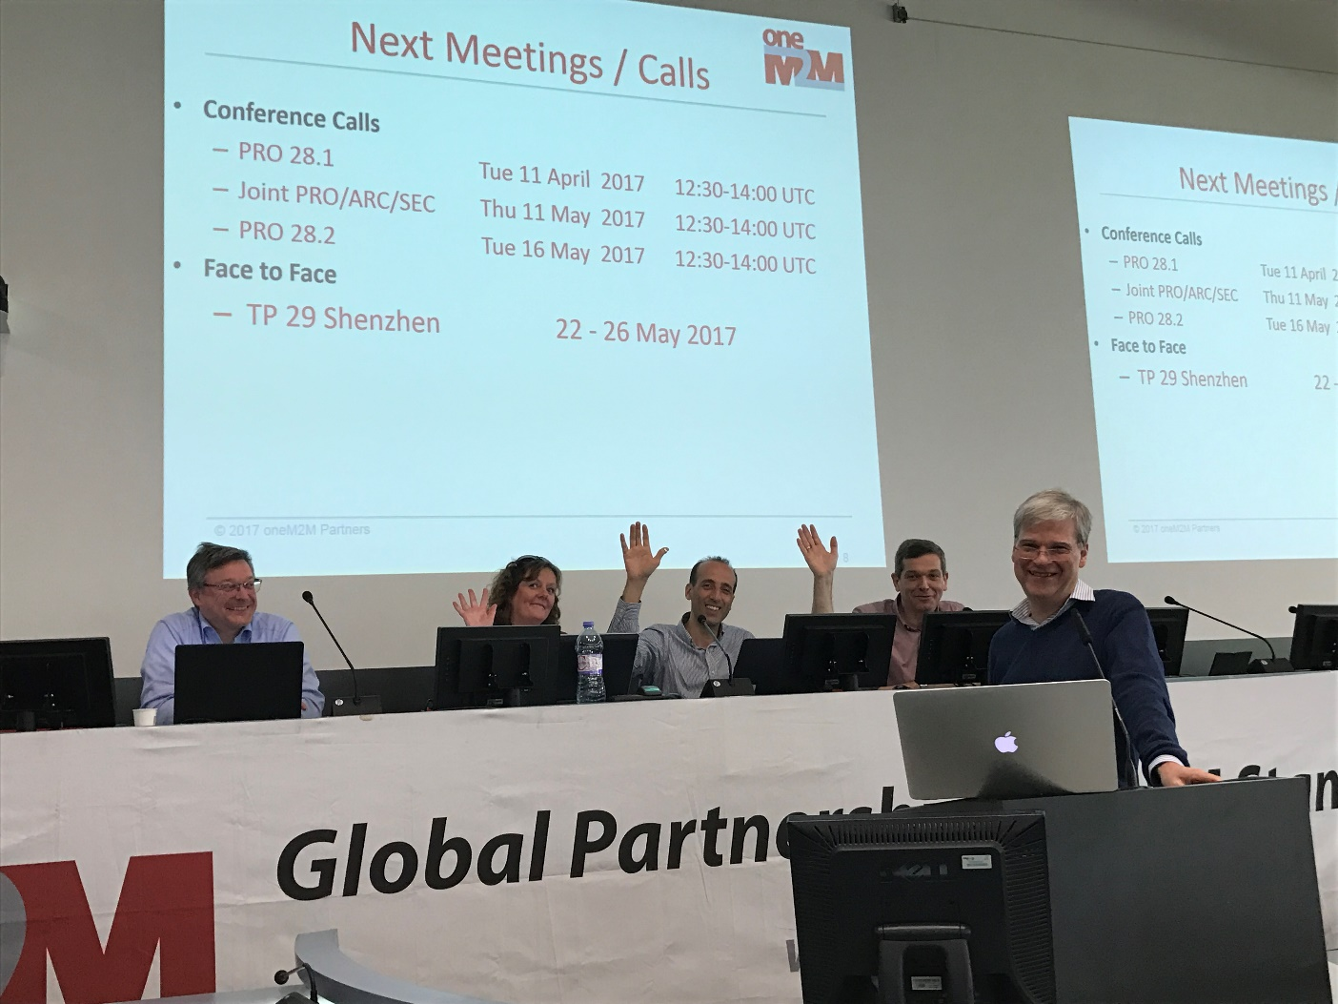
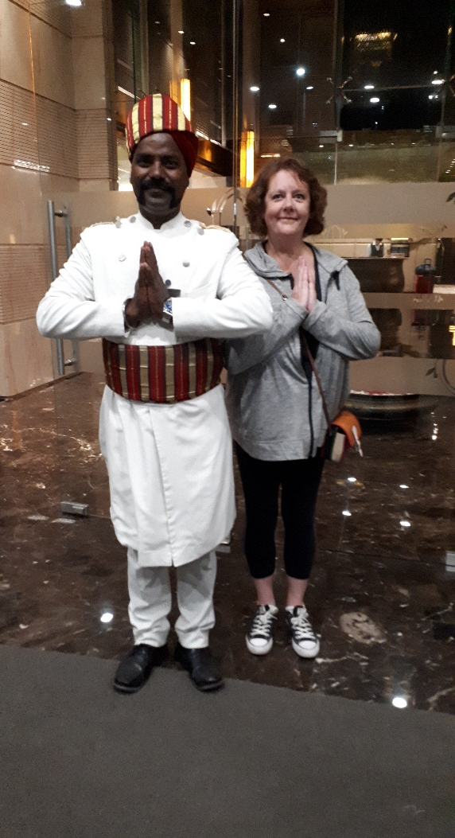
Supporting TP over the years
Karen Hughes

Slide 12
TP Sectt.
ATIS: Steve Barclay (no longer working at ATIS), Nicole Butler, Katie Bagwill, Emily Hoefer (no longer working at ATIS)
ARIB: Kazuo Makamura (retired)
ETSI: Victoria Gray, Estelle Mancini, Gerry McAuley (no longer working for ETSI), Anna Riondet (no longer working for ETSI), Laurent Velez, Sabine Dahmen-Lhuissier, Gabriella Vincent
TIA: Jeff West (no longer working for TIA)
TTA: Peter Kim, Joey Lee, Changho Ryoo
TTC: Kazunori Matsuo (Retired), Masa Sumita (no longer working for TTC)
TSDSI: Akash Malik

Slide 13
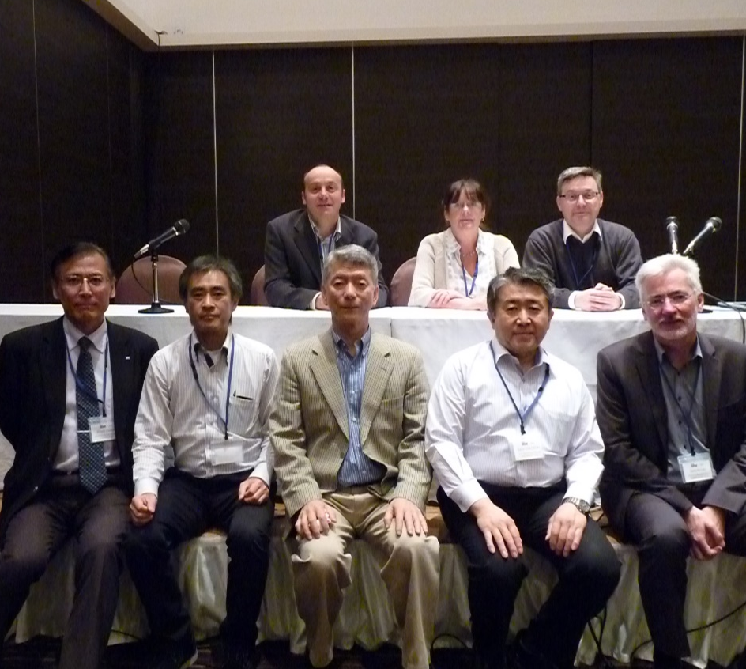
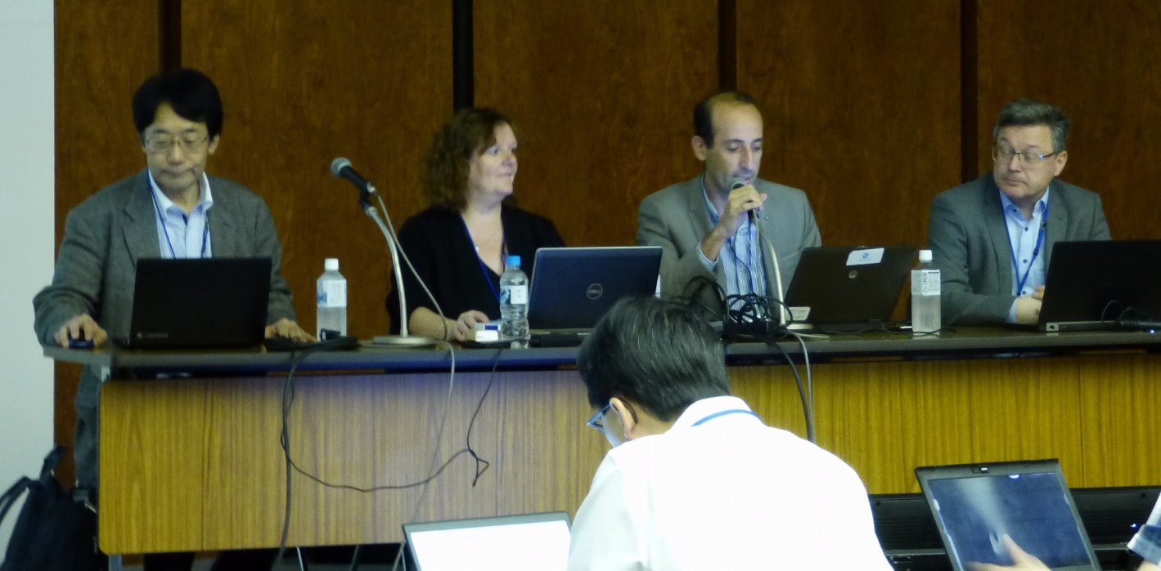
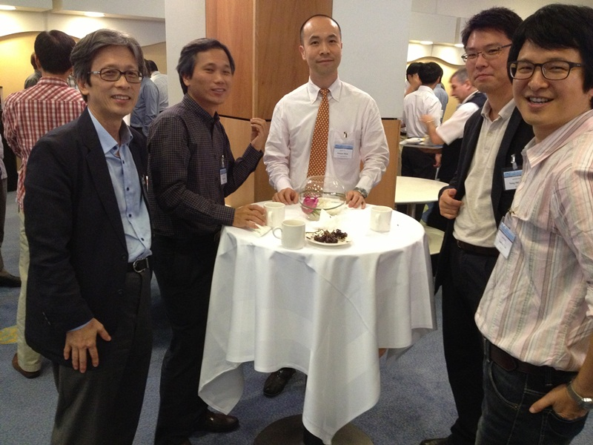
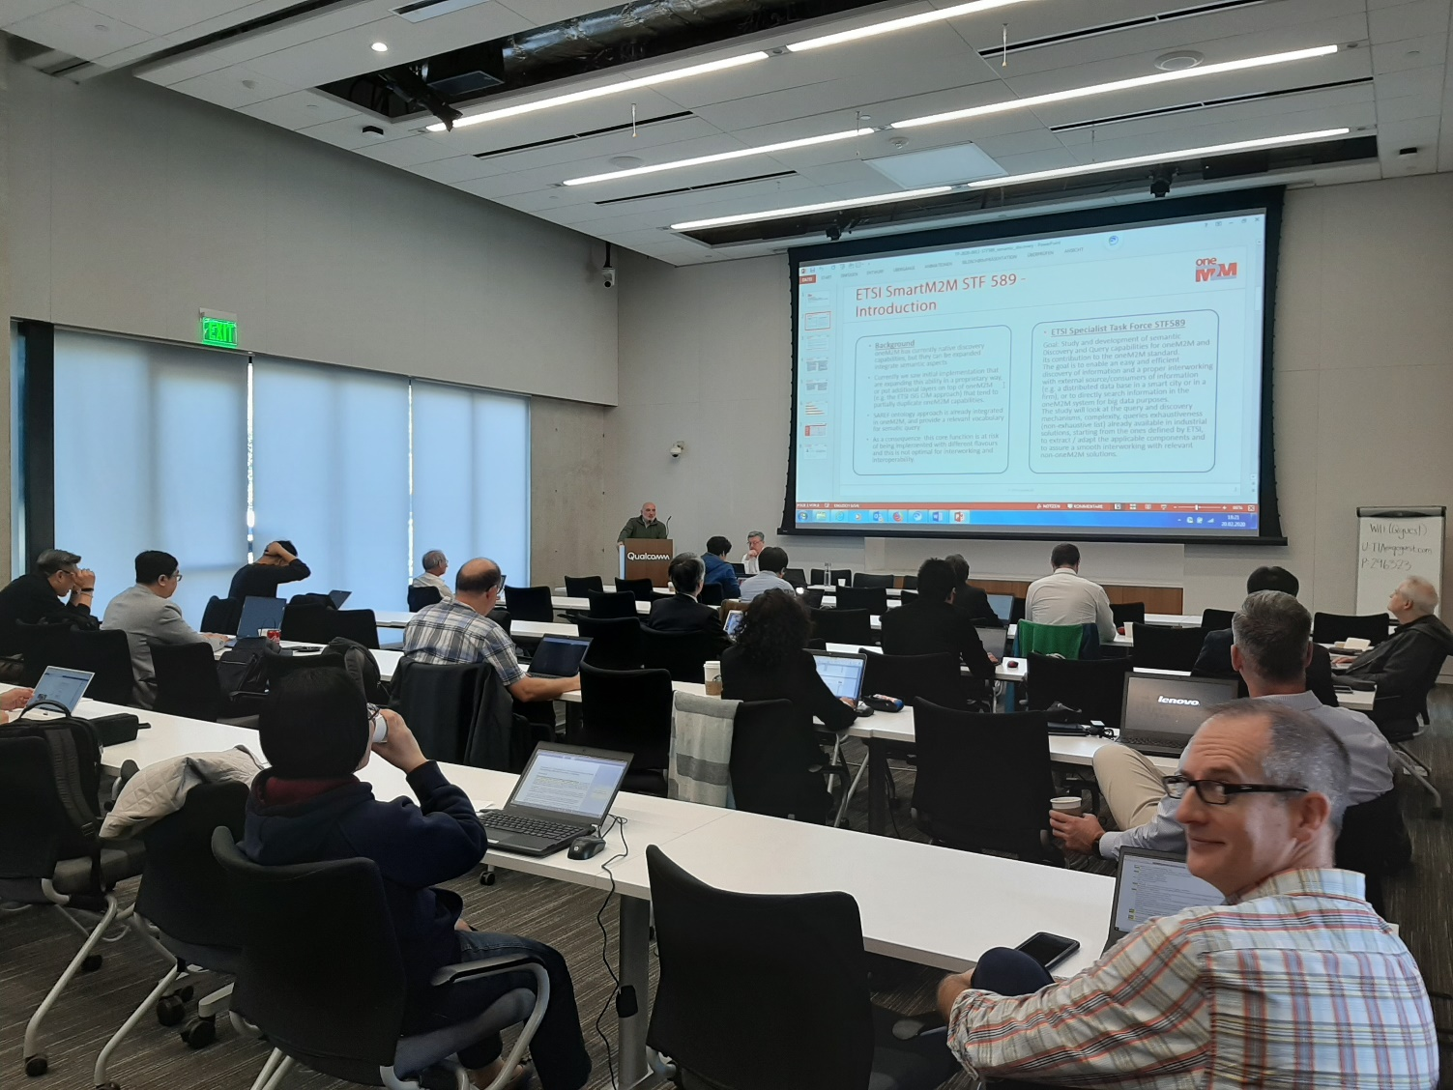
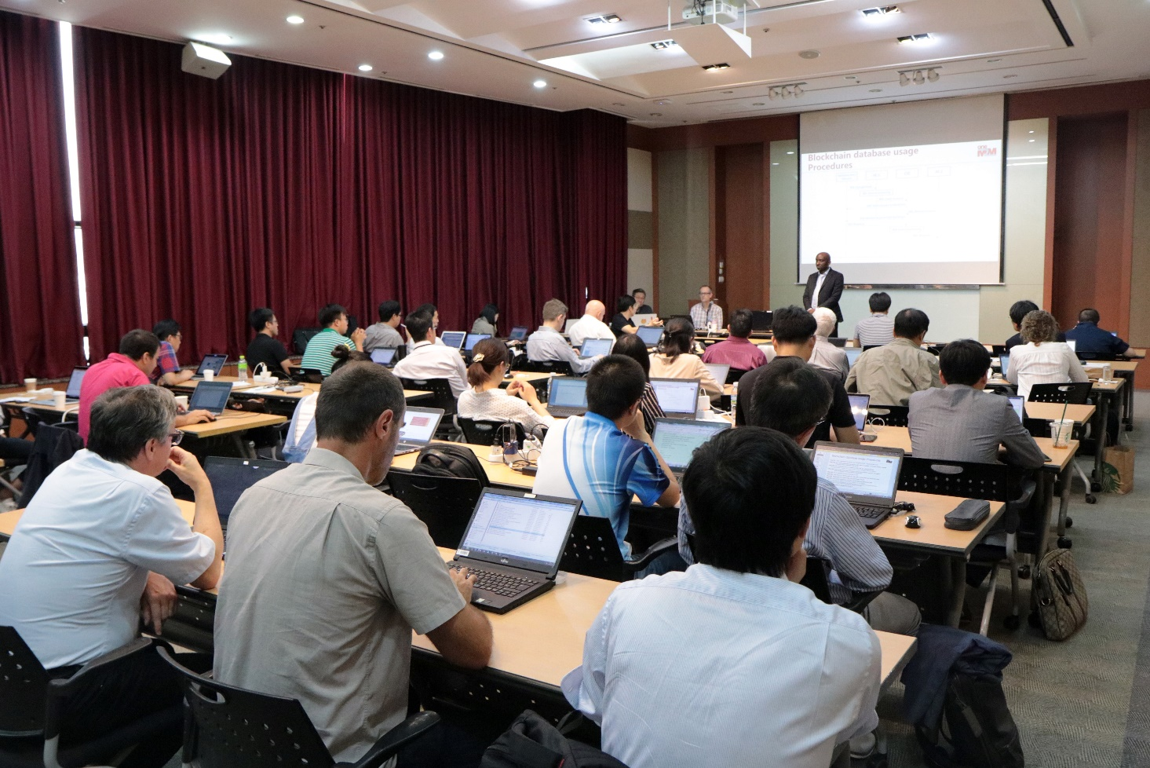
Memories

Slide 14
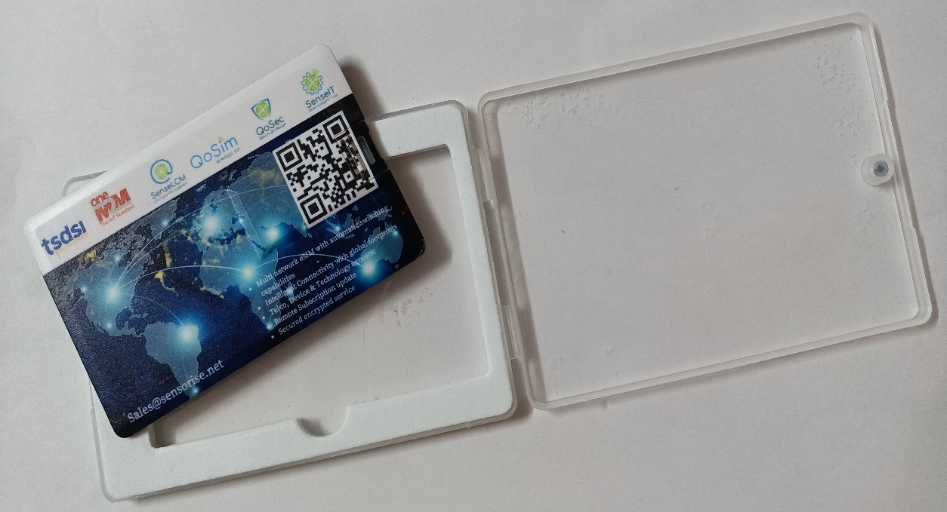
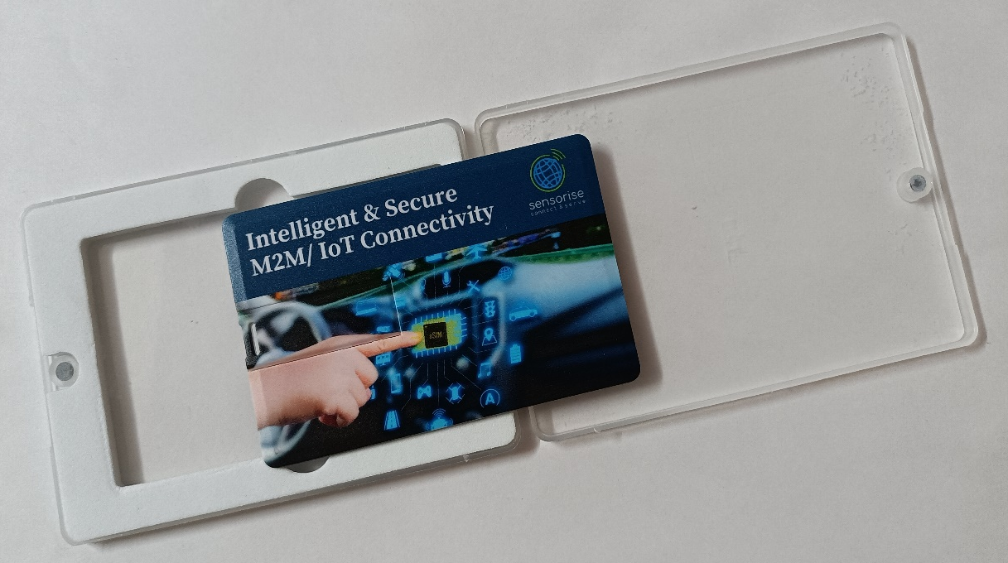
Souvenirs for oneM2M@10
Thank you Sensorise for sponsoring the souvenirs!
© 2022 oneM2M

Slide 15
Thank You

