Slide 1
An Introduction to
oneM2M Tutorials using Jupyter Notebooks
28 September 2022
www.oneM2M.org
Andreas Kraft, Deutsche Telekom
Ken Figueredo

Slide 2
Objective: A “5-minute” way for developers to experiment with oneM2M
Introduce the basics of oneM2M
short talks (about 5 minutes) for easy consumption
implementation examples of oneM2M capabilities using Jupyter Notebooks (illustrative explanations, easy to document and usable by developers)
Encourage viewers to access more detailed oneM2M documents and training courses
The first set of the oneM2M Tutorials using Jupyter Notebooks is now online!
Videos on oneM2M YouTube channel https://www.youtube.com/playlist?list=PLDd4EJmw5gUnA_d1RgYnxrOrYeYuHdH5u
Also accessible via oneM2M Wiki https://wiki.onem2m.org/index.php?title=OneM2M_Jupyter_Notebooks
We are half-way through recording the series

Slide 3
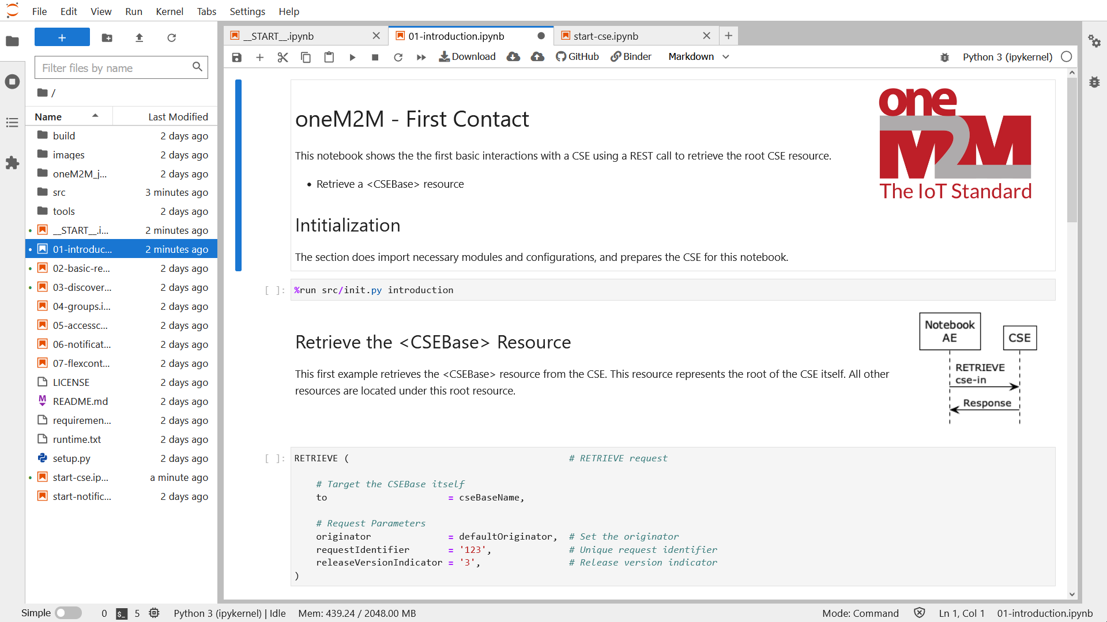
Example: “First Contact” notebook

Slide 4
How you can help
Watch the talks and try out the exercises – all it takes is 5 minutes! https://wiki.onem2m.org/index.php?title=OneM2M_Jupyter_Notebooks
Share information with colleagues and via your contacts
Send feedback and ideas for other talks

Slide 5
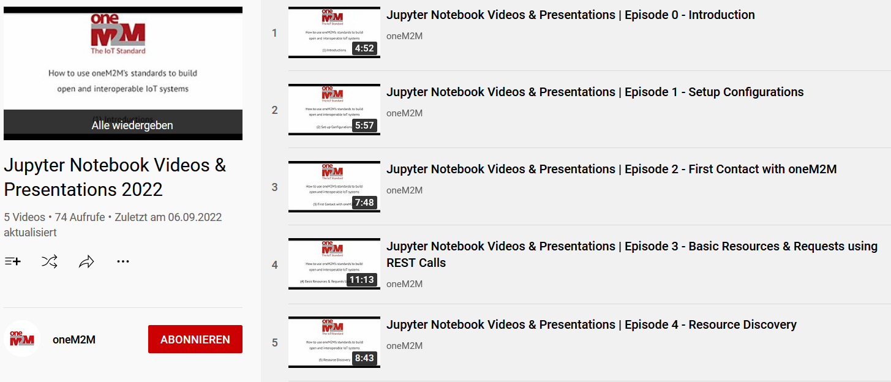
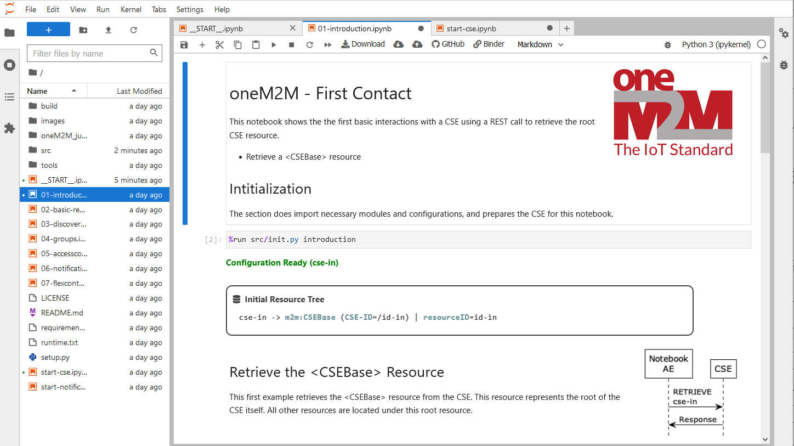
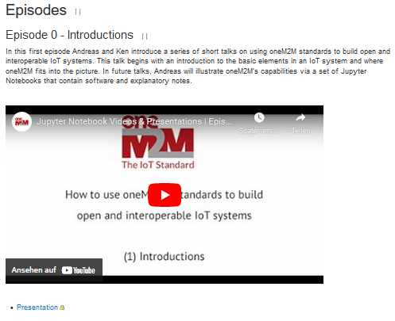
Summary
The first set of the oneM2M Tutorials using Jupyter Notebooks is now online!
oneM2M Wiki https://wiki.onem2m.org/index.php?title=OneM2M_Jupyter_Notebooks
YouTube https://www.youtube.com/playlist?list=PLDd4EJmw5gUnA_d1RgYnxrOrYeYuHdH5u
GitHub & Discussions https://github.com/oneM2M/onem2m-jupyter-notebooks
https://github.com/oneM2M/onem2m-jupyter-notebooks/discussions
MyBinder Runtime https://mybinder.org/v2/gh/oneM2M/onem2m-jupyter-notebooks/master?urlpath=lab/tree/__START__.ipynb

Slide 6
Thank you

