Slide 1
oneM2M- ITU-T Collaboration TS-0003 Security Solutions document Transposition.
28/08/2022
Rana Kamill
ITU-T/ oneM2M Liaison Rapporteur
BT

Slide 2
Timeline
The collaboration process between oneM2M and ITU-T SG20 (Internet of things (IoT) and smart cities and communities (SC&C)) started in 2018.
The ITU-T SG20 initially gave oneM2M 28 comments to apply throughout the document. Some changes could be made, and few were not in line with how things are done in oneM2M.
We have created a table with comments from ITU-T experts and responses from oneM2M which we have updated after each call. The table was colour coded: Red for Comments that were not possible to implement or would take a long time to implement, Amber for comments that were in the process of being implemented and green for the ones that have been completed.

Slide 3
Timeline
The last ITU-T SG20 was a face to face meeting that took place in Geneva between the 18th and 28th of July in Geneva.
Three official meetings were between the ITU-T and oneM2M were scheduled and added two the agenda.
Three unofficial/ offline meetings, one of which lasted for 5 hours.
More comments and requests to make changes were made during the offline meetings. Some of these changes were regarding sections that we have already reviewed and discussed. Last minute comments were addressed to our best ability and the document has been progressing through the approval stages.
The document has been agreed by Q6, approved by WP2,

Slide 4
ITU-T Structure
Types of ITU-T decision-making “soft” and “hard” criteria
Traditional Approval Process (TAP)
Alternative Approval Process (AAP)

Slide 5
ITU-T Decision making process
ITU-T Recommendation Approval There are two methods for approving Recommendations between WTSAs:
Traditional Approval Process (TAP) for Recommendations having policy or regulatory implications Member States (MS) have final decision Alternative.
Approval Process (AAP) for all other Recommendations MSs and SMs both fully participate.
TAP is typically longer, and it is the route taken when more than one member state is not in full agreement with the approval.

Slide 6
ITU-T Decision making process
ITU is a United Nations Specialized Agency – ONLY Member States have the right to vote However, agreement of Sector Members is important for approval of technical Recommendations The rules allow for a public/private partnership, while respecting MS rights Most decisions, but not all of them, are made on the basis of consensus

Slide 7
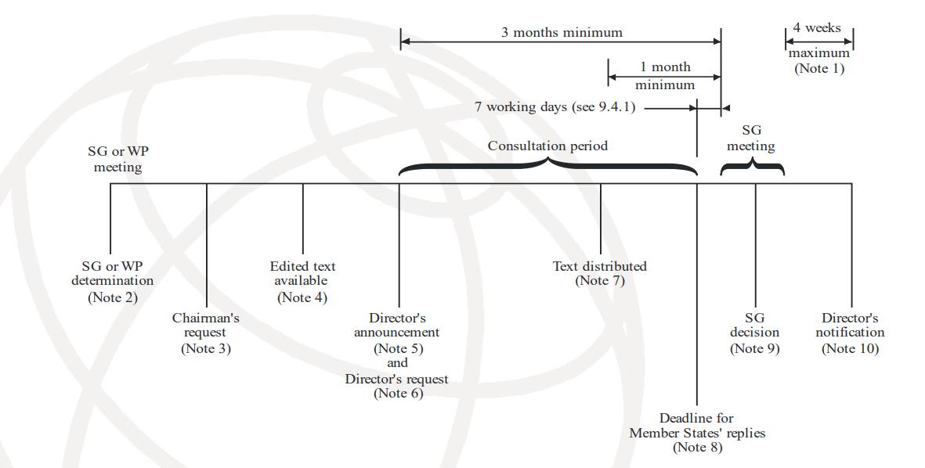
TAP Process Chart

Slide 8
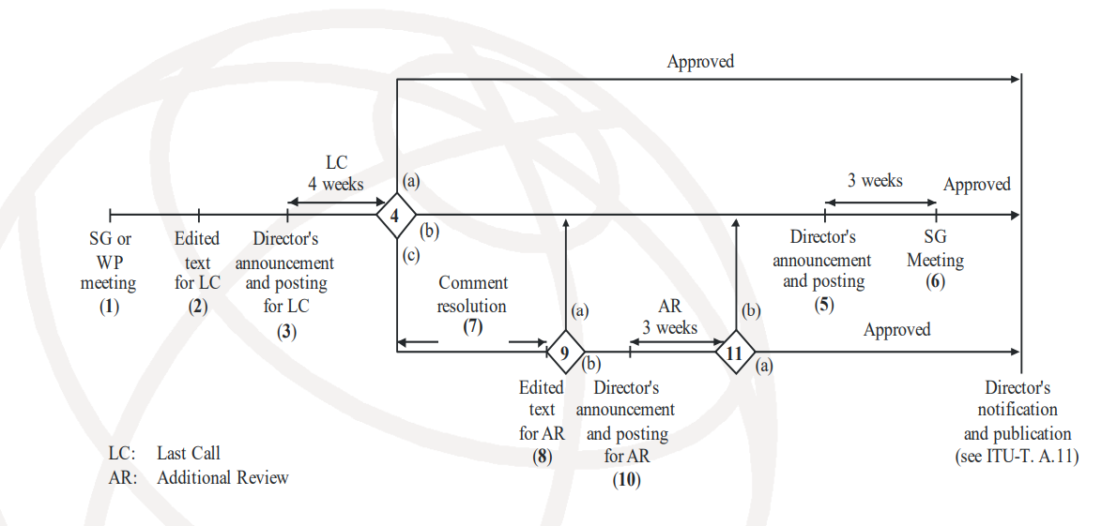
AAP Process Chart

Slide 9
Challenges
IPR issues and Russian concerns:
The chair of Q6 asked at the beginning of the meeting whether anyone had knowledge of intellectual property rights issues, including patents, copyright for software or text, marks, the use of which may be required to implement the Recommendations being considered.
A concern expressed by the Russian Administration on oneM2M related Recommendation was addressed properly during the meeting.
Statement from the Russian Federation:
“The Russian Federation believes that the use of the trademark and proper name “oneM2M” throughout the text of the Recommendation is inconsistent with the ITU-T Guidelines related to the inclusion of Marks in ITU-T Recommendations.
The Russian Federation encourages oneM2M in future releases of the Recommendation to avoid using its trademark and proper names throughout the text of the specification to be consistent with the ITU-T Guidelines related to the inclusion of Marks in ITU-T Recommendations.”

Slide 10
Challenges
A.5 qualification status:
A.5 is an ITU-T process that all organisations it collaborates with have to go through. It was brought up in the third meeting that TSDSI has joined oneM2M which would make oneM2M lose its A.5 qualification status which would stop the collaboration and the transportation of the oneM2M Security Solutions document.
We argued that we should not lose our A.5 qualification and that since a new organisation joined, our qualification should just be reviewed. We also highlighted that TSDSI is a member of 3GPP which regularly inputs into ITU-R.
A letter from TSDSI was sent to the ITU-T SG20 chairman and secretariat confirming that TSDSI’S ‘Copyright, Software Copyright and Trademarks Guidelines will be fully compatible with ITU-T’s current policies and guidelines on the same.’

Slide 11
Challenges
Referencing:
It was advised that we need to submit a document with all references changed to ITU-T recommended format. Without submitting the references document, the collaboration could not continue. The document was prepared and submitted to SG-20 and collaboration continued.

Slide 12
Challenges
Formatting:
An updated version of the document with many formatting changes (including changing capital letters in titles to small letters, except for the first word) was sent to oneM2M to review. The document included some additional comments on numbering and changing the location of some sub sections. Some of these recommendations were made and most formatting changes were rejected. The ITU-T has accepted our reviewed document and uploaded it as a ‘Document for determination’ on its website.

Slide 13
Summary- Where are we now?
Document agreed by Q6- Sent for approval by WP2.
Document approved by WP2, sent for approval by SG20 TP.
Document approved by SG20 TP.
A copy of the document to be sent for determination has been published on the ITU-T website on the 14th of September 2022.
The document is currently going through TAP (Traditional Approval Process).

Slide 14
Summary- What is next?
TAP process: Once the process is completed, TS-0003 Rel. 2 will be fully transposed by the ITU-T.
The UK has presented a liaison statement suggesting developing a better mechanism of collaboration between oneM2M and the ITU-T.
The ITU-T showed willingness to collaborate with oneM2M to transpose future releases and to develop a better collaboration method which will be discussed with the ITU-T before and during the next meeting in January 2023.

Slide 15
Benefits of the collaboration between oneM2M and ITU-T.
The ITU-T recommendations are recognised worldwide since the ITU is part of the UN.
Although oneM2M and ETSI are very popular in Europe, some countries generally refer to ITU-T standards especially in North Africa and South America.
Collaboration with ITU-T gives us more visibility and makes oneM2M more popular worldwide.
The more we collaborate with international organisations, the more we benefit from the expertise of international experts and the easier it becomes for oneM2M standards to be implemented worldwide.
Benefits of getting oneM2M Documents transposed by ITU-T

Slide 16
oneM2M- ITU-T collaboration
Any questions?
Please email rana.Kamill@bt.com
Thank you!

