Slide 1
SDS Status Report to TP56
Group Name: oneM2M SDS
Source: Peter Niblett, Poornima Shandilya, SeungMyeong Jeong, Wei Zhou
Meeting Date: 2022-09-26 to 2021-09-30

Slide 2
Summary
16 new SDS contributions have been agreed against Rel-2,3,4
11 contributions to date have been agreed against Rel-5
Recommend we start R5 TSs now
Decision has been reached on IANA registration for CoAP
We will change the CoAP option numbers for R2, R3, R4
This is a breaking change, but interoperation with unchanged clients is still possible
Issue tracking system is being used
91 issues currently open, 57 have been closed

Slide 3
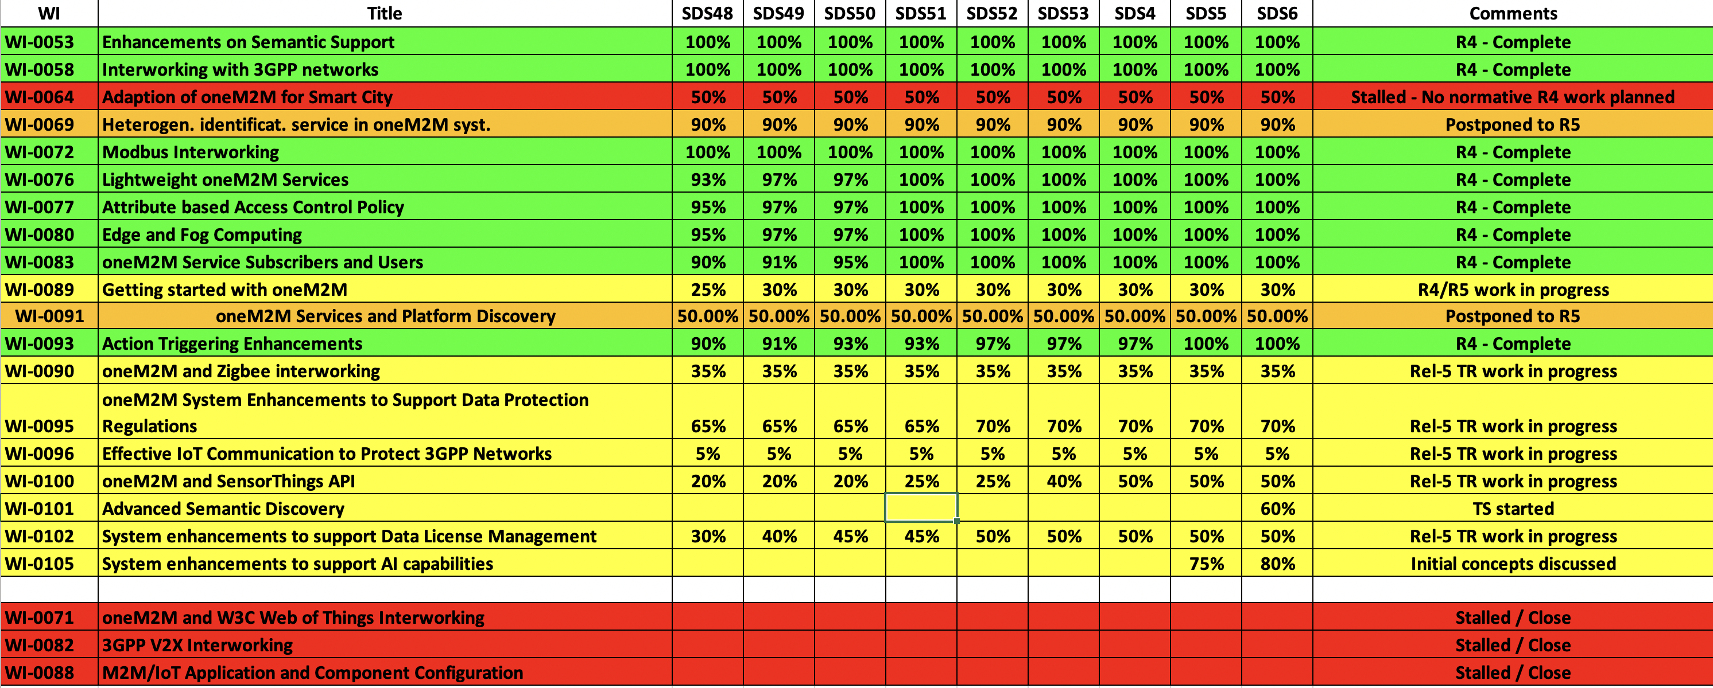
SDS WI Status
Complete
On track
Running behind schedule
Work has stalled

Slide 4
Rel-4 Progress
Stage 3 work complete for all Rel-4 features
TS-0001 and TS-0040 have been reviewed by editHelp.
TS-0003, TS-0004, TS-0009, TS-0022 are ready for editHelp
Some TSs have not changed since R3.
Do we just change the document number and history?
TS-0008 (CoAP binding) needs some work
Some agreed CRs still to be applied
Waiting for IANA registration

Slide 5
Rel-5 Progress
Eleven contributions for R5 TS’s have now been agreed
Will be added to a CR pack when the new versions of the TSs are started.

Slide 6
Items for Decision
CR Packs:
TS-0001 – TP-2022-0097 – 01-R2, 01-R3, 02-R4 = 4
TS-0004 – TP-2022-0095 – 01-R2, 01-R3, 04-R4 = 6
TS-0008 – TP-2022-0096 – 01-R2, 01-R3, 01-R4 = 3
TS-0022 – TP-2022-0098 – 01-R2, 01-R3, 01-R4 = 3

Slide 7
Conference Calls
Meeting | Date | Time (UTC)
SDS | Mon 10-Oct-2022 | 12:00 – 13:30
SDS 56.1 | Mon 24-Oct-2022 | 12:00 – 13:30
SDS 56.2 | Mon 31-Oct-2022 | 12:00 – 13:30
Dates subject to confirmation

