Slide 1
oneM2M promotion activities to support developers
SeungMyeong Jeong (KETI)
2023.06.27

Slide 2
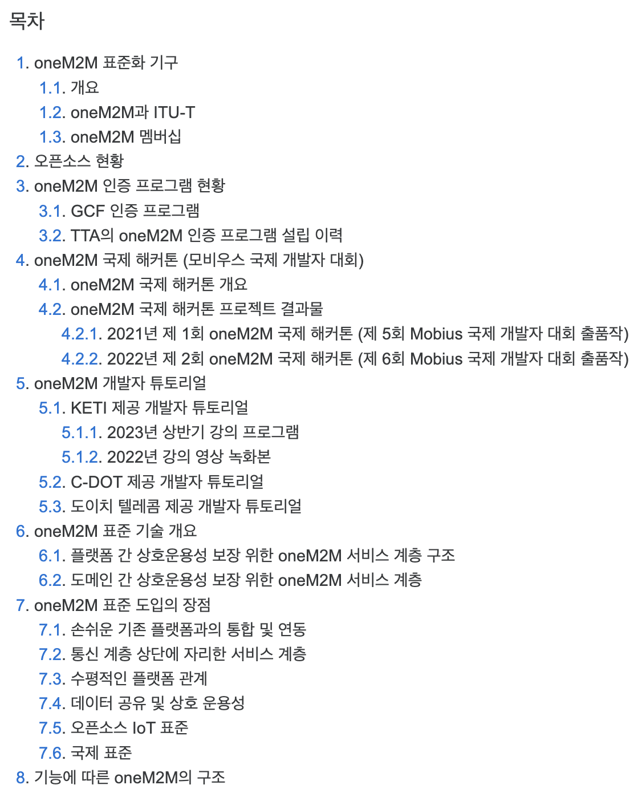
Outline
oneM2M Open Source Implementations
oneM2M Developer Tutorials
oneM2M International Hackathons
AIoT Exhibitions and oneM2M Workshop (coming up)
https://namu.wiki/w/oneM2M

Slide 3
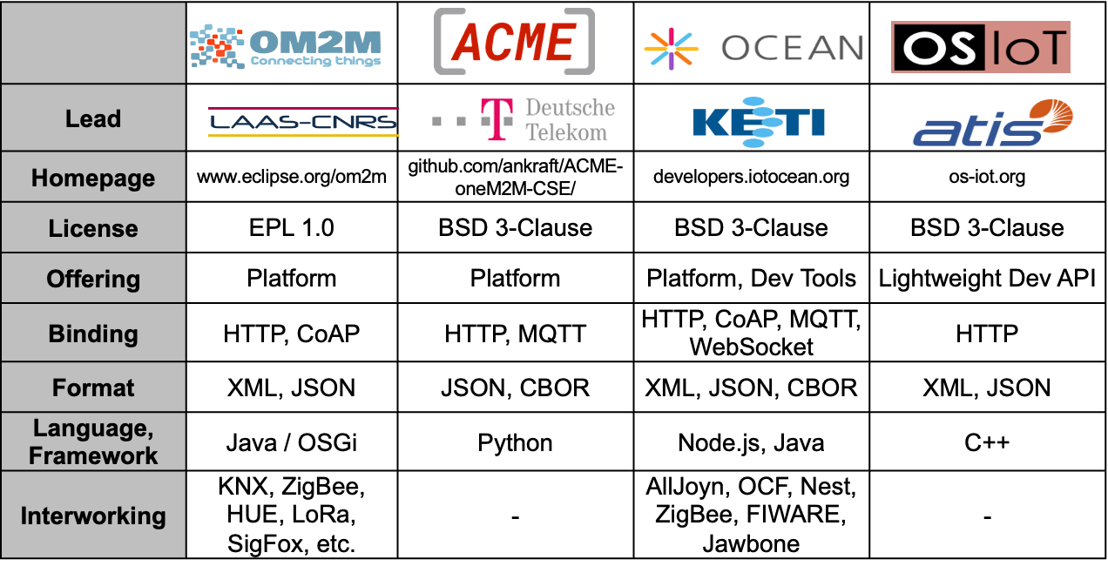
Open Source Implementations
OSS for oneM2M are growing and enhancing
Other implementations for lightweight devices are going to be provided soon (in ’23)
Mobius now supports geo-query from Rel-4
Andreas Kraft (DT)

Slide 4
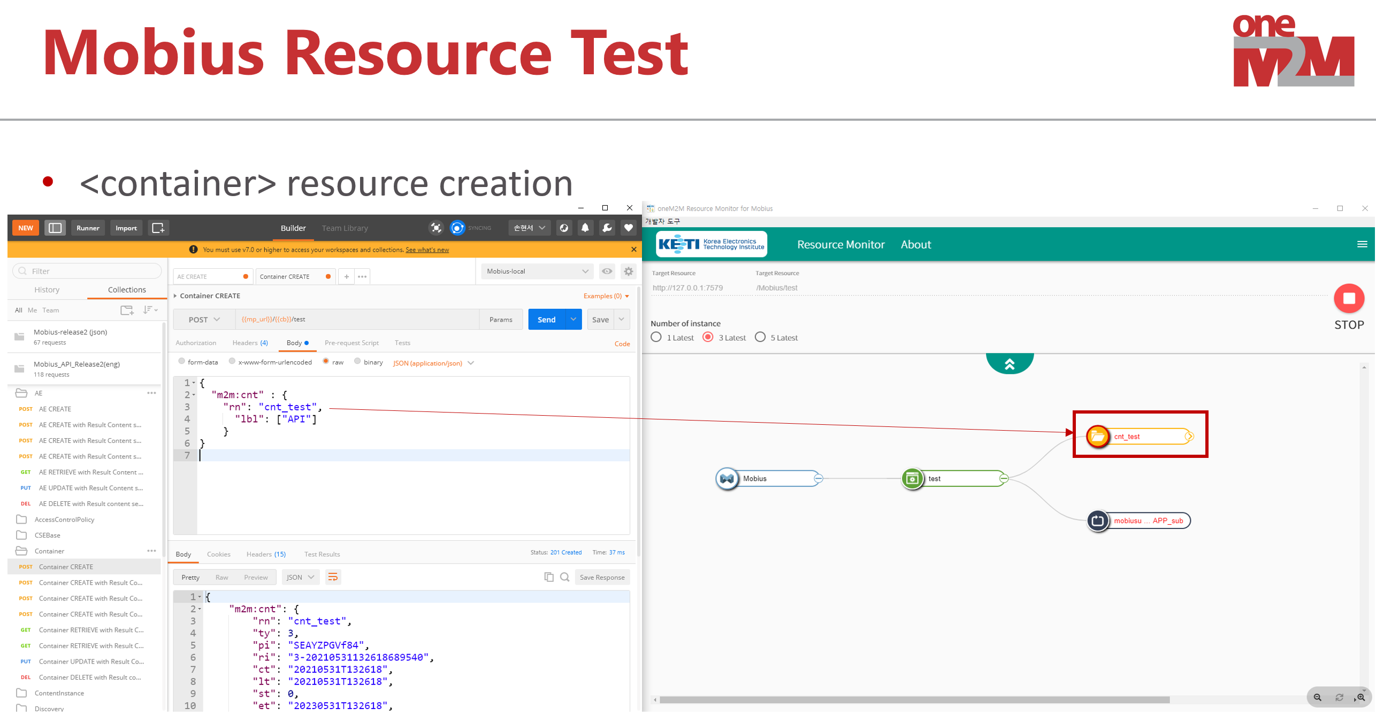
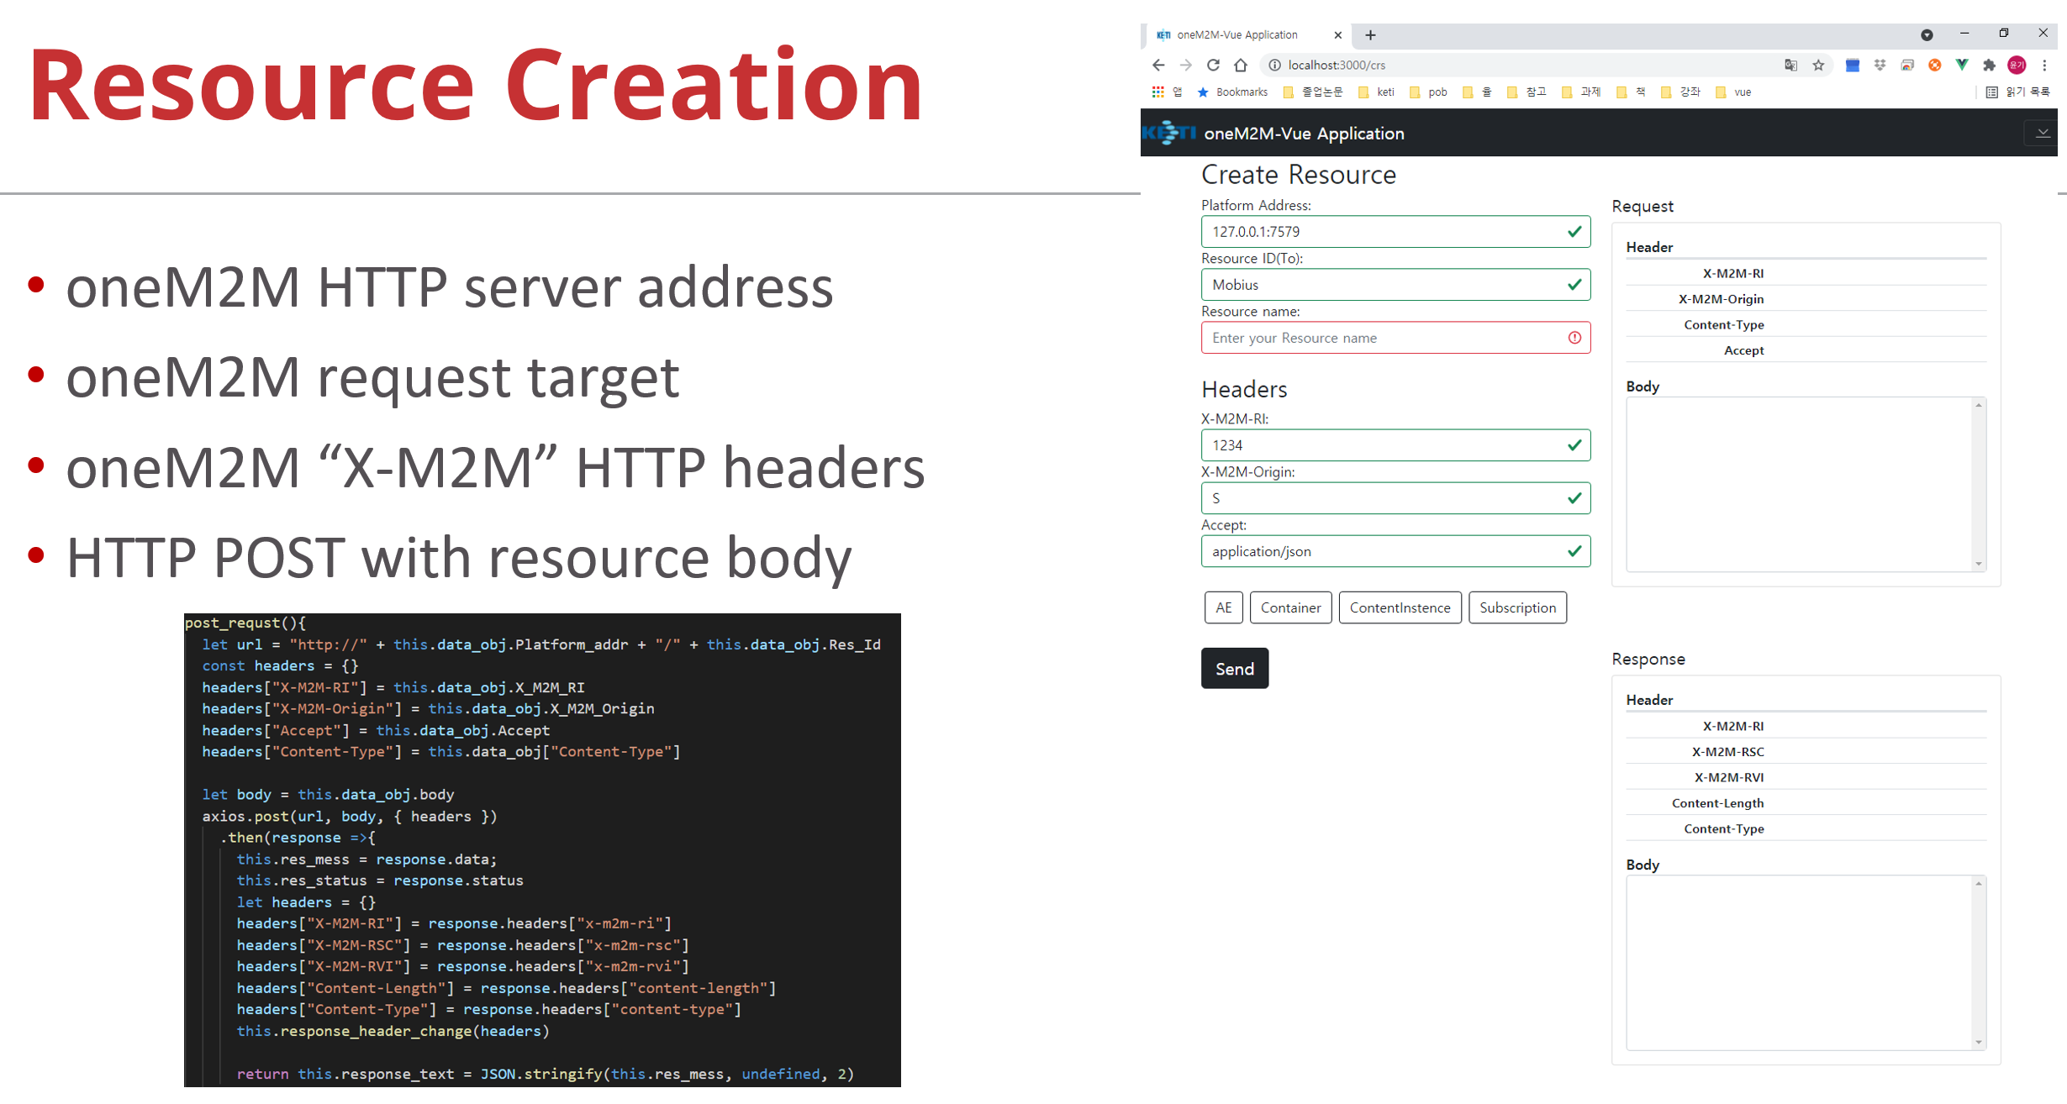
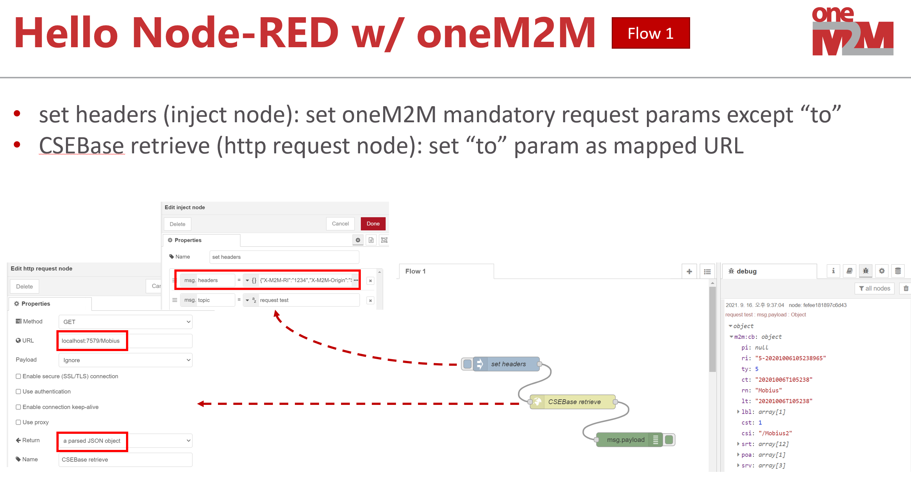
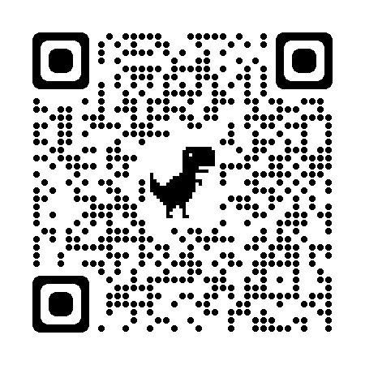
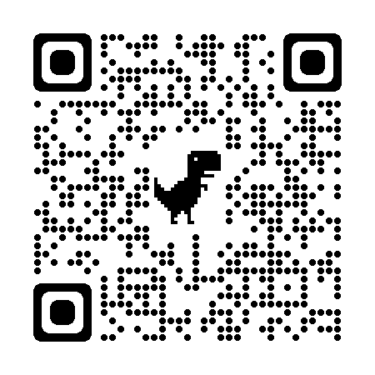
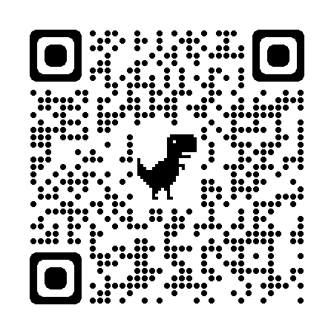
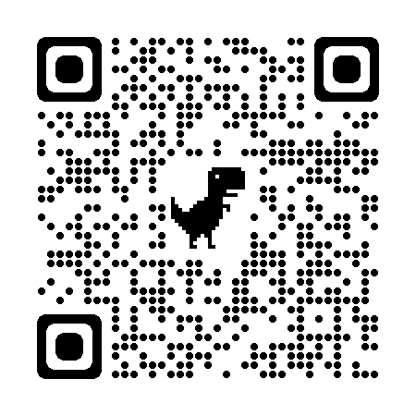
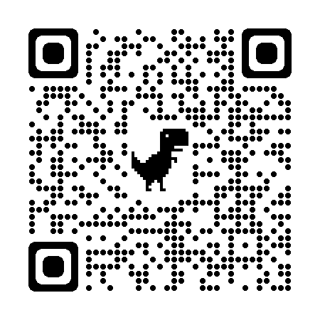
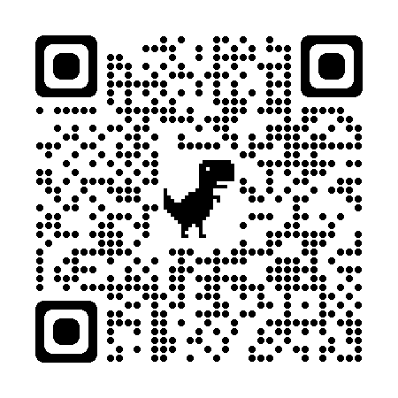
oneM2M Developer Tutorials
A series of developer tutorial videos are available on the web like Youtube
Basic course recordings from 2023 tutorials at the TTA Academy will be available soon
oneM2M Developers Tutorial 2020
(ENG, KETI)
oneM2M Developers Tutorial 2021
(KOR, KETI)
oneM2M Developers Tutorial 2022 (basics and advanced courses)
(KOR, KETI)
2018 Tutorials
(ENG, C-DOT)
Tutorial w/ Jupyter Notebook
(ENG, DT)
https://www.youtube.com/@iotketi

Slide 5
oneM2M Developer Tutorials
Tutorials from KETI are available 24/7 on the Youtube (ENG/KOR) and include
oneM2M Overview
oneM2M Platform (i.e. Mobius) and Tools
oneM2M Architecture and APIs
oneM2M Protocols
oneM2M Practice 101 (i.e. Postman and MQTT client) NEW in 2023 (MQTT)
oneM2M Practice 102 (i.e. Jupyter Notebook w/ javascript kernel) NEW in 2023
oneM2M Virtual Devices
oneM2M Access Control
oneM2M Dashboard
oneM2M Interworking overview with SDT
oneM2M – ZigBee Interworking
oneM2M – LoRaWAN Interworking
oneM2M Node-RED Application
oneM2M Vue.js Application
Also, IoT Drone GCS (Grond Control System) and Metaverse (Roblox) with oneM2M in the second half of 2023

Slide 6
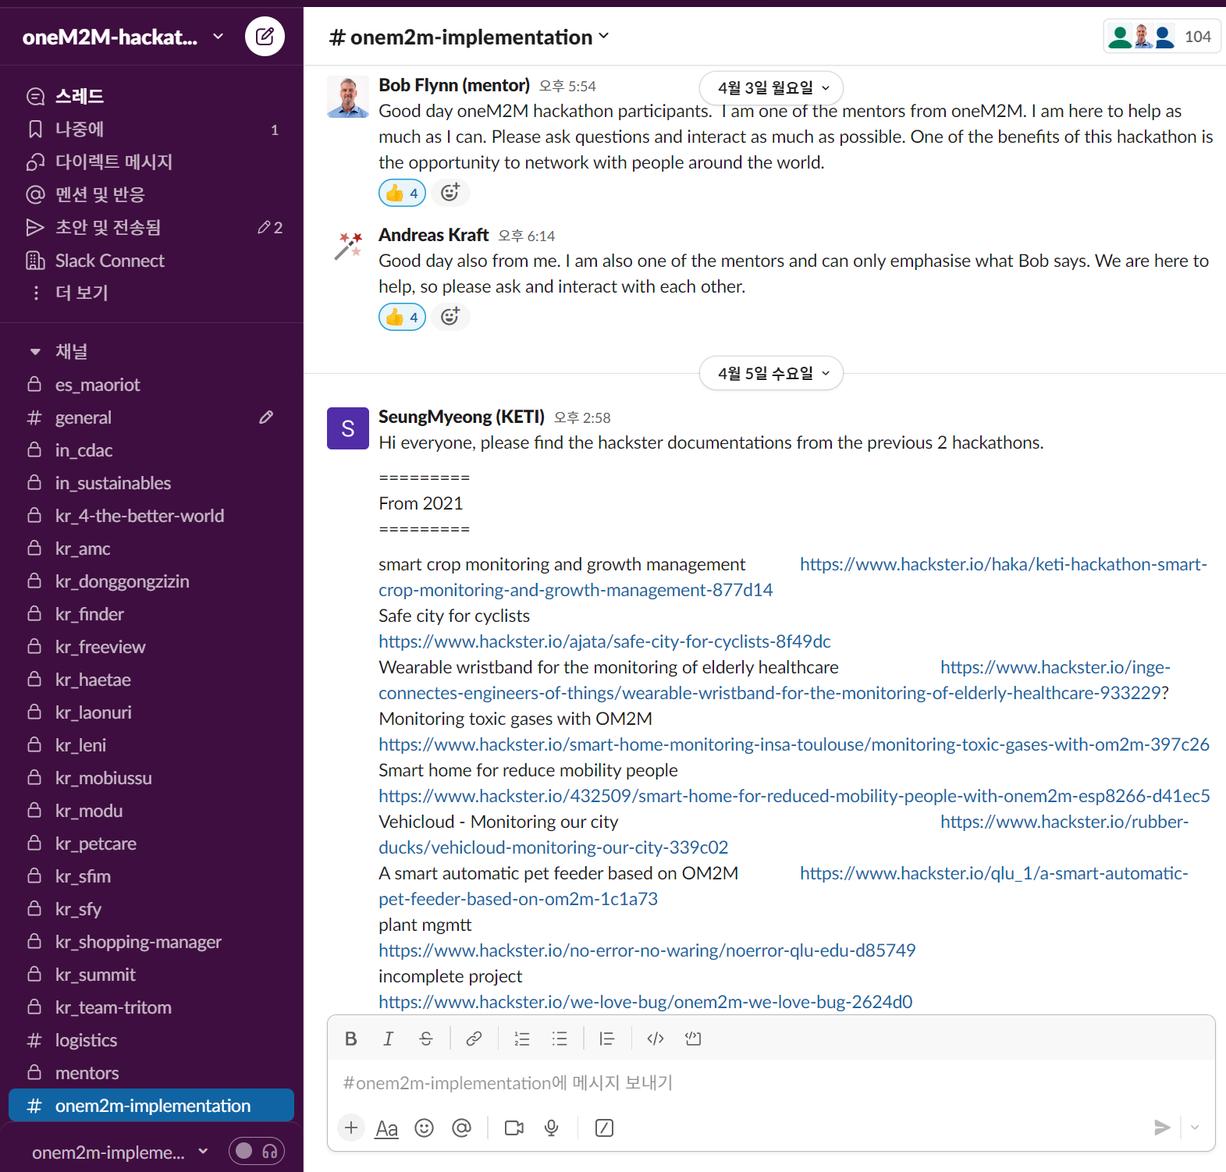
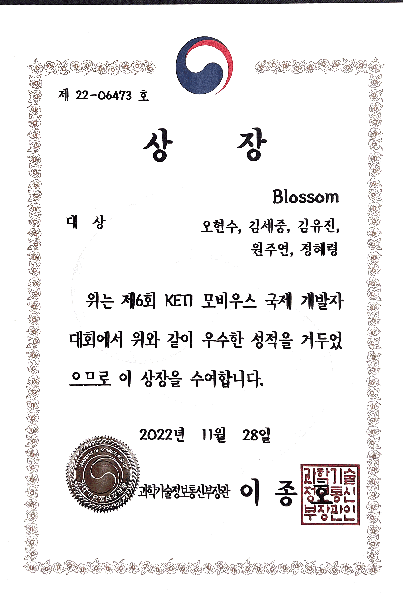
oneM2M International Hackathons
There has been oneM2M hackathons by ETSI and Mobius developer events by KETI
Since 2021, KETI, ETSI and TTA host oneM2M International Hackathon together, funded by KETI
The hackathons are run online/remotely with tutorials and the mentors’ support

Slide 7
oneM2M International Hackathon (2021)
Winners
1st Prize: oneM2M Autonomous cooperative smart delivery
system (KR)
2nd Prizes: Cellular IoT Irrigation System (US) A smart automatic pet feeder (CN)
Video of the Hackathon Awards Ceremony

Slide 8
oneM2M International Hackathon (2022)
Winners
1st Prize: Fire Situation Monitoring System (KR)
2nd Prizes: Air quality monitoring system (AT) Smart School Bus (KR)
Video of the Hackathon Awards Ceremony

Slide 9
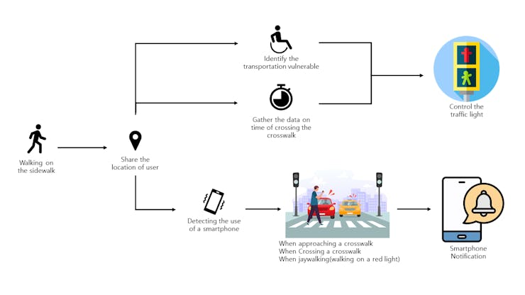
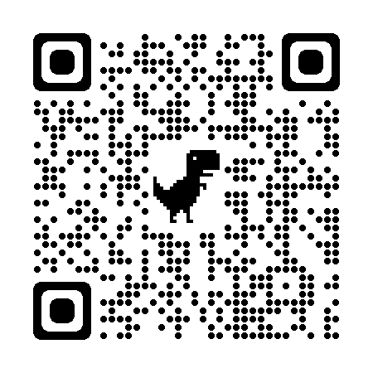
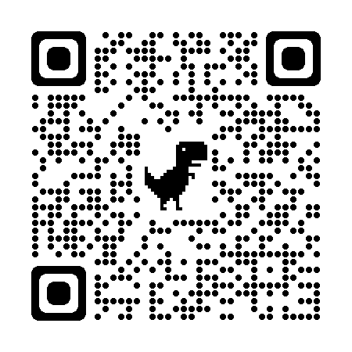
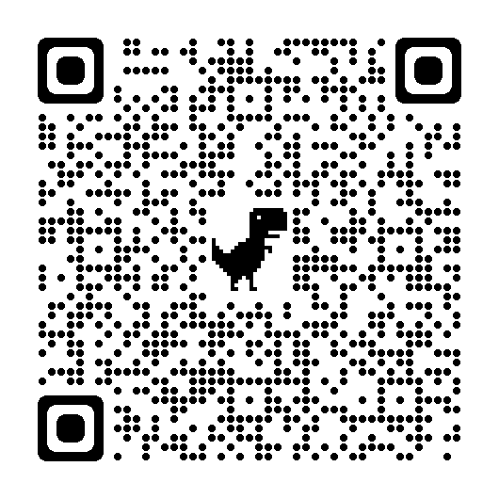
oneM2M International Hackathon (2023)
https://www.mobius-contest.co.kr/en/
More oneM2M APIs implemented
More participations from SMEs
Totally 24 teams onboard
Awards ceremony recording will be posted soon
https://www.youtube.com/@keti
Smart Traffic Light Alarm App
(1st Prize)
Smart Farm Infrastructure with Metaverse (2nd Prize)
Remotely Operated AI Enabled Robot Using oneM2M (2nd Prize)

Slide 10
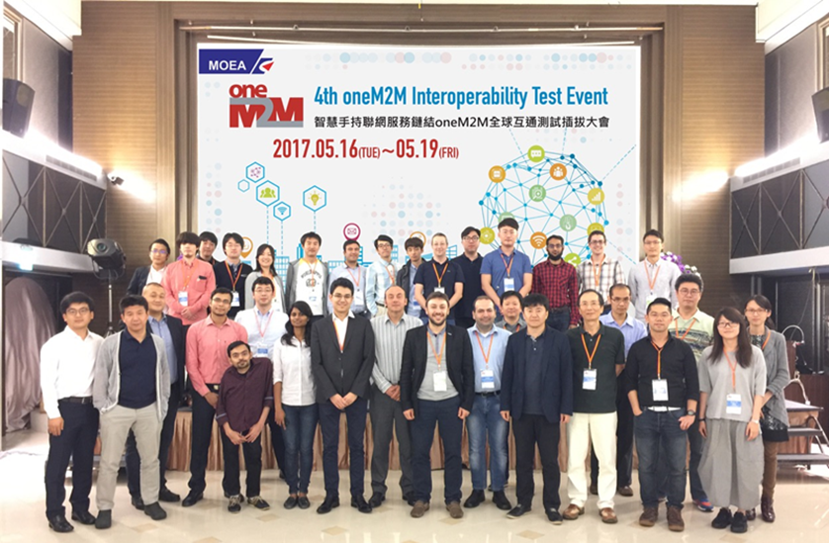
AIoT Exhibitions and oneM2M Workshop
For oneM2M promotion, the exhibition and workshop in Taiwan are being prepared
Background: There was the oneM2M Interoperability Test Event in 2017 @Taipei hosted by III
Exhibition
2023 AIoT Week Korea (11th to 13th in Oct.) in Seoul
2023 AIoT Taiwan (25th to 27th in Oct.) in Taipei
R&D projects using oneM2M and couple of 2023 int’l hackathon awarded projects will be presented
oneM2M Workshop @Taipei
To promote oneM2M in Taiwanese market, oneM2M technical workshop jointly hosted by KETI, III, TAICS, CIAT & TTA
Half day event, one of the days of AIoT Taiwan
III: Institute for Information Industry
TAICS: Taiwan Association of Information and Communication Standards
CIAT: Cloud Computing and IoT Association in Taiwan

