Slide 1
Collaboration with ISG MEC on Edge Computing
TP-2023-0052-oneM2M_MEC_whitepaper_collaboration
Group Name: TP
Source: JaeSeung Song (Sejong Univ. )
Meeting Date: 2023-06-26

Slide 2
Discussion so far
oneM2M has been developing TR-0052 on Edge/Fog Computing
TR-0052 captures various Edge/Fog IoT use cases and potential solutions
TR-0052 identifies key issues with underlying network information (relevant with ISG MEC)
ETSI MEC developed IoT APIs
ISG MEC developed various APIs for IoT applications
MEC wants to host various IoT applications (i.e., IoT services)
Active contributors to oneM2M TR-0052 and ISG MEC collaborate to write a white paper
Started on April 2019
Stalled in 2022
Restarted in 4Q 2022
Completed and plan to publish on Jul. 2023

Slide 3
Discussion so far
oneM2M has been developing TR-0052 on Edge/Fog Computing
TR-0052 captures various Edge/Fog IoT use cases and potential solutions
TR-0052 identifies key issues with underlying network information (relevant with ISG MEC)
ETSI MEC developed IoT APIs
ISG MEC developed various APIs for IoT applications
MEC wants to host various IoT applications (i.e., IoT services)
Active contributors to oneM2M TR-0052 and ISG MEC collaborate to write a white paper
Started on April 2019
Stalled in 2022
Restarted in 4Q 2022
Completed and plan to publish on Jul. 2023
White paper title:
“Enabling Multi-access Edge Computing in Internet-of-Things: how to deploy ETSI MEC and oneM2M”

Slide 4
Working participants
oneM2M contributors:
JaeSeung Song (Sejong University, oneM2M Technical Plenary Vice Chair)
Roland Hechwartner (Deutsche Telekom, oneM2M Technical Plenary Chair)
Enrico Scarrone (TIM, ETSI TC SmartM2M Chair, oneM2M Steering Committee Chair)
Bob Flynn (Exacta Global Smart Solutions, oneM2M TDE WG Vice Chair)
Lee Jieun (Sejong University, oneM2M delegate)
ISG MEC contributors:
Dario Sabella (Intel, ETSI ISG MEC chair)
Arif Ishaq (Athonet, ETSI ISG MEC delegate)
Laurent Velez (ETSI CTI, MEC and oneM2M)
Robert Gazda (InterDigital, ETSI MEC delegate)
Samar Shailendra (Intel, 3GPP SA6 delegate)

Slide 5
Contents

Slide 6
High-level conceptual architecture with MEC and oneM2M
5G Core Network
IoT Server (Cloud)
Mobile Edge
Cloud (MEC)
oneM2M
IoT Service Platform
IoT UE
oneM2M
Edge Instance
oneM2M
Client
Radio Access Network
(RAN)
MEC
platform
MEC Enabler
Client
Edge Configuration Server

Slide 7
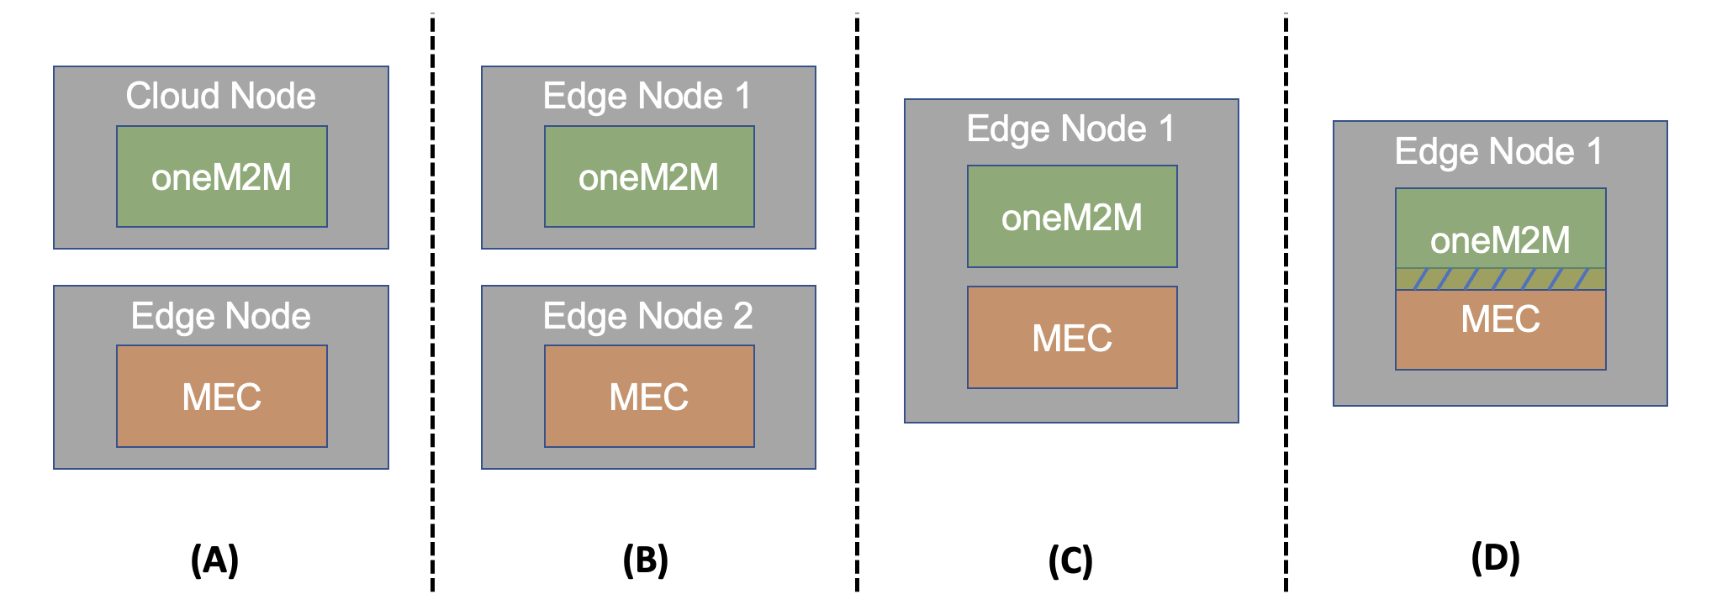
Deployment scenarios
Option A: deploy the oneM2M as a cloud, MEC as an edge
Option B: oneM2M and MEC as an edge with the different physical node
Option C: oneM2M and MEC in the same physical edge node
Option D: oneM2M and MEC are tightly coupled in the same edge node

Slide 8
Next steps
Plan to publish at ETSI IoT Week
Further collaborations are expected (Member company driven)
Investigate option D (a formal interworking)
How to deploy oneM2M edge platform to ETSI MEC platform as MEC applications?
Collaborations between open-source communities
Co-host hackathons or interoperability events

Slide 9
Thank you!

