Slide 1
Marcom Update to TP 59
Bindoo Srivastava, Marcom Chair
26 June 2023

Slide 2
Outline
Reactions to the PR issued on oneM2M Security Specs approval @ ITU
Campaign proposal by PPR – showcasing oneM2M Champions
ETSI-oneM2M joint white paper on MEC
Discussion on a white paper proposal amplifying message of depth of oneM2M
Aetheros’ oneM2M based solutions
New Webpage listing links to ALL resources
Developer Resources
oneM2M Webinars under India EU PP
Recent Events/Speak Opps.
IEEE Globecomm IEEE Global Communications Conference 4–8 December 2023 // Kuala Lumpur, Malaysia
Other Upcoming Speaking opportunities
CY23 Focus Activities
Other Highlights

Slide 3
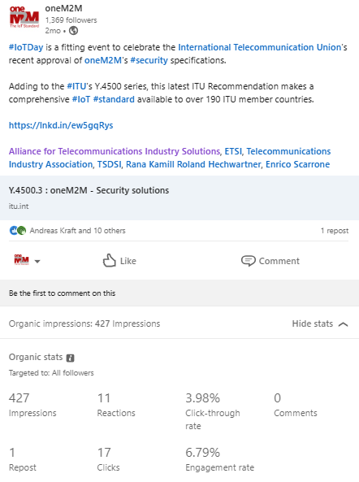
Reactions to the PR issued on oneM2M Security Specs approval @ ITU
Twitter post picked up 101 views, LinkedIn post - over 400 impressions, 10 interactions with followers.
Editor CSO magazine was provided information sought by them on the security specs. Possibility of a follow-on interview being explored by PPR
Security Boulevard want an interview: PPR is trying to e-connect Rana with the editor for the interview (exploring during ETSI IoT week when Rana will be in ETSI 6 Jul?)

Slide 4
Campaign proposal by PPR - oneM2M Champions
Campaign: Champion Series
Showcase the importance of ‘Contributors across oneM2M’ and why each person chooses to play an active role in defining and developing standards to address the need for interoperable and scalable IoT systems.
Objective: Promote membership and increase brand exposure across key target regions.
Post: Carousel style
Need volunteers (at least 3 – 4 )
need headshot and quote giving their reasons of the importance of being an active member of oneM2M.

Slide 5
ETSI-oneM2M joint white paper on MEC: Promotion Campaign
Campaign Proposal – opportunity to generate/rekindle interest in oneM2M via MEC.
On standby to promote the white paper through a Feature content and sponsored LinkedIn post.
Queries from Jayne (PPR) on the white paper :
The white paper talks about interworking between oneM2M and IoT. In some places it seems to suggest that is possible today – but it also identifies that further work is needed to build on this, such as a high interworking framework. Are there plans for this new work to be launched within oneM2M to deliver this? If so, what stage is this at?
Yes, if a operator owns both oneM2M and ETSI MEC, the operator can do whatever they want. :-) However, oneM2M and ETSI MEC doesn't have a standardized interworking mechanism. In the white paper, the authors have just identified possibilities and potential benefits to have standardized interworking. If any member companies want to continue developing such mechanisms, I believe oneM2M and ETSI MEC folks will be happy to support.
Is this the first time that guidance on MEC and oneM2M interworking has been shared? If so, what impact will this have on the IoT landscape as a whole? Could we for example say something like: “The IoT ecosystem will benefit from new 5G capabilities as new guidance on edge computing and IoT interworking is published today.”
The IoT ecosystem can benefit what MEC can bring.. for example, oneM2M platform can be hosted in a multi-vendor multi-access edge computing environment.

Slide 6
White Paper to amplify message of depth of oneM2M?
oneM2M is evolving – to incorporate newer technologies like Metaverse etc.
Few active contributing members are now “not so active” why?
change in business priorities?
satisfied with the solution/offering available
All the functionalities of oneM2M are not essentially required when we create initial solutions/products
Several IoT/M2M folks are not quite aware of oneM2M and how one can start with the basics and then add features....
A White Paper to emphasise this?

Slide 7
Aetheros’ oneM2M based solution
Executive Interview with Aetheros’ Ray Bell on their oneM2M based solution
Aetheros adopted oneM2M framework for their Aetheros Operating System - that is used to offer smart metering and other solutions/services in various regions
Its deployments to be published on oneM2M website
Thanks !!! to KDDI expert Mr Yamamoto San who introduced Aetheros CEO to oneM2M.
Plan to explore possibility of conducting webinar with Aetheros to showcase oneM2M based deployment in utilities.
https://www.iotm2mcouncil.org/iot-library/news/smart-energy-news/aetheros-to-power-us-smart-meter-deployments/

Slide 8
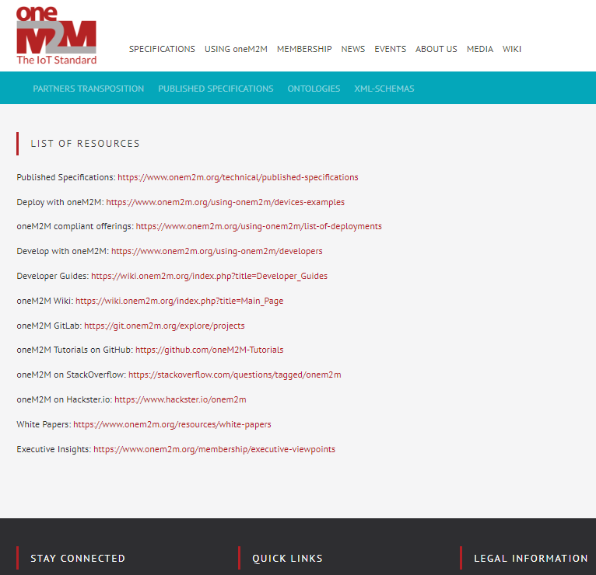
New Webpage Listing all oneM2M Resources
Link to the “List of Resources”
https://www.onem2m.org/home/working-documents

Slide 9
oneM2M Webinars under India EU Cooperation on ICT Related standardization, Policy & Regulation
Webinars on oneM2M conducted under aegis of Indo-EU PP proposed to be made available on oneM2M website.
Team working on acquiring approvals form project officers

Slide 10
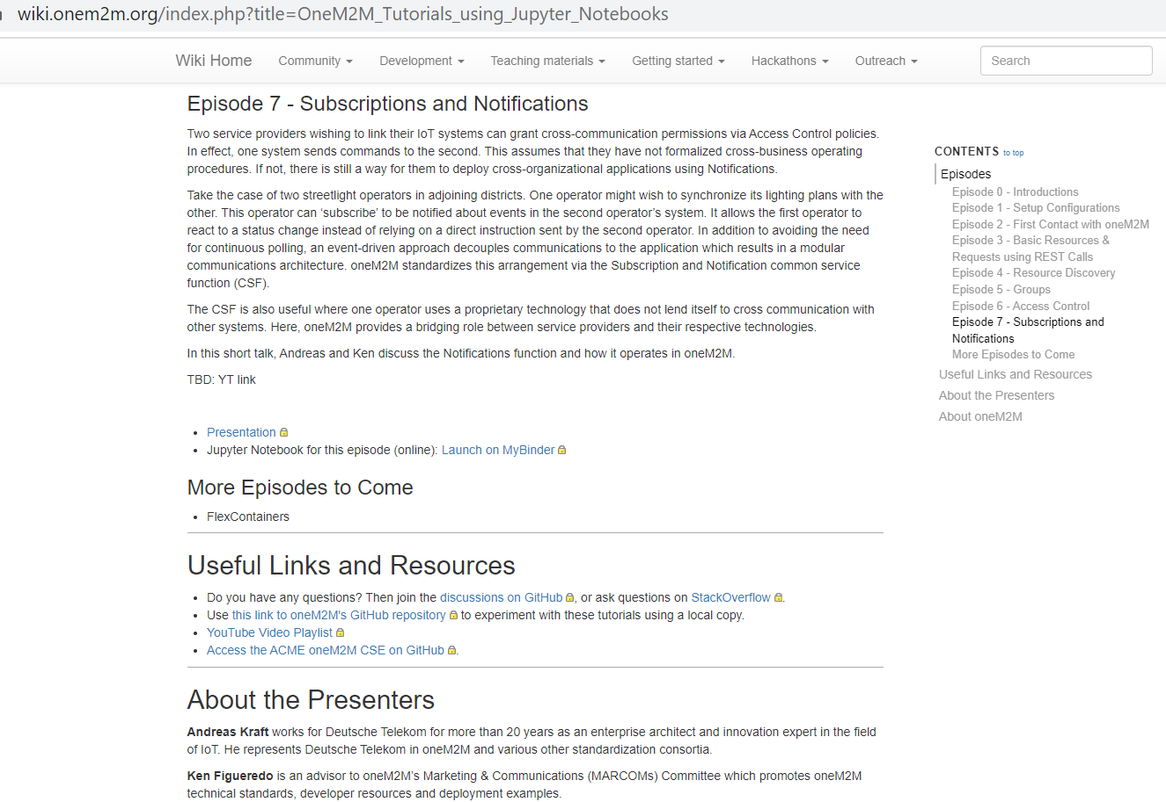
Developer Resources - Updates
8 episodes available now
Courtesy Andreas Kraft & Ken Figueredo

Slide 11
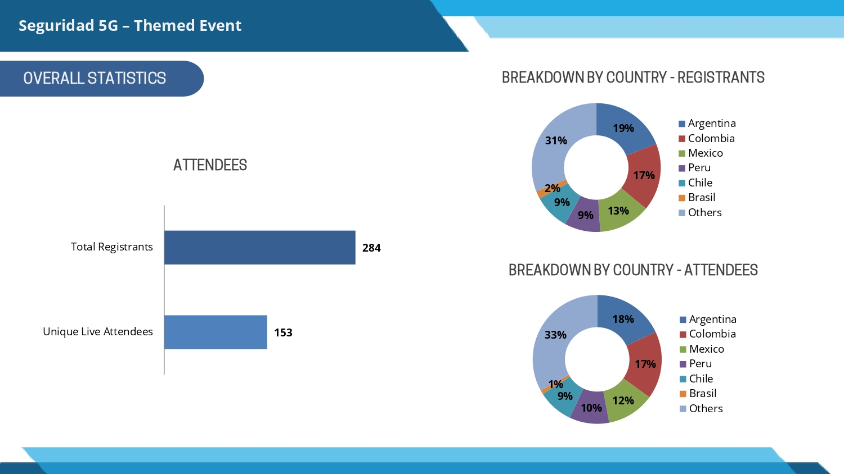
Recent Events/Speak Opps.
Bob Flynn @ Edge Computing Expo North America 17-18 May 2023
Rana Kamill @ TeleSemana May 17, 2023
Aurindam Bhattacharya @ Regional workshop on ‘M2M & IoT security & use cases’ organized by Mumbai LSA, Department of Telecommunications 26 May 2023
WTISD celebration - 8 June 2023 - Bindoo Srivastava (Courtesy Dr Hideyuki Iwata San)

Slide 12
Opportunity: IEEE Globecomm IEEE Global Communications Conference | 4–8 Dec’23 | Kuala Lumpur, Malaysia
IEEE GlobeComm Conference in Dec 2023 | Malaysia
An industry program, podium pitches and executive forum that will be run along the conference duration.
For industry presentation, you may view it at: https://globecom2023.ieee-globecom.org/authors/information-industry-presentations
You may submit your proposal via email for industry presentation to Dr Nordin, nordin@ieee.org, our IF&E co-chairs for review and discussion among the OC committee for suitability of the topics etc. Kindly copy us for our reference, should you decide to submit your proposal to IEEE.
For podium pitches, it’s a 5 minutes talk about anything related to communication at the exhibition booths. This can be arranged for MTSFB.
For the executive forum, you can submit the experts' CV to us for nomination, however, this depends on the availability of seats for the speakers.

Slide 13
Other Events/ Speaking Opportunities
ETSI IoT Week || 4-6 July 2023
Engagement with Penn State University during TP62 || 14-18 Aug’23 || PSU
Smart Nation Expo 2023 || 16 -21 Sep’23 || Kuala Lumpur (being explored)
IoT Security & Stds based IoT/M2M practical implementations of solutions | 25-26 Sep’23 | New Delhi
TTDD 2023 || 3-6 Oct’23
Korea IoT week (11-13 Oct’23)
9th IEEE World Forum on IoT – 12 to 27 Oct’23 // Aveiro, Portugal (Hybrid)
IMC 2023 (27-29 Oct’23)
IoT Tech Expo & Edge Computing Expo - Europe || 26-27 Sep 23 || Amsterdam - speaker TBD
IoT Tech Expo - Global (30th November – 1st December) – London: Rana Kamill
Opportunity to contribute an article to Architecture & Governance magazine. We have contributed articles in the past, most recently last year.

Slide 14
CY’23 Focus Activities
oneM2M Brochure
oneM2M Tutorials – translate from Korean to English
oneM2M icons library
Capacity Building on oneM2M - In the wake of ITU-T SG20 endorsement?
University outreach :
Outreach at TP61 with Penn State university (Aug-Sep?
developer series? Q2-Q3 (Developer Series – 7 out of 8 ready)
Retain mindshare by emphasising value of oneM2M and promoting new information around relevant oneM2M TP/SSC milestones through Regular features/media interactions/speaking opportunities - Metaverse, Rel 5 etc.

Slide 15
Key Highlights – May’/Jun 23
External Publications: NIL publications in May’23 (06 TOTAL in CY’23) *ETSI Enjoy! (Ken submitted article in June 2023)
oneM2M Developers Resources – Total 8 out of 9 now available on YouTube and Wiki)
Engagement: 2 Executive Insights published in May and 2 in June. (10 Total in CY’23)
Visibility:
Total Events organized (nil@oneM2M, 2@Partner, 2@Regional level)
Speaking Opportunities – 2 availed
Social Media (Till May’23): LinkedIn 1365 followers (▲9 in May’23), 32 total posts CY’23; Twitter 1456 followers, 111 total posts CY’23
Communiques & PRs:
PRs – 1 issued; carried by 5 agencies
Media Queries - 2
Refer oneM2M Promotions Tracker
Notes:
External Publications:
ETSI Enjoy! (Ken submitted article in June 2023)
Executive Interviews:
TP#58 and Release 5 Standardization Activities – 22nd Mar’23 by Roland Hechwartner (oneM2M TP Chair)
DT IoT Hub – 4th May’23 – By Andre Dutra (DT)
oneM2M in Utilities by Atheros – 5th Jun’23 Ray Bell
IIT Hyderabad – Dr. Sachin Chaudhai 22nd June 2023
Partner events
TTA – oneM2M International Hackathon
TTA - oneM2M Global seminar - 13 June 2023
Regional level
WTISD celebration (Speaking Opportunity)- 8 June 2023
IoT week Berlin- (19-22 Jun23)
Speaking Opportunities –
Rana Kamill in Telesemana webinar (17 May)
Bob Flynn speaking in IoT Tech Expo & Edge Computing Expo - North America | 18th May ‘23) | Santa Clara, CA
Media Queries - 2
CSO
Security Boulevard
***

Slide 16
Reference Slides

Slide 17
oneM2M Brochure
Being updated

Slide 18
3rd International Hackathon & Global IoT Seminar (TTA)
Update being provided by SeungMyeong

Slide 19
Thought Leadership – Articles CY’23
Global Journals
The Fast Mode - Metaverse standards
Pipeline Magazine (2023 predictions)
Trade Journals
Regional
Partner Communiques
ETSI Enjoy Jan
Activities Tracker link
Notes:
2023 IoT trends for A&G via PrPR

Slide 20
Engagement – Executive Insights (CY23)
oneM2M in the News – 1210 Subscribers
Press Releases – 1
Media queries to oneM2M_PressMedia@list.onem2m.org being forwarded to Bindoo, Aurindam, Ken, Akash
Executive Insights
IoT systems and the evolution of solution requirements by nTels – 9th Jan’23
Standardization in Smart Elevator by Patrick Cox (TRE-E scrl) – 16th Jan’23
Standardization in Smart Lift Sector by Marco Cogliati (TRE-E scrl) – 1st Feb’23
CDOT’s Common Service Platform – 22nd Feb’23
India’s Standard Based IoT Ecosystem – 23rd Feb’23
TP#58 and Release 5 Standardization Activities – 22nd Mar’23
DT IoT Hub – 4th May’23
TP#59 – 11th May’23
Aetheros (Electric Utility) – 5th Jun’23
IIIT Hyderabad student outreach – 22nd Jun’23
Activities Tracker link
Notes:
Interview in pipeline –
https://futureiot.tech/

Slide 21
oneM2M in Press
oneM2M PRESS RELEASE | May 2023 | oneM2M specifications approved by more than 190 ITU member countries as ITU standard to simplify IoT adoption
EE News Europe | April 2023 | 'Horizontal' IoT Implementations
Journal du Net | March 2023 | L'IoT, barrière aux catastrophes naturelles
International Institute of Information Technology (Hyderabad) | January 2023 | IITH's Smart City team wins Best Technology award in Korean hackathon
ETSI Enjoy! | January 2023 | Research and Innovation in IoT Standardization
The Fast Mode | January 2023 | Standardization is Key for Metaverse Success
Notes:
International Institute of Information Technology (Hyderabad) blog post (January 2023) - IITH's Smart City team wins Best Technology award in Korean hackathon ETSI Enjoy! January 2023Research and Innovation in IoT Standardization
ETSI Enjoy! January 2023Research and Innovation in IoT Standardization

Slide 22
oneM2M in News
16 March 2023 | In Anticipation of Metaverse Standardization
7 February 2023 | Security for oneM2M based smart city network
2 February 2023 | The Journey to Massive IoT Through Interoperable and Open Standards

Slide 23
Thank You

